Slide 1
Analyzing H1B DATA USING HADOOP ECOSYSTEM
Presented by :
Name : KIRAN PADGHAMKAR
Student ID : S181107500060
Center: Pune Deccan

Slide 2
objective
We will be performing analysis on the H1B visa applicants which is employment-based between the years 2011-2016.Analyzing h1b data to provide flexibility to make another vise policy.

Slide 3
Big data
Big data is a term that describes the large volume of data – both structured and unstructured – that inundates a business on a day-to-day basis.
But it’s not the amount of data that’s important. It’s what organizations do with the data that matters.
Big data can be analyzed for insights that lead to better decisions and strategic business moves.

Slide 4
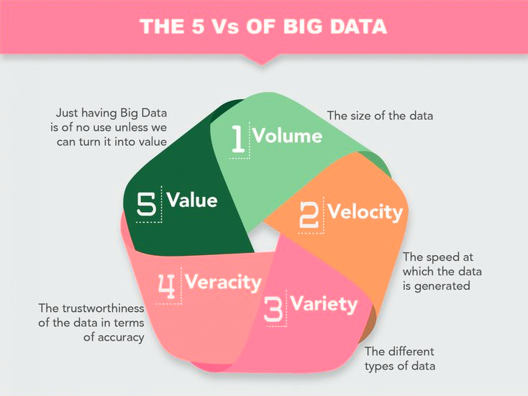

Slide 5
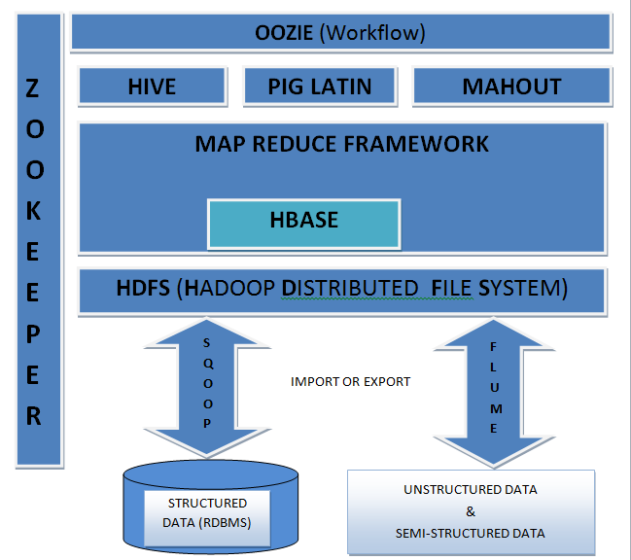
Hadoop Ecosystem

Slide 6
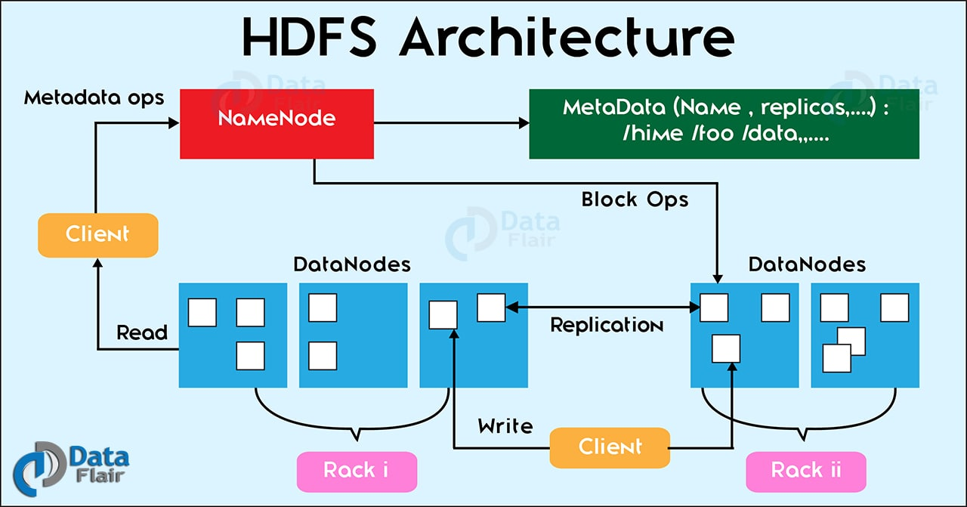

Slide 7
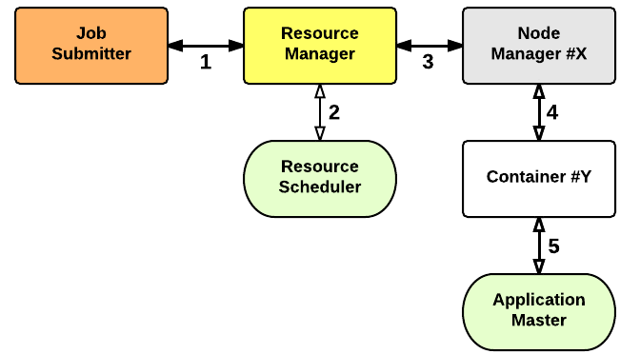
YARN ARCHITECTURE

Slide 8
Advantages of Hadoop
Scalable : Hadoop is a highly scalable storage platform, because it can store and distribute very large data sets across hundreds of inexpensive servers that operate in parallel
2. Cost effective :Hadoop also offers a cost effective storage solution for businesses' exploding Data sets Hadoop, on the other hand, is designed as a scale-out architecture that can affordably store all of a company’s data for later use.
3. Flexible : Hadoop enables businesses to easily access new data sources and tap into different types of data (both structured and unstructured) to generate value from that data.
4. Fast : Hadoop's unique storage method is based on a distributed file system that basically 'maps' data wherever it is located on a cluster.
If you're dealing with large volumes of unstructured data, Hadoop is able to efficiently process terabytes of data in just minutes, and petabytes in hours.
5. Resilient to failure : A key advantage of using Hadoop is its fault tolerance. When data is sent to an individual node, that data is also replicated to other nodes in the cluster, which means that in the event of failure

Slide 9
Technology used
MapReduce : a parallel processing software framework. It is comprised of two steps. Map step is a master node that takes input and partitions them into smaller sub-problems and then distributes them to worker nodes. After the map step has taken place, the master node takes the answer to all of the sub-problems and combines them to produce output.
Hive : a data warehousing and SQL like query language that presents the data in the form of tables. Hive programming is similar to data Warehousing
Pig : a platform for manipulating data stored in HDFS and that includes a compiler for map reduce programs and high level language called Pig Latin.it provides a way to perform data extractions, transformation and loading and basic analysis without having to write Map Reduce programs
Sqoop : a connection and transfer mechanism that moves the data between Hadoop and relational databases

Slide 10
Analyzing Factors
We will be performing analysis on the H1B visa applicants between the years 2011-2016. After analyzing the data, we can derive the following facts.
1. a) Is the number of petitions with Data Engineer job title increasing over time?
b) Find top 5 job titles who are having highest avg growth in applications.[ALL]
2. a) Which part of the US has the most Data Engineer jobs for each year?
b) find top 5 locations in the US who have got certified visa for each year.[certified]
3. Which industry(SOC_NAME) has the most number of Data Scientist positions?
[certified]
4. Which top 5 employers file the most petitions each year? - Case Status - ALL

Slide 11
Analyzing Factors
5. Find the most popular top 10 job positions for H1B visa applications for each year?
a) for all the applications
b) for only certified applications.
6. Find the percentage and the count of each case status on total applications for each year. Create a line graph depicting the pattern of All the cases over the period of time.
7. Create a bar graph to depict the number of applications for each year [All]
8. Find the average Prevailing Wage for each Job for each Year (take part time and full time separate). Arrange the output in descending order - [Certified and Certified Withdrawn.]
9. Which are the employers along with the number of petitions who have the success rate more than 70% in petitions. (total petitions filed 1000 OR more than 1000) ?
10. Which are the job positions along with the number of petitions which have the success rate more than 70% in petitions (total petitions filed 1000 OR more than 1000)?
11. Export result for question no 10 to MySql database.

Slide 12
1. a) Is the number of petitions with Data Engineer job title increasing over time?
Technology used : HIVE
Solution : petitions with Data Engineer job title increasing over time year by year.

Slide 13
1. b) Find top 5 job titles who are having highest avg growth in applications.[ALL]
Technology Used : PIG
Solution :
JOB_TITLE | AVG_GROWTH
SENIOR SYSTEMS ANALYST JC60 | 4255.4
SOFTWARE DEVELOPER 2 | 3480.8
PROJECT MANAGER 3 | 3233.4
SYSTEMS ANALYST JC65 | 2985
MODULE LEAD | 2917.2

Slide 14
2. a) Which part of the US has the most Data Engineer jobs for each year?
Technology Used : PIG
Solution :
WORK_SITE | YEAR | NO OD DATA ENGG JOB
SAN FRANCISCO, CALIFORNIA | 2011 | 20
SAN FRANCISCO, CALIFORNIA | 2012 | 30
MENLO PARK, CALIFORNIA | 2013 | 45
MENLO PARK, CALIFORNIA | 2014 | 46
SAN FRANCISCO, CALIFORNIA | 2015 | 61
MENLO PARK, CALIFORNIA | 2016 | 128

Slide 15
2. b) find top 5 locations in the US who have got certified visa for each year.[certified]
Technology Used : HIVE
Solution :
WORK_SITE YEAR COUNT
NEW YORK, NEW YORK 2011 23172
HOUSTON, TEXAS 2011 8184
CHICAGO, ILLINOIS 2011 5188
SAN JOSE, CALIFORNIA 2011 4713
SAN FRANCISCO, CALIFORNIA 2011 4711

Slide 16
3. Which industry(SOC_NAME) has the most number of Data Scientist positions? [certified]
Technology Used : PIG
Solution :
INDUSTRY | NO OF JOB
STATISTICIANS | 572
COMPUTER AND INFORMATION RESEARCH SCIENTISTS | 419
OPERATIONS RESEARCH ANALYSTS | 380
COMPUTER AND INFORMATION RESEARCH SCIENTISTS | 181
COMPUTER OCCUPATIONS ALL OTHER | 160

Slide 17
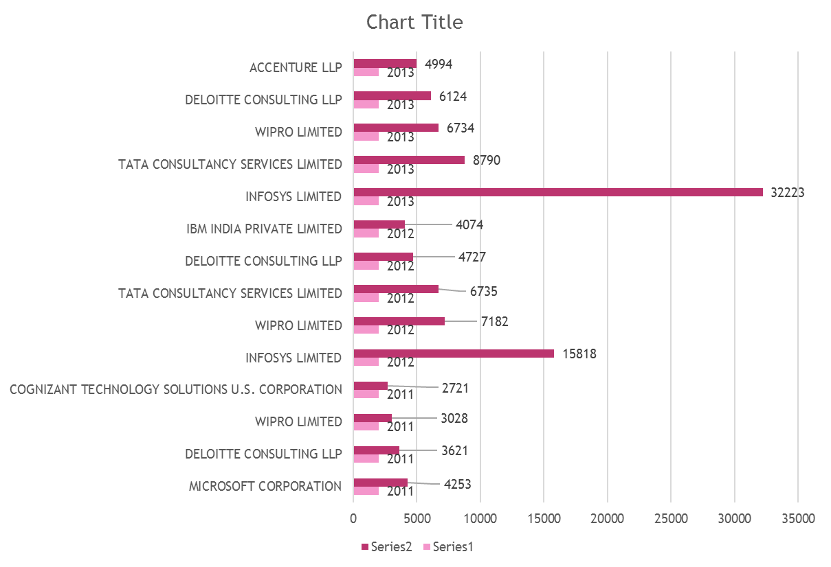
4. Which top 5 employers file the most petitions each year? - Case Status - ALL
Technology Used : PIG
Solution :

Slide 18
5. Find the most popular top 10 job positions for H1B visa applications for each year? a) for all the applications.
JOB TITLE | YEAR | NO OF APPLICATION
PROGRAMMER ANALYST | 2016 | 53743
SOFTWARE ENGINEER | 2016 | 30668
SOFTWARE DEVELOPER | 2016 | 14041
SYSTEMS ANALYST | 2016 | 12314
COMPUTER PROGRAMMER | 2016 | 11668
BUSINESS ANALYST | 2016 | 9167
COMPUTER SYSTEMS ANALYST | 2016 | 6900
SENIOR SOFTWARE ENGINEER | 2016 | 6439
DEVELOPER | 2016 | 6084
TECHNOLOGY LEAD - US | 2016 | 5410
Technology Used : HIVE
Solution :

Slide 19
5. Find the most popular top 10 job positions for H1B visa applications for each year? b) for only certified applications.
Technology Used : HIVE
Solution :
JOB_TITLE | YEAR | YEAR | YEAR | YEAR | YEAR | YEAR
 | 2011 | 2012 | 2013 | 2014 | 2015 | 2016
PROGRAMMER ANALYST | 28806 | 29226 | 29906 | 38625 | 48203 | 52320
SOFTWARE ENGINEER | 11224 | 12273 | 12973 | 17278 | 23352 | 32451
COMPUTER PROGRAMMER | 8038 | 8483 | 10202 | 13796 | 12971 | 13524
SYSTEMS ANALYST | 7850 | 8399 | 7850 | 9161 | 11498 | 12876
BUSINESS ANALYST | 3444 | 4144 | 7809 | 6529 | 9343 | 10203
COMPUTER SYSTEMS ANALYST | 3152 | 4084 | 7641 | 6473 | 8238 | 9546
ASSISTANT PROFESSOR | 3050 | 3420 | 4993 | 6204 | 7919 | 8305
PHYSICAL THERAPIST | 2911 | 3290 | 4554 | 5055 | 7234 | 8610
SENIOR SOFTWARE ENGINEER | 2595 | 3284 | 4316 | 4911 | 7009 | 8125
SENIOR CONSULTANT | 2585 | 3033 | 3996 | 4535 | 5324 | 6254

Slide 20
6. Find the percentage and the count of each case status on total applications for each year. Create a line graph depicting the pattern of All the cases over the period of time.
Technology Used : MAPREDUCE
Solution :

Slide 21
7. Create a bar graph to depict the number of applications for each year [All]
Technology Used : MAPREDUCE
Solution :

Slide 22
8.Find the average Prevailing Wage for each Job for each Year (take part time and full time separate).Arrange the output in descending order - [Certified and Certified Withdrawn]
Technology Used : HIVE
Solution :
(JAPANESE TEACHING ASSISTANT,2013,N),17076.0
(INSTRUCTOR, PSYCHOLOGY,2013,N),16972.0
(ASSISTANT VOLLEYBALL COACH,2013,N),16889.0
(DIRECTOR OF RELIGIOUS ACTIVITIES AND EDUCATION,2013,N),16764.0
(COSTUMER,2013,N),16640.0
(ASSISTANT WOMEN'S SOCCER COACH,2013,N),16120.0
(BILINGUAL SPECIAL EDUCATION TEACHER ASSISTANT,2013,N),15080.0

Slide 23
9. Which are the employers along with the number of petitions who have the success rate more than 70% in petitions. (total petitions filed 1000 OR more than 1000) ?
Technology Used : MAPREDUCE
Solution :
Employer_name | Total applications | Certified+certified_withdrawn applications | Sccess_rate
HTC GLOBAL SERVICES INC | 1164 | 1164 | 100
INFOSYS LIMITED | 130592 | 129992 | 99.54055
DIASPARK INC | 1419 | 1412 | 99.50669
ACCENTURE LLP | 33447 | 33244 | 99.39307
TECH MAHINDRA (AMERICAS) INC | 10732 | 10661 | 99.33843
TATA CONSULTANCY SERVICES LIMITED | 64726 | 64297 | 99.33721
YASH TECHNOLOGIES INC | 2214 | 2198 | 99.27733
YASH & LUJAN CONSULTING INC | 1372 | 1362 | 99.27114
HCL AMERICA INC | 22678 | 22512 | 99.26801
RELIABLE SOFTWARE RESOURCES INC | 1992 | 1975 | 99.14659
NTT DATA INC | 4611 | 4571 | 99.13251
ERP ANALYSTS INC | 1785 | 1769 | 99.10364

Slide 24
10. Which are the job positions along with the number of petitions which have the success rate more than 70% in petitions (total petitions filed 1000 OR more than 1000)?
Technology Used : MAPREDUCE
Solution :
JOB_POSITION | NO OF APPLICATION | SUCESSES RATE
COMPUTER PROGRAMMER | 1276 | 100
ASSOCIATE CONSULTANT | 4393 | 99.93
SYSTEMS ENGINEER | 10036 | 99.9
TEST ANALYST | 4928 | 99.81
CONSULTANT | 7426 | 99.81
TECHNOLOGY LEAD | 28350 | 99.8
TECHNICAL TEST LEAD | 5374 | 99.79
TECHNOLOGY ARCHITECT | 4707 | 99.76
(TECHNOLOGY ANALYST | 26055 | 99.76
SENIOR PROJECT MANAGER | 2774 | 99.74

Slide 25
11. Export result for question no 10 to MySql database.
Technology Used : SQOOP
Solution :
1.mysql –u root –p
2. create database h1b_DATA;
3. use h1b_DATA
4.CREATE TABLE suc_rate(job_title varchar(100)NOT NULL,total_no_of_appl INT NOT NULL,certifiedANDcertified_withdrwan_count INT NOT NULL,
5.desc suc_rate;
+---------------------------------------+--------------+------+-----+---------+-------+
| field | type | null | key | default | extra |
+---------------------------------------+--------------+------+-----+---------+-------+
| job_title | varchar(100) | no | | null | |
| total_no_of_appl | int(11) | no | | null | |
| certifiedandcertified_withdrwan_count | int(11) | no | | null | |
| success_rate | float | no | | null | |
+---------------------------------------+--------------+------+-----+---------+-------+
6. sqoop export --connect jdbc:mysql://localhost/h1b --username 'root' --password 'hduser' --table success_rate --export-dir /problem10 --input-fields-terminated-by ',' --mysql-delimiters -m 1;

Slide 26
Conclusion:
Petitions for data engineer job are increasing over time.
Possibility of application getting certified increases every year.
Jobs for Data Science are more In Statistician industries.
Success rate of INFOSYS LIMITED is more .
For System Engineer –US has more success rate.
Sqoop is Usefull when we have data on HDFS that need to be exported into the MySQL tables or vice-versa.
Hive helps in cleaning up data.CSV file can be easily converted into TSV Text file.
For normal group by join and filter based data retrieval ,Pig is very efficient.
MapReduce code written in java makes complex analysis quite easy. Codes required to be written to collects user inputs and performing complex join operations are handled efficiently using this approach.

Slide 27
THANK YOU

