Slide 1
PROJECT TITLE
PIP104 University Project-II
Review-3
AI Powered Server Log Management Software
Batch Number:
Roll Number | Student Name
20201CEI0161 | A Deepak Venkat (TL)
20201CEI0157 | S Pranay Kiran
20201CEI0172 | Akshay Jayesh
20201CEI0164 | M Kesava
Under the Supervision of,
Ms. Shaik salma
Assistant Professor
School of Computer Science & Engineering
Presidency University

Slide 2
AI Powered Server Log Management Software

Slide 3
ABSTRACT
In software engineering, logging traditionally aids in root cause analysis and failure identification. Recent advancements in automated log file analysis have expanded its utility to include real-time system health monitoring, user behavior analysis, and domain knowledge extraction. However, the lack of a standardized format remains a significant obstacle. Focusing on the last five years, this paper summarizes key research topics, categorizes log files used in studies, and offers an informative foundation for future investigators, providing insights into diverse log data applications.

Slide 4
Introduction
Effective server log management is essential in the ever-changing IT environment of today. Our project uses artificial intelligence (AI) to present a novel solution.
It provides real-time anomaly detection and forecast insights by automating the processes of log gathering, parsing, and analysis.
IT workers find this program invaluable since it streamlines difficult log management procedures.
It provides a user-friendly interface, cutting-edge machine learning techniques, and improved server speed and security.
It deals with Real-time anomaly detection and issue prevention.
It provides User-friendly interface for ease of use.

Slide 5
LITERATURE SURVEY
Landscape of Automated Log Analysis: A Systematic Literature Review
and Mapping Study(Link: DOI)
Authors: ukasz Korzeniowski, Krzysztof Goczyła
Summary:
Logging is a common practice in software engineering to provide insights into working systems. The main uses of log files have always been failure identification and root cause analysis. In recent years, novel applications of logging have emerged that benefit from automated analysis of log files, for example, real-time monitoring of system health, understanding users’ behavior, and extracting domain knowledge. Although nearly every software system produces log files, the biggest challenge in log analysis is the lack of a common standard for both the content and format of log data. This paper provides a systematic review of recent literature (covering the period between 2000 and June 2021, concentrating primarily on the last five years of this period) related to automated log analysis. Our contribution is three-fold: we present an overview of various research areas in the field; we identify different types of log files that are used in research, and we systematize the content of log files. We believe that this paper serves as a valuable starting point for new researchers in the field, as well as an interesting overview for those looking for other ways of utilizing log information.

Slide 6
LITERATURE SURVEY
Web Service Reliability Test Method Based on Log Analysis (Link: DOI)
Authors: Xuetao Tian, Honghui Li, Feng Liu
Summary:
A web service reliability test method for C/S architecture software based on log analysis is presented in this paper. In this method, the software usage model is constructed automatically to describe the real situation on the users’ access to the web service by Markov chain. The test cases are generated according to Random Walk and applied to software reliability test. In the experiment process, MTBF (focusing on server crash) was chosen to be the software reliability evaluation index. Through the testing and analysis of a real web software, MTBF obtained by testing result is similar to that from the realistic log, and the web service reliability test method is validated.

Slide 7
LITERATURE SURVEY
LogLens: A Real-time Log Analysis System(Link: DOI)
Authors: Biplob Debnath, Mohiuddin Solaimani, Muhammad Ali Gulzar, Nipun Arora,
Cristian Lumezanu, Jianwu Xu, Bo Zong, Hui Zhang§, Guofei Jiang§, and Latifur Khan
Summary:
Administrators of most user-facing systems depend on periodic log data to get an idea of the health and status of production applications. Logs report information, which is crucial to diagnose the root cause of complex problems. In this paper, we present a real-time log analysis system called LogLens that automates the process of anomaly detection from logs with no (or minimal) target system knowledge and user specification. In LogLens, we employ unsupervised machine learning based techniques to discover patterns in application logs, and then leverage these patterns along with the real-time log parsing for designing advanced log analytics applications. Compared to the existing systems which are primarily limited to log indexing and search capabilities, LogLens presents an extensible system for supporting both stateless and stateful log analysis applications. Currently, LogLens is running at the core of a commercial log analysis solution handling millions of logs generated from the large scale industrial environments and reported up to 12096x man-hours reduction in troubleshooting operational problems compared to the manual approach.

Slide 8
SOFTWARE USED
Programming Languages:
Django & Python
Libraries:
Googlesearch
Webbrowser
Subprocess
Numpy
Scikit-learn
Json
Version Control System:
Github

Slide 9
HARDWARE USED
1.Computing Device:
Utilize a standard computing device capable of running the selected software tools.
Ensure compatibility and optimal performance during experimentation.
2.Internet Connectivity:
Establish a stable internet connection to facilitate communication with the Search Engines.

Slide 10
Existing Systems
In the rapidly evolving landscape of IT infrastructure, organizations face a critical challenge in efficiently managing and resolving errors that occur across servers, applications, and databases. The current manual processes for error log retrieval, categorization, and resolution are time-consuming and often prone to human errors, leading to increased downtime and operational inefficiencies. To address these challenges, we propose the development of an AI-powered software solution with the following key objectives:
Automated Error Log Retrieval:
The existing manual methods of error log retrieval from servers, applications, and databases result in delays and inefficiencies.
Lack of real-time error log analysis hampers the organization's ability to proactively address issues.

Slide 11
PROBLEM STATEMENT
2. Dynamic Categorization and Segregation:
The manual categorization of error logs based on severity and frequency is prone to inconsistencies and delays.
Dynamic categorization ensures a swift and accurate response to errors, reducing the mean time to resolution.
3. Integration with Knowledge Bases (KB):
Manual searches for solutions on Google, Bing, and OEM support sites are time-intensive and may not yield optimal results.
Integration with external knowledge bases will enhance the system's ability to suggest relevant links for error resolution.
4. Enhanced Effectiveness in Link Relevance:
The current lack of intelligence in link suggestions results in suboptimal error resolution.
The target is to achieve a 95% effectiveness in relevance for suggested links, ensuring that the proposed solutions are accurate and applicable.

Slide 12
ADVANTAGES & DISADVANTAGES
ADVANTAGES:
Reduced Downtime
Increased Accuracy in Error Categorization
Efficient Knowledge Access
Improved Error Resolution Intelligence
DISADVANTAGES:
Initial Implementation Complexity
Dependency on Data Quality
Privacy and Security Concerns
Training and Adoption Challenges

Slide 13
PROPOSED METHOD
Automated Error Log Retrieval:
Existing manual methods lead to delays and inefficiencies.
Lack of real-time analysis hampers proactive issue resolution.
Dynamic Categorization and Segregation:
Manual categorization prone to inconsistencies and delays.
Dynamic categorization ensures swift and accurate error response.
Integration with Knowledge Bases (KB):
Manual searches on search engines are time-intensive.
Integration with external knowledge bases for efficient error resolution.
Enhanced Effectiveness in Link Relevance:
Current lack of intelligence in link suggestions.
Target: Achieve 95% effectiveness in relevance for suggested links.

Slide 14
ADVANTAGES
Efficiency Boost:
Advantage: Quicker identification and resolution of errors, minimizing downtime.
Precision in Error Categorization:
Advantage: Dynamic categorization reduces inconsistencies, ensuring accurate and timely responses.
Streamlined Knowledge Access:
Advantage: Integration with knowledge bases improves overall efficiency in error resolution.
Intelligent Error Resolution:
Advantage: Targeting 95% effectiveness in link relevance enhances error resolution intelligence.

Slide 15
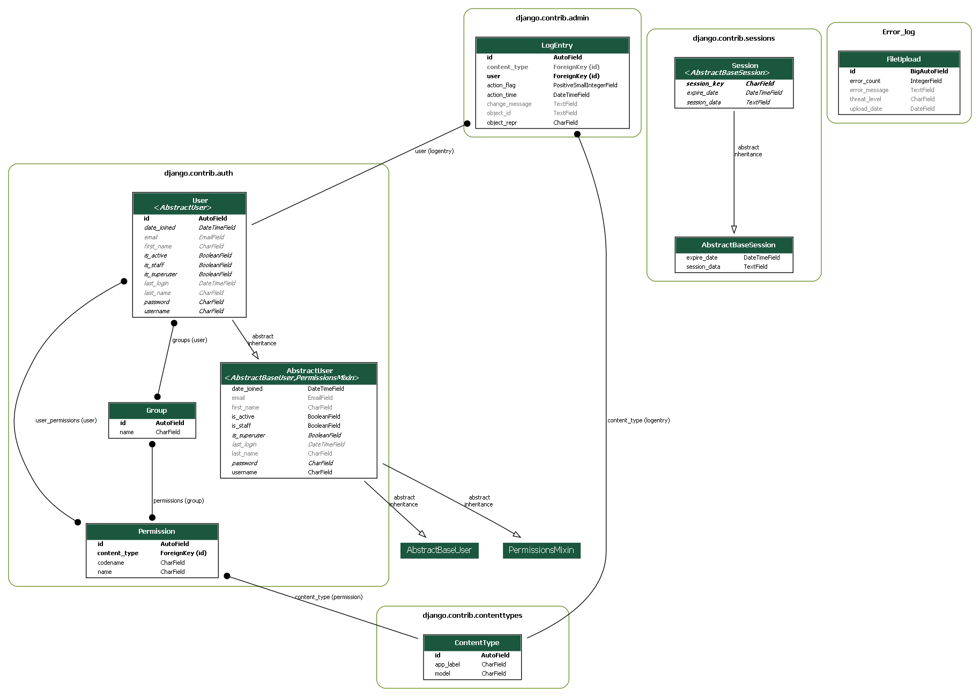
UML Diagrams
UML – CLASS DIAGRAM

Slide 16
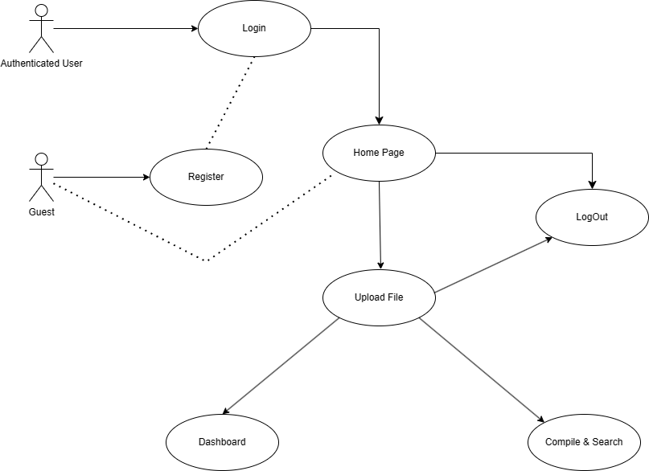
UML Diagrams
UML- USE CASE DIAGRAM

Slide 17
ALGORITHM
# Automated Error Resolution System
def user_navigation(request):
return render('home.html') if authenticated else render_login_page()
@login_required
def upload_file(request):
try:
uploaded_file = get_uploaded_file(request)
if uploaded_file:
file_name, language = save_and_get_file_info(uploaded_file)
result = compile_file(language, file_name)
if result.successful_compilation():
handle_successful_compilation(language)
else:
handle_compilation_error(language, result.error_message)
else:
display_no_file_uploaded_error()
except Exception as e:
handle_other_exceptions(e)
def retrieve_dashboard_data():
error_counts, upload_counts, extracted_error_counts = query_database()
return render('dashboard.html', {
'error_counts': to_json(error_counts),
'upload_counts': to_json(upload_counts)
})
def predict_threat_level(compilation_error):
error_type = extract_error_type(compilation_error)
return use_machine_learning_model(error_type)

Slide 18
IMPLEMENTATION
1. Django Web Application
Views:
Home View: Renders the home page.
Protected View: Renders a protected view.
User Registration View: Handles user registration using Django's UserCreationForm.
Upload File View (Protected): Renders the upload file view for authenticated users.
Compile and Search View: Processes uploaded files, attempts compilation, and provides dynamic error analysis.
Integration:
Machine Learning Model Integration: Utilizes a machine learning model for threat level prediction.
Real-time Feedback: Provides real-time feedback on compilation errors for developers.

Slide 19
IMPLEMENTATION
2. Machine Learning Model
Functionality:
Error Extraction: Identifies specific error types in compilation errors.
Threat Level Prediction: Uses a K-Nearest Neighbors classifier for predicting threat levels.
Data Handling:
Data Source: Utilizes JSON data for training the machine learning model.
Label Encoding: Transforms categorical features and labels using scikit-learn's LabelEncoder.
3.Performance Optimization:
Optimize code and database interactions for improved performance.
Address any bottlenecks or inefficiencies in the data exchange process.
9.Documentation:
Maintain comprehensive documentation detailing the code structure, functionality, and integration processes.
Include information on API endpoints, data formats, and any authentication mechanisms.

Slide 20
CODE(Back-end)
def compile_and_search(request):
response = None
if request.method == 'POST':
uploaded_file = request.FILES.get('file')
try:
if uploaded_file:
file_name, file_extension = os.path.splitext(uploaded_file.name)
language = file_extension[1:] # Exclude the dot in the extension
with open(f'Error_log/uploaded_file.{language}', 'wb') as destination:
for chunk in uploaded_file.chunks():
destination.write(chunk)
if language == 'py':
result = subprocess.run(['python', '-m', 'py_compile', f'Error_log/uploaded_file.{language}'], capture_output=True)
request.session['python_response'] = result.stderr.decode('utf-8') if result.returncode != 0 else None
elif language == 'java':
result = subprocess.run(['javac', f'Error_log/uploaded_file.{language}'], capture_output=True)
request.session['java_response'] = result.stderr.decode('utf-8') if result.returncode != 0 else None
if result.returncode == 0:
response = f"File compiled successfully. No syntax errors found for {language.capitalize()}."
if language=='py':
FileUpload.objects.create(error_count=0, threat_level='', error_message='')

Slide 21
CODE(Back-end)
request.session['python_response'] = None
request.session['java_response'] = None
else:
if language=='py’:
compilation_error = result.stderr.decode('utf-8')
response = f"Compilation error for {language.capitalize()}:\n\n{compilation_error}"
threat_level = predict_threat_level(compilation_error)
extracted_error = Error_Extraction(compilation_error)
error_count = FileUpload.objects.filter(threat_level='').count() + 1
FileUpload.objects.create(error_count=error_count, threat_level=threat_level, error_message=extracted_error)
response += f"\n\nPredicted Threat Level: {threat_level}"
else:
compilation_error = result.stderr.decode('utf-8')
error_lines = compilation_error.strip().split('^')
response = f"Compilation error for {language.capitalize()}:\n"
for i, error_line in enumerate(error_lines, start=1):
response += f"{i}.{error_line.strip()}\n"
search_query = f"{language.capitalize()} compilation error: {compilation_error}"
google_results = list(search(search_query, num=5, stop=5, pause=2))
if google_results and language=='java':
google_search_url = f"https://www.google.com/search?q={'+'.join(search_query.split())}"
webbrowser.open_new_tab(google_search_url)
el

Slide 22
CODE(back-end)
# Open a maximum of 2 tabs
se:
max_tabs = 2
for i, result in enumerate(google_results):
if i >= max_tabs:
break
webbrowser.open_new_tab(result)
else:
response = "No file uploaded."
except Exception as e:
# Handle other exceptions
response = f"Error: {str(e)}"
return render(request, 'Error_log/upload_file.html', {'response': response})

Slide 23
CODE(Machine Learning Model)
X = [entry["error_type"] for entry in data.values()]
y = [entry["threat_level"] for entry in data.values()]
le_error_type = LabelEncoder()
X_encoded = le_error_type.fit_transform(X)
le_threat_level = LabelEncoder()
y_encoded = le_threat_level.fit_transform(y)
knn_classifier = KNeighborsClassifier(n_neighbors=3, weights='distance', metric='manhattan')
knn_classifier.fit(X_encoded.reshape(-1, 1), y_encoded)
def predict_threat_level(compilation_error):
# Use the Error_Extraction function to get the specific error type
error_type = Error_Extraction(compilation_error)
# Encode the input feature
error_type_encoded = le_error_type.transform([error_type])
input_features = np.array(error_type_encoded).reshape(1, -1)
# Make predictions using the trained model
threat_level_encoded = knn_classifier.predict(input_features)
# Decode the predicted threat level
predicted_threat_level = le_threat_level.inverse_transform(threat_level_encoded)[0]
return predicted_threat_level

Slide 24
Testing
TestCase Number | TestCase Scenario | Expected Result | Result
TC-01 | Clicking submit without entering details | Alert ”Please fill all the details” | Pass
TC-02 | Clicking submit without entering username | Alert ”Please fill Username” | Pass
TC-03 | Clicking submit without entering Password | Alert ”Please fill Password” | Pass
TC-04 | Clicking submit without entering login details | Alert ”Please fill all the Details” | Pass
TC-05 | Clicking submit entering wrong username | Alert ”Please fill Correct details” | Pass
TC-06 | Clicking submit without entering username | Alert ”Please fill Username” | Pass
TC-07 | Clicking submit without entering Password | Alert ”Please fill Password” | Pass

Slide 25
OUTCOMES
1. Achievements
a. Efficient Error Handling
Streamlined file upload and compilation processes.
Real-time feedback for immediate error insights.
b. Threat Level Prediction
Integration of K-Nearest Neighbors for threat level predictions.
Dynamic analysis and prediction for Python errors.
c. Google Search Integration
Dynamic search for error solutions on Google.
Java compilation errors trigger relevant Google results.

Slide 26
OUTCOMES
2. User-Centric Interface
a. User Interaction
User-friendly views: Home, protected, and upload file.
Streamlined user onboarding with Django's user creation form.
b. Practical Impact
Real-world integration considerations.
Aiming for practical assistance in the development process.
3. Future Focus
a. Continual Enhancements
Data expansion for a diverse error dataset.
Opportunities for model parameter fine-tuning.
b. Integration with Software Development
Explore deployment in software development environments.
Aim for real-time assistance during development.

Slide 27
OUTCOMES
4. Conclusion
a. Key Achievements
Streamlined error handling and dynamic error solutions.
Integration of machine learning for threat level prediction.
b. Impact
Advancing software development practices.
Potential for more efficient and error-resilient coding.

Slide 28
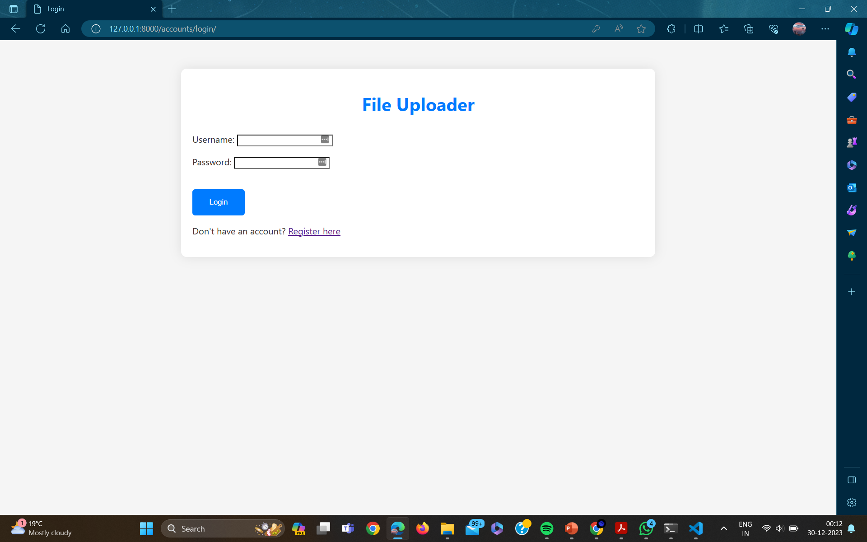
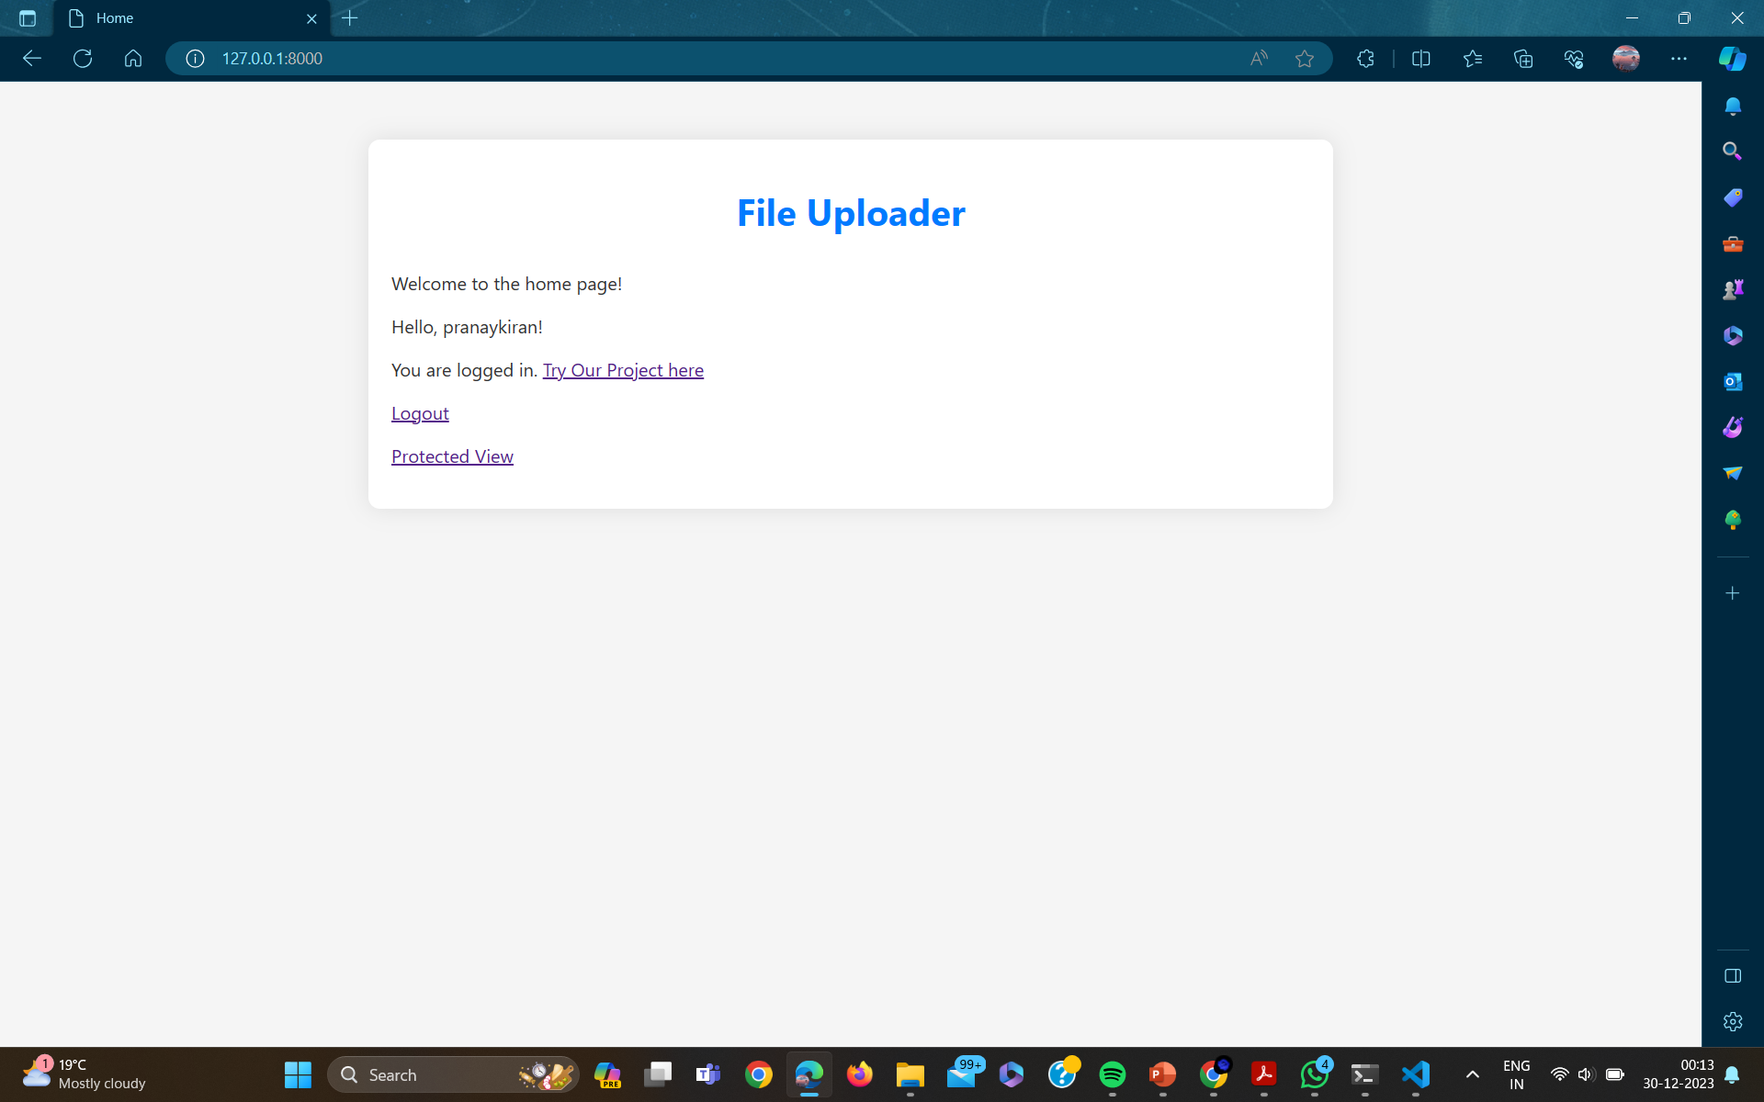

Slide 29
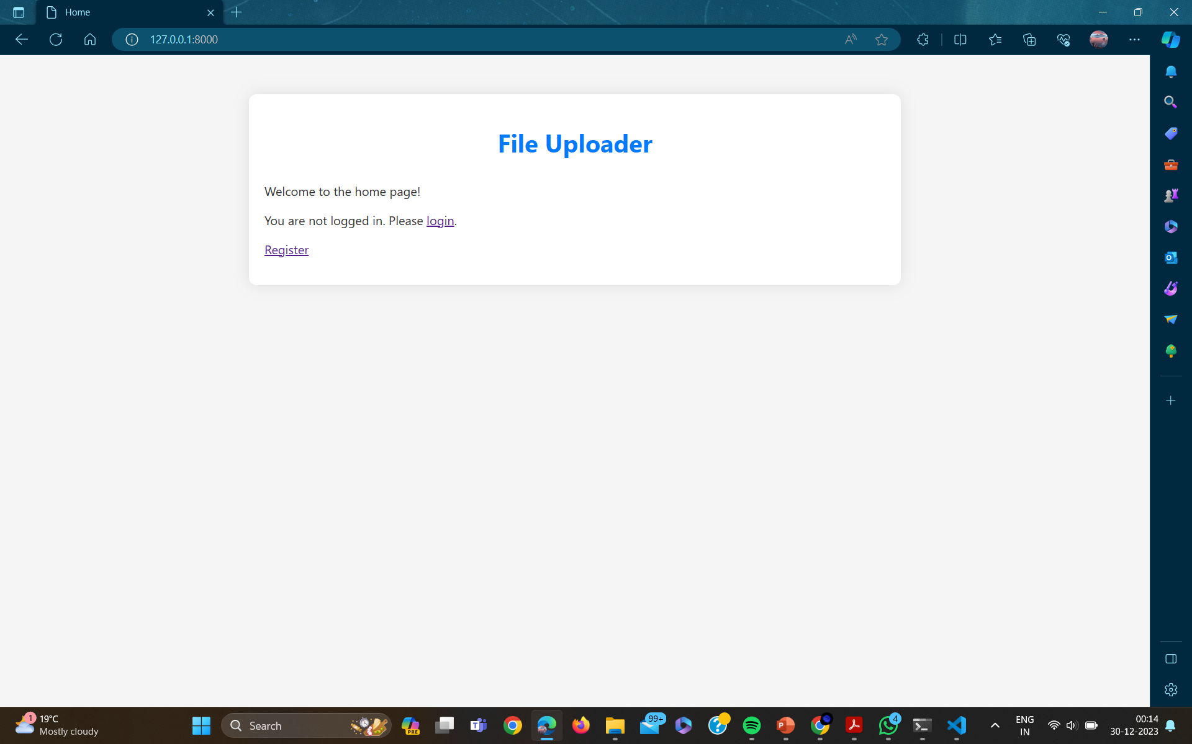
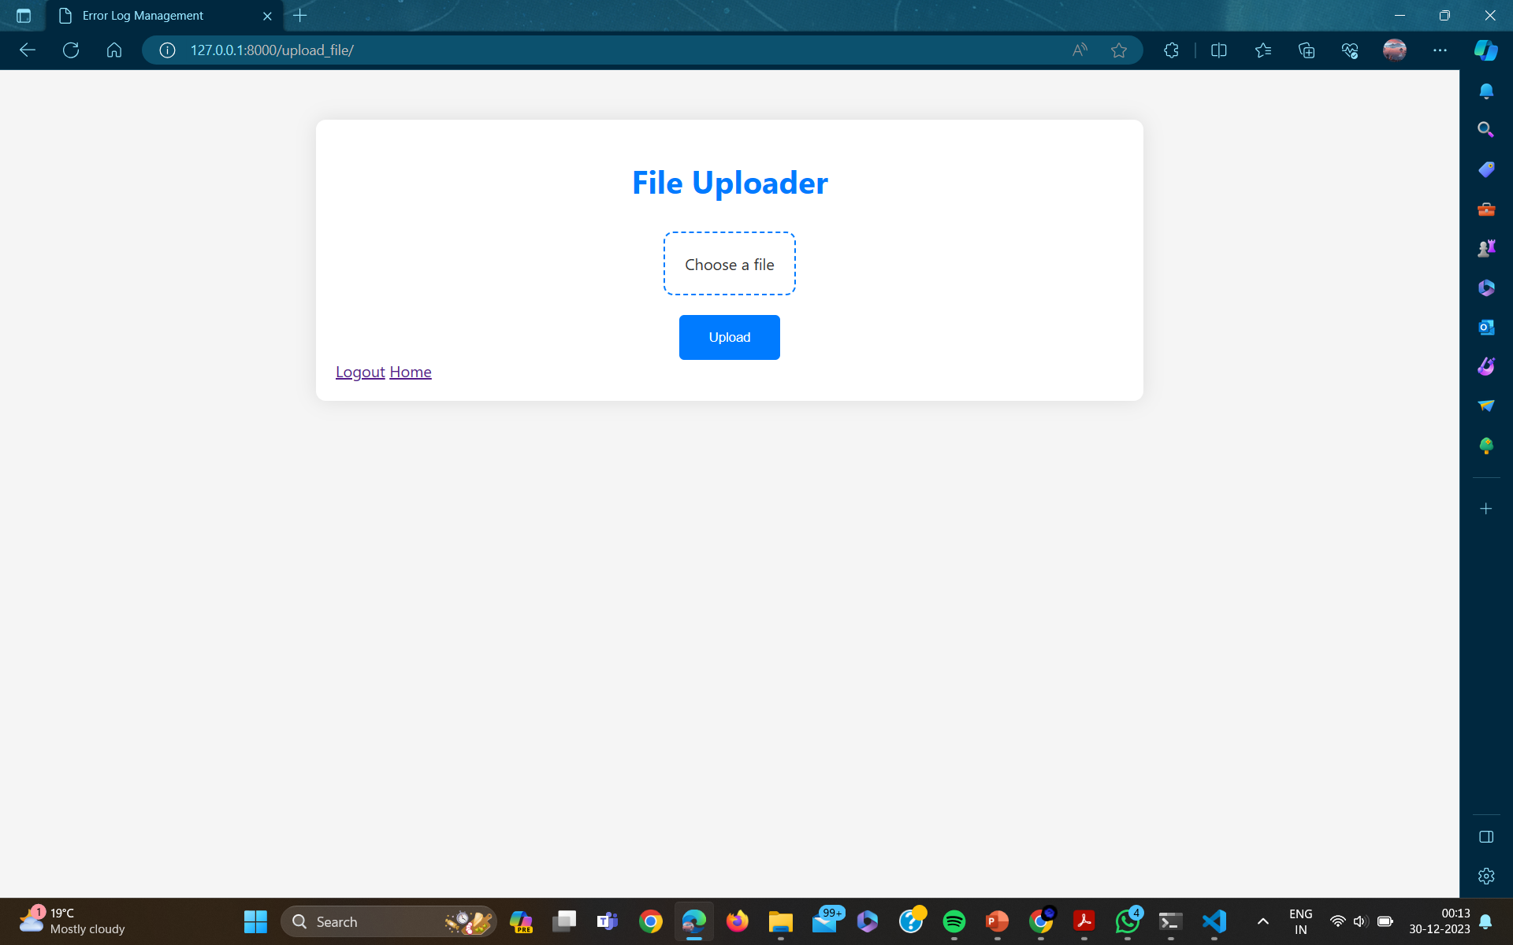

Slide 30
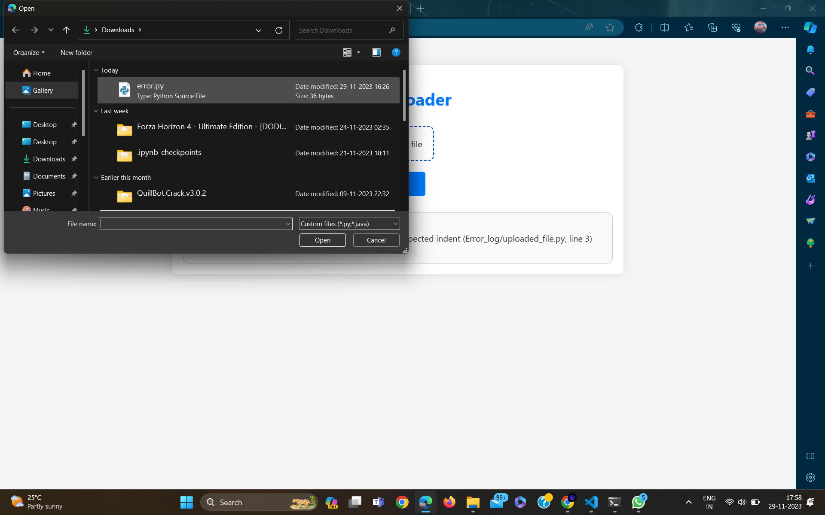
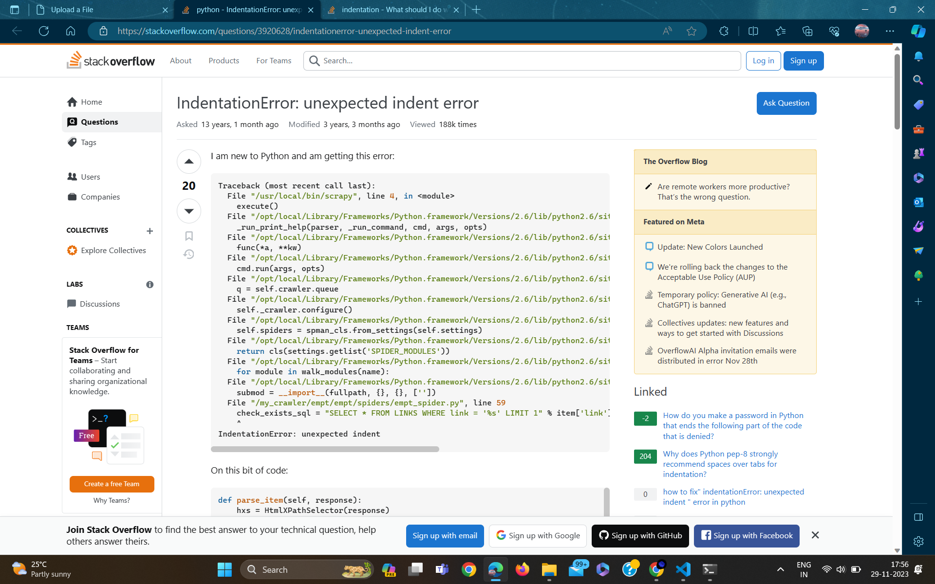

Slide 31
Conclusion
The Automated Error Resolution System presents a transformative approach to streamline error handling and enhance operational efficiency. By combining user-friendly interfaces, real-time analytics, and intelligent error prediction, the system empowers users to navigate and resolve errors with unprecedented ease. This proactive solution is poised to significantly minimize downtime, boost accuracy, and elevate overall system reliability, marking a pivotal advancement in error resolution methodologies.

Slide 32
Future Scope
Machine Learning Refinement:
Continuously enhance the machine learning models for error prediction and threat level assessment through iterative training on diverse datasets.
Explore advanced algorithms and techniques to improve the accuracy and robustness of error categorization.
Integration of Additional Languages:
Extend language support beyond Python and Java to cater to a broader range of development environments.
Incorporate dynamic language detection mechanisms to automatically identify the language of uploaded files.
Collaborative Error Resolution:
Implement collaborative features, allowing users to share and discuss error solutions, fostering a knowledge-sharing community within the platform.

Slide 33
Future Scope
Customizable Dashboards and Reporting:
Allow users to customize dashboards to display key metrics and insights relevant to their specific workflows.
Implement comprehensive reporting functionalities to provide in-depth analysis and historical trends of error occurrences.
Security and Compliance Features:
Strengthen security measures to ensure the protection of sensitive information within the error logs and user data.
Incorporate features that align with industry compliance standards, providing a secure and trustworthy error resolution environment.
User Feedback Mechanism:
Introduce a feedback system for users to provide insights on the effectiveness of suggested error solutions, contributing to ongoing system improvements.
Implement user-driven enhancements based on feedback to align the platform with evolving user needs.

Slide 34
Timeline of Project
Review-0 →13-Oct-2023→ PROJECT OVERVIEW
Review-1→10-Nov-2023 →WORKING ON THE ML MODEL AND DEVELOPING THE SOFTWARE
Review-2 →30-Nov-2023 →TRAINING THE MODEL AND TESTING THE SOFTWARE
Review-3→30-Dec-2023→CHECKING THE EFFECTIVENESS AND ACCURACY
OF THE SOFTWARE

Slide 35
References
[1] D. Yuan, S. Park, and Y. Zhou, ‘‘Characterizing logging practices in open source software,’’ in Proc. 34th Int. Conf. Softw. Eng. (ICSE), Jun. 2012,
[2] M. Fuller, E. Brighton, M. Schiewe, D. Das, T. Cerny, and P. Tisnovsky,
‘‘Automated error log resolution: A case study,’’ in Proc. 36th Annu. ACM
Symp. Appl. Comput., Mar. 2021,
[3] X. Wang, D. Wang, Y. Zhang, L. Jin, and M. Song, ‘‘Unsupervised
learning for log data analysis based on behavior and attribute features,’’
in Proc. Int. Conf. Artif. Intell. Comput. Sci., Jul. 2019,
[4] R. C. Raga and J. D. Raga, ‘‘A comparison of college faculty and student
class activity in an online learning environment using course log data,’’ in
Proc. IEEE SmartWorld Ubiquitous Intell. Comput. Adv. Trust. Comput.
Scalable, Dec. 2018,
[5] G. Qi, W. T. Tsai, W. Li, Z. Zhu, and Y. Luo, ‘‘A cloud-based triage log
analysis and recovery framework,’’ Simul. Model. Pract. Theory, vol. 77, Aug. 2020.

Slide 36
References
[6] X. Tian, H. Li, and F. Liu, ‘‘Web service reliability test method based
on log analysis,’’ in Proc. IEEE Int. Conf. Softw., Rel. Secur. Companion
(QRS-C), Jul. 2017,
[7] D. Zou, H. Qin, and H. Jin, ‘‘UiLog: Improving log-based fault diagnosis
by log analysis,’’ J. Comput. Sci. Technol., vol. 31, no. 5,
2016, doi: 10.1007/s11390-016-1678-7.
[8] S. Locke, H. Li, T. H. P. Chen, W. Shang, and W. Liu, ‘‘LogAssist:
Assisting log analysis through log summarization,’’ IEEE Trans. Softw.
Eng., early access, May 26, 2021, doi: 10.1109/TSE.2021.3083715.
[9] J. Cándido, M. Aniche, and A. Van Deursen, ‘‘Log-based software
monitoring: A systematic mapping study,’’ PeerJ Comput. Sci., vol. 7, Oct. 2021
[10] D. Obrâbski and J. Sosnowski, ‘‘Log based analysis of software application
operation,’’ Adv. Intell. Syst. Comput., vol. 987,
Oct. 2020
[11] Q. Cao, Y. Qiao, and Z. Lyu, ‘‘Machine learning to detect anomalies
in web log analysis,’’ in Proc. 3rd IEEE Int. Conf. Comput. Commun.
(ICCC), Dec. 2017,

Slide 37
Thank You

