Slide 1
PROJECT TITLE
PIP104 University Project-II
Review-3
AI Powered Server Log Management Software
Batch Number:
Roll Number | Student Name
20201CEI0161 | A Deepak Venkat (TL)
20201CEI0157 | S Pranay Kiran
20201CEI0172 | Akshay Jayesh
20201CEI0164 | M Kesava
Under the Supervision of,
Mrs. Shaik Salma Begum
Assistant Professor
School of Computer Science & Engineering
Presidency University

Slide 2
AI Powered Server Log Management Software

Slide 3
ABSTRACT
In software engineering, logging traditionally aids in root cause analysis and failure identification. Recent advancements in automated log file analysis have expanded its utility to include real-time system health monitoring, user behavior analysis, and domain knowledge extraction. However, the lack of a standardized format remains a significant obstacle. Focusing on the last five years, this paper summarizes key research topics, categorizes log files used in studies, and offers an informative foundation for future investigators, providing insights into diverse log data applications.

Slide 4
Introduction
Effective server log management is essential in the ever-changing IT environment of today. Our project uses artificial intelligence (AI) to present a novel solution.
It provides real-time anomaly detection and forecast insights by automating the processes of log gathering, parsing, and analysis.
IT workers find this program invaluable since it streamlines difficult log management procedures.
It provides a user-friendly interface, cutting-edge machine learning techniques, and improved server speed and security.
It deals with Real-time anomaly detection and issue prevention.
It provides User-friendly interface for ease of use.

Slide 5
LITERATURE SURVEY
Landscape of Automated Log Analysis: A Systematic Literature Review and Mapping Study(Link: DOI)
Authors: ukasz Korzeniowski, Krzysztof Goczyła
Summary:
The automated log analysis in software engineering literature from 2000 to June 2021 is systematically reviewed in this research. It classifies log file kinds, organizes log file information, and gives a summary of study areas. While providing several applications of log analysis and insightful information for novice researchers, the study also recognizes the ongoing problem of inconsistent log data format and content standards. Although it doesn't provide a single standard, it offers a thorough foundation for comprehending and applying log data in a variety of contexts.

Slide 6
LITERATURE SURVEY
Web Service Reliability Test Method Based on Log Analysis (Link: DOI)
Authors: Xuetao Tian, Honghui Li, Feng Liu
Summary:
This article suggests a log analysis based web service reliability test procedure for Client/Server (C/S) architecture software. It uses Random Walk to create test cases, Markov chain to automatically build a software use model to mimic user access situations, and MTBF to assess program dependability (with a focus on server breakdowns). A genuine online program is tested and analyzed to validate the approach, showing that the obtained MTBF and realistic log data are similar. It does not, however, provide a general solution for all C/S architectural scenarios or solve more general dependability issues beyond server breakdowns.

Slide 7
LITERATURE SURVEY
LogLens: A Real-time Log Analysis System(Link: DOI)
Authors: Biplob Debnath, Mohiuddin Solaimani, Muhammad Ali Gulzar, Nipun Arora,
Cristian Lumezanu, Jianwu Xu, Bo Zong, Hui Zhang§, Guofei Jiang§, and Latifur Khan
Summary:
This paper introduces LogLens, a real-time log analysis system that employs unsupervised machine learning for automated anomaly detection in application logs, requiring minimal system knowledge and user specification. LogLens supports both stateless and stateful log analysis applications, going beyond conventional log indexing and search solutions. It currently operates in a commercial log analysis solution, demonstrating significant efficiency gains, but it doesn't address limitations related to specific types of anomalies or potential challenges in diverse environments beyond industrial settings.

Slide 8
SOFTWARE USED
Back-End:
Python
Django Framework
Machine Learning Models
Libraries Included: Json,Scikit-Learn,GoogleSearch,WebBrowser etc.
Front-End:
HTML5
CSS3

Slide 9
HARDWARE REQUIREMENTS
Computing Machine with minimum Requirements stated below:
Windows 7 or above
Internet Connection
8 Gigabytes of Memory
1 Gigabyte of Diskspace

Slide 10
Existing Systems
In the rapidly evolving landscape of IT infrastructure, organizations face a critical challenge in efficiently managing and resolving errors that occur across servers, applications, and databases. The current manual processes for error log retrieval, categorization, and resolution are time-consuming and often prone to human errors, leading to increased downtime and operational inefficiencies. To address these challenges, we propose the development of an AI-powered software solution with the following key objectives:
1.Automated Error Log Retrieval
2. Dynamic Categorization and Segregation
3. Enhanced Effectiveness in Link Relevance

Slide 11
ADVANTAGES & DISADVANTAGES
ADVANTAGES:
Reduced Downtime
Increased Accuracy in Error Categorization
Efficient Knowledge Access
Improved Error Resolution Intelligence
DISADVANTAGES:
Initial Implementation Complexity
Dependency on Data Quality
Privacy and Security Concerns
Training and Adoption Challenges

Slide 12
PROPOSED METHOD
Automated Error Log Retrieval:
Lack of real-time analysis hampers proactive issue resolution.
Dynamic Categorization and Segregation:
Dynamic categorization ensures swift and accurate error response.
Integration with Knowledge Bases (KB):
Integration with external knowledge bases for efficient error resolution.
Enhanced Effectiveness in Link Relevance:
Target: Achieve 95% effectiveness in relevance for suggested links.

Slide 13
ADVANTAGES
Precision in Error Categorization:
Advantage: Dynamic categorization reduces inconsistencies, ensuring accurate and timely responses.
Streamlined Knowledge Access:
Advantage: Integration with knowledge bases improves overall efficiency in error resolution.
Intelligent Error Resolution:
Advantage: Targeting 95% effectiveness in link relevance enhances error resolution intelligence.
Precision in Error Categorization:
Advantage: Dynamic categorization reduces inconsistencies, ensuring accurate and timely responses.

Slide 14
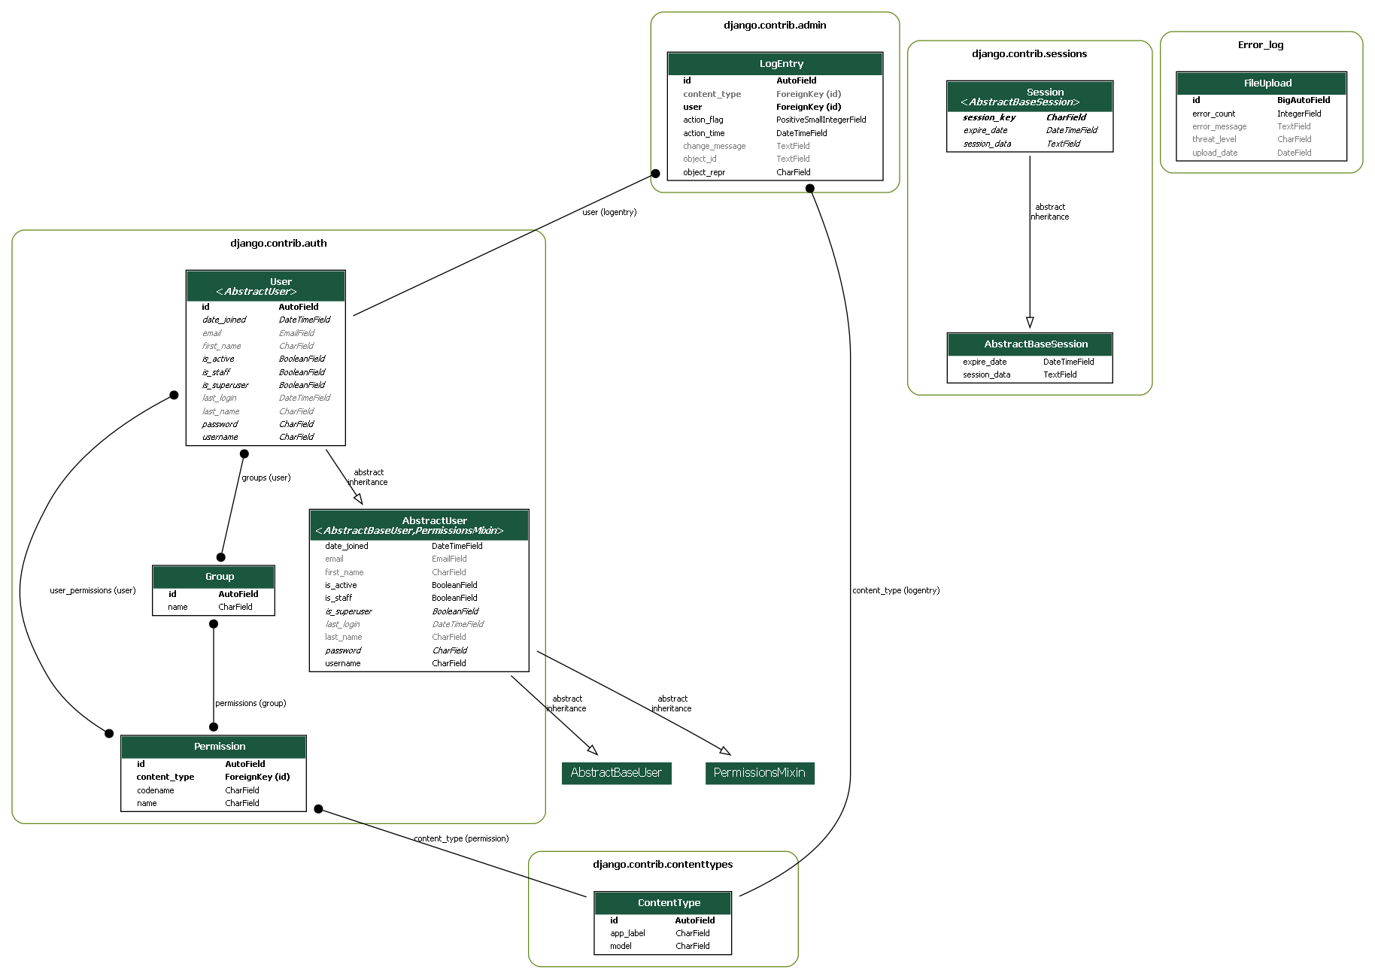
UML Diagrams
UML – CLASS DIAGRAM

Slide 15
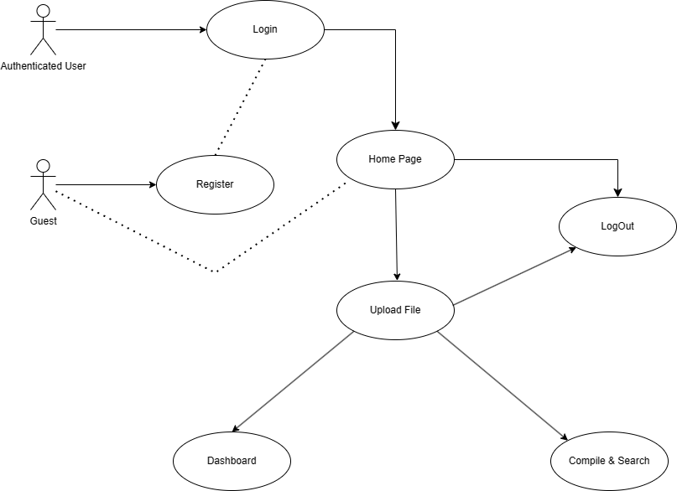
UML Diagrams
UML- USE CASE DIAGRAM

Slide 16
ALGORITHM
def handle_file_upload(request):
try:
uploaded_file = get_uploaded_file(request)
if uploaded_file:
file_name, language = save_and_get_file_info(uploaded_file)
result = compile_file(language, file_name)
if result.successful_compilation():
handle_successful_compilation(language)
else:
handle_compilation_error(language, result.error_message)
else:
display_no_file_uploaded_error()
except Exception as e:
handle_other_exceptions(e)
def show_dashboard():
error_counts, upload_counts, extracted_error_counts = query_database()
render('dashboard.html', {
'error_counts': to_json(error_counts),
'upload_counts': to_json(upload_counts)
})
def predict_error_threat(compilation_error):
error_type = extract_error_type(compilation_error)
return use_machine_learning_model(error_type)

Slide 17
IMPLEMENTATION
1. Django Web Application
Views:
User Registration View: Handles user registration using Django's UserCreationForm.
Upload File View (Protected): Renders the upload file view for authenticated users.
Compile and Search View: Processes uploaded files, attempts compilation, and provides dynamic error analysis.
Integration:
Machine Learning Model Integration: Utilizes a machine learning model for threat level prediction.
Real-time Feedback: Provides real-time feedback on compilation errors for developers.

Slide 18
IMPLEMENTATION
2. Machine Learning Model
Functionality:
Threat Level Prediction: Uses a K-Nearest Neighbours classifier for predicting threat levels.
Data Handling:
Label Encoding: Transforms categorical features and labels using scikit-learn's LabelEncoder.
3.Documentation:
Maintain comprehensive documentation detailing the code structure, functionality, and integration processes.
Include information on data formats, and any authentication mechanisms.

Slide 19
CODE(Back-end)
def compile_and_search(request):
response = None
if request.method == 'POST':
uploaded_file = request.FILES.get('file')
try:
if uploaded_file:
file_name, file_extension = os.path.splitext(uploaded_file.name)
language = file_extension[1:] # Exclude the dot in the extension
with open(f'Error_log/uploaded_file.{language}', 'wb') as destination:
for chunk in uploaded_file.chunks():
destination.write(chunk)
if language == 'py':
result = subprocess.run(['python', '-m', 'py_compile', f'Error_log/uploaded_file.{language}'], capture_output=True)
request.session['python_response'] = result.stderr.decode('utf-8') if result.returncode != 0 else None
elif language == 'java':
result = subprocess.run(['javac', f'Error_log/uploaded_file.{language}'], capture_output=True)
request.session['java_response'] = result.stderr.decode('utf-8') if result.returncode != 0 else None
if result.returncode == 0:
response = f"File compiled successfully. No syntax errors found for {language.capitalize()}."
if language=='py':
FileUpload.objects.create(error_count=0, threat_level='', error_message='')

Slide 20
CODE(Back-end)
request.session['python_response'] = None
request.session['java_response'] = None
else:
if language=='py’:
compilation_error = result.stderr.decode('utf-8')
response = f"Compilation error for {language.capitalize()}:\n\n{compilation_error}"
threat_level = predict_threat_level(compilation_error)
extracted_error = Error_Extraction(compilation_error)
error_count = FileUpload.objects.filter(threat_level='').count() + 1
FileUpload.objects.create(error_count=error_count, threat_level=threat_level, error_message=extracted_error)
response += f"\n\nPredicted Threat Level: {threat_level}"
else:
compilation_error = result.stderr.decode('utf-8')
error_lines = compilation_error.strip().split('^')
response = f"Compilation error for {language.capitalize()}:\n"
for i, error_line in enumerate(error_lines, start=1):
response += f"{i}.{error_line.strip()}\n"
search_query = f"{language.capitalize()} compilation error: {compilation_error}"
google_results = list(search(search_query, num=5, stop=5, pause=2))
if google_results and language=='java':
google_search_url = f"https://www.google.com/search?q={'+'.join(search_query.split())}"
webbrowser.open_new_tab(google_search_url)

Slide 21
CODE(back-end)
# Open a maximum of 2 tabs
else:
max_tabs = 2
for i, result in enumerate(google_results):
if i >= max_tabs:
break
webbrowser.open_new_tab(result)
else:
response = "No file uploaded."
except Exception as e:
# Handle other exceptions
response = f"Error: {str(e)}"
return render(request, 'Error_log/upload_file.html', {'response': response})

Slide 22
CODE(Machine Learning Model)
X = [entry["error_type"] for entry in data.values()]
y = [entry["threat_level"] for entry in data.values()]
le_error_type = LabelEncoder()
X_encoded = le_error_type.fit_transform(X)
le_threat_level = LabelEncoder()
y_encoded = le_threat_level.fit_transform(y)
knn_classifier = KNeighborsClassifier(n_neighbors=3, weights='distance', metric='manhattan')
knn_classifier.fit(X_encoded.reshape(-1, 1), y_encoded)
def predict_threat_level(compilation_error):
# Use the Error_Extraction function to get the specific error type
error_type = Error_Extraction(compilation_error)
# Encode the input feature
error_type_encoded = le_error_type.transform([error_type])
input_features = np.array(error_type_encoded).reshape(1, -1)
# Make predictions using the trained model
threat_level_encoded = knn_classifier.predict(input_features)
# Decode the predicted threat level
predicted_threat_level = le_threat_level.inverse_transform(threat_level_encoded)[0]
return predicted_threat_level

Slide 23
Testing
TestCase Number | TestCase Scenario | Expected Result | Result
TC-01 | Clicking submit without entering details | Alert ”Please fill all the details” | Pass
TC-02 | Clicking submit without entering username | Alert ”Please fill Username” | Pass
TC-03 | Clicking submit without entering Password | Alert ”Please fill Password” | Pass
TC-04 | Clicking submit without entering login details | Alert ”Please fill all the Details” | Pass
TC-05 | Clicking submit entering wrong username | Alert ”Please fill Correct details” | Pass
TC-06 | Clicking submit without entering username | Alert ”Please fill Username” | Pass
TC-07 | Clicking submit without entering Password | Alert ”Please fill Password” | Pass

Slide 24
RESULTS
1. Achievements
a. Efficient Error Handling
Streamlined file upload and compilation processes.
Real-time feedback for immediate error insights.
b. Threat Level Prediction
Integration of K-Nearest Neighbors for threat level predictions.
c. Google Search Integration
Dynamic search for error solutions on Google.
2. User-Centric Interface
a. Practical Impact
Real-world integration considerations.
Aiming for practical assistance in the development process.

Slide 25
RESULTS
3. Conclusion
a. Key Achievements
Streamlined error handling and dynamic error solutions.
Integration of machine learning for threat level prediction.
b. Impact
Advancing software development practices.
Potential for more efficient and error-resilient coding.

Slide 26
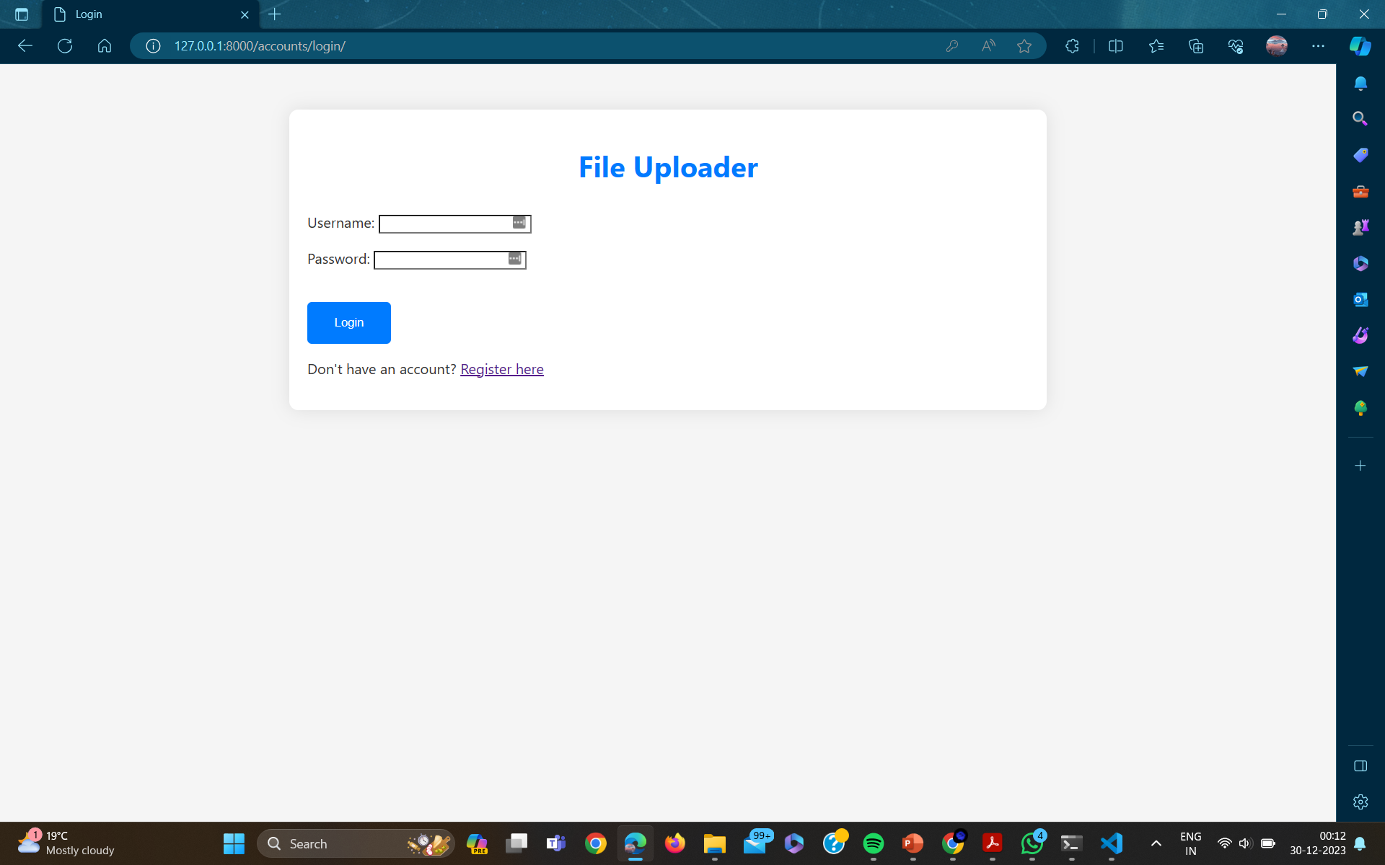
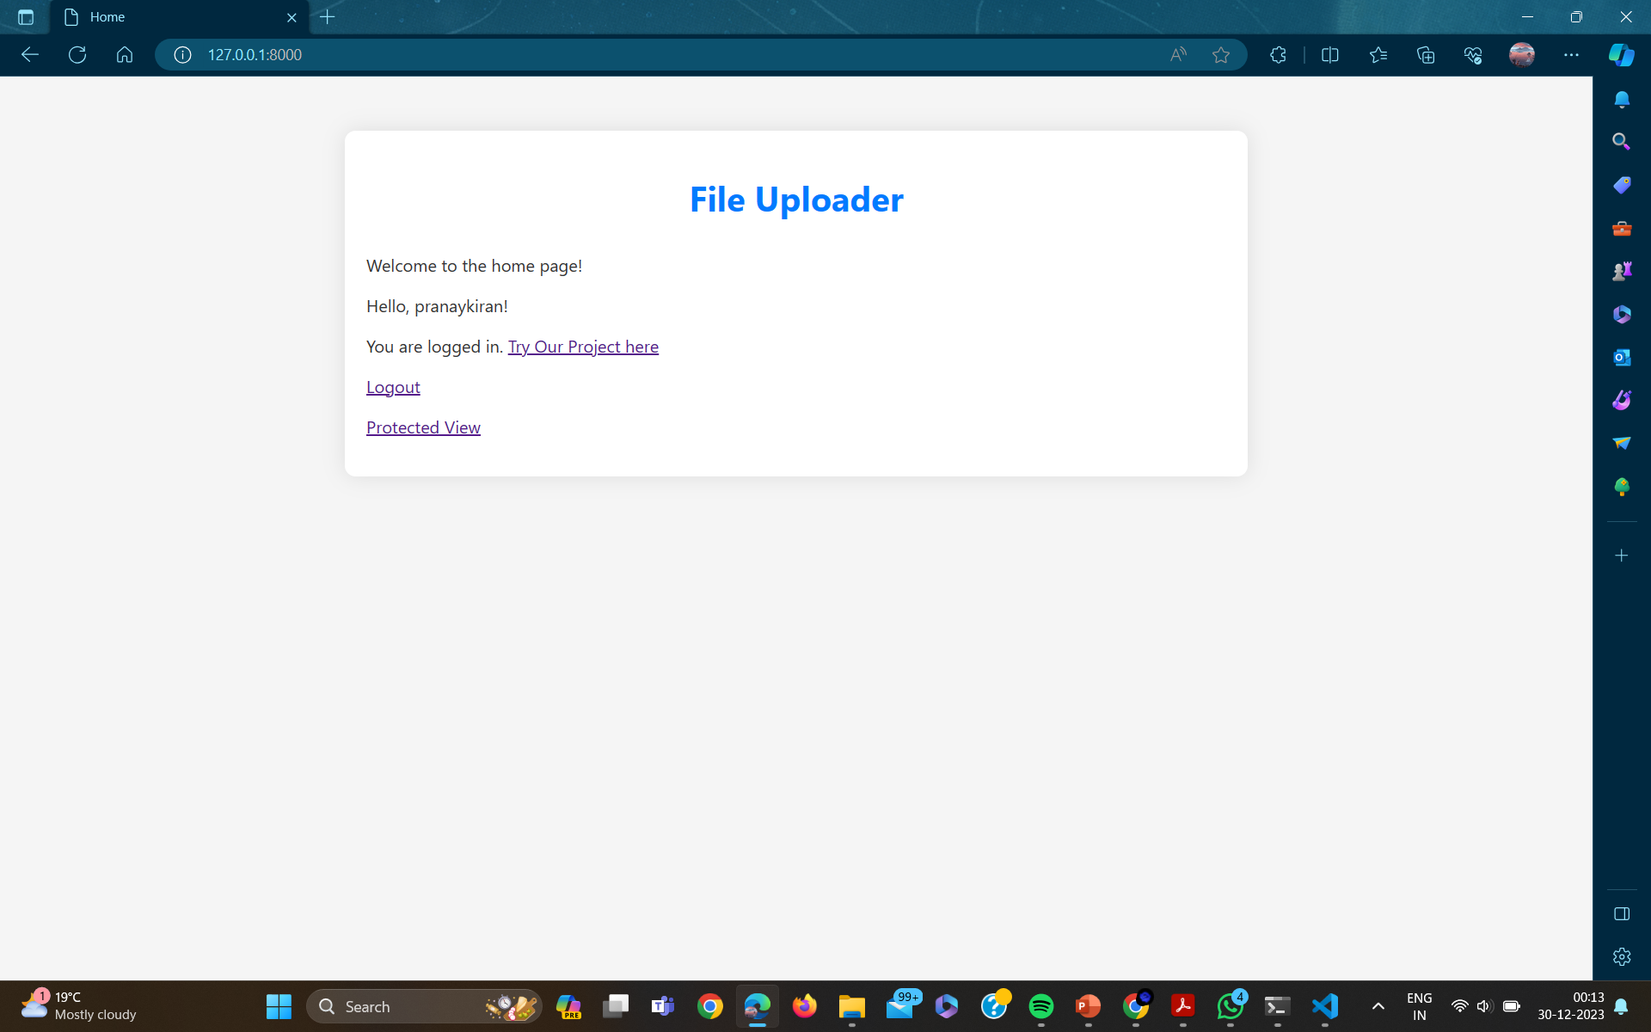

Slide 27
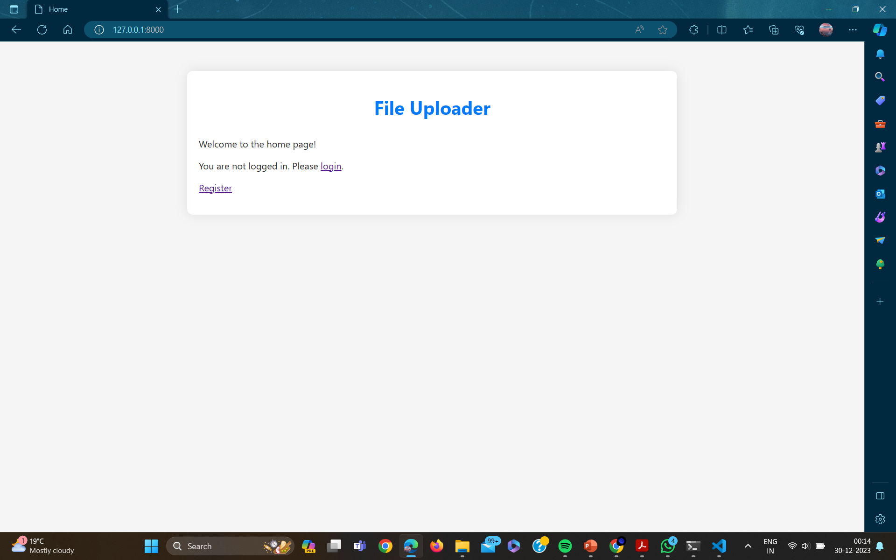
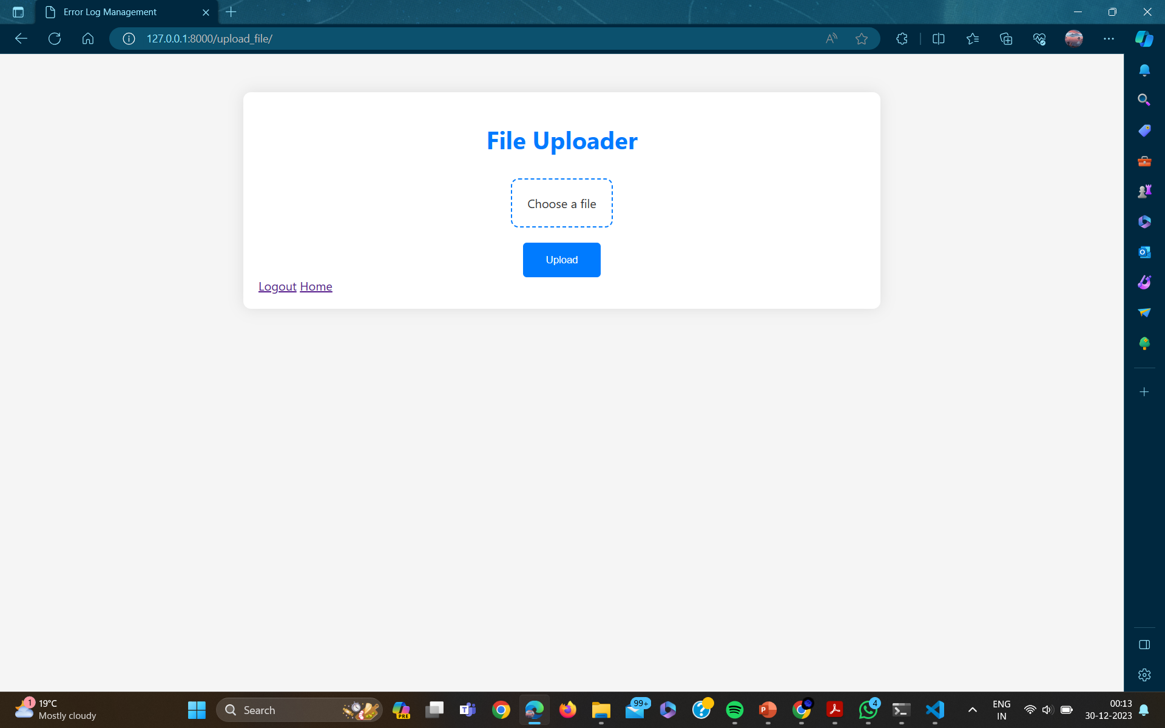

Slide 28
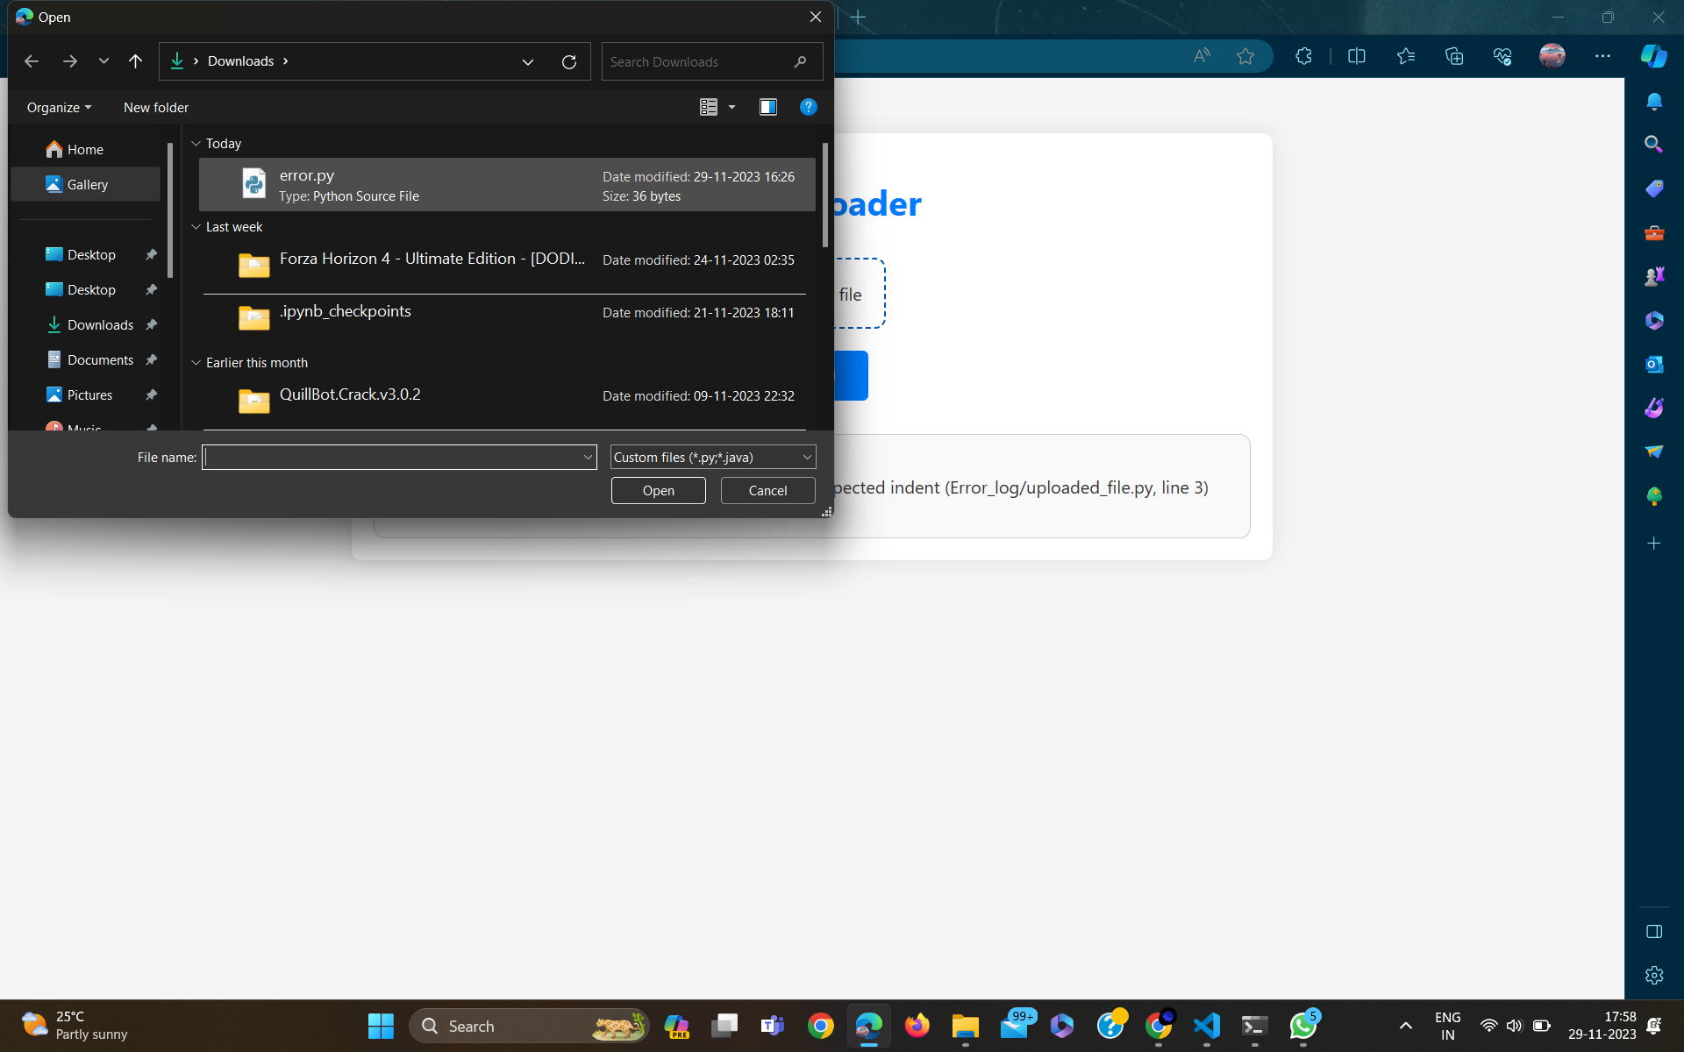
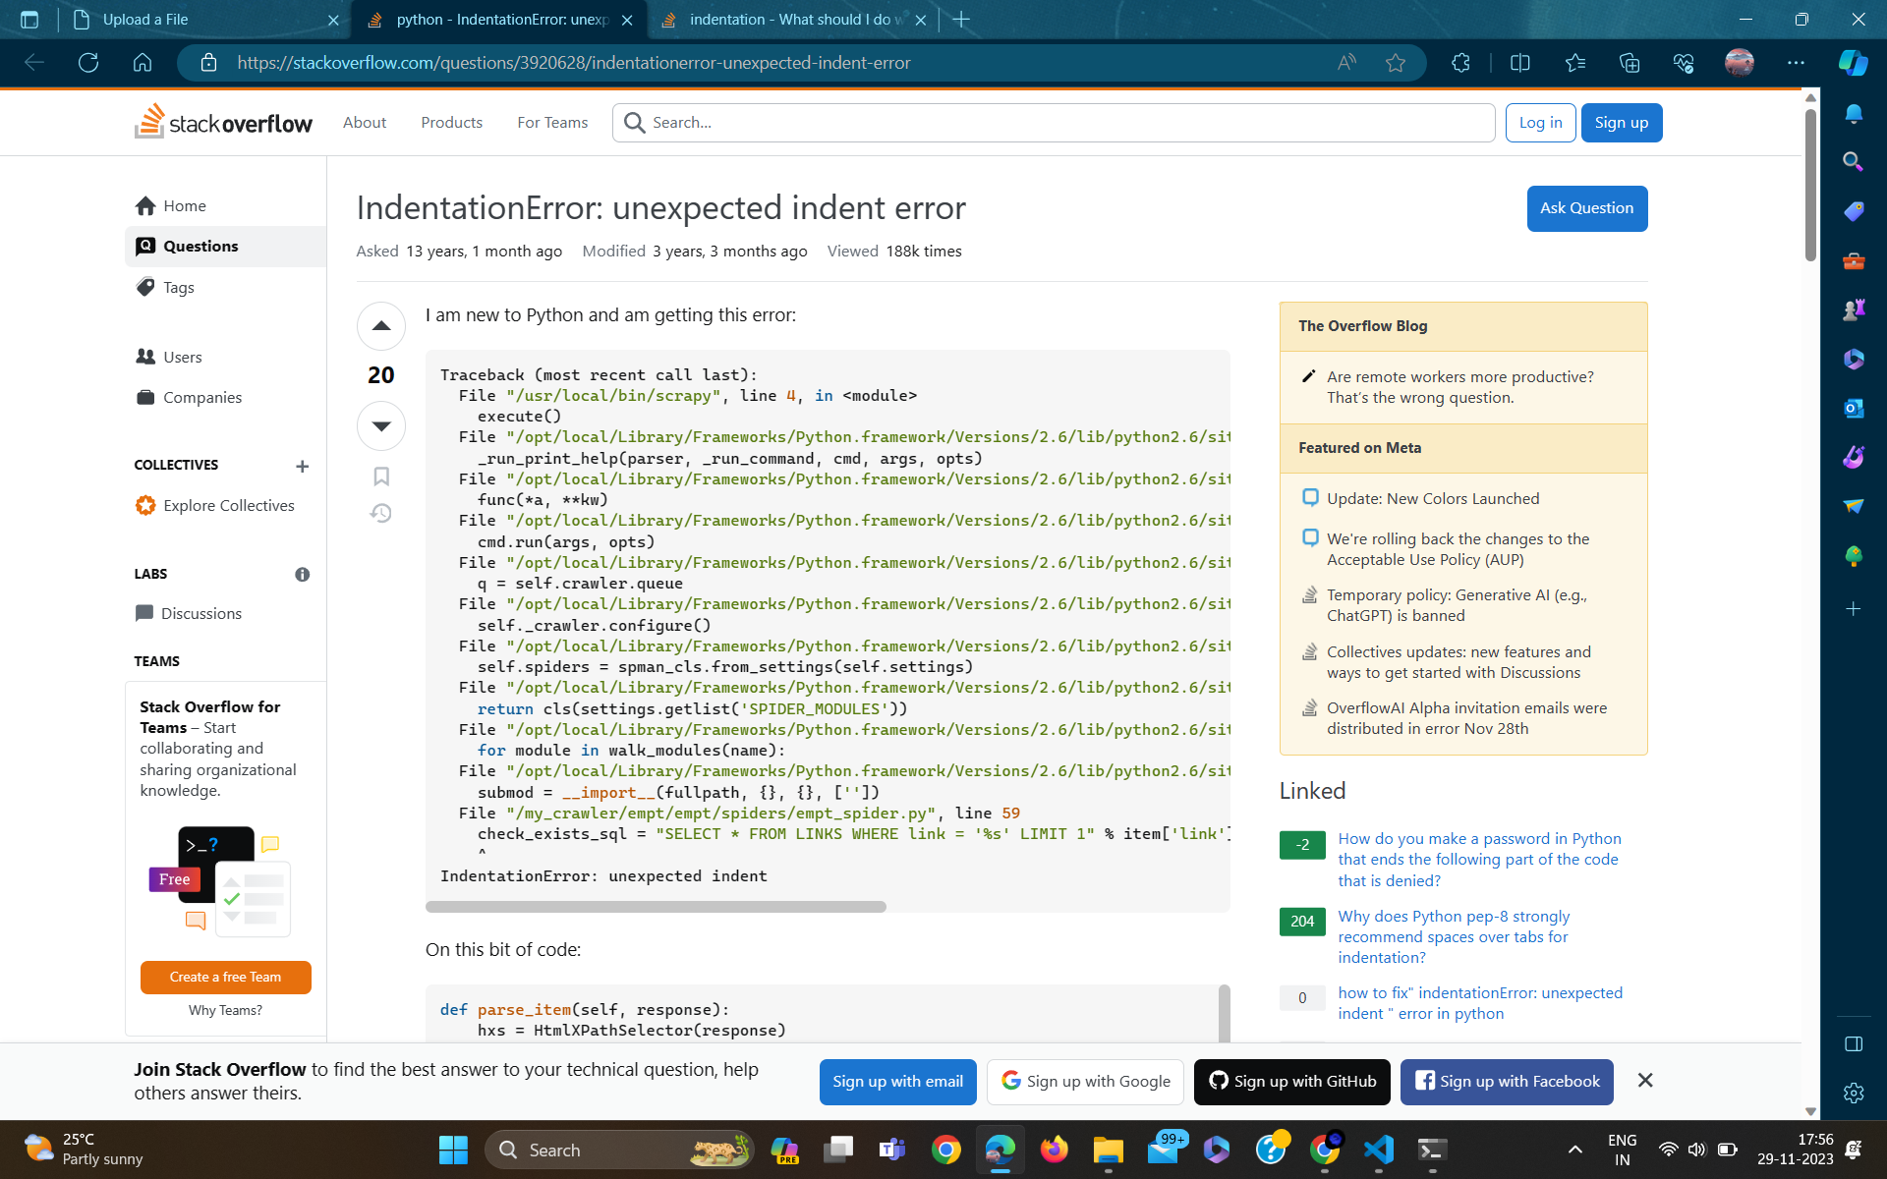

Slide 29
Conclusion
The Automated Error Resolution System presents a transformative approach to streamline error handling and enhance operational efficiency. By combining user-friendly interfaces, real-time analytics, and intelligent error prediction, the system empowers users to navigate and resolve errors with unprecedented ease. This proactive solution is poised to significantly minimize downtime, boost accuracy, and elevate overall system reliability, marking a pivotal advancement in error resolution methodologies.

Slide 30
Future Scope
Integration of Additional Languages:
Extend language support beyond Python and Java to cater to a broader range of development environments.
Incorporate dynamic language detection mechanisms to automatically identify the language of uploaded files.
Customizable Dashboards and Reporting:
Allow users to customize dashboards to display key metrics and insights relevant to their specific workflows.
Implement comprehensive reporting functionalities to provide in-depth analysis and historical trends of error occurrences.

Slide 31
Future Scope
User Feedback Mechanism:
Introduce a feedback system for users to provide insights on the effectiveness of suggested error solutions, contributing to ongoing system improvements.
Implement user-driven enhancements based on feedback to align the platform with evolving user needs.

Slide 32
References
[1] D. Yuan, S. Park, and Y. Zhou, ‘‘Characterizing logging practices in open source software,’’ in Proc. 34th Int. Conf. Softw. Eng. (ICSE), Jun. 2012,
[2] M. Fuller, E. Brighton, M. Schiewe, D. Das, T. Cerny, and P. Tisnovsky,
‘‘Automated error log resolution: A case study,’’ in Proc. 36th Annu. ACM
Symp. Appl. Comput., Mar. 2021,
[3] X. Wang, D. Wang, Y. Zhang, L. Jin, and M. Song, ‘‘Unsupervised
learning for log data analysis based on behavior and attribute features,’’
in Proc. Int. Conf. Artif. Intell. Comput. Sci., Jul. 2019,
[4] R. C. Raga and J. D. Raga, ‘‘A comparison of college faculty and student
class activity in an online learning environment using course log data,’’ in
Proc. IEEE SmartWorld Ubiquitous Intell. Comput. Adv. Trust. Comput.
Scalable, Dec. 2018,
[5] G. Qi, W. T. Tsai, W. Li, Z. Zhu, and Y. Luo, ‘‘A cloud-based triage log
analysis and recovery framework,’’ Simul. Model. Pract. Theory, vol. 77, Aug. 2020.

Slide 33
Thank You

