Slide 1

Why Hibernate?
In JDBC, Java programmer should know how to write queries in SQL.
JDBC is Database dependent(earlier if we were using MySQL and later if we change to oracle then the queries has to be rewritten.)
Handling the JDBC connections and properly closing the connection is also a big issue. Properly closing the connection is must.

Slide 2
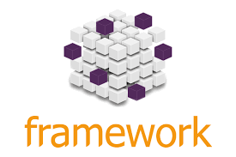
Framework
A framework is a structure that you can build software on. It serves as a foundation, so you're not starting entirely from scratch.
The purpose of framework is to allow designers and developers to focus on building an unique feature for their web based projects rather than re-inventing by coding.
Framework is specially created to help you boost the performance and efficiency of your web app development task.

Slide 3

Hibernate
Hibernate is a framework which provides some abstraction layer, meaning that the programmer does not have to worry about the implementations, Hibernate does the implementations for you internally like Establishing a connection with the database, writing query to perform CRUD operations etc.
Hibernate is an ORM Tool.

Slide 4
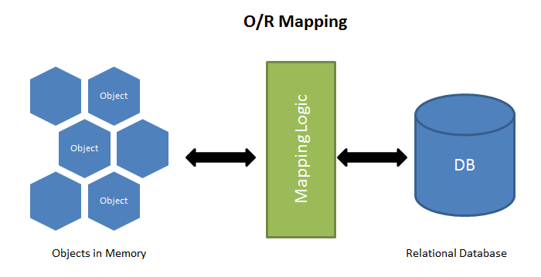
ORM Tool
Object-Relational Mapping (ORM) is a technique that lets you query and manipulate data from a database using an object-oriented paradigm.
An ORM library is a completely ordinary library written in your language of choice that encapsulates the code needed to manipulate the data, so you don't use SQL anymore, you interact directly with an object in the same language you're using.

Slide 5
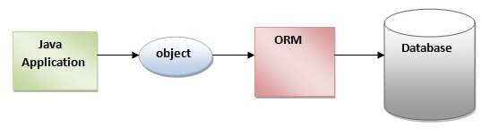
How Hibernate Works?
In Hibernate framework we use Objects to develop persistence logic which are independent of database software.
In hibernate every class will be mapped to table and every object will be mapped to column or table data.
To tell the program which class to be converted as table we will use an annotation @Entity before class, this will create the table and object or variable created will be considered as column.
By initializing the objects we can insert data into table.
To declare any column as Primary key we will use @Id annotation before declaring that variable.
In a Class we should have only one primary key or @Id.

Slide 6

How to Establish Connection thru Hibernate
EntityManagerFactory interface has createEntityManagerFactory() method of Persistence class which helps in establishing connection to database and will create table for @Entity class.
EntityManager is used to perform crud operations on database. Every factory requires a manager.
EntityTransaction is used whenever we are making changes to database or operation which will affect the database.

Slide 7
Different Methods Of EntityManager
First we will use setters to set the values to object and we will use persist() method and pass the object as parameter which will save the object as table columns.
Find() method is used to find the object based on primary key which will return the object containing that Primary key.
Remove() method will delete the values. Before removing we will find the object.
merge() is used to alter the table. Before merging we will find the object.
For executing queries which don't have particular methods we will use CreateQuery("HQL") to execute such queries.

Slide 8

Note:
To make table name different from class name we use entity property name. i.e. Entity(name="Employee_Details").
If we want to specify name for column other than variable name we use column annotation. i.e. @Column(name="Employee_details").
To make a column NotNull we have to use nullable property of annotation column i.e. @Column(nullable=true);
To make a column Unique we have to use nullable property of annotation column i.e. @Column(Unique=true);
To restrict the length we use length property but we don't usually use this as it is already done in the frontend. i.e. @Column(length=20);

Slide 9
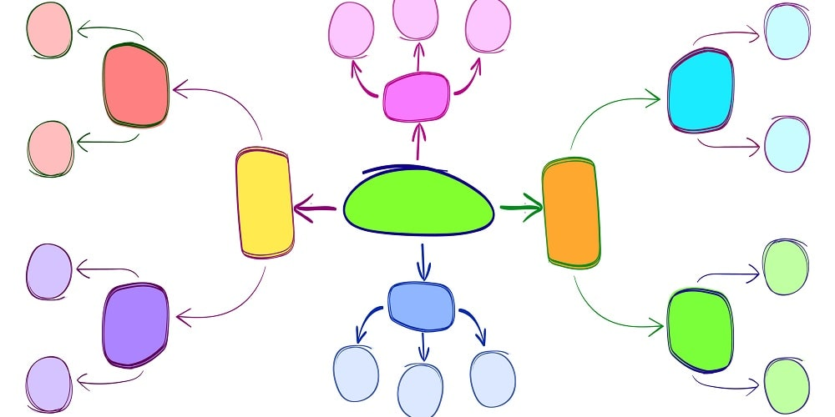
Mapping
Hibernate mappings are one of the key features of hibernate, they help in establishing the relationship between two database tables.
We can establish either uni-directional or bi-directional mapping i.e., we can either model them as an attribute on only one of the associated entities or on both. It will not impact your database mapping tables, but it defines in which direction you can use the relationship in your model and criteria queries.
The relationship that can be established between entities are- one to one, one to many/many to one and many to many.

Slide 10
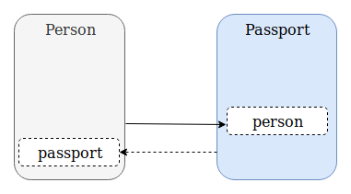
One to One
It represents the one-to-one relationship between two tables.
Example: One person can have only one passport. Similarly one passport belongs to only one person so there is one to one mapping between them.

Slide 11
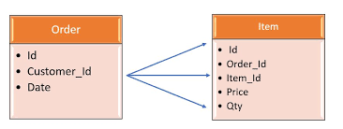
One to Many or Many to one
It represents the one-to-many relationship between two tables.
Example: One order can have many item. similarly many item can be present in single order.

Slide 12
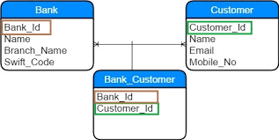
Many to Many
It represents the many to many relationships between two tables.
Example: One Bank can have multiple customers. similarly that customer can have account in various banks.

Slide 13
Note:
Generated Value-@GeneratedValue (strategy=GeneratedType.Identity) it is used for automatically generating Id.
Joined Column- If we don’t want one extra column to get created or in the case of one to many or many to many if we don’t want a table to get created for the foreign key then we can use joined column property in the parent class and mapped by property in the child class and we can avoid the extra column or extra table.
Cascading – It is used in the case of mapping, implementing this by making any changes to parent class it will affect the child class for example if we want to remove a table which has a child table linked to it, directly we cannot do that first we have to delete the child table then only we can delete parent table but if we use cascading property we can delete directly.

