Slide 1

WHY JDBC?
As a developer we will be developing application which needs to connect to a data source, like a database. Send queries and update statements to the database. Retrieve and process the results received from the database in answer to our query.
So we need a tool to connect between java program and Database. Here, JDBC comes into picture.

Slide 2
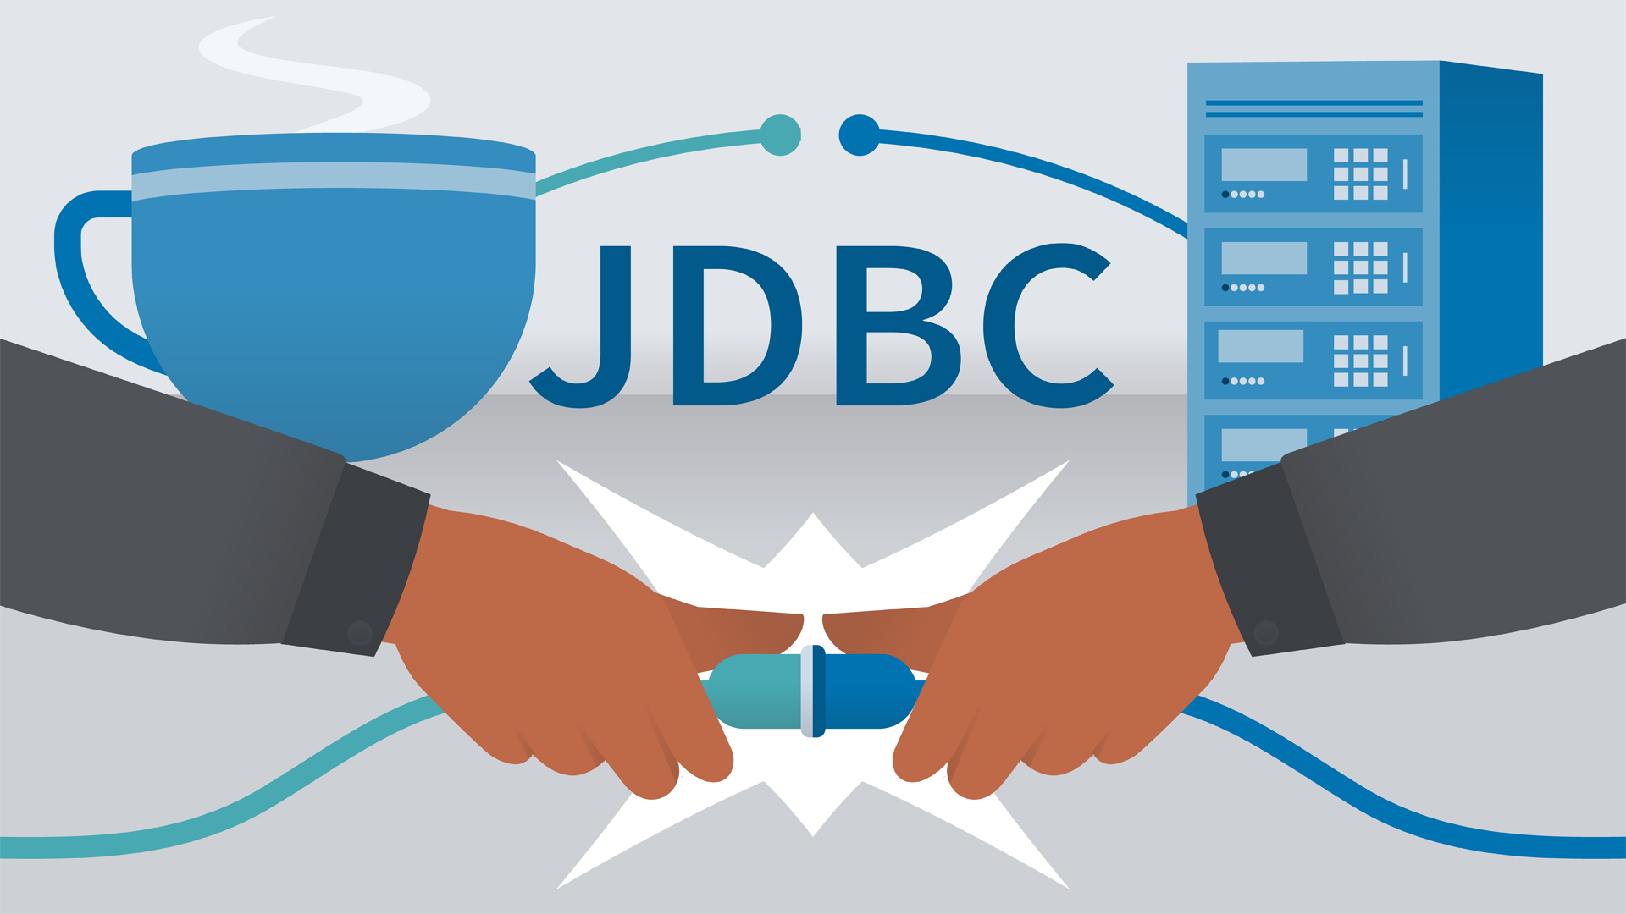
WHAT IS JDBC?
JDBC stands for Java Database Connectivity.
JDBC is a Java API to connect and execute the query with the database.
JDBC works with Java on a variety of platforms, such as Windows, Mac OS, and various versions of UNIX.
The classes and interfaces of JDBC allows the application to send request made by users to the specific databases.

Slide 3
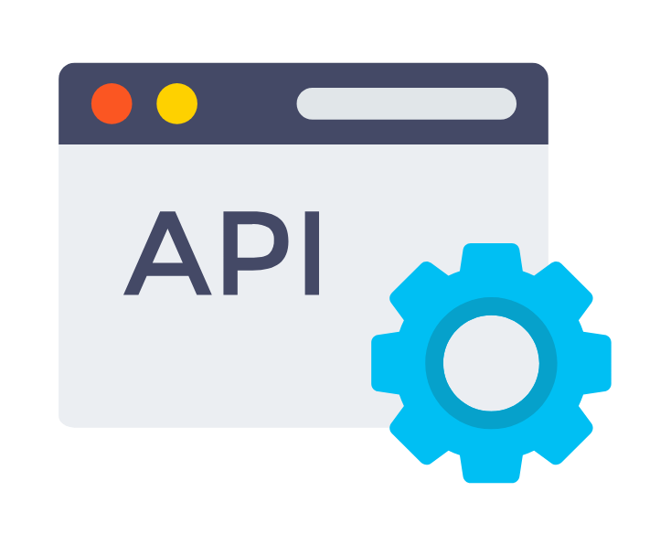
API
API is the acronym for Application Programming Interface, which is a software intermediary that allows two applications to talk to each other.
When you use an application on your mobile phone, the application connects to the Internet and sends data to a server. The server then retrieves that data, interprets it, performs the necessary actions and sends it back to your phone. The application then interprets that data and presents you with the information you wanted in a readable way. This is what an API is - all of this happens via API.

Slide 4
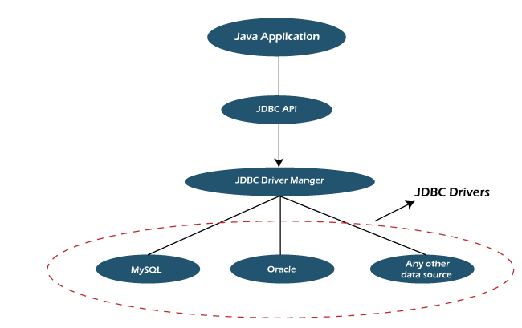
JDBC ARCHITECTURE

Slide 5
Explanation:
Application: It is a java applet or a servlet that communicates with a data source.
The JDBC API: The JDBC API allows Java programs to execute SQL statements and retrieve results. Some of the important classes and interfaces defined in JDBC API are as follows:
DriverManager: It plays an important role in the JDBC architecture. It uses some database-specific drivers to effectively connect enterprise applications to databases.
JDBC drivers: To communicate with a data source through JDBC, you need a JDBC driver that intelligently communicates with the respective data source.

Slide 6
Basic JDBC Components
Driver − This interface handles the communications with the database server.
Connection − This interface has all methods for contacting a database.
Statement − We use objects created from this interface to submit the SQL statements to the database.
ResultSet − These objects hold data retrieved from a database after you execute an SQL query using Statement objects. It acts as an iterator to allow you to move through its data.
SQLException − This class handles any errors that occur in a database application.

Slide 7
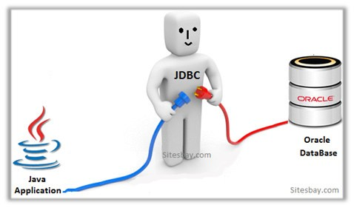
JDBC Driver
JDBC Driver is a software component that enables java application to interact with the database.
There are 4 types of JDBC drivers:
JDBC-ODBC bridge driver
Native-API driver (partially java driver)
Network Protocol driver (fully java driver)
Thin driver (fully java driver)

Slide 8
Steps For Connectivity Between Java Program and Database
Import the Packages.
Load and Register the drivers.
Establish a connection using the Connection class object.
Create a statement.
Execute the query.
Process the result.
Close the connections.

Slide 9
1.Import the Packages
This is for making the JDBC API classes immediately available to the application program. The following import statement should be included in the program irrespective of the JDBC driver being used:
Import java.sql.*
2.Load and register the drivers
This is for establishing a communication between the JDBC program and the MySQL database. The following line of code does this job:
Class.forName(“com.mysql.cj.jdbc.Driver”); 3. Establish a connection using the Connection class object
Once the required packages have been imported and the MySQL JDBC driver has been loaded and registered, a database connection must be established. This is done by using the getConnection() method of the DriverManager class. The getConnection() requires three input parameters, namely, a connect string, a username, and a password.
Connection conn = DriverManager.getConnection(URL, username, passwd);

Slide 10
4. Create a statement
This is to instantiate objects that run the query against the database connected to. This is done by the createStatement() method of the conn Connection object created above. A call to this method creates an object instance of the Statement class. The following line of code illustrates this:
Statement stmt = conn.createStatement();
5. Execute the query
Once a Statement object has been constructed, the next step is to execute the query. This is done by using the executeQuery() method of the Statement object. A call to this method takes as parameter a SQL SELECT statement and returns a JDBC ResultSet object.
ResultSet rset = sql_stmt.executeQuery (“Query”);
6.Process the result
Once the query has been executed, there are two steps to be carried out: The first step is done using the next() method of the ResultSet object. A call to next() is executed in a loop to fetch the rows one row at a time, with each call to next() advancing the control to the next available row. The next() method returns the Boolean value true while rows are still available for fetching and returns false when all the rows have been fetched.

Slide 11
The second step is done by using the getXXX() methods of the JDBC rset object. Here getXXX() corresponds to the getInt(), getString() etc with XXX being replaced by a Java datatype.
String str; while (rset.next()) { str = rset.getInt(1)+ " "+ rset.getString(2)+ " "+rset.getFloat(3)+ " "rset.getInt(4)+ "\n"; }
7.Close the Connection
Once the ResultSet and Statement objects have been used, they must be closed explicitly. This is done by calls to the close() method of the ResultSet and Statement classes. The following code illustrates this:
rset.close(); sql_stmt.close();

Slide 12
Thank You...

