Slide 1

Spring Boot
Spring boot is a module of spring framework which is used to create stand-alone, production-grade Spring based Applications with minimum programmer’s efforts.

Slide 2
Spring Boot Starters
Spring boot Starters make the development of Spring Boot based Java Applications much faster and easier.
It automatically downloads the maven dependencies as well as pre-defined setups.
Thus, it makes the developer’s job easy by preventing the manual selection of the right dependencies / versions.

Slide 3
Some of the most used Spring Boot Starters
spring-boot-starter-data-jpa Starter for using Spring Data JPA with Hibernate.
spring-boot-starter-web Starter for building web, including RESTful, applications using Spring MVC. Uses Tomcat as the default embedded container.
spring-boot-starter-test Starter for testing Spring Boot applications with libraries including JUnit Jupiter, Ham crest and Mockito.
spring-boot-starter-data-jdbc Starter for using Spring Data JDBC.

Slide 4
Advantages of Spring Boot
No Requirement for Complex XML Configuration.
Embedded Tomcat Server to run Boot applications.
An auto-Configuration feature by Spring boot that configures your application automatically for certain dependencies.
Decreased boilerplate code.
It provides opinionated 'starter' POMs to simplify our Maven configuration.
It creates stand-alone Spring applications that can be started using Java -jar.

Slide 5
Difference between Spring MVC and Spring Boot :
S.No. | SPRING MVC | SPRING BOOT
1. | Spring MVC is a Model View, and Controller based web framework widely used to develop web applications. | Spring Boot is built on top of the conventional spring framework, widely used to develop REST APIs.
2. | If we are using Spring MVC, we need to build the configuration manually. | If we are using Spring Boot, there is no need to build the configuration manually.
3. | In the Spring MVC, a deployment descriptor is required. | In the Spring Boot, there is no need for a deployment descriptor.
4. | Spring MVC specifies each dependency separately. | It wraps the dependencies together in a single unit.
5. | Spring MVC framework consists of four components : Model, View, Controller, and Front Controller. | There are four main layers in Spring Boot: Presentation Layer, Data Access Layer, Service Layer, and Integration Layer.
6. | It takes more time in development. | It reduces development time and increases productivity.
7. | Spring MVC do not provide powerful batch processing. | Powerful batch processing is provided by Spring Boot.
8. | Ready to use feature are provided by it for building web applications. | Default configurations are provided by it for building a Spring powered framework.

Slide 6
Annotations used in Spring Boot
@SpringBootApplication: This annotation is used to mark a configuration class that declares one or more @Bean methods and also triggers auto-configuration and component scanning.
@Bean: It is applied on a method to specify that it returns a bean to be managed by Spring context.
@ RestController: It is used to build REST API in a declarative way. @RestController annotation is applied to a class to mark it as a request handler, and Spring will do the building and provide the RESTful web service at runtime.
@ Service: It is used at class level. It tells the Spring that class contains the business logic.
@ Repository: It is a class-level annotation. The repository is a DAOs (Data Access Object) that access the database directly. The repository does all the operations related to the database.
@Configuration It indicates that a class is a configuration class that may contain bean definitions.

Slide 7
@Autowired Marks a constructor, field, or setter method to be auto wired by Spring dependency injection.
@ PostMapping It maps the HTTP POST requests on the specific handler method. It is used to create a web service endpoint that creates. It is used instead of using: @RequestMapping(method = RequestMethod.POST)
@ GetMapping It maps the HTTP GET requests on the specific handler method. It is used to create a web service endpoint that fetches. It is used instead of using: @RequestMapping(method = RequestMethod.GET)
@ DeleteMapping It maps the HTTP DELETE requests on the specific handler method. It is used to create a web service endpoint that deletes a resource. It is used instead of using: @RequestMapping(method = RequestMethod.DELETE)
@ PutMapping It maps the HTTP PUT requests on the specific handler method. It is used to create a web service endpoint that creates or updates. It is used instead of using: @RequestMapping(method = RequestMethod.PUT)

Slide 8
@ RequestBody It is used to bind HTTP request with an object in a method parameter. Internally it uses HTTP MessageConverters to convert the body of the request. When we annotate a method parameter with @RequestBody, the Spring framework binds the incoming HTTP request body to that parameter.
@PathVariable It is used to extract the values from the URI. It is most suitable for the RESTful web service, where the URL contains a path variable. We can define multiple @PathVariable in a method.
@RequestParam: It is used to extract the query parameters form the URL. It is also known as a query parameter. It is most suitable for web applications. It can specify default values if the query parameter is not present in the URL.
@EnableSwagger2 It is used to enable the Swagger2 for your Spring Boot application.
@Controller It indicates that a particular class serves the role of a controller. Spring Controller annotation is typically used in combination with annotated handler methods based on the @RequestMapping annotation. It can be applied to classes only. It’s used to mark a class as a web request handler.

Slide 9
Status Code
An HTTP Status Code refers to a 3-digit code that is part of a server's HTTP Response. The first digit of the code describes the category in which the response falls. This already gives a hint to determine whether the request was successful or not.
The Internet Assigned Numbers Authority (IANA) maintains the official registry of HTTP Status Codes. Below are the different categories:
Informational (1xx): Indicates that the request was received and the process is continuing. It alerts the sender to wait for a final response.
Successful (2xx): Indicates that the request was successfully received, understood, and accepted.
Redirection (3xx): Indicates that further action must be taken to complete the request.
Client Errors (4xx): Indicates that an error occurred during the request processing and it is the client who caused the error.
Server Errors (5xx): Indicates that an error occurred during request processing but that it was by the server.

Slide 10
Some of the most common HTTP codes:
Code | Status | Description
200 | OK | The request was successfully completed.
201 | Created | A new resource was successfully created.
400 | Bad Request | The request was invalid.
401 | Unauthorized | The request did not include an authentication token or the authentication token was expired.
403 | Forbidden | The client did not have permission to access the requested resource.
404 | Not Found | The requested resource was not found.
405 | Method Not Allowed | The HTTP method in the request was not supported by the resource. For example, the DELETE method cannot be used with the Agent API.
500 | Internal Server Error | The request was not completed due to an internal error on the server side.
503 | Service Unavailable | The server was unavailable.

Slide 11

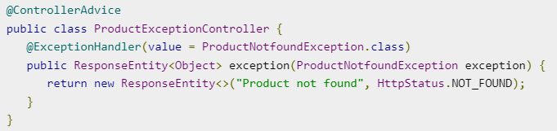
Exception handling in Spring Boot
Handling exceptions and errors in APIs and sending the proper response to the client is good for enterprise applications.
The @ControllerAdvice is an annotation, to handle the exceptions globally.
The @ExceptionHandler is an annotation used to handle the specific exceptions and sending the custom responses to the client.
For Examples if I want to throw an custom exception there are three steps.
1.To create exception by extending runtime exception.
2.Create controller advice class using @ControllerAdvice to handle exception globally.

Slide 12
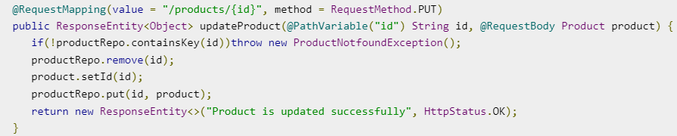
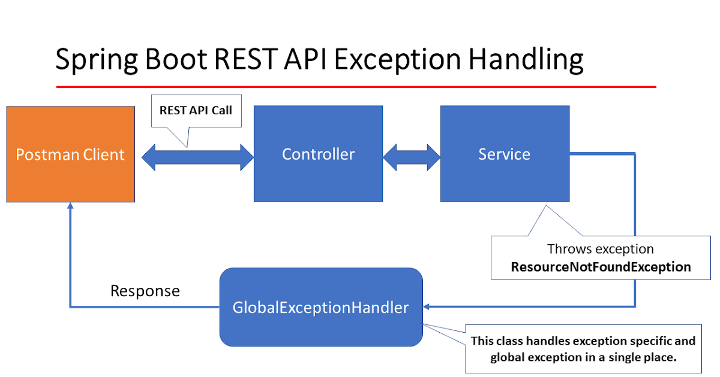
3.Throw exception

Slide 13
Response Entity
ResponseEntity is meant to represent the entire HTTP response. We can control anything that goes into it such as HTTP status code, headers, and body.

