Slide 1
Experiential Learning Phase -I :
Course Code:
Sustainable Development Goals (SDGs)
KISHAN KUMAR S D-1RV22CS087
KUSHAL R U– 1RV22CS93
KISHORE PATIL– 1RV22CS088
KIRAN V – 1RV22CS086

Slide 2
PRINCIPLES OF CIRCULAR ECONOMY
Design for Waste Elimination
Maximize Product and Material Use
Regenerate Natural Systems
Adopt Systemic Thinking
Innovate Business Models
Foster Cross-Sector Collaboration
Embrace Renewable Resources
Prioritize Energy Efficiency
Ensure Transparency and Accountability

Slide 3
DIFFERENCES BETWEEN LINEAR AND CIRCULAR ECONOMY
Linear Economy Management:
Focuses on the traditional linear model of production, consumption, and disposal.
Emphasizes extraction of resources, production of goods, and disposal of waste.
Results in resource depletion, pollution, and waste accumulation.
Relies heavily on finite resources and generates environmental degradation.
Short-term focus on economic growth without considering long-term sustainability.
Circular Economy Management:
Shifts towards a closed-loop system where resources are reused, recycled, or regenerated.
Promotes sustainable production, consumption, and waste management practices.
Aims to minimize resource depletion, pollution, and waste generation.
Prioritizes resource efficiency, renewable resources, and ecosystem health.
Encourages long-term thinking, innovation in business models, and collaboration across sectors.
Focuses on creating a regenerative and resilient economy that works within the limits of the planet's resources.

Slide 4
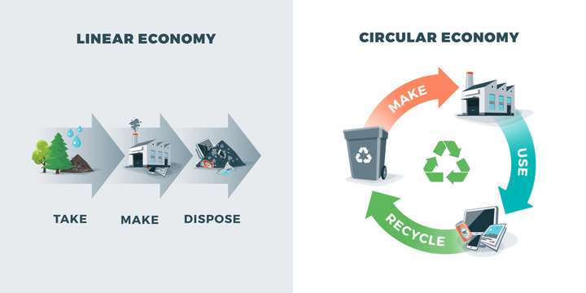

Slide 5
INDUSTRIAL ECOLOGY
Definition: Industrial ecology is an interdisciplinary approach that seeks to understand and optimize the use of resources within industrial systems while minimizing environmental impact.
It views industrial systems as interconnected networks, similar to ecosystems, where outputs from one process become inputs for another, fostering resource efficiency and waste reduction.
Tools and Techniques
Material Flow Analysis (MFA): MFA quantifies the flow of materials through industrial systems, helping to identify inefficiencies and opportunities for improvement.
Input-Output Analysis (IOA): IOA assesses the interdependencies between different sectors of the economy, revealing opportunities for resource optimization and waste reduction.
Life Cycle Assessment (LCA): LCA evaluates the environmental impacts of products or processes throughout their life cycle, informing decision-making and eco-design efforts.
Design for Disassembly (DfD):
DfD involves designing products with the ease of disassembly and separation of components in mind.
This facilitates the recovery and recycling of valuable materials at the end of a product's life.

Slide 6
Challenges and Opportunities
Barriers to Implementation:
Complexity
Interdependence
Integration
Adaptation
Synchronization
Coordination
Opportunities: Innovation in eco-design and clean technologies, collaboration between industry, government, and academia, and the development of supportive policies and incentives.

Slide 7
Renewable Energy Technologies
Solar Power: Photovoltaic (PV) panels convert sunlight into electricity, while solar thermal systems use solar energy for heating and cooling.
EX:
The Bhadla Solar Park
The Bhadla Solar Park is the World's largest Solar Power Plant. It is based in Bhadla village, in India's Rajasthan's Jodhpur district – a region known for its solar-friendly high temperatures.
Pavagada solar park
The Pavagada solar park located in the Tumkur district of Karnataka is the biggest solar power station in India and one of the biggest such facilities in the world.
Wind Power: Wind turbines harness the kinetic energy of wind to generate electricity, providing a clean and renewable alternative to fossil fuels.
Hydroelectric Power: Hydroelectric dams and run-of-river turbines generate electricity from the energy of flowing

Slide 8
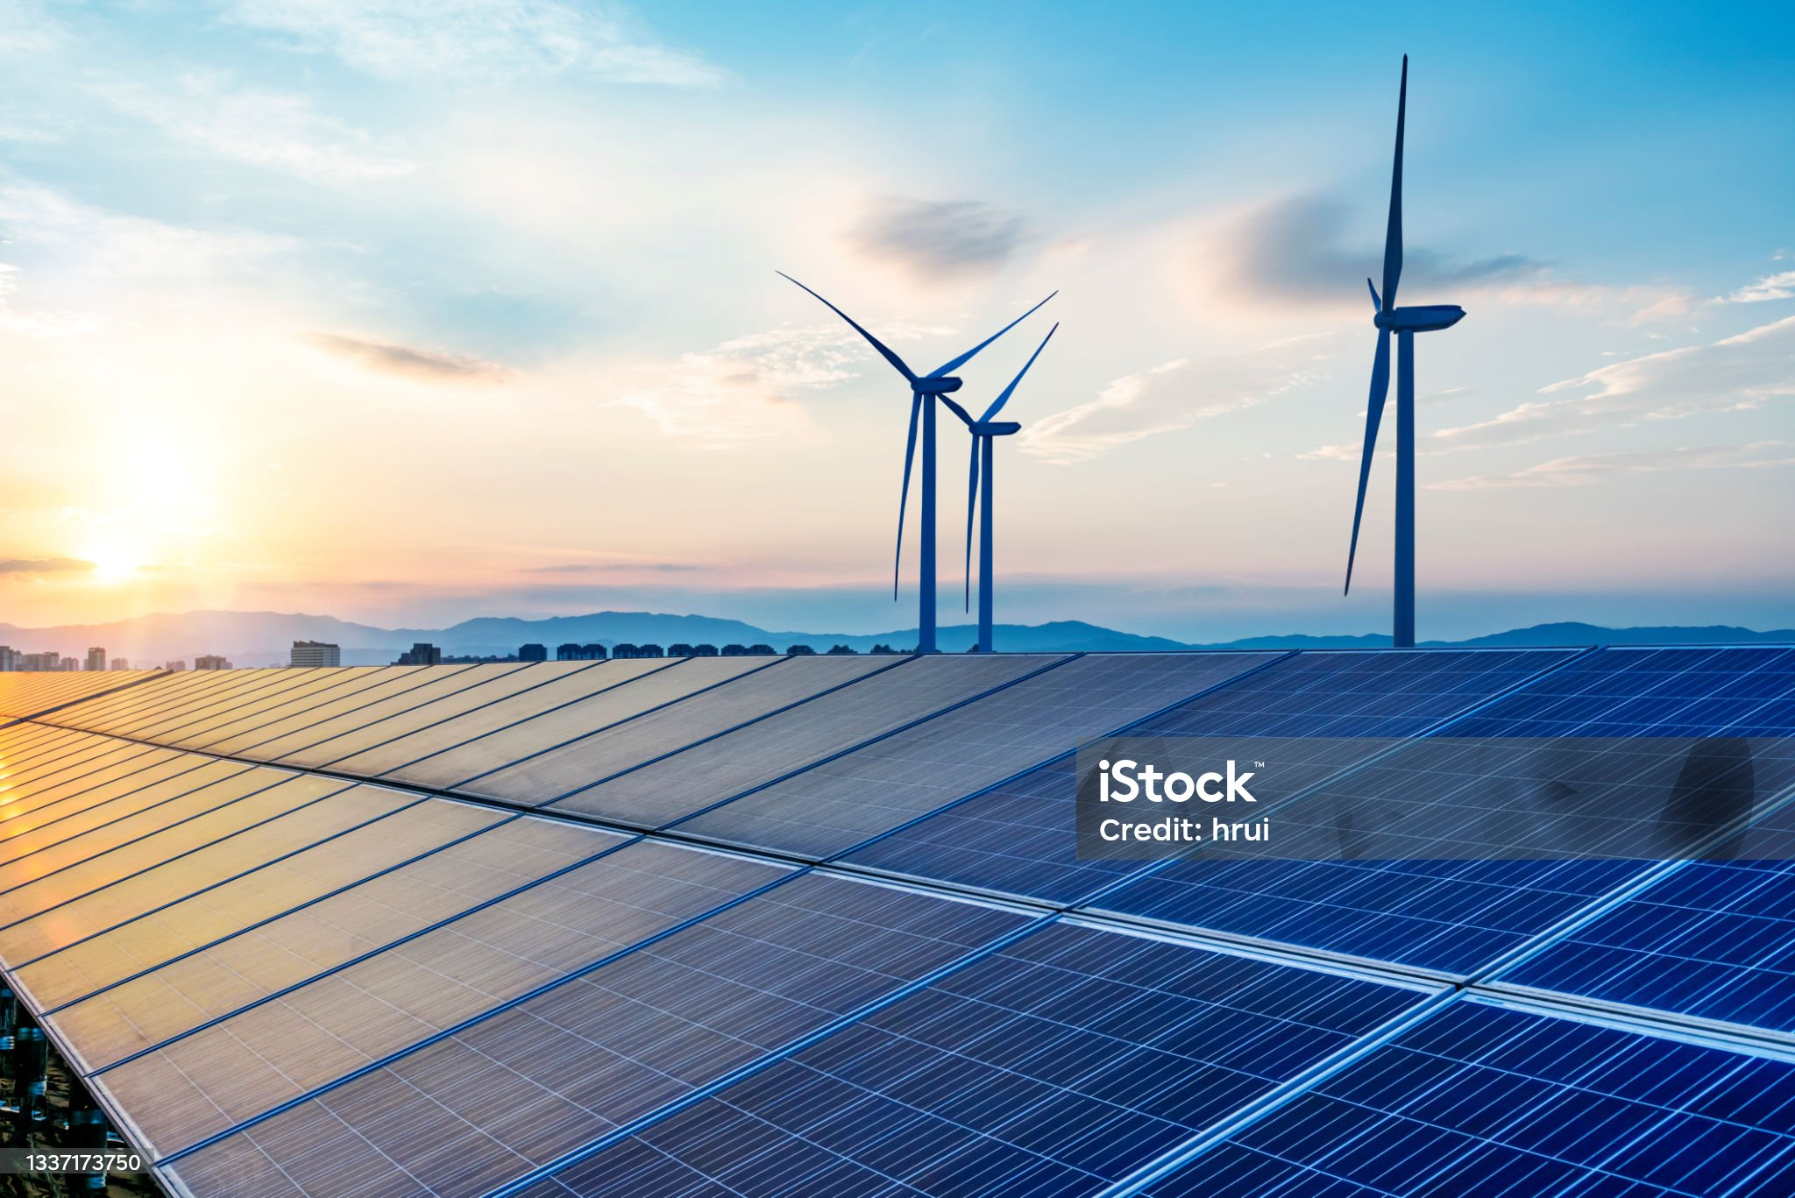

Slide 9
Energy Efficiency Technologies
Building Retrofitting: Energy-efficient lighting, insulation, HVAC systems, and smart building technologies reduce energy consumption and improve indoor comfort.
Transportation: Electric vehicles (EVs), hybrid vehicles, and fuel-efficient engines reduce fuel consumption and emissions in the transportation sector.
Renewable Energy Integration: Technologies such as microgrids, energy storage systems, and grid-tied inverters enable the integration of renewable energy sources like solar and wind into existing energy systems, reducing reliance on fossil fuels.
Industrial Process Optimization: Automation, machine learning, and predictive maintenance technologies optimize industrial processes, reducing energy waste and improving overall efficiency.
Waste Heat Recovery: Heat exchangers and cogeneration systems capture waste heat generated during industrial processes and convert it into usable energy, improving overall energy efficiency and reducing emissions.
Energy-Efficient Appliances: Energy Star-rated appliances, such as refrigerators, washing machines, and dishwashers, incorporate advanced technologies to minimize energy consumption while maintaining performance.
Efficient Lighting Solutions: LED lighting, daylight harvesting systems, and occupancy sensors reduce energy consumption in commercial and residential buildings by providing efficient illumination only when needed.

Slide 10
Future Outlook
Emerging Trends: Circular economy initiatives, digitalization and Industry 4.0 technologies, and the integration of sustainability into business strategies.
Role of Industrial Ecology: Industrial ecology will play a crucial role in transitioning towards more sustainable and resilient industrial systems, contributing to global efforts to address climate change and resource scarcity.
Conclusion
Recap of Key Points: Industrial ecology offers a holistic approach to sustainability, emphasizing resource efficiency, waste reduction, and collaboration between stakeholders.
Call to Action: Encourage the adoption of industrial ecology principles and the development of collaborative initiatives to create more sustainable industrial systems.

