Slide 1
AIR QUALITY PREDICTION
TEAM 15

Slide 2
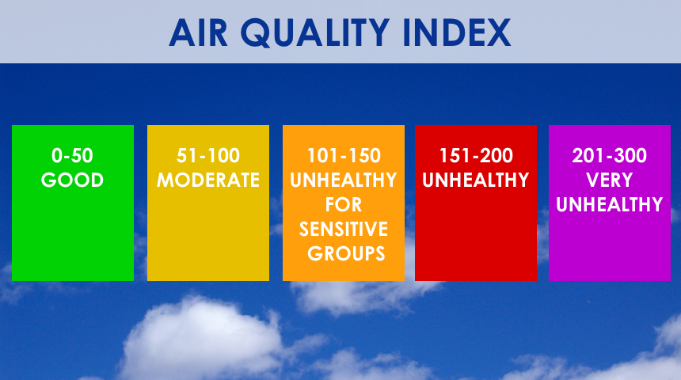
1.PROJECT GOALS AND OBJECTIVES:
We forecast the air quality of India by using machine learning to predict the air quality index of a given area. Air quality index of India is a standard measure used to indicate the pollutant (so2, no2, rspm, spm. etc.) levels over a period.
Some of the main objectives of our project are:
• The objective of an air quality prediction model is to provide accurate and timely information about the quality of the air in a specific area.
• To make air quality information accessible and understandable to the general public, prediction models raise awareness about the importance of air quality and its impact on health and the environment.
• To forecast pollutant concentrations, these models help individuals, especially those vulnerable to respiratory diseases, to take precautions such as reducing outdoor activities during high pollution periods or using protective equipment like masks.

Slide 3
2. Dataset and Data Preparation:
The dataset which we are using in our project is India air quality.
It comprises of air quality index of each state of India over the years.
We use this dataset to predict the air quality index for further years.
Dataset link: https://www.kaggle.com/datasets/shrutibhargava94/india-air-quality-data/code?datasetId=1675&searchQuery=model+
We also use another dataset named poptable.csv.
It comprises of latitudes and longitudes of every state of India.
We use this information to plot the areas with severe AQI on the India map.
Dataset link: https://www.kaggle.com/datasets/danishxr/poptable
Firstly we use the data preprocessing techniques to clean the abnormalities in the dataset.
Then we will perform required data analysis methods on the data.

Slide 4
3. DATA EXPLORATION AND ANALYSIS:
Descriptive Statistics:
Compute summary statistics such as mean, median, standard deviation, minimum, and maximum for air quality parameters and other relevant features.
Analyze the distribution of air quality parameters using histograms, density plots, or violin plots to understand their variability and range.
Time Series Analysis:
Plot time series graphs of air quality parameters over time to identify trends, seasonality, and patterns.
Decompose time series data into trend, seasonality, and residual components.
Data Visualization:
Create informative visualizations such as line plots, scatter plots, bar charts, and box plots to present key findings and insights.
Use interactive visualization tools if available to facilitate exploration and interpretation of the data.
Visualize spatial patterns of air quality parameters using maps, highlighting areas with high and low pollution levels.

Slide 5
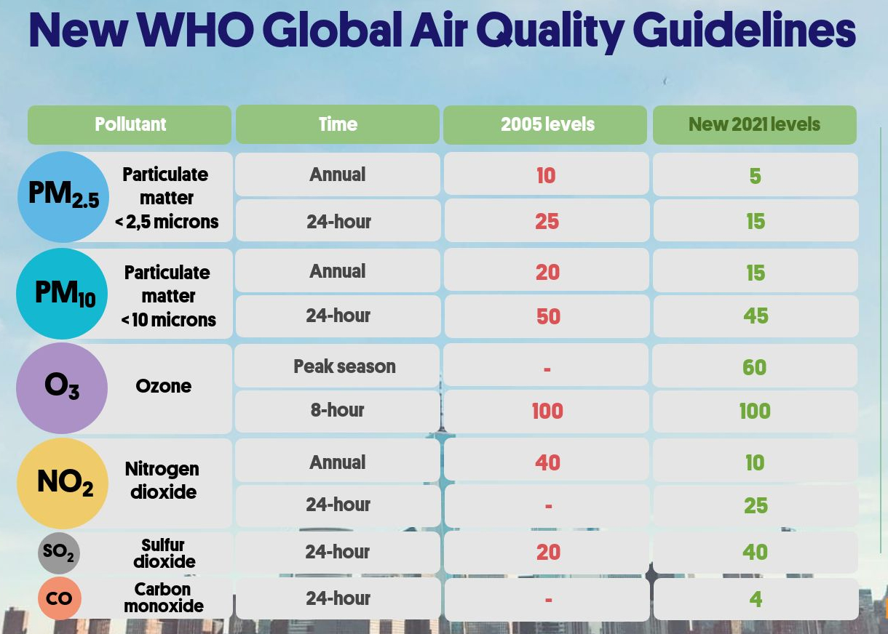
4. FEATURE ENGINEERING:
Analyze the importance of features in the model’s predictions using techniques such as:
Temporal Features: Extract time-related features such as hour of the day, day of the week, month, and year from timestamps.
Geographical Features: Integrate geographical information such as latitude, longitude, and altitude as features, as air quality can vary significantly based on location.
Historical Features: Generate historical aggregates or summaries of air quality parameters over previous time periods (e.g., daily averages, weekly maximums) as additional features. Compute differences or percentage changes between current and past air quality measurements to capture temporal trends and deviations.
Environmental Features: Incorporate data such as composition of gases that are present in the air predictor variables, as they often influence air quality.

Slide 6
5. MODEL SELECTION:
Nature of the Problem:
Determine whether the problem is regression-based (predicting continuous air quality values) or classification-based (predicting air quality categories).
Consider the temporal nature of the data and any dependencies between consecutive observations (e.g., time series forecasting).
Complexity vs. Interpretability:
Balance between model complexity and interpretability based on the project requirements and stakeholders’ needs.
Choose models that strike the right balance between complexity and explainability, considering the trade-offs between performance and model transparency.
Performance Metrics:
Select appropriate performance metrics for evaluating model performance, such as Mean Absolute Error (MAE), Mean Squared Error (MSE), Root Mean Squared Error (RMSE), or R-squared score (R2) for regression tasks.
Scalability and Efficiency:
Assess the scalability and computational efficiency of candidate models, especially if dealing with large datasets or real-time prediction requirements.
Consider distributed computing frameworks or algorithms that can handle big data efficiently if scalability is a concern.

Slide 7
6. MODEL TRAINING AND EVALUATION:
Data Preparation:
Prepare the dataset by splitting it into training, validation, and test sets. Ensure that the split preserves the temporal order of the data if it’s time series data.
Normalize or standardize the features to bring them to a similar scale, which can improve the convergence and performance of some models.
Select a Model:
We are choosing a Time series forecasting model for the project. We are also choosing linear regression algorithm.
Tuning:
We used hyperparameter tuning using techniques like gradient descent which avoids overfitting.
Model Training:
Train the selected model on the training dataset using the optimized hyperparameters.
Validation:
Evaluate the model using appropriate performance metrics (Root Mean Squared Error) to measure its predictive accuracy.

Slide 8
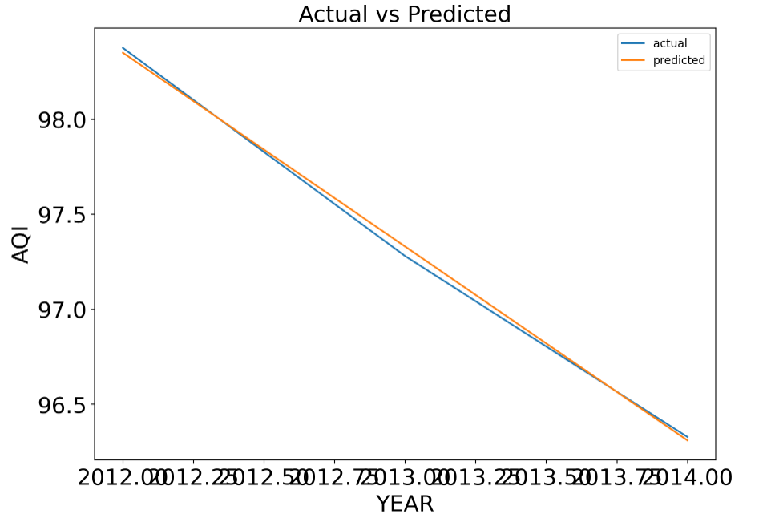
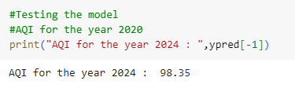
7. RESULTS:
8. CONCLUSION:
At the end we are able to predict the air quality index(AQI) using the model with very less error.
We are getting predicted values similar to the actual values in a straight line.
Predicting AQI

Slide 9


