Slide 1
CUSTOMER SHOPPING ANALYSIS
Customer shopping behaviour is shaped by loyalty, not just promotions
What 3,900 purchases reveal about customer segments, product demand, discounts, subscriptions, and growth priorities.
DECISION READOUT · CUSTOMER GROWTH

Slide 2
02
METHOD
EXHIBIT 01
The analysis turns 3,900 transactions into a usable decision base
DATASET
PREPARATION
METHOD
3,900 purchases
Prepared for comparison
Built for business questions
Across 18 fields covering customer, product, purchase, and fulfilment behaviour.
Missing ratings imputed by product category median; age groups and purchase-frequency fields added.
Python for cleaning and feature engineering, PostgreSQL for business questions, Power BI for visualization.
SO WHAT
The dataset is structured enough to move from description to targeting.

Slide 3
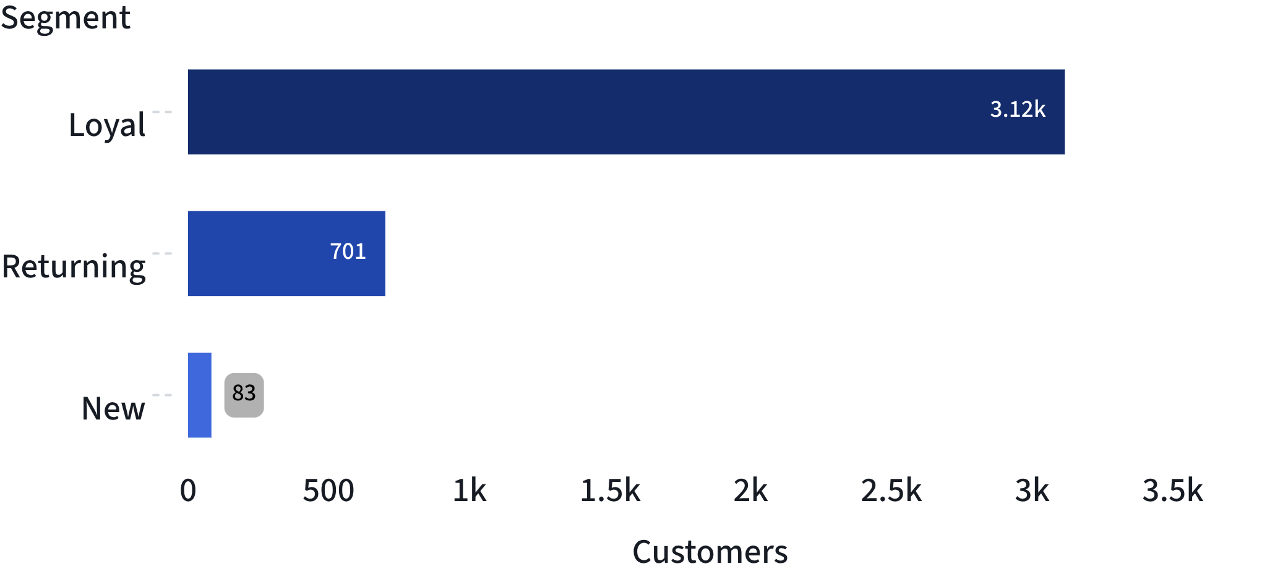
03
CUSTOMER SEGMENTS
EXHIBIT 02
Loyal customers dominate the base, leaving a smaller pipeline to build
THE COMMERCIAL OPPORTUNITY IS TWO-SIDED
Protect the loyal core.
Move returning and new customers forward.
Loyal · 3,116 Returning · 701 New · 83
CUSTOMER SEGMENTS · 3,900 PURCHASES
SO WHAT
Retention protects the base; conversion work belongs in the smaller returning and new pools.

Slide 4
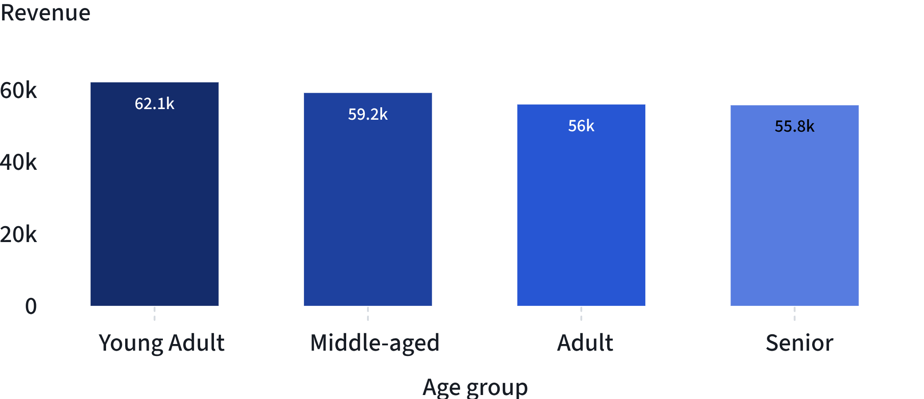
04
REVENUE CONCENTRATION
EXHIBIT 03
Revenue concentration points to clear targeting priorities
REVENUE BY AGE GROUP
TWO TARGETING SIGNALS
Male customers generated 157,890 in revenue.
Female customers generated 75,191.
Young Adults lead.
They generated 62,143, followed by Middle-aged customers at 59,197.
Revenue is distributed across age groups, but the youngest cohort is the strongest single contributor.
SO WHAT
Start with Young Adults, while keeping the broader age base in view.

Slide 5
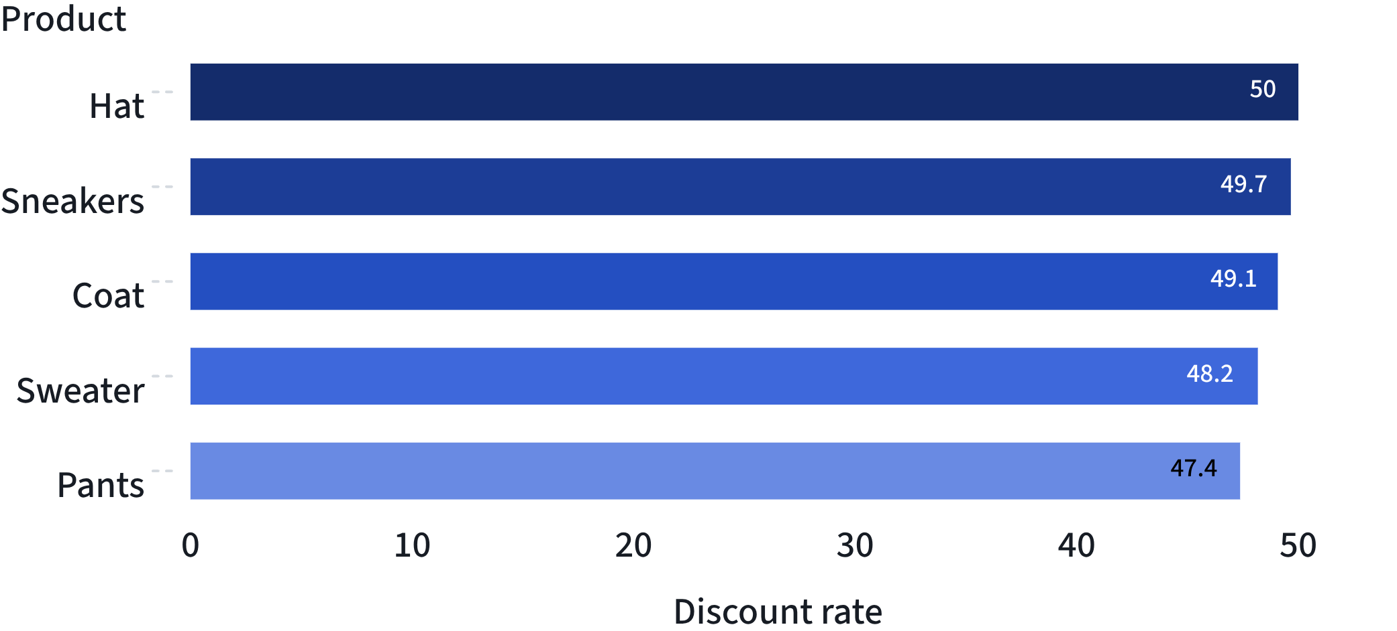
05
DISCOUNT DEPENDENCE
EXHIBIT 04
Discounts are widespread, but not evenly distributed across products
PRODUCTS MOST DEPENDENT ON DISCOUNTING
A TIGHT CLUSTER
47.37%–50.00%
Hat leads at 50.00%. The top five sit within a tight 2.63-point range.
Use discount depth as a margin-control lever, not only a volume lever.
SO WHAT
The pattern is category-wide: review the economics of the 47–50% discount band.

Slide 6
06
SUBSCRIPTION ECONOMICS
EXHIBIT 05
Subscriptions are not yet changing individual spend
Status | Average spend | Total revenue | Customers
Subscriber | 59.49 | 62,645 | 1,053
Non-subscriber | 59.87 | 170,436 | 2,847
THE GAP IS PRIMARILY SCALE
59.49 ≈ 59.87
Average spend is nearly identical.
Subscription growth should focus on conversion and retention benefits, not assume higher basket size today.
SO WHAT
Build subscription value through adoption and retention, not a presumed basket uplift.

Slide 7
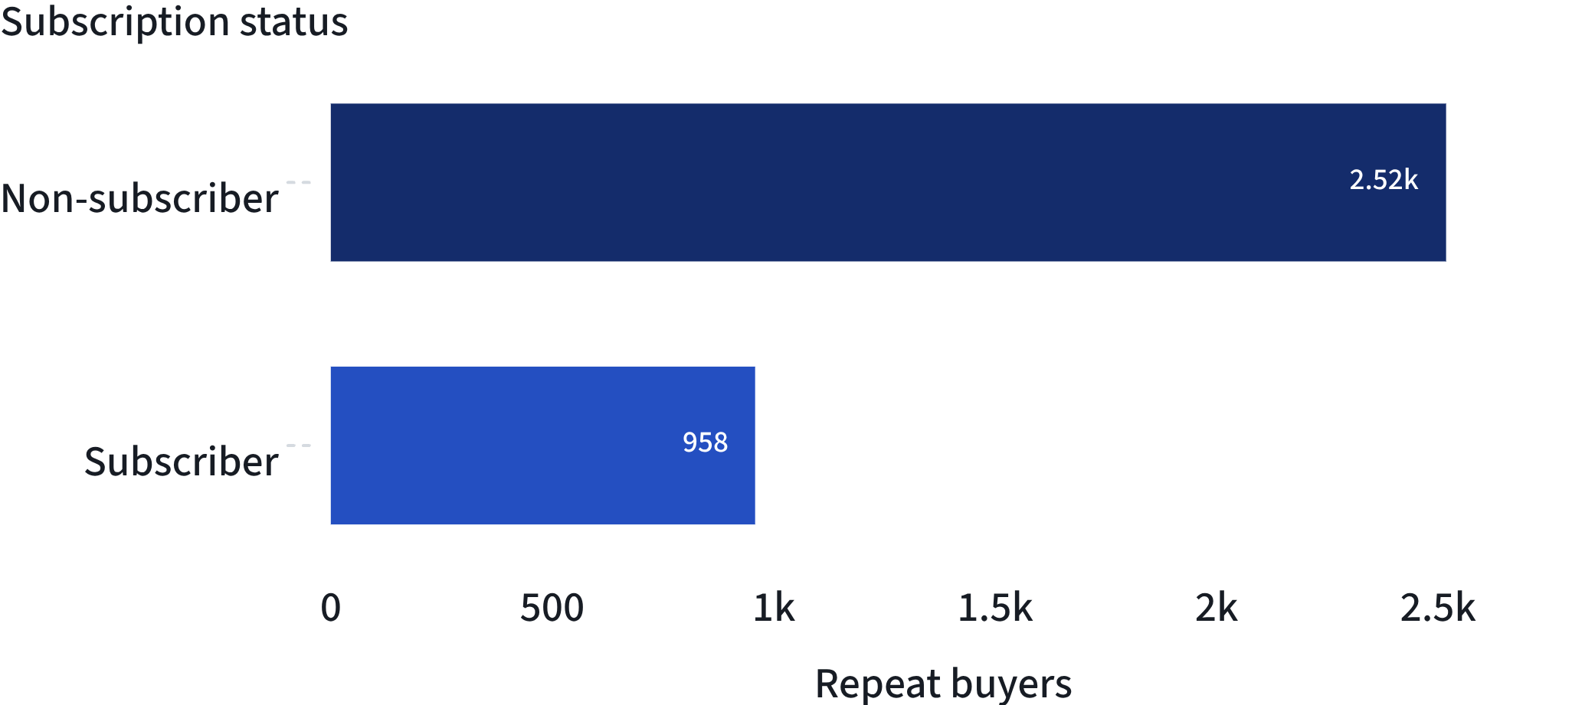
07
REPEAT BUYING
EXHIBIT 06
Repeat buying is a larger pool than subscription adoption
REPEAT BUYERS BY SUBSCRIPTION STATUS
A CONVERSION POOL HIDING IN PLAIN SIGHT
2.6×
Repeat buyers outnumber subscribers by roughly 2.6 to 1 in this view.
The clearest near-term audience for subscription conversion is the 2,518 repeat buyers outside the programme.
SO WHAT
Convert demonstrated repeat behaviour before chasing customers with less evidence of commitment.

Slide 8
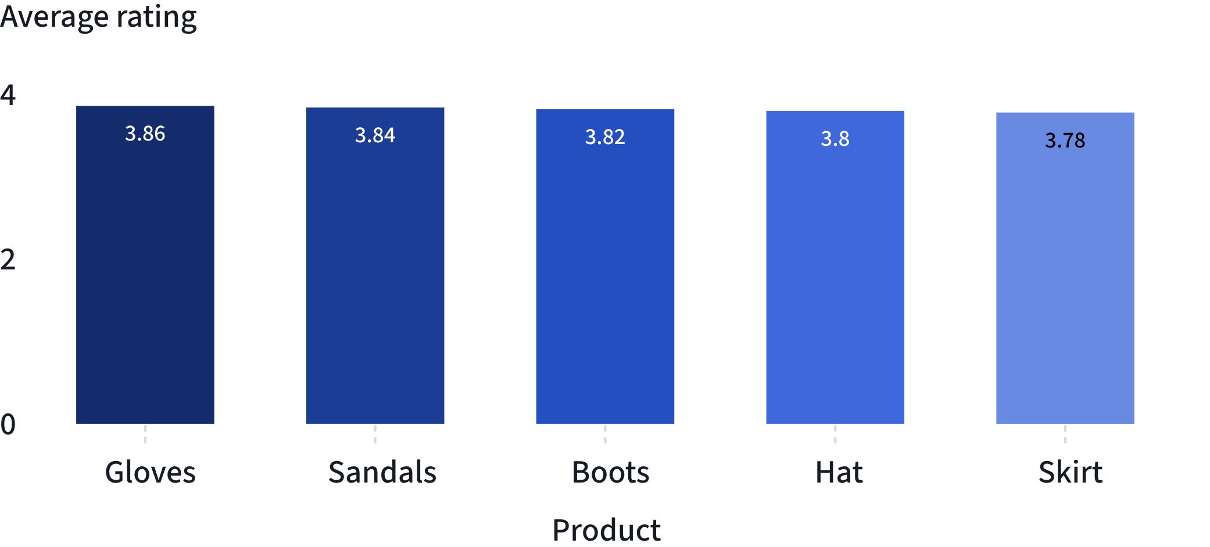
08
PRODUCT SIGNALS
EXHIBIT 07
Product signals are positive, but tightly clustered
TOP-RATED PRODUCTS
THE SIGNAL IS REAL, NOT BREAKOUT
0.08
The top-five rating spread is only 0.08 points.
Feature top-rated items in campaigns, but combine ratings with purchase volume and discount dependence.
SO WHAT
Ratings can guide creative emphasis, but they should not carry the growth case alone.

Slide 9
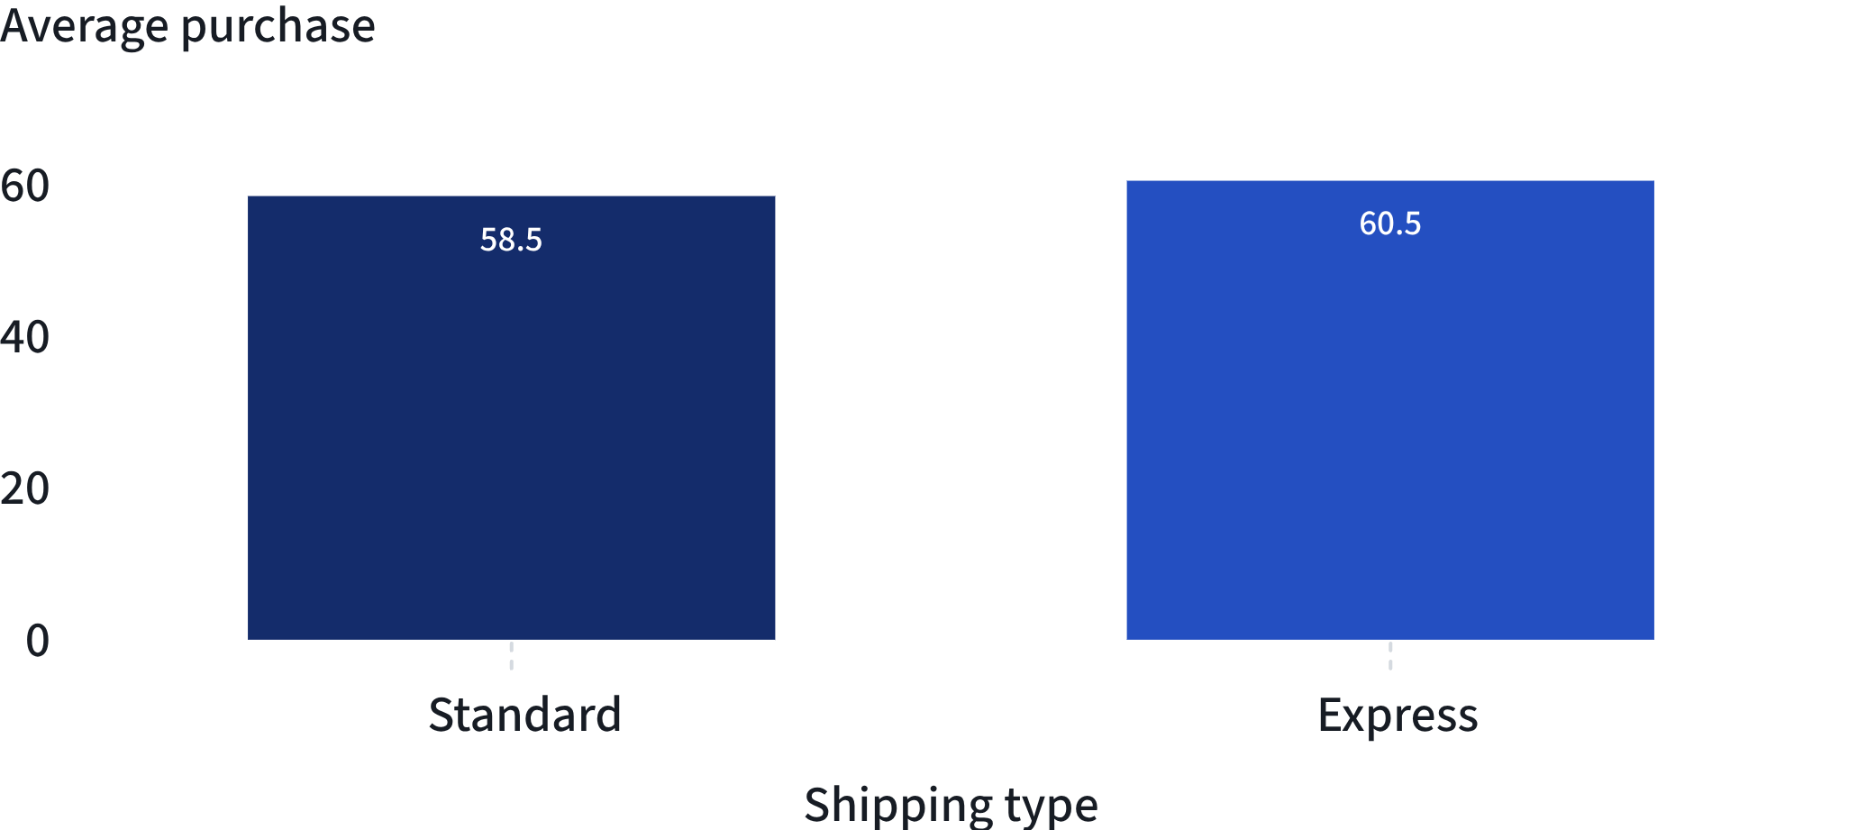
09
FULFILMENT SIGNAL
EXHIBIT 08
Express shipping correlates with slightly larger baskets
AVERAGE PURCHASE BY SHIPPING TYPE
A MODEST PREMIUM
+2.02
Express shipping averages 60.48 versus 58.46 with Standard shipping.
Pair fulfilment messaging with high-value or time-sensitive campaigns.
SO WHAT
Test Express as a premium convenience cue, while treating the relationship as a correlation.

Slide 10
10
GROWTH PRIORITIES
CLOSE
Five actions translate the analysis into growth
01
02
03
04
05
Convert repeat buyers
Protect loyalty
Rebalance discounts
Focus campaigns
Test convenience
Reward the 3,116 loyal customers with retention benefits.
Prioritize Young Adults and the strongest-rated products.
Position Express shipping in higher-value journeys.
Target the 2,518 repeat buyers outside the subscription programme.
Review products clustered around 47–50% discount rates.
FROM CUSTOMER BASE TO CONVERSION, MARGIN, CAMPAIGN, AND FULFILMENT PRIORITIES
SO WHAT
Use loyalty as the growth engine, and promotions and convenience as controlled levers around it.

