Slide 1
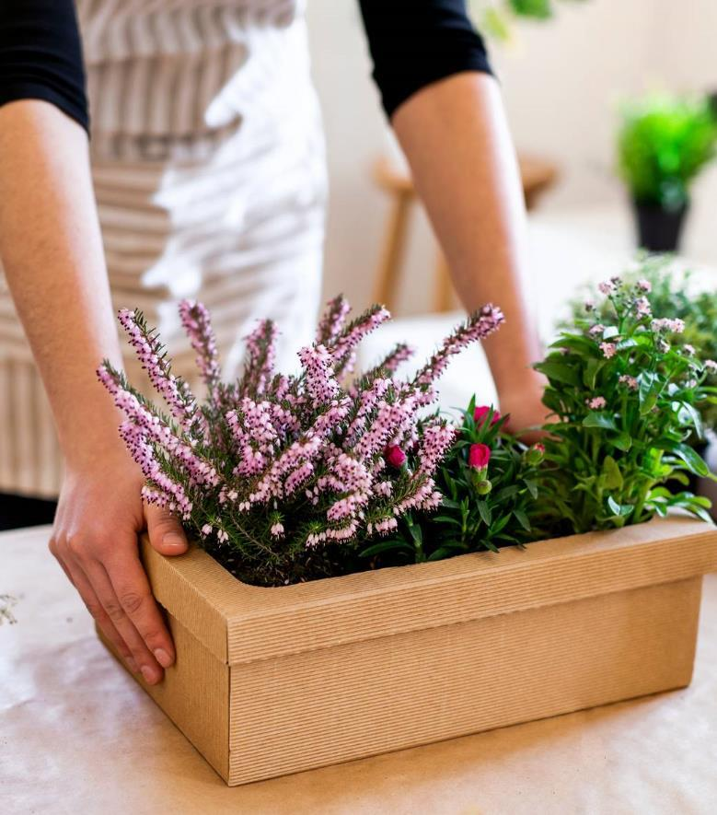
Garden App Demo 1
Group Kira: Daniel Dietrich, Gavin Cyr, Kira Luethe, Richard Williams, Todd Wood

Slide 2
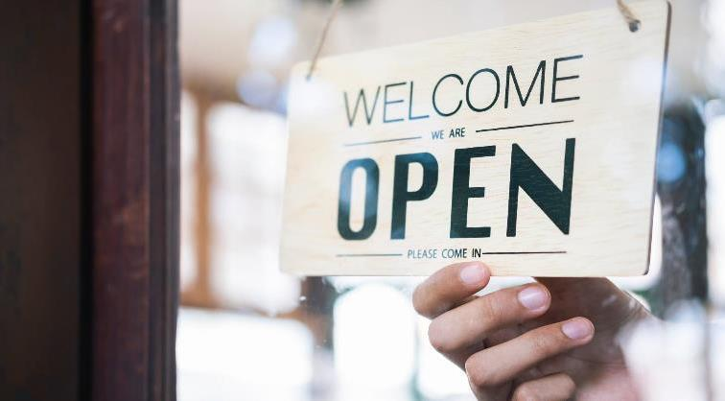
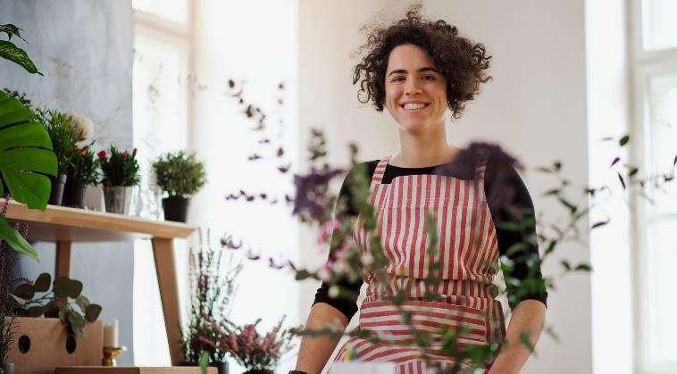
Agenda
Kira- User Interface
Todd- Plant Lookup
Gavin – Zipcode Lookup
Dan – User Authentication
Richard “Matt” - API

Slide 3
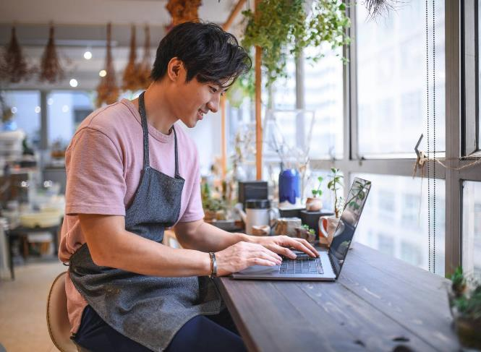
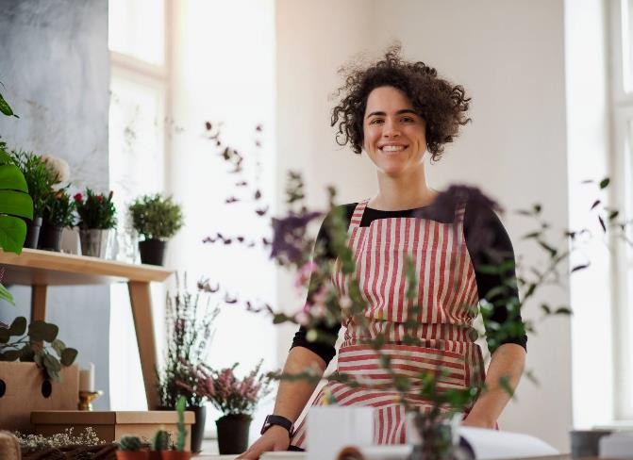
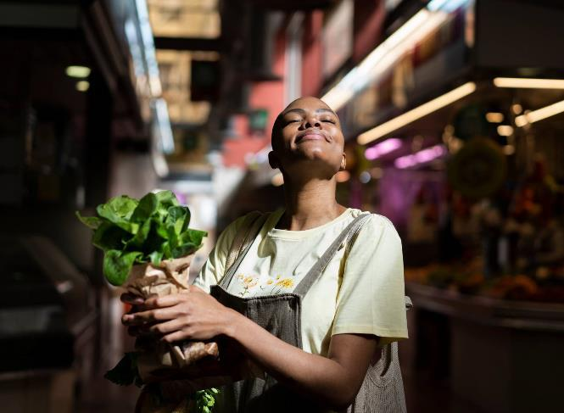
Topic one
Subtitle

Slide 4
Content
Subtitle
Subtitle
Add text, images, art, and videos.
Add transitions, animations, and motion.
Save to OneDrive, to get to your presentations from your computer, tablet, or phone.
Open the Design Ideas pane for instant slide makeovers.
When we have design ideas, we’ll show them to you right there.

Slide 5
User Interface
Kira Luethe

Slide 6
User Interface
Subtitle
Subtitle
Add text, images, art, and videos.
Add transitions, animations, and motion.
Save to OneDrive, to get to your presentations from your computer, tablet, or phone.
Open the Design Ideas pane for instant slide makeovers.
When we have design ideas, we’ll show them to you right there.

Slide 7
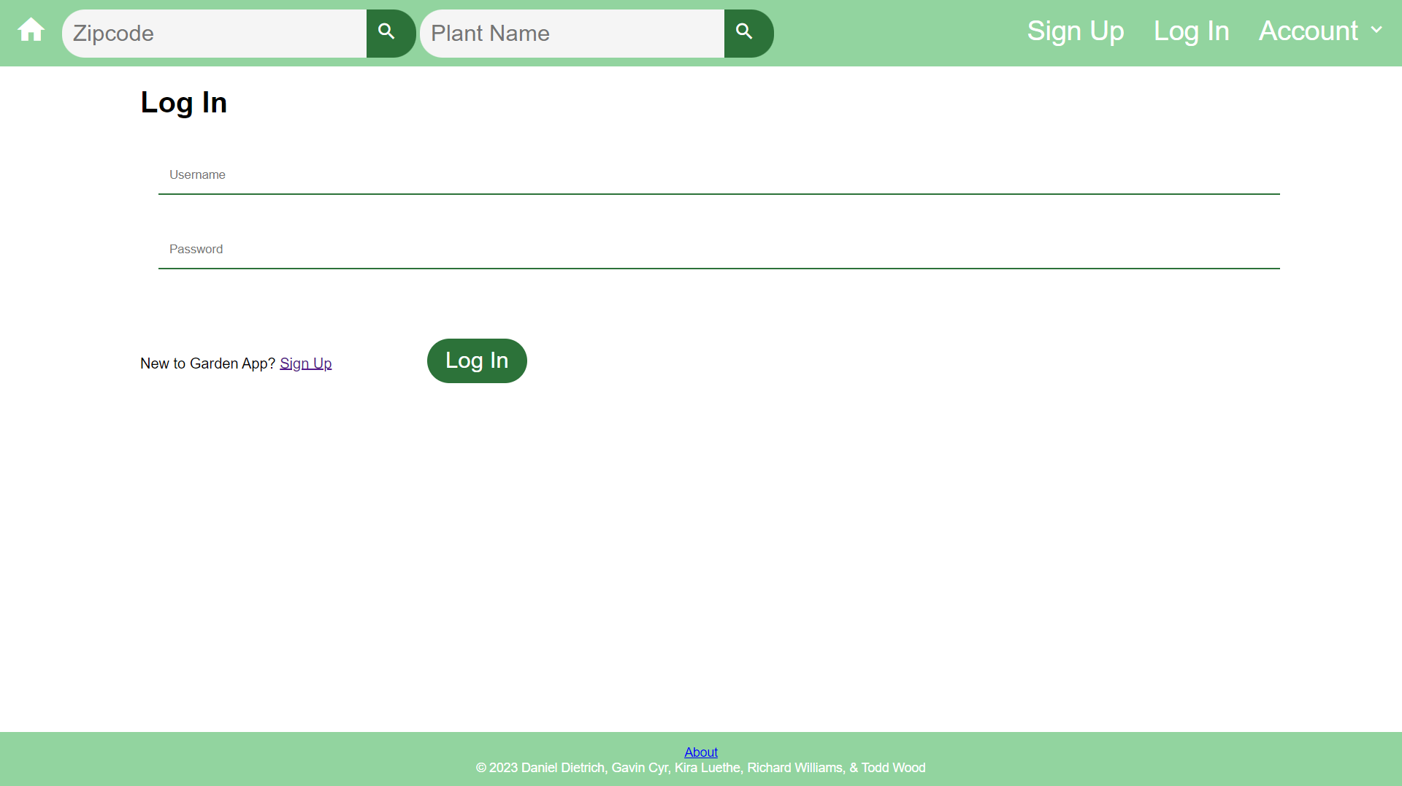

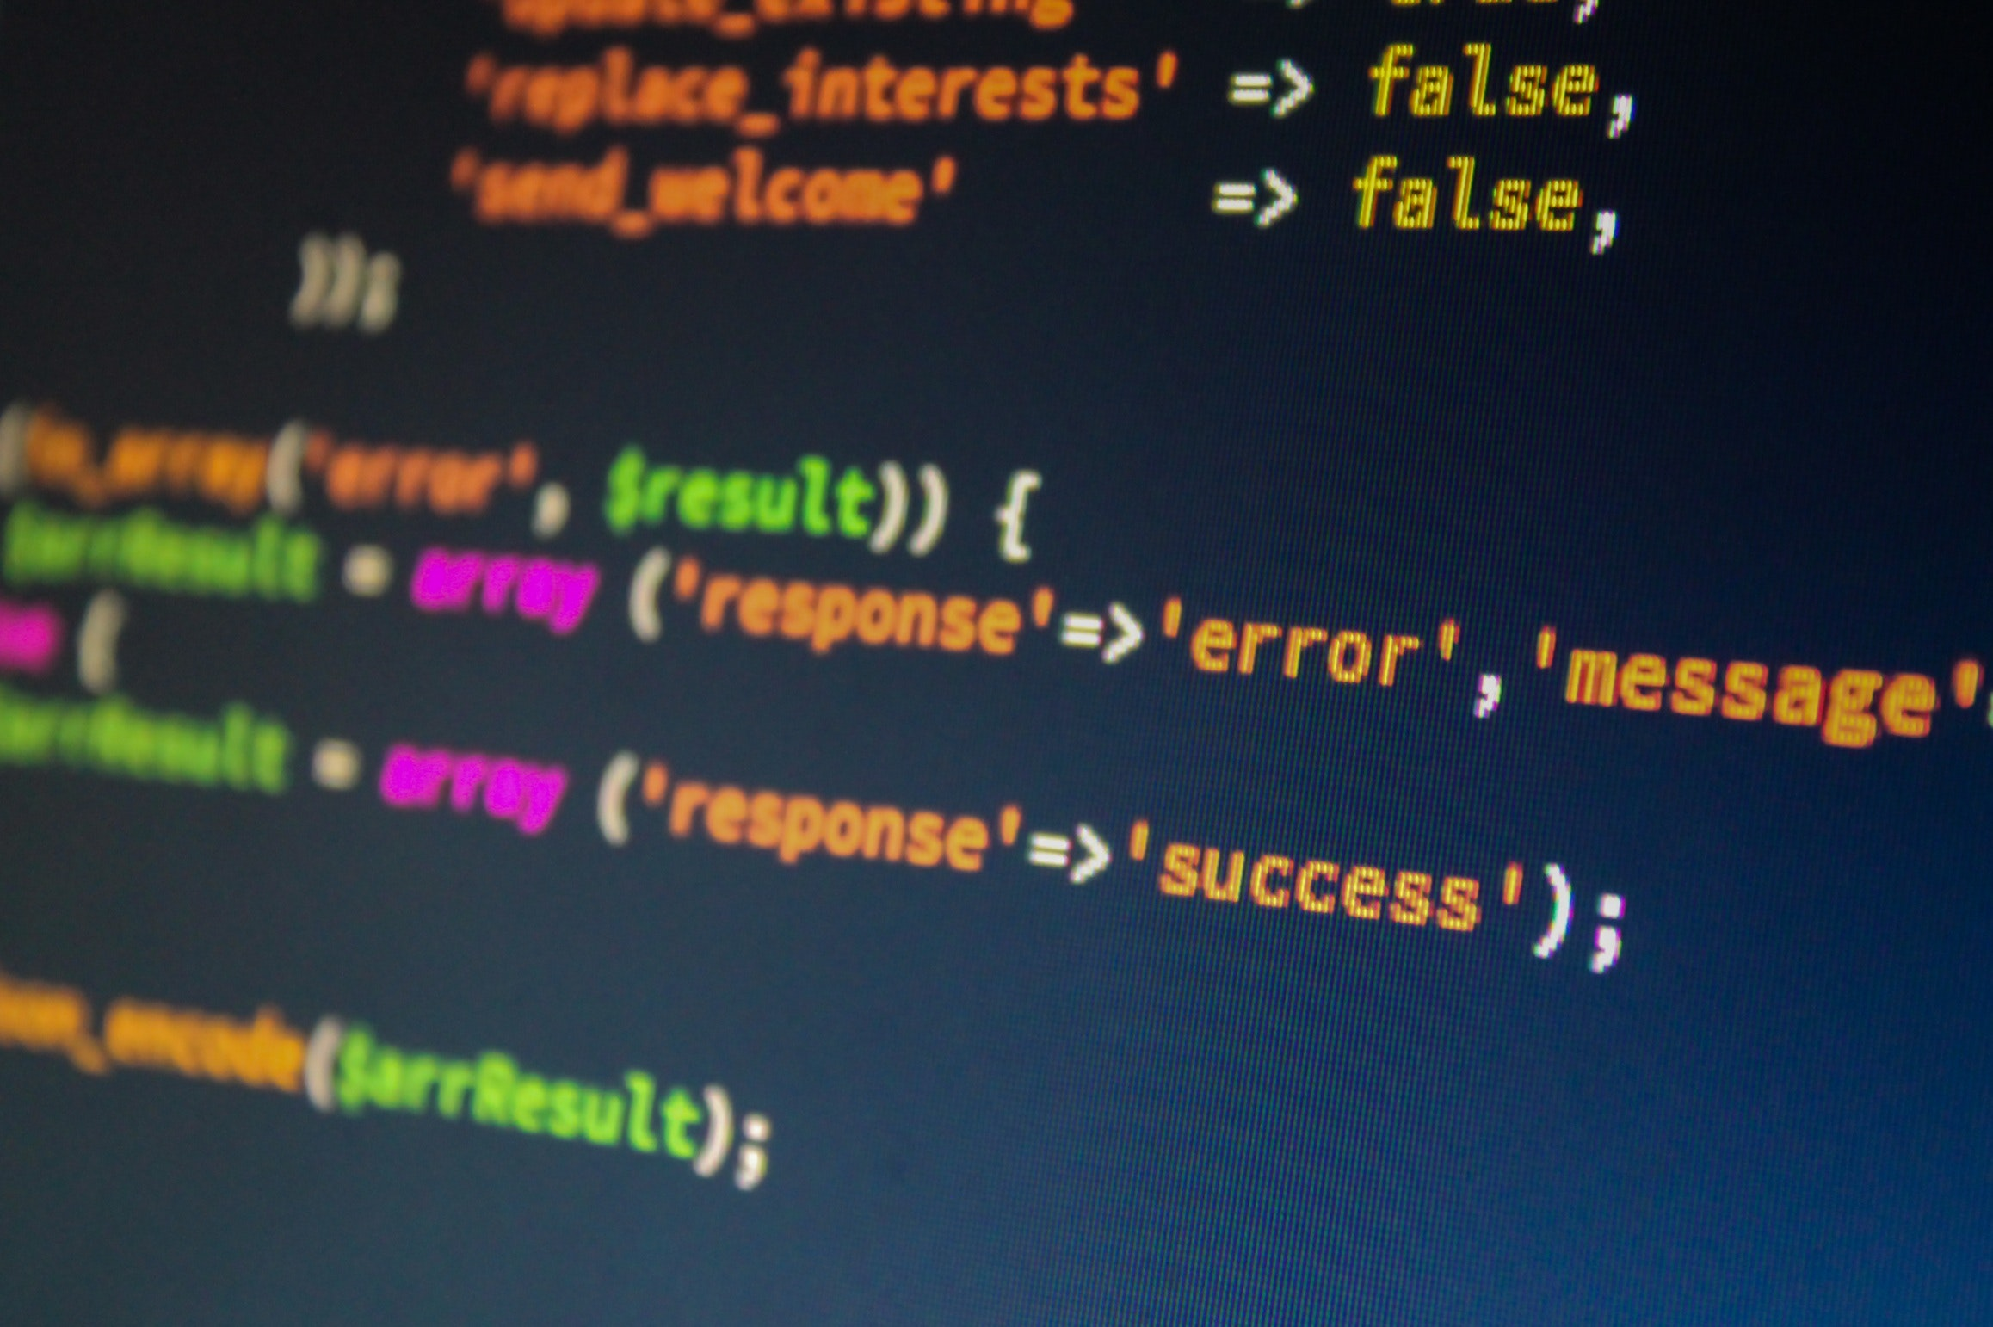
User Authentication
Daniel Dietrich

Slide 8
User Authentication Outline:
Features:
How It Works:
Secure Password Hashing.
Page Routing based on Authentication Results.
Initialization of Session Tokens upon Successful Authentication.
Destruction of Session upon Sign Out selection.
User enters Username and Password on Login Page.
Entered Password is hashed and stored User Password is retrieved from Database.
Passwords are compared.
If Username/Password combination is valid, Session Tokens are initialized, and User is redirected to Account Information Page.

Slide 9
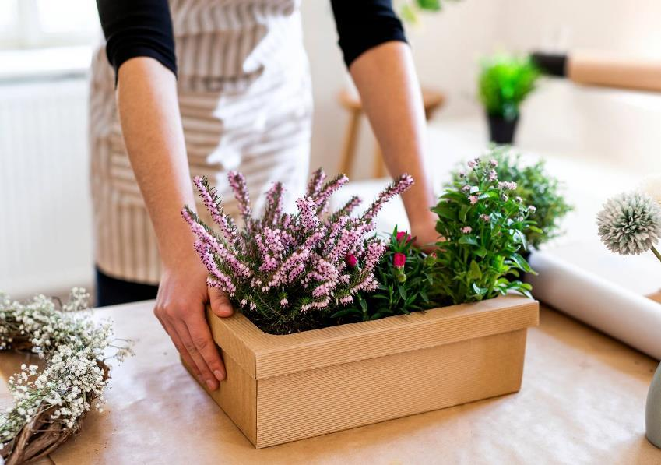
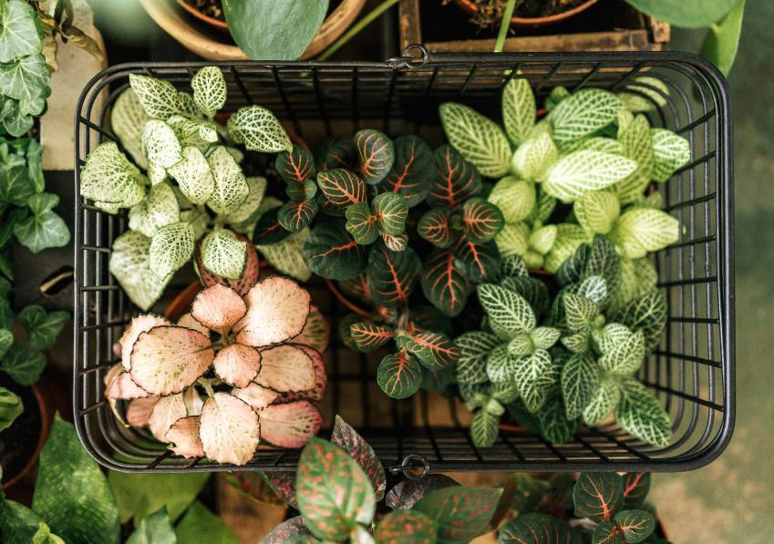
Thank you

