Slide 1
Datamining board games dataset
Tuomo Kalliokoski, Petra Puumala, Maria Zudina

Slide 2
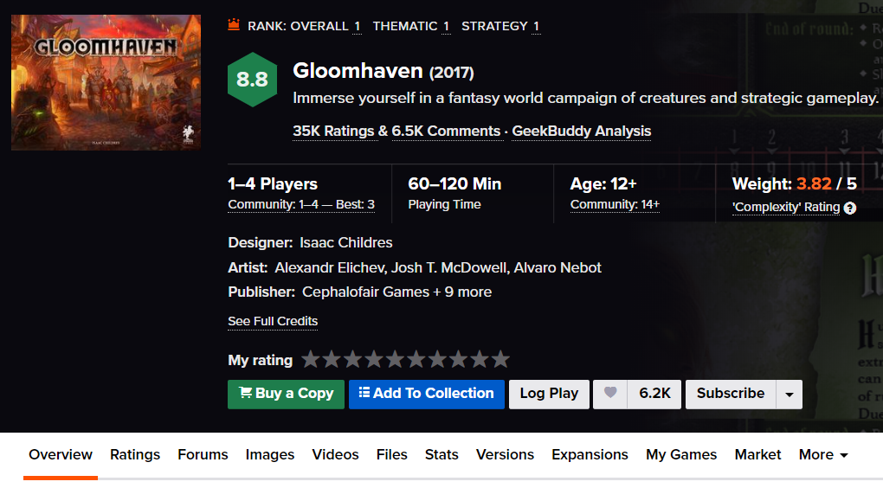
data
A dataset containing the attributes and the ratings for around 94,000 among board games and expansions as get from BoardGameGeek.
The data is at least 3 years old
Dataset had variables containing all data from this view and also data from the other tabs (bottom row) for each game

Slide 3
goal
The main goal was to explore BGG’s data and find out what makes a game successful
We decided the definition for a successful game:
High average rating + high number of ratings
We made the ratio from these two variables

Slide 4
sqlite to csv-format + data pruning
The dataset had 5 tables and only one had interesting data in it
It had about 60 columns and 90400 rows.
We removed multiple uninteresting columns. F. ex. Link to image-file, game’s depiction, BGG statistics..
We wanted to include only ”perfect” games so we removed game expansions, compilations and games that had a low number of ratings
Then we saved the data in to csv-format
Now we still had about 29000 games left.

Slide 5
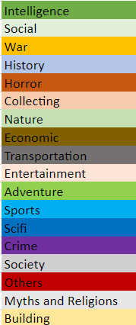
data editing + pruning
Data still needed a lot of editing.
Game category column was in form: "Economic,Negotation,Political", "Civilization,Nautical",...
We combined small categories in to bigger ones
f. ex. World War I and World War II categories both to War category…
First about 80 categories, after combining 18
We separated different categories into own columns and made binary variables from those.
Then we did the same for game mechanic column
The count didn’t decrease as much as categories’

Slide 6
data editing + pruning
In first step we removed games that had under 5 ratings.
Now we moved the limit to 100 ratings so we could really focus on the games that have significant number of ratings.
We explored variables containing information about suggested player amount with PCA
Instead of PCA we ended up with making 4 different binaric variables from suggested player amount variables. This model worked better for our goal.
Game time divided also into 4 categories (next slide)
We binarized data in all possible cases or scaled it between 0 and 1

Slide 7
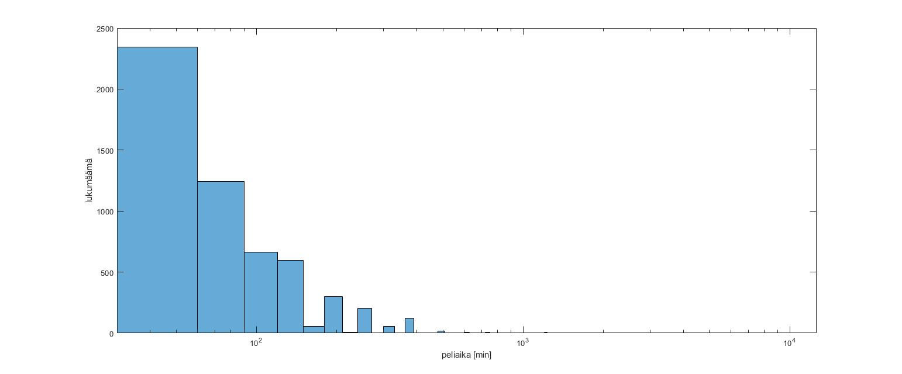
GAME TIME

Slide 8
analysis
Removed variables:
mChitPullSystem mPaperandPencil mRockPaperScissors cBook
cChildrensGame
cElectronic
cHumor
cPrintAndPlay
(m=mechanic, c=category)
We created a new column. 100 most successful games have a binaric true value and others have false.
We listed and then deleted those columns from binarized data that didn’t show up in top 100 games.
F. ex: ”If none of the games that has category Book in it isn’t in the top 100 games, then Book category isn’t desirable if you wan’t to make a successful game”

Slide 9
association rule mining
We made association rules from the preprocessed data
We were interested in the 100 most popular games
We set minimum support to 1/5 and got 90 rules

