Slide 1

Datamining Board Games Dataset
Tuomo Kalliokoski, Petra Puumala, Maria Zudina

Slide 2
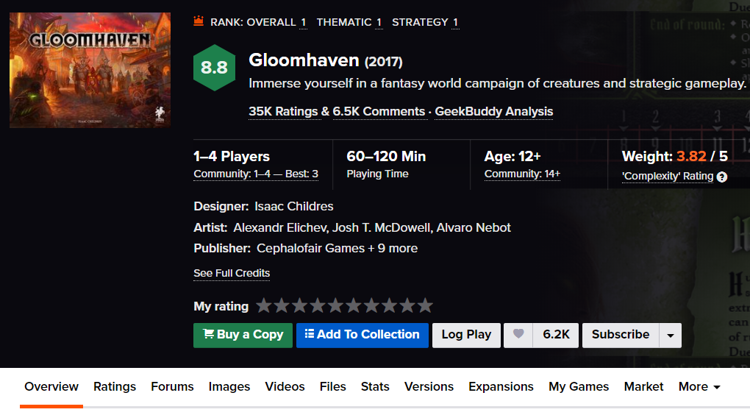
Dataset: BoardGameGeek
A dataset containing the attributes and the ratings for around 94,000 board games and expansions listed at BoardGameGeek webpage
The data is at least 3 years old
Dataset had variables containing all data from this view and also data from the other tabs (bottom row) for each game

Slide 3
Project Goal
Our main goal was to explore BGG’s data and find out what makes a game successful
”To find a recipe for a successful game”
Our definition for a successful game:
High average rating + high number of ratings (popularity)
We made the ratio from these two variables

Slide 4
SQLite to csv-format + data pruning: What are we looking at?
The dataset had 5 tables and only one had interesting data in it
It had about 60 columns and 90400 rows.
We removed multiple uninteresting columns. F. ex. Link to image-file, game’s depiction, BGG statistics..
We wanted to include only ”full” games so we removed game expansions, compilations and games that had a low number of ratings
Then we saved the data in to csv-format
Now we still had about 29000 games left

Slide 5
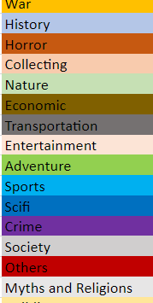
Data editing + more pruning: How do we organize the data?
Data still needed a lot of editing.
Game category column was in form: "Economic,Negotation,Political", "Civilization,Nautical",...
We separated different categories into columns and converted their data into binary variables.
Then we combined small categories into bigger ones
World War I and World War II categories both into War category…
Then we did the same for game mechanic column
The count didn’t decrease as much as categories’
<- Combined categories

Slide 6
Data editing + even more pruning: Cutting down to the top
First we removed the games that had under 5 ratings.
Eventually we moved the limit to 100 ratings so we could really focus on the games that have significant number of ratings.
We explored variables containing information about suggested player amount with PCA
Instead of PCA we ended up with making 4 different binaric variables from suggested player amount variables. This model worked better for our goal.
Game time was also divided into 4 categories (next slide)
We binarized data in all possible cases or scaled it between 0 and 1

Slide 7
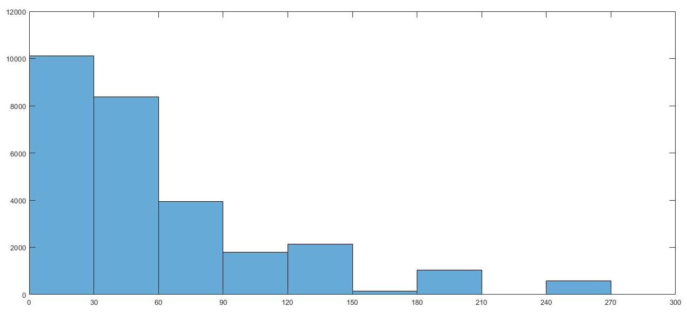
GAME TIME

Slide 8
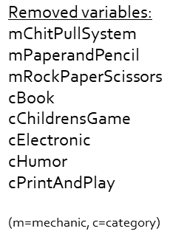
Analysis
We created a new column: 100 most successful games have a binaric true value and others have false.
We listed and then deleted those columns from binarized data that didn’t show up in top 100 games.
”If none of the games that have a category ’Book’ in them are in the top 100, then the ’Book’ category isn’t desirable if you want to make a successful game”

Slide 9
Association rule mining
We searched frequent itemsets from the data with apriori algorithm
We were interested in the 100 most popular games
We set minimum support to 1/5 and got 90 rules

Slide 10
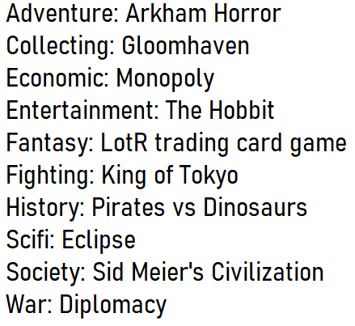
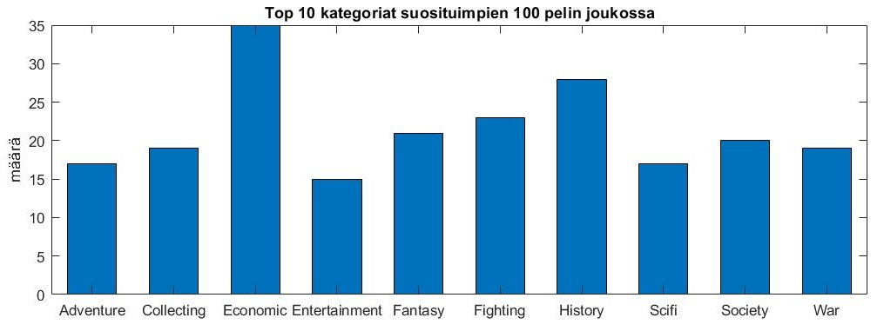
Results: Categories

Slide 11
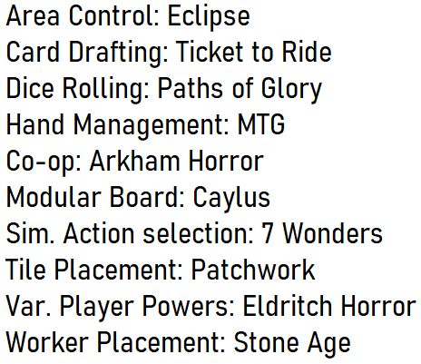
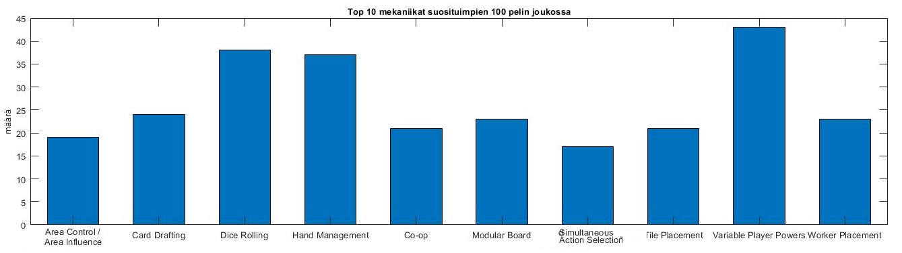
Results: Mechanics

Slide 12
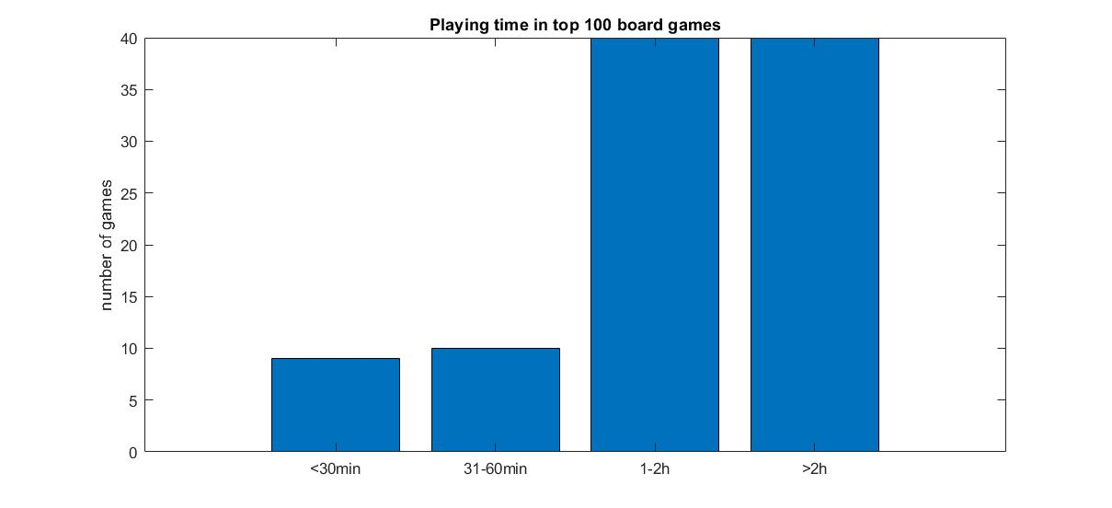
Results: Playing times

Slide 13
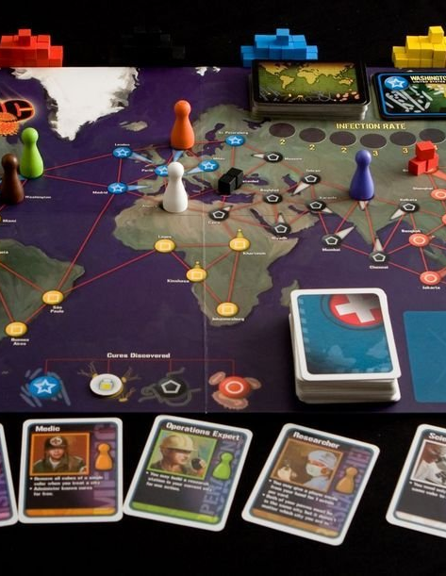
Results: Combination
The only visibly popular combination was Dice Rolling + Variable Player Powers.
26% of top100 games had this combination
Example of the game: Pandemic (seen on the picture)

Slide 14
Thank you!
Any questions?

