Slide 1

Real-Time Stock Market Insights Using Big Data
Colin Kirby
EEL4798

Slide 2
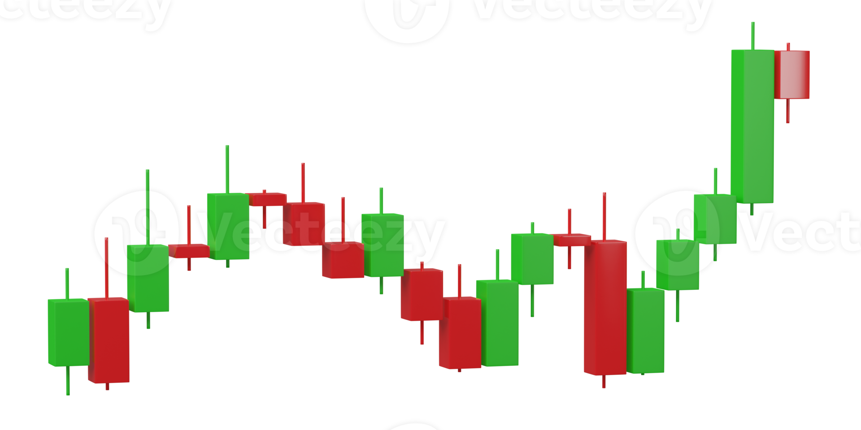
Context
The growing data challenge.
Stock market Data
Massive amounts of structured data (e.g. prices, volumes).
Social media sentiment
Unstructured data (e.g. tweets, reddit posts) influencing decisions.
The problem
Real-time processing of these diverse data streams is difficult.

Slide 3
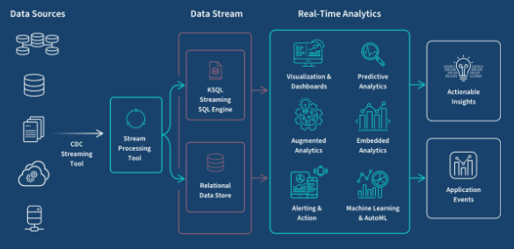
Motivation
Why Real-Time Stock Market Analysis Matters.
Timely Decisions
Traders need rapid insights for high-frequency trading.
Social media as a signal
Sentiment can predict market trends early.
Our goal
Build a scalable pipeline for analyzing financial and social media data.

Slide 4
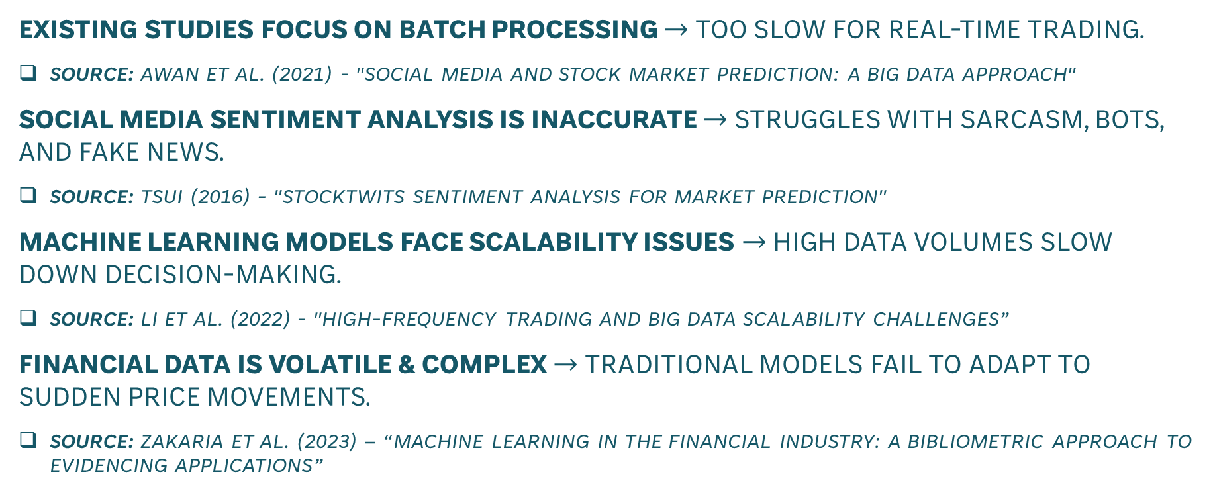
Understanding current market analysis challenges
Existing Studies focus on batch processing $→$ Too slow for real-time trading.
Source: Awan et al. (2021) - "Social Media and Stock Market Prediction: A Big Data Approach"​
Social media sentiment analysis is inaccurate $→$ Struggles with sarcasm, bots, and fake news.
Source: Tsui (2016) - "StockTwits Sentiment Analysis for Market Prediction"
Machine learning models face scalability issues $→$ High data volumes slow down decision-making.
Source: Li et al. (2022) - "High-Frequency Trading and Big Data Scalability Challenges”
Financial Data is volatile & Complex $→$ Traditional models fail to adapt to sudden price movements.
SOURCE: Zakaria et al. (2023) – “Machine learning in the financial industry: A bibliometric approach to evidencing applications”

Slide 5

Challenges In Stock Market Analysis
REAL-TIME Processing Bottlenecks
MOST MODELs use batch processing, delaying insights.
Data noise & Social media manipulation
Fake news, bots, spam affect sentiment accuracy.
Computational Constraints
Handling massive data streams requires high PROCESSING power.
LATENCY & SCALABILITY
Current data pipelines struggle with real-time updates.

Slide 6





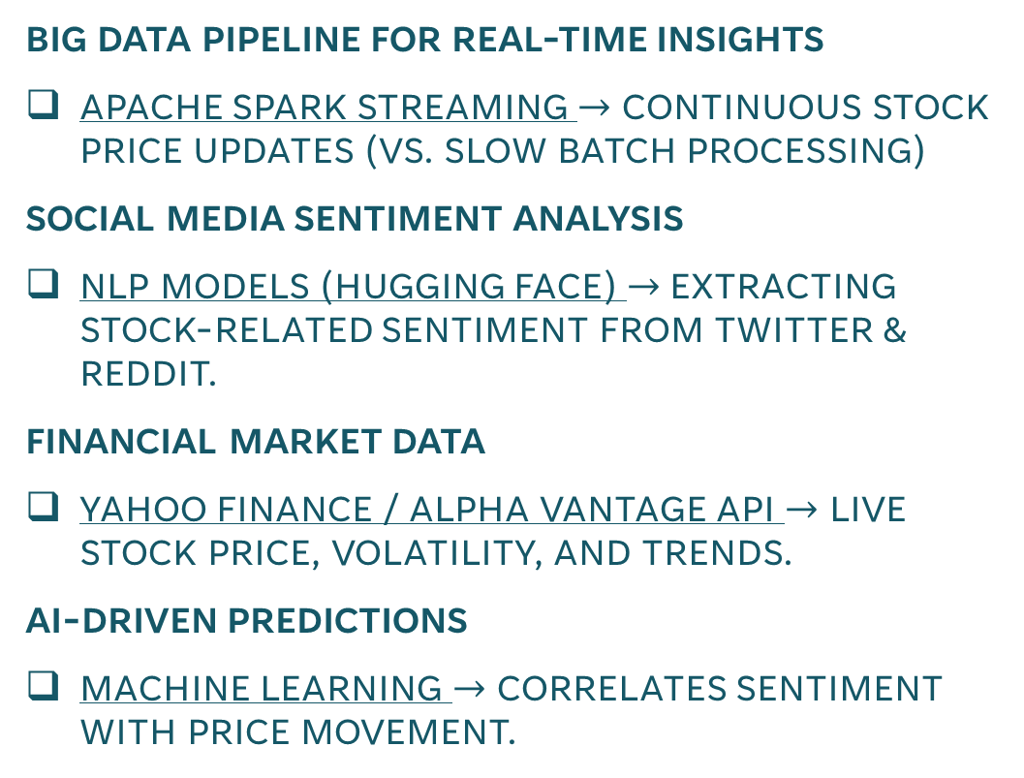
OUR Solution
Big data Pipeline for real-time insights
Apache Spark Streaming $→$ Continuous stock price updates (vs. slow batch processing)
Social media sentiment analysis
NLP models (Hugging face) $→$Extracting stock-related sentiment from twitter & reddit.
Financial market data
Yahoo finance / alpha vantage api $→$ Live stock price, volatility, and trends.
Ai-driven predictions
Machine learning $→$ Correlates sentiment with price movement.

Slide 7

Expected Outcomes
Improving market analysis with big data.
Faster decision-making
Real-time insights instead of delayed batch processing.
Improved market predictions
Ai-driven analytics detect stock trends based on sentiment shifts.
Higher accuracy in sentiment analysis
NLP Models filter noise from social media data.
Scalable & Efficient processing
Apache spark handles large-scale market data seamlessly.

Slide 8
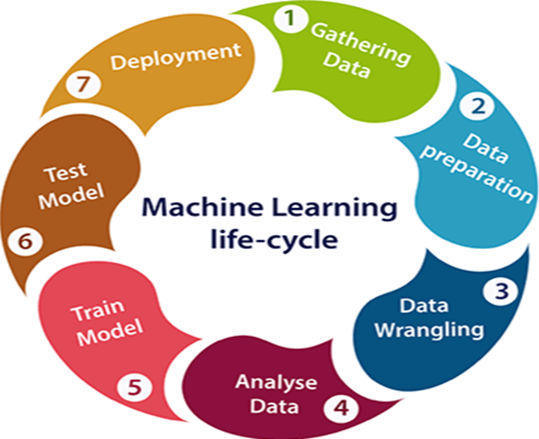
Experimental Methodology
How we test and validate our approach.
Testing & Evaluation
SPEED : Measure latency in processing stock & sentiment data.
Accuracy : Compare model predictions vs actual stock trends.
Machine learning performance metrics
Train / Test Split (80 / 20) for predictive modeling.
Validate sentiment influence on price movements.
Benchmark & Scalability testing
Stress-test Apache spark under high data loads.
Ensure real-time insights with minimal delay.

Slide 9
Conclusion
Final thoughts & Key takeaways.
Real-Time Stock Analysis is essential
High-frequency trading requires fast & accurate insights.
Challenges exist in processing & sentiment accuracy
Existing models struggle with latency, data noise, scalability.
Proposed solution bridges the gap
Apache Spark + NLP + ML Models improve decision making.
Future work & next steps
Test on larger datasets to refine predictions.
Explore deep learning models (Stretch goal).

