Slide 1
Abstraction and Overriding Methods

Slide 2
Abstract Classes
One of the 4 pillars of OOP
The process of simplifying complex systems by focusing on essential properties while hiding unnecessary details.
It involves creating models or representations of real-world entities or systems that capture only the relevant characteristics needed for a particular purpose.

Slide 3
Abstract Classes
Publication
Title Price Copies
SellCopy()
Magazine
OrderQty CurrIssue
AdjustQty() RecNewIssue()
Book
Author
OrderCopies()

Slide 4
Abstract Classes
If we want to deal with a new type of Publication which is genuinely neither Book nor Magazine such a Newspaper, it will naturally become another new subclass of Publication
As Publication will never be instantiated, the only purpose of why the class exists is to gather together the generalized features for inheritance

Slide 5
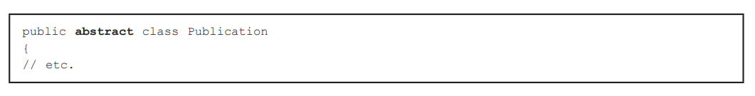
Abstract Classes
We can enforce the fact the Publication is non-instantiable by declaring it “abstract”

Slide 6
Importance of Abstraction
Modularity – breaks down a system into smaller, more manageable components
Code reusability – defines reusable templates that can be instantiated multiple times
Information hiding – separates the external interface of an object from its internal implementation details. Allows developers to modify the internal implementation without affecting other parts of the system

Slide 7
Overriding Methods
A subclass inherits the methods of its superclass and must therefore always provide at least that set of methods
This implementation of a method can be changed in a subclass called the overriding method
To do this, write a new version in the subclass which replaces the inherited attribute/method

Slide 8
Overriding Methods
The new method should essentially perform the same functionality as the method that it is replacing.
This can help improve the method and make the function more appropriate to a specific subclass

Slide 9
Overriding Methods Example
Imagine a special category of magazine which has a disc attached to each copy called DiscMag
Create a subclass of Magazine to deal with DiscMags
When a new issues of a DiscMag arrives, not only do we want to update the current stock, but we want to check that the disks are correctly attached.
DiscMag needs additional functionality in the RecNewIssue() method

Slide 10
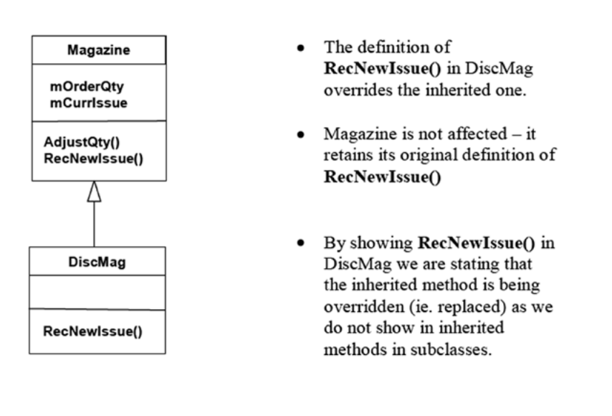
Overriding Methods Example

Slide 11
Implementing Override Method
To implement DiscMag we must create a subclass of Magazine.
No additional instance or methods are required though it is possible to create some if needed
The constructor for DiscMag simple passes ALL its parameters directly on to the superclass
A version of RecNewIssue() is defined in DiscMag to override the one inherited from Magazine

Slide 12
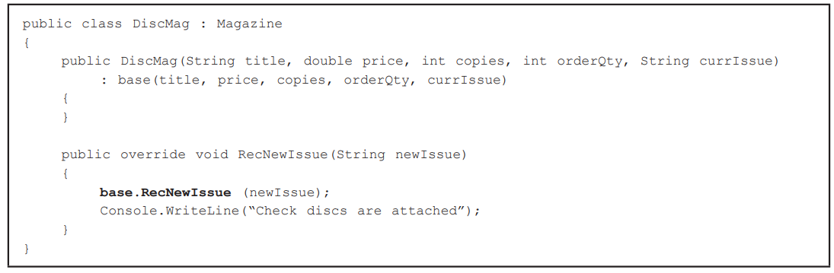
Implementing Override Method

Slide 13
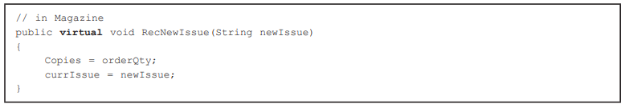
Implementing Override Method
One final change is required
Before a method can be overridden, permission for this must be granted by the author of the superclass
This can be done using the keyword virtual

Slide 14
Exercise
Create the code for the following:
Animal
Species
Run(int legs)
Human
Name
Run(int legs)

Slide 15
Exercise Answer
public abstract class Animal {
string Species;
public Animal (string Species){
this.Species = Species;
}
public virtual void Run(int Legs){
}
}

Slide 16
Exercise Answer
public class Human:Animal {
string Name;
public Human (string Species, string Name) : base (Species){
this.Name = Name;
}
public override void Run(int Legs){
base.Run(Legs);
}
}

Slide 17
Activity
Create the code for the following:
Human
Name Age
Talk(string Sentence)
Student
Student_ID
Talk(String Sentence)
Instructor
Faculty_ID
Talk(string Sentence) Teach(string x)

