Slide 1
Inheritance in OOP

Slide 2
Generalization and Specialization
Classes are a generalized form from which objects with differing details can be created. Objects are thus “instances” of their class.
For example, Student 55 is an instance of class Student. More concisely, 55 is a Student.

Slide 3
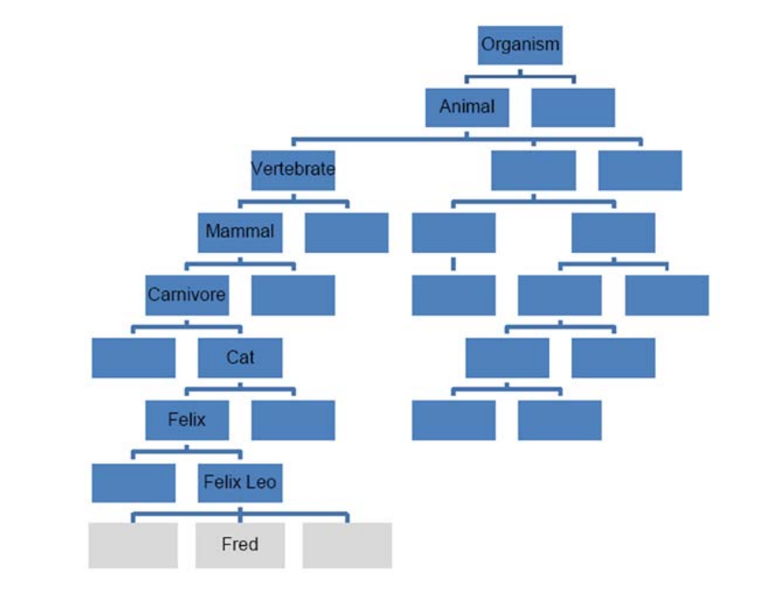
Generalization and Specialization
One hierarchy that we all have some familiarity with is the animal kingdom.
Kingdom - animals
Phylum - vertebrates
Class - mammal
Order - carnivore
Family - cat
Genus - felix
Species - felix leo

Slide 4
Generalization and Specialization
Fred is a felix leo is a felix is a cat is a carnivore
Carnivores eat meat so Fred has the characteristics “eat meat”
Fred is a felix leo is a felix is a cat is a carnivore is a mammal is a vertebrate
Vertebrates have a backbone, so Fred has the characteristic “has a backbone”

Slide 5
Generalization and Specialization
The “is a” relationship links an individual to a hierarchy of characteristics. This sort of relationship applies to many real-world entities
In this class we will portray this as thin arrow( )
The “has a” relationship is where a class contains or uses another class.
In this class, we will portray this as a thick arrow ( )
This is NOT considered as inheritance

Slide 6
Inheritance
We specify the general characteristics high up in the hierarchy and more specific characteristics lower down.
We call this as generalization and specialization
All the characteristics from classes above the class/object in the hierarchy are automatically feature in it.
We call this as inheritance

Slide 7
Inheritance
Consider BOOKS and MAGAZINES as specific types of publications
Specific object should NOT be shown in class diagrams
Magazine
Title Price OrderQty CurrIssue Copies
SellCopy() AdjustQty() RecNewIssue()
Book
Title Author Price Copies
SellCopy() OrderCopies()

Slide 8
Inheritance
We can separate (“factor out”) these common members into a superclass called publication
Magazine
Title Price OrderQty CurrIssue Copies
SellCopy() AdjustQty() RecNewIssue()
Book
Title Author Price Copies
SellCopy() OrderCopies()
Publication
Title Price Copies
SellCopy()

Slide 9
Inheritance
Publication
Title Price Copies
SellCopy()
Book class has 4 instance variables 2 methods
Title, price, copies, author, sellcopy(), and ordercopies()
Magazine class has 5 instance variables and 3 methods
Magazine
OrderQty CurrIssue
AdjustQty() RecNewIssue()
Book
Author
OrderCopies()

Slide 10
Practice activity 1
Arrange the following classes into a suitable hierarchy and draw these on a class diagram
A current account
A deposit account
A bank account
Simon’s deposit account

Slide 11
Practice activity 1
Bank Account
Simon’s deposit account should NOT be shown on a class diagram as this is a specific instance of a class (object)
Deposit Account
Current Account

Slide 12
Practice activity 2
Arrange the following classes into a suitable hierarchy and draw these on a class diagram
A building
A house
A car
A tire

Slide 13
Practice activity 2
Building
A house is a type of building and can inherit the attributes of building. However, this is not true of a car.
A car HAS A tire
House
Car
Tire

Slide 14
Quiz on Inheritance
Arrange the following classes into a suitable hierarchy and draw these on a class diagram with their corresponding attributes/methods:
A Building (3 attributes, 2 methods)
University of the Cordilleras (4 attributes, 3 methods)
A school (4 attributes, 2 methods)
A student (3 attributes, 1 method)
A human (2 attributes, 1 method)

Slide 15
References
Object Oriented Programming using C# by Simon Kendal (2011) ISBN 978-87-7681-814-2

