Slide 1
Inheritance with Constructors

Slide 2
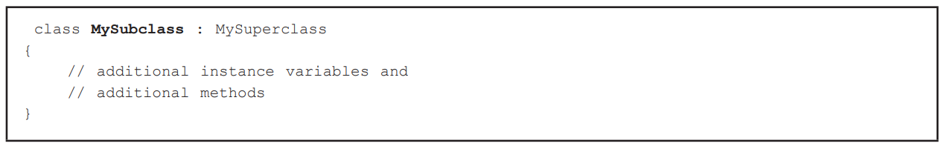
Implementing inheritance in C#
No special features are required to create a superclass. Thus, any class can be a superclass unless specifically prevented.
A subclass specifies it is inheriting features from a superclass using the “:” symbol

Slide 3
Inheritance with Constructors
Constructors are methods that create objects from a class. Each class (sub or super) should encapsulate its own initialization in a constructor, usually relating to setting the initial state of its instance variables
Constructors are methods given the same name as the class
A constructor for superclass, or base class, should deal with general initialization

Slide 4
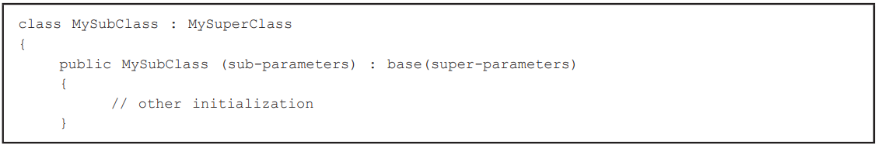
Inheritance with Constructors
Each subclass can have its own constructor for specialized initialization, but it must often invoke the behavior of the base constructor. It does this using the keyword “base”.

Slide 5
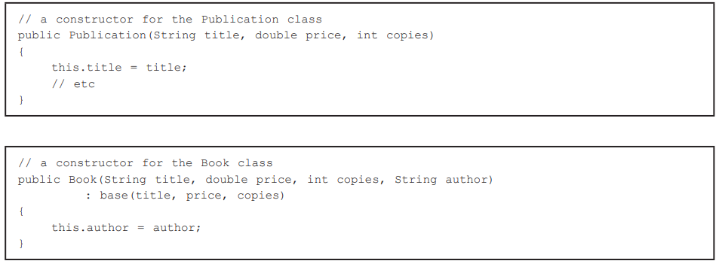
Inheritance with Constructors
The book constructor requires four parameters. Three of which are immediately passed on to the based constructor

Slide 6
Constructor Rules
Rules exist that govern the invocation of a superconstructor
If the superclass has a parameterless (default) constructor, this will be called automatically if no explicit call to base is made in the subclass constructor
If the superclass has parameters, this MUST call base

Slide 7
Constructor Rules
MySuperClass
MySuperClass()
MySuperClass
MySuperClass() MySuperClass(x)
MySuperClass
MySuperClass(x)
MySubClass
MySubClass()
MySubClass
MySubClass() Can call base
MySubClass
MySubClass() Must call base

Slide 8
Constructor Rules
MySuperClass
MySuperClass()
It is legal, though bad practice, to have a subclass with no constructor because superclass has a parameterless constructor
MySubClass
MySubClass()

Slide 9
Constructor Rules
MySuperClass
MySuperClass() MySuperClass(x)
If the subclass constructor does not call the base constructor, then the parameterless superclass constructor will be called
MySubClass
MySubClass() Can call base

Slide 10
Constructor Rules
MySuperClass
MySuperClass(x)
Because the superclass has no parameterless constructor, the subclass must have a constructor and must call the super constructor using base
MySubClass
MySubClass() Must call base

Slide 11
Sample Activity 1
Create a UML diagram using inheritance and constructors using the following given:
A Motorcycle
A Vehicle
A Car
The inherited class must have a base parameter

Slide 12
Sample Activity 1
Vehicle
Vehicle(x)
Motorcycle
Motorcycle(x)
Car
Car(x)

Slide 13
Sample Activity 2
Based on sample activity 1, write the program with the given parameters:
Motorcycle has the parameter:
string helmet_brand
Vehicle has the parameters:
string brand
int no_of_tires
int horse_power
Car has the parameter:
int max_passenger
string transmission

Slide 14
Sample Activity 2
public Vehicle (string brand, int no_of_tires, int horse_power){
this.brand = brand;
this.no_of_tires = no_of_tires;
this.horse_power = horse_power;
}
public Motorcycle (string brand, int no_of_tires, int horse_power, string helmet_brand) : base (brand, no_of_tires, horse_power){
this.helmet_brand = helmet_brand;
}
public Car (string brand, int no_of_tires, int horse_power, int max_passenger, string transmission) : base (brand, no_of_tires, horse_power){
this.max_passenger = max_passenger;
this.transmission = transmission;
}

Slide 15
Activity
Create a UML diagram AND the code for the program with the given parameters:
Carnivore has the parameter:
string genus
Mammal has the parameters:
string hair_color
int no_of_legs
boolean can_swim
Animal has the parameter:
double height
double weight

