Slide 1
Polymorphism

Slide 2
Class Types
Within the hierarchical classification of animals:
Pinky is a pig (species sus scrofa)
Pinky is (also, more generally) a mammal
Pinky is (also, even more generally) an animal
We can specify the type of thing an organism is at different levels of detail:
Higher level = less specific
Lower level = more specific

Slide 3
Class Types
If you were asked to give someone a pig, you could give them Pinky or any other pig.
If you were asked to give someone a mammal you could given them Pink, any other pig, or any other mammal.
If you were asked to give someone an animal, you could given them Pink, or any other pig, or any other mammal, or any other animal.

Slide 4
Class Types
The idea here is that an object in a classification hierarchy has an “is a” relationship with every class from which it is descended and each classification represents a type of animal
This is true in OOP as well. Every time we define a class, we create a new “type” which determines compatibility between variables, parameters, etc.

Slide 5
Class Types
If we want a DiscMag, it must be an object of class DiscMag
If we want a Magazine, it could be an object of class Magazine, or an object of class DiscMag
If we want a Publication, it could be a Book, Magazine, or DiscMag
<<abstract>>
Publication
Book
Magazine
DiscMag

Slide 6
Which is Legal?
Publication p = new Book();
Publication p = new DiscMag();
Magazine m = new DiscMag();
DiscMag dm = new Magazine();
Publication p = new Publication();
<<abstract>>
Publication
Book
Magazine
DiscMag

Slide 7
Which is Legal?
Publication p = new Book();
Publication p = new DiscMag();
Magazine m = new DiscMag();
DiscMag dm = new Magazine();
Publication p = new Publication();
<<abstract>>
Publication
Book
Magazine
DiscMag

Slide 8
Polymorphism
Because an instance of a subclass is an instance of its superclass, we can handle subclass objects as if they were superclass objects.
This characteristic is termed “polymorphism”, originally meaning “having multiple shapes”

Slide 9
Polymorphism
Thus, a Publication comes in various shapes. It could be a Book, a Magazine, or a DiscMag.
We can invoke the SellCopy() method on any of these Publication irrespective of their specific details
Publication
Title Price Copies
SellCopy()

Slide 10
Polymorphism
If p “is a” Publication, it might be a Book or a Magazine or a DiscMag
Whichever it is, we know that it has a SellCopy() Method so we can invoke p.SellCopy() without worrying about what exactly “p” is
Publication
Title Price Copies
SellCopy()

Slide 11
Polymorphism
This can make programming simpler when we are manipulating objects within an inheritance hierarchy
We can create new types of Publications that can invoke p.SellCopy() such as a Newspaper without having to create any functionality within the new class

Slide 12
CashTill Class
Imagine we want to develop a class CashTill which processes a sequence of items being sold. It would go something like:
SellBook(Book pBook)
SellMagazine (Magazine pMagazine)
SellDiscMag (DiscMag pDiscMag)

Slide 13
CashTill Class
Using Polymorphism. It would look like:
SellCopy (Publication pPub)

Slide 14
CashTill Class
Every subclass is “type-compatible” with its superclass. Therefore, any subclass object can be passed as a Publication parameter

Slide 15
CashTill Class
Without polymorphism, we would need to check for each item “p” so we are calling the right method to sell a copy of that subtype:
If “p” is a Book, call SellCopy() method for Book
If “p” is a Magazine, call SellCopy() method for Magazine
If “p” is a DiscMag, call SellCopy() method for DiscMag

Slide 16
CashTill Class
Instead, we trust C# to look at the object “p” at run time to determine its “type”:
p.sellCopy()

Slide 17
CashTill Class
If the object is a Book, it will invoke the SellCopy() method for a Book.
If “p” is a Magazine, then it will invoke the SellCopy() method for a Magazine.
Polymorphism often allows programmers to avoid conditional statements

Slide 18
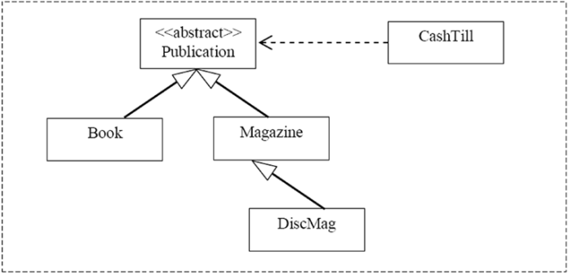
Implementing CashTill Class

Slide 19
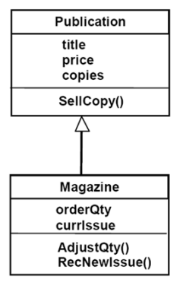
Practice Exercise
Assuming Publication is NOT an abstract type, which are Legal?
Publication p = new Publication(); p.SellCopy();
Publication p = new Publication(); p.RecNewIssue();
Publication p = new Magazine(); p.SellCopy();
Publication p = new Magazine(); p.RecNewIssue();
Magazine m = new Magazine(); m.RecNewIssue();

Slide 20
Practice Exercise
Legal – you can invoke SellCopy() on a publication
Illegal – the RecNewIssue() method does not exist in publication
Legal – Magazine is a type of publication therefore you can assign an object of type magazine a variable of type publication
Illegal – while we can invoke RecNewIssue on a magazine, the compiler does not know that p is a magazine
Legal – m is a magazine and we can invoke this method on magazines

Slide 21
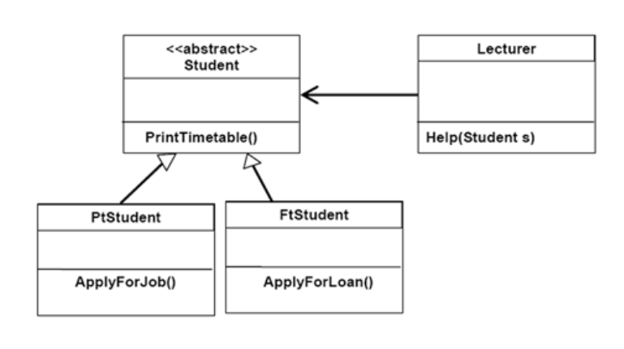
Practice Exercise
Which of the following code segments are valid?
Student s = new Student();
Lecturer l = new Lecturer();
l.Help(s);
Student s = new FtSudent();
Lecturer l = new Lecturer();
l.Help(s);

Slide 22
Practice Exercise
Which of the following code segments are valid?
This is NOT valid as class student is abstract
This is valid

