Slide 1
Unified Modeling Language (UML)

Slide 2
Introduction to UML
Unified Modeling Language (UML) is a standardized modeling language used in software engineering.
It provides a set of diagrams and symbols to visually represent software systems.
Not language specific thus a software design, communicated via UML diagrams, can be implemented in a range of Object Oriented languages.

Slide 3
Types of UML Diagrams
Class Diagrams
Object Diagrams
Sequence Diagrams
Use Case Diagrams
Activity Diagrams
Component Diagrams
Package Diagram

Slide 4
Importance and Benefits of UML
Improved Communication: UML provides a standardized way to visually represent various aspects of a software system, including its structure, behavior, and interactions.
Clearer Visualization of System Architecture: UML diagrams help in visualizing the overall architecture of the software system.
Better Understanding of System Requirements: UML allows stakeholders and developers to model system requirements using various diagrams.
Facilitates Iterative Development and Agile Practices: UML is well-suited for iterative and agile software development approaches.

Slide 5
Class Diagrams
Classes are the basic components of any object oriented software system and UML class diagrams provide an easy way to represent these.
Class diagrams show multiple classes and how they are related to each other. Thus a class diagram shows the architecture of a system.
A class consists of : a unique name (conventionally starting with an uppercase letter), a list of attributes (int, double, boolean, string etc), a list of methods.

Slide 6
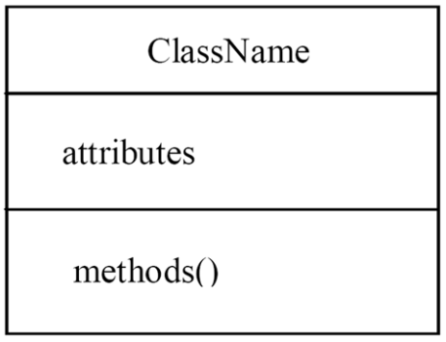
Class Diagrams

Slide 7
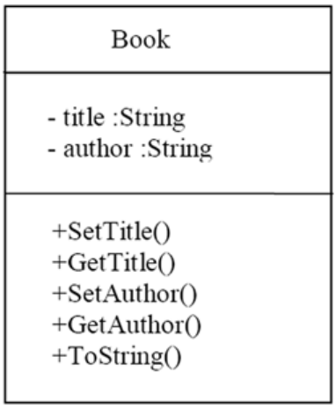
Class Diagrams

Slide 8
Diagrams
For attributes and methods visibility modifiers are shown. Attributes are normally kept private and methods are normally made public.
Accessor methods are created to provide access to private attributes when required.
Class Book, with String attributes of title and author, and the following methods SetTitle(), GetTitle(), SetAuthor(), GetAuthor() and ToString()

Slide 9
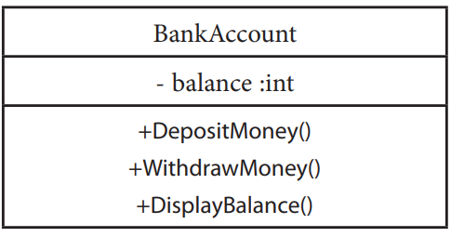
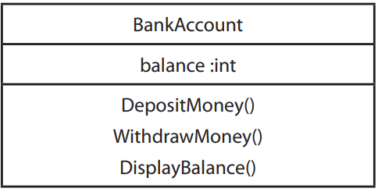
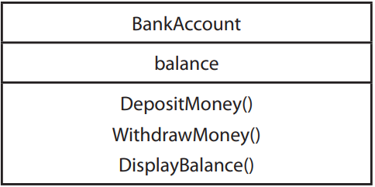

Valid Diagrams

Slide 10
UML Syntax
Visibility defines the accessibility of classes, attributes, operations, and other elements within a system, specifying whether they can be accessed from outside the class in which they are defined.
‘+’ public
‘-’ private
‘#’ protected
‘~’ package

Slide 11
UML Syntax
Public visibility (+) indicates that the element is accessible from outside the class and can be accessed by any other class in the system.
Private visibility (-) indicates that the element is accessible only within the class in which it is defined and cannot be accessed from outside the class.
Protected visibility (#) indicates that the element is accessible within the class and its subclasses (inheritance hierarchy) but not from outside.
Package or default visibility (~) indicates that the element is accessible within the same package or namespace but not from outside.

Slide 12
UML Relations
Association represents a relationship between two or more classes in which objects of one class are connected to objects of another class.
It's depicted as a solid line between classes on a class diagram.
Associations can have roles, multiplicities, and navigabilities.

Slide 13
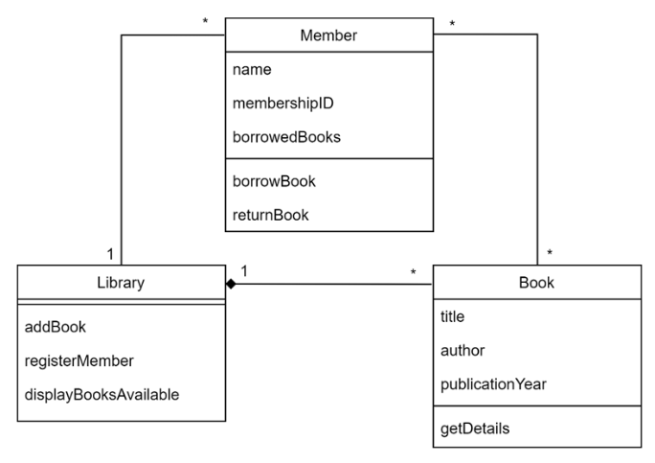
UML Relations

Slide 14
UML Relations
Multiplicity defines the number of instances of one class that can be associated with a single instance of another class in a particular relationship. It specifies the cardinality or range of valid values for a given association or attribute.
Multiplicity can be applied to both associations between classes and attributes within a class.

Slide 15
UML Relations - Multiplicity
"0..1" - Zero or one: Indicates that there can be zero or one instances of the associated class.
"1" - Exactly one: Indicates that there must be exactly one instance of the associated class.
"0..*" - Zero or more: Indicates that there can be zero or more instances of the associated class.
"1..*" - One or more: Indicates that there must be at least one instance of the associated class, but there can be more.
"n" - Specific number: Indicates a specific number of instances of the associated class, where "n" represents the exact number.
"m..n" - Range: Indicates a range of valid values, where "m" represents the minimum number of instances and "n" represents the maximum number of instances.

Slide 16
UML Relations - Multiplicity
Many members can return/borrow Many books
1 Library can have Many books
1 Library can have Many members

Slide 17
UML Relations
Navigability defines whether an object in one class can navigate to objects in another class through the association.
It's represented by an arrowhead on the association line, indicating the direction in which navigation is possible.
Navigability can be bidirectional (with arrows at both ends) or unidirectional (with an arrow at one end).

Slide 18
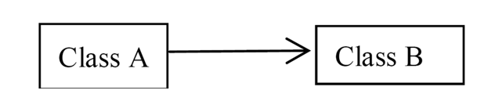
UML Relations - Navigability
In an association Class A ‘uses’ objects of Class B
Navigability is from A to B
Class A object can access the Class B object(s) with which it is associated. The reverse is not true – the Class B object doesn’t ‘know about’ the Class A object

Slide 19
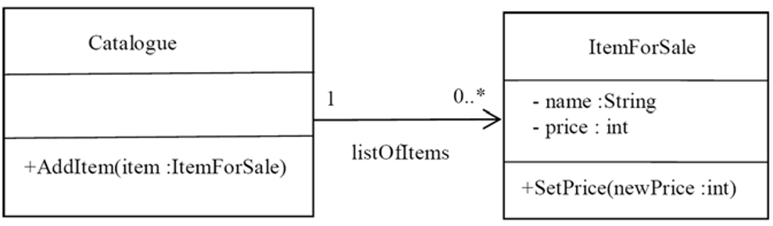
UML Relations - Navigability
Catalogue needs access to 0 or more ItemForSale so items can be added or removed from a Catalogue.
ItemForSale does not need to access a Catalogue in order to set its price or perform some other method associated with the item itself.

Slide 20

UML Relations - Navigability
Each refers to the other class
Navigability A to B and B to A
A Class A object can access the Class B object(s) with which it is associated
Also, a Class B object can access the Class A object(s) with which it is associated

Slide 21

UML Relations - Navigability
Given a Degree we may wish to know which Students are studying on that Degree.
Alternatively starting with a student we may wish to know the Degree they are studying.

Slide 22
UML Relations
Dependency represents a relationship between two classes where a change in one class may affect the other class.
It's depicted as a dashed line with an arrow pointing from the dependent class to the independent class.
Dependencies are often used to indicate that one class uses another class or relies on it in some way.

Slide 23
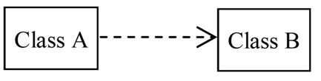
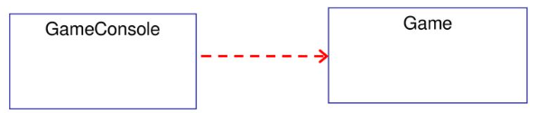
UML Relations - Dependency
Changes to Class B may affect Class A
Class A in some way uses facilities defined by Class B
Game Console (play method) depends on Game

Slide 24
UML Relations
Aggregation represents a "whole-part" relationship between classes, where one class (the whole) contains or owns objects of another class (the part).
It's depicted as a line with a diamond-shaped hollow at the whole end.
Aggregation implies a weaker form of ownership compared to composition.

Slide 25

UML Relations - Aggregation
Aggregation denotes a situation where Object(s) of Class B ‘belong to’ Class A
Object of Class B retain an existence independent of Class A.

Slide 26


UML Relations - Aggregation
We think of the tires as belonging to the car they are on, but at the garage they may be removed and placed on a rack to be repaired.
Their existence isn’t dependent on the existence of a car with which they are associated.
Car
Tire

Slide 27
UML Relations
Composition is a stronger form of aggregation where the part class objects are exclusively owned by the whole class objects.
It's depicted similarly to aggregation but with a solid diamond at the whole end.
Composition implies a lifecycle dependency, meaning the part objects cannot exist independently of the whole objects.

Slide 28

UML Relations - Composition
Composition is similar to aggregation but implies a much stronger belonging relationship
Object(s) of Class B are ‘part of ’ a Class A object
Objects of Class B never exist other than as part of Class A

