Slide 1
Customer Sentiment &
Emotion Intelligence Platform
End-to-End NLP System for Emotion Classification, Priority Scoring & Live Deployment
Kirellos Nader · Fayrous Hassan · Loaa Elshatby
Karim Yunis · Mazen Eldayash · Luay Mohamed
September 2026 · TechTrek Final Project
github.com/KirellosNader/emotion-intelligence-platform

Slide 2
Agenda
01
Project Overview & Dataset
02
System Architecture
03
Classical ML Models
04
Deep Learning Models
05
Transformer (DistilBERT)
06
Full Model Comparison
07
Topic Modeling & Priority Scoring
08
SQL Analytics Layer
09
Streamlit App & Deployment
10
Key Findings & Limitations

Slide 3
Project Overview
What does the platform do?
Emotion Classification
Topic Modeling
Priority Scoring
SQL Analytics
Streamlit App
Classify customer text into 6 emotions using 9 benchmarked models
LDA-based topic extraction (3 topics / emotion) for deeper intent analysis
Rule-based triage engine assigning High / Medium / Low priority
30 analytical queries across 7 database tables
3-tab live prediction web app deployed with Docker
Dataset: dair-ai/emotion (HuggingFace)
16,000 labeled texts · 6 emotion classes · Imbalanced (~9:1 joy vs surprise) · Train 13,000 / Val 2,000 / Test 3,200

Slide 4
System Architecture
Project folder structure & technology stack
emotion-intelligence-platform/
Technology Stack
app/app.py Streamlit web application
scikit-learn
PyTorch
Classical ML + TF-IDF
Deep Learning models
data/emotion_analysis.db SQLite analytics DB (7 tables)
HuggingFace
Gensim LDA
notebooks/ Training & analysis Jupyter notebooks
DistilBERT fine-tuning
Topic modeling
saved_models/ Deployed TF-IDF + LinearSVC artifacts
SQLite3
Streamlit
sql/analytical_queries.sql 30 SQL queries across 7 tables
Analytics database
Web application
all_results/ Full experiment bundle (gitignored)
Docker
OpenAI API
Dockerfile Docker build configuration
Containerized deploy
RAG generation (optional)

Slide 5
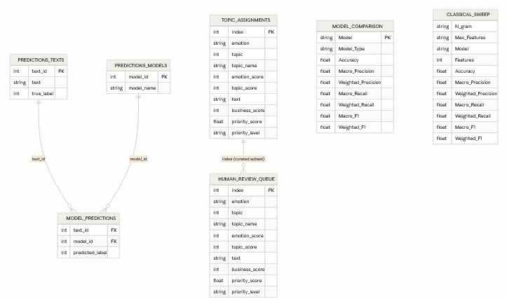
Database Schema
emotion_analysis.db — 7 tables, SQLite
Tables Overview
TOPIC_ASSIGNMENTS
Main triage table (emotion, topic, priority)
MODEL_COMPARISON
Benchmark metrics for all 9 models
CLASSICAL_SWEEP
Hyperparameter grid-search results
HUMAN_REVIEW_QUEUE
60-item QA / edge-case queue
PREDICTIONS_TEXTS
Ground-truth texts + true labels
PREDICTIONS_MODELS
Model registry (9 models)
MODEL_PREDICTIONS
Bridge: text_id x model_id → prediction

Slide 6
Classical ML Models
TF-IDF feature extraction + 3 classifiers benchmarked
Baseline Comparison
Probability Calibration (CalibratedClassifierCV)
Model | Accuracy | Macro F1
TF-IDF + Linear SVM | 88.94% | 86.19%
TF-IDF + Log. Regression | 87.44% | 84.79%
TF-IDF + Naive Bayes | 62.72% | 33.36%
0.1544
0.3054
0.0585
Brier Score
Log Loss
Top-label ECE
Confidence Threshold Analysis
Best Config: Unigram (1,1), max_features=5,000
Threshold | Coverage | Accuracy | Macro F1
0.50 | 96.34% | 90.95% | 88.19%
0.70 | 80.09% | 96.49% | 94.94%
0.90 | 49.09% | 99.43% | 98.97%
Emotion | Precision | Recall | F1
sadness | 94.03% | 91.10% | 92.54%
joy | 92.79% | 90.02% | 91.38%
love | 75.84% | 86.59% | 80.86%
anger | 87.61% | 90.05% | 88.81%
fear | 85.45% | 85.01% | 85.23%
surprise | 77.52% | 86.96% | 81.97%
● At threshold 0.9 → 99.43% accuracy on 49% of data
● Plain unigrams (5k vocab) beat all richer configurations

Slide 7
Deep Learning Models
6 embedding-based neural architectures evaluated
Model | Accuracy | Macro F1 | Weighted F1
GRU | 90.97% | 87.95% | 91.19%
LSTM | 90.34% | 87.59% | 90.60%
RNN | 86.59% | 84.35% | 86.78%
CNN | 84.97% | 82.85% | 84.98%
Embedding MLP | 84.38% | 80.38% | 84.60%
BiLSTM | 80.69% | 79.37% | 80.86%
Key Observations
● GRU outperforms LSTM by ~0.36 accuracy pts
● BiLSTM severely underperforms (training issue — to revisit)
● Love & Surprise: low precision across all DL models due to class imbalance
● GRU reaches 90.97% — within 2 pts of DistilBERT
Best DL Model: GRU — Per-Class Results
Emotion | Precision | Recall | F1
sadness | 96.21% | 95.18% | 95.69%
joy | 96.88% | 87.03% | 91.70%
love | 71.55% | 95.40% | 81.77%
anger | 92.59% | 92.59% | 92.59%
fear | 88.83% | 86.30% | 87.55%
surprise | 67.72% | 93.04% | 78.39%
● Embedding-based models all trained end-to-end with word indices
● All 6 weights saved to all_results/deep_learning/weights/*.pt

Slide 8
Transformer: DistilBERT (Fine-Tuned)
Best overall model across all 9 benchmarked
92.72%
90.21%
92.91%
87.81%
93.76%
About DistilBERT
Accuracy
Macro F1
Weighted F1
Macro Precision
Macro Recall
● Distilled version of BERT, retaining ~97% language understanding
Per-Class Classification Report
● 40% smaller and 60% faster than full BERT
Emotion | Precision | Recall | F1 | Support
sadness | 97.79% | 95.07% | 96.41% | 933
joy | 98.07% | 90.21% | 93.97% | 1,072
love | 74.70% | 96.17% | 84.09% | 261
anger | 94.54% | 92.13% | 93.32% | 432
fear | 88.86% | 90.70% | 89.77% | 387
surprise | 72.90% | 98.26% | 83.70% | 115
● Fine-tuned on the dair-ai/emotion training split
● Best Macro F1 of 90.21% — #1 across all 9 models
● Saved as HuggingFace model (model.safetensors ~260 MB)
● NOT deployed in the app due to size — LinearSVC serves instead
● Natural next step: deploy DistilBERT when compute allows

Slide 9
Full Model Comparison
All 9 models ranked by Macro F1
Rank | Model | Type | Accuracy | Macro F1 | Weighted F1
#1 | DistilBERT (fine-tuned) | Transformer | 92.72% | 90.21% | 92.91%
#2 | GRU | Deep Learning | 90.97% | 87.95% | 91.19%
#3 | LSTM | Deep Learning | 90.34% | 87.59% | 90.60%
#4 | TF-IDF + Linear SVM (tuned) | Classical | 89.34% | 86.80% | 89.43%
#5 | TF-IDF + Log. Regression (tuned) | Classical | 87.84% | 85.29% | 88.04%
#6 | RNN | Deep Learning | 86.59% | 84.35% | 86.78%
#7 | CNN | Deep Learning | 84.97% | 82.85% | 84.98%
#8 | Embedding MLP | Deep Learning | 84.38% | 80.38% | 84.60%
#9 | BiLSTM | Deep Learning | 80.69% | 79.37% | 80.86%
● DistilBERT vs best classical: only ~3.4% accuracy gap → LinearSVC deployed for lightweight serving
● GRU is the best non-transformer model (90.97%) · BiLSTM is the worst DL model (training issue)

Slide 10
Topic Modeling & Priority Scoring
LDA Topic Modeling (3 topics per emotion)
Priority Scoring System
Sadness
Loss & Daily Sadness · Worthlessness & Guilt · Self-Blame & Misery
Anger
90
Joy
Happiness & Gratitude · Positive Achievement · Contentment & Satisfaction
Fear
85
Love
Affection & Caring · Emotional Attachment · Playful & Romantic Affection
Sadness
80
Anger
Irritation & Anger · Conflict & Resentment · Intense Anger & Frustration
Surprise
50
Fear
Nervousness & Fear · Insecurity & Vulnerability · Anxiety & Paranoia
Love
30
Surprise
Joy
20
Amazement & Unexpected · Curiosity & Exploration · Strangeness & Amazement
Urgency Keywords (score = 100): urgent · immediately · asap · critical · emergency · serious

Slide 11
SQL Analytics Layer
30 queries across 7 tables — sql/analytical_queries.sql
Q1–9
Q10–16
Q17–20
Q21–30
Topic & Business Insights
Model Benchmarks
Human Review QA
Prediction Analytics
topic_assignments
model_comparison, classical_sweep
human_review_queue, topic_assignments
predictions_texts, predictions_models, model_predictions
● Top priority queue
● Best models by Macro F1
● Review queue breakdown
● Per-model accuracy (JOIN)
● Emotion & topic distributions
● Avg metrics by model type
● Missed-urgent items
● RANK() window function
● Urgency hit rates by emotion
● N-gram sweep analysis
● Business score by priority level
● CTE best-model
● Avg priority per emotion/topic
● Best classical config
● PARTITION BY per-class best model
Advanced SQL: JOINs across 3 tables · CTEs · RANK() / AVG() window functions · PARTITION BY · CASE-based accuracy pivot

Slide 12
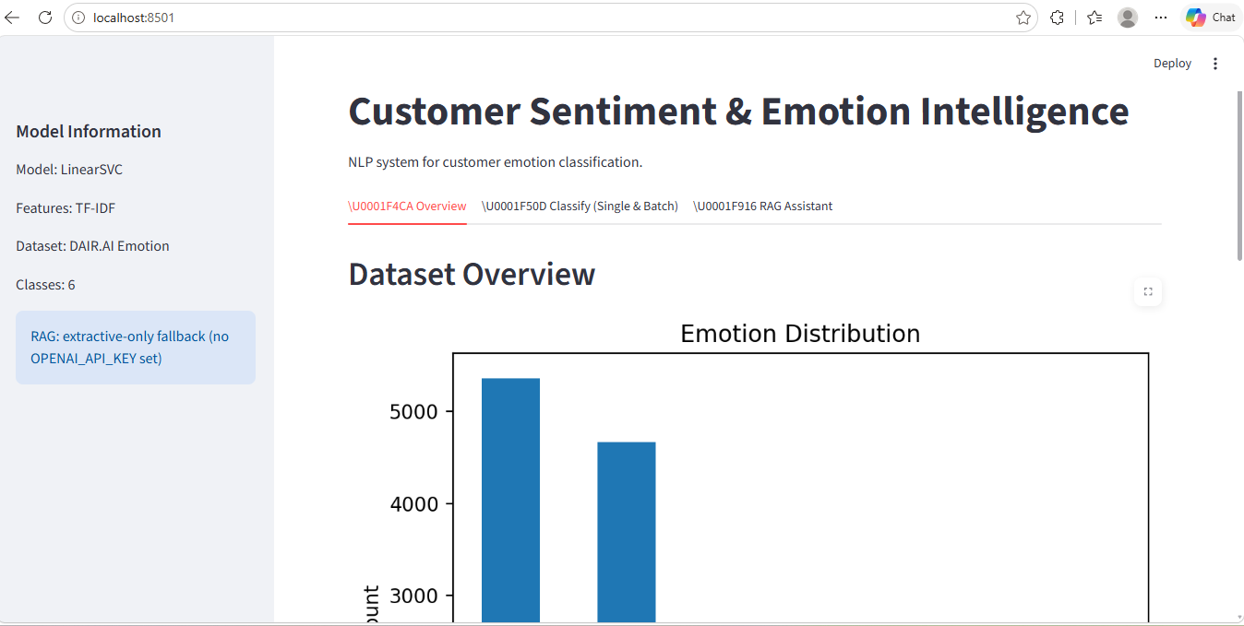
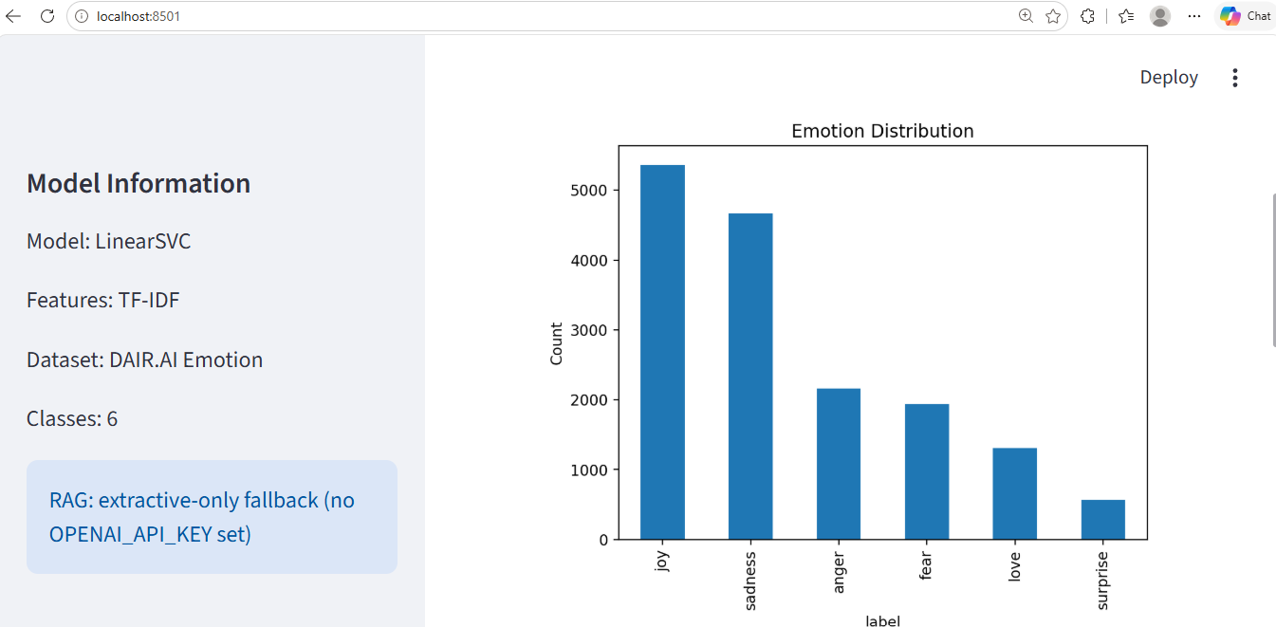
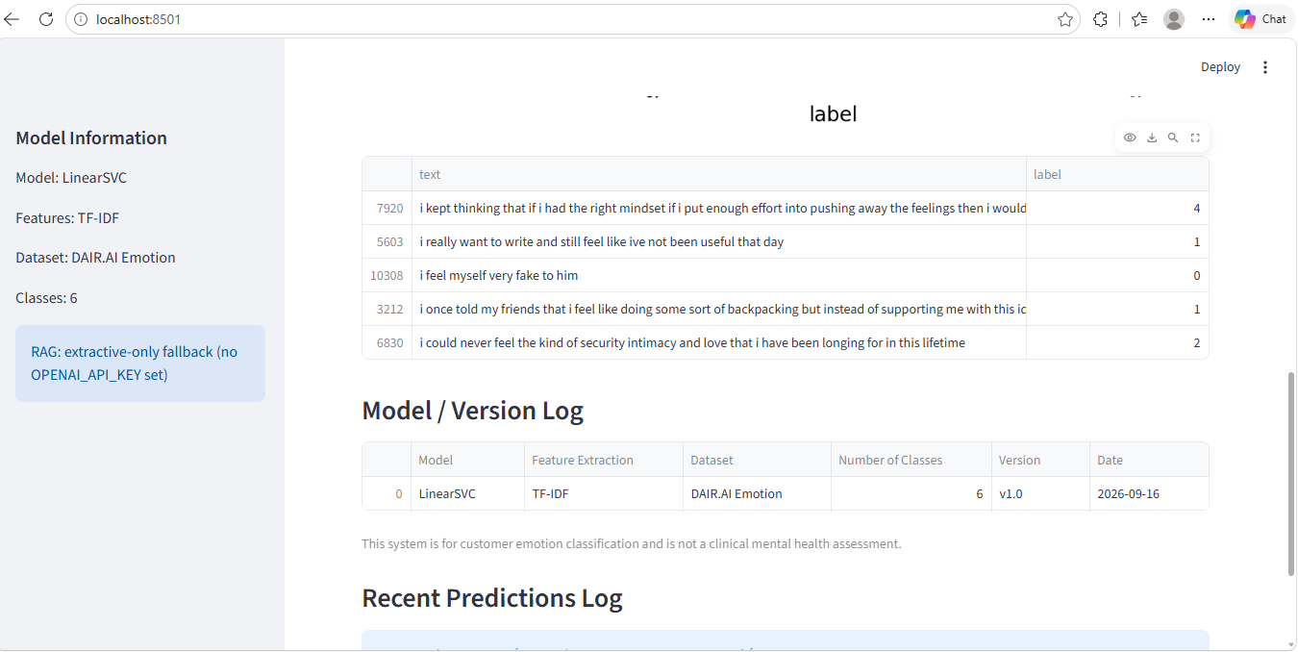
Streamlit Application — Overview Tab
Left: App header with model info sidebar · Right: Full emotion distribution bar chart · Bottom: Sample data table & model version log

Slide 13
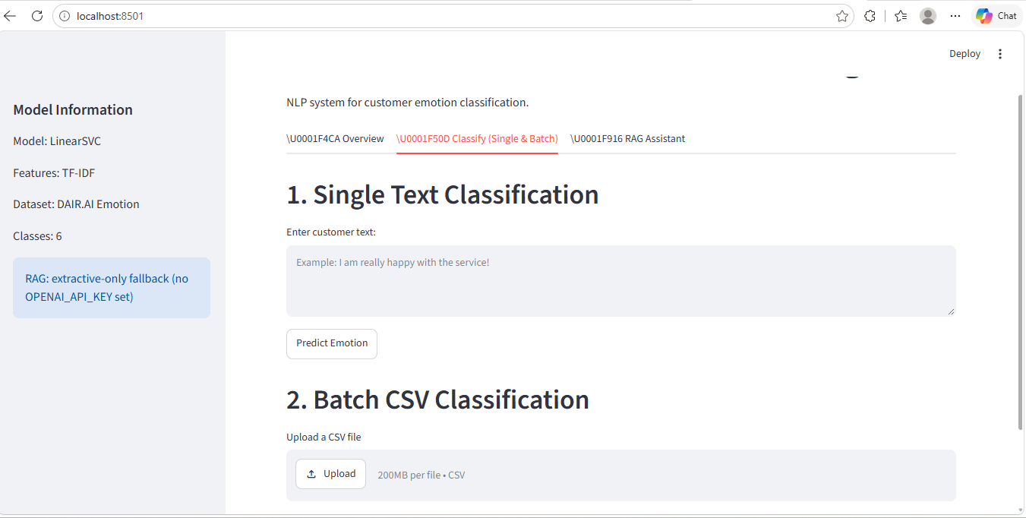
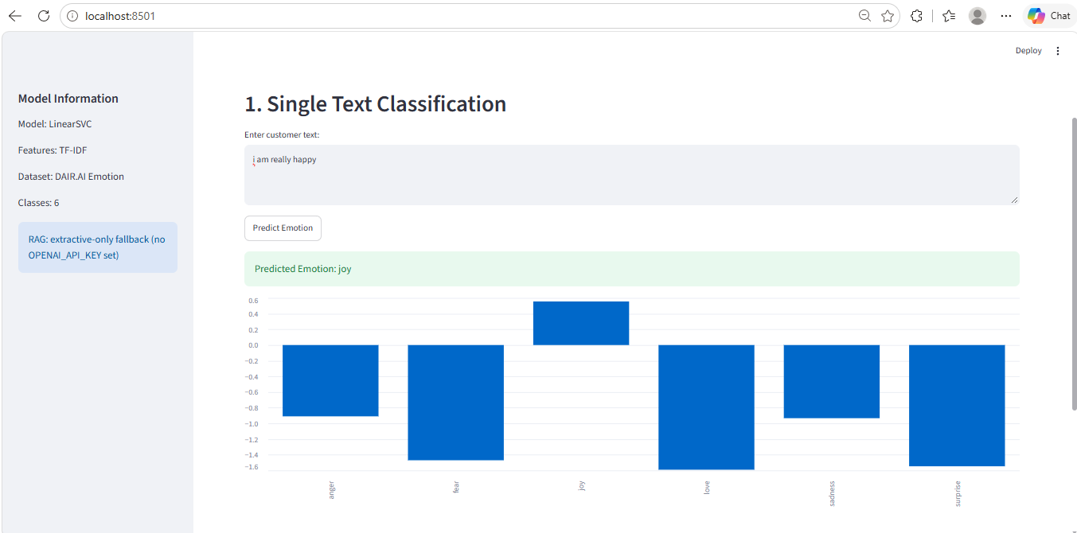
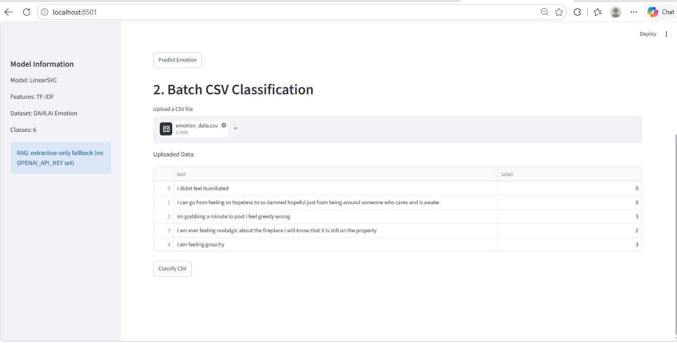
Streamlit Application — Classify Tab
Left: Single text input + batch CSV upload interface · Right: Prediction result for 'i am really happy' → Joy with decision scores · Bottom: Batch CSV preview

Slide 14
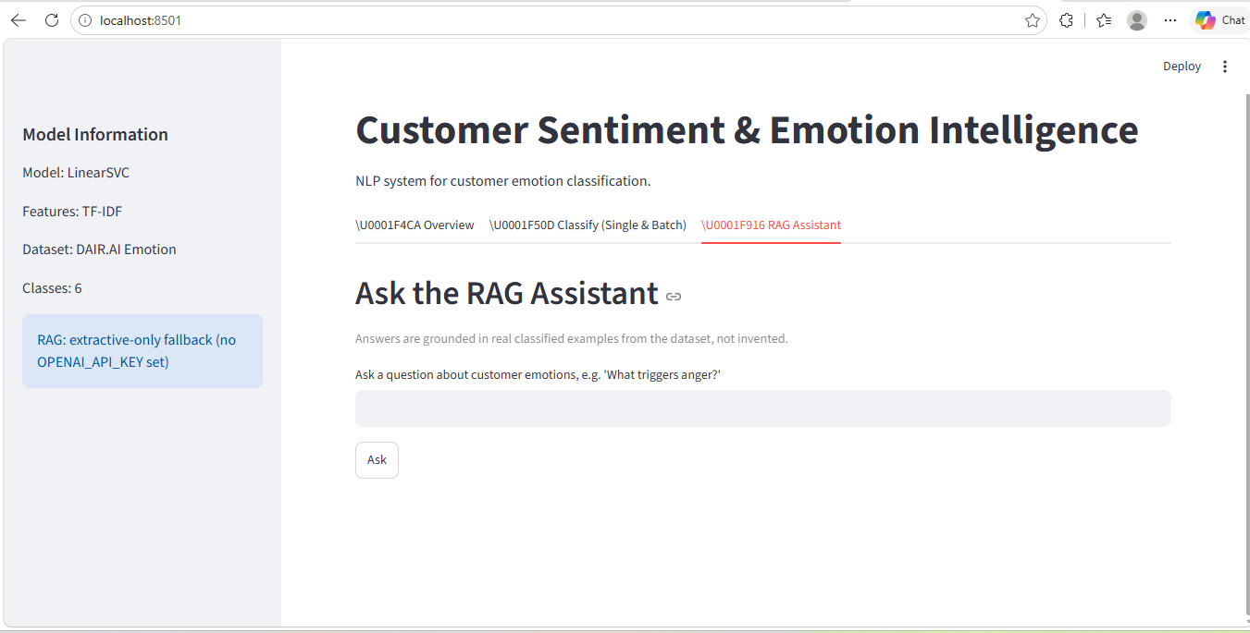
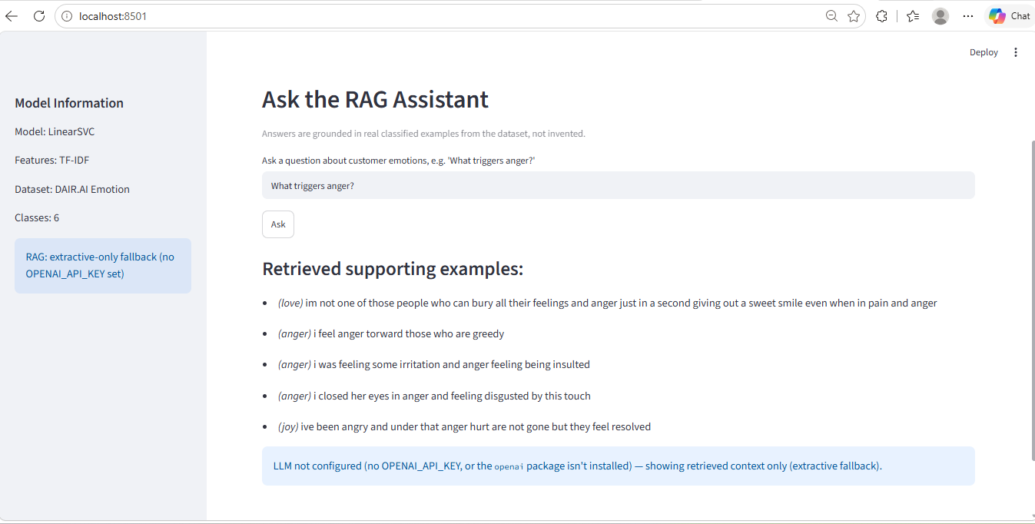
Streamlit Application — RAG Assistant Tab
How RAG Works
1. Retrieve
2. Augment
3. Generate
Fallback
TF-IDF cosine similarity finds top-5 most relevant examples from the labeled dataset
Retrieved examples form the grounded context passed to the LLM
GPT-4o-mini synthesizes an answer based ONLY on the retrieved examples (no hallucination)
Without OpenAI API key → extractive-only mode (shows retrieved examples directly)

Slide 15
Experiment Artifacts (all_results/)
Excluded from git due to file size — fully documented here
classical/
deep_learning/
transformer/
topic_modeling/
best_model.joblib, calibrated_model.joblib,
calibration_summary.csv, threshold_analysis.csv,
lr_vs_svm_baseline.csv, ngram_sweep.csv
dl_metrics.csv, classwise_report.csv,
histories/*.json (training curves),
weights/*.pt (6 PyTorch weight files)
history.json, transformer_metrics.csv,
transformer_classwise_report.csv,
model/ (config + model.safetensors + tokenizer)
topic_name_mapping.json,
topic_top_words_by_emotion.json,
emotion_topic_counts.csv
⚠ Joblib files are large
⚠ .pt files are hundreds of MB
⚠ model.safetensors ~260 MB
⚠ Part of overall gitignored folder
priority_scoring/
human_review/
summary/
emotion_analysis.db
emotion_weights.json, topic_weights.json,
urgency_keywords.json,
topic_assignments_master.csv (~2 MB)
human_review_queue.csv
(60-item QA queue)
full_model_comparison.csv
(source of model_comparison SQL table)
Full analytics DB copy
bundled with experiment run
⚠ Master CSV is 2 MB
⚠ Part of overall gitignored folder
⚠ Part of overall gitignored folder
⚠ ~2.7 MB

Slide 16
Key Findings & Limitations
Transformer advantage is modest
Unigrams win the sweep
Priority scoring validated
DistilBERT (92.72%) beats best classical by only ~3.4%
LinearSVC deployed for lightweight serving
Unigram (1,1) + 5k vocab outperforms all richer
n-gram configurations
Negative emotions (anger, fear, sadness) get highest
business priority scores — directionally correct
GRU = best DL model
Confidence thresholding works
RAG adds explainability
90.97% accuracy — within 2 pts of DistilBERT
BiLSTM severely underperforms (training issue)
At threshold 0.90: 99.43% accuracy on 49% of data
Great for high-stakes automated decisions
Grounded, evidence-backed Q&A about customer emotions
Works extractively without OpenAI key
Limitations
Small single-domain dataset (16K tweets) — may not generalize to emails / tickets · BiLSTM result unreliable — training issue to revisit · RAG generation requires external OpenAI API key · Minority classes (love, surprise) carry high metric variance (few test examples) · No multi-label support — assumes one emotion per text

Slide 17
Thank You!
Customer Sentiment & Emotion Intelligence Platform
9 Models · 6 Emotions · 30 SQL Queries · Live Streamlit App · Docker Deployment
github.com/KirellosNader/emotion-intelligence-platform
Kirellos Nader · Fayrous Hassan · Loaa Elshatby · Karim Yunis · Mazen Eldayash · Luay Mohamed
September 2026 · TechTrek Final Project

