Slide 1
Dynamic Load Balancing for Real-Time Healthcare IoT Using Fog Computing
Review - 2
Authors : Mohammed Alaa Ala’anzy and Raiymbek Zhanuzak

Slide 2
Team Members :
Team 10BitMistake
CB.SC.U4CSE23526 | Leena Sri K
CB.SC.U4CSE23527 | Lavishka Dhamija
CB.SC.U4CSE23528 | M. Sanjana
CB.SC.U4CSE23559 | Anurup R Krishnan
CB.SC.U4CSE23330 | Kirethik B
CB.SC.U4CSE23341 | Nantha Kumaran

Slide 3
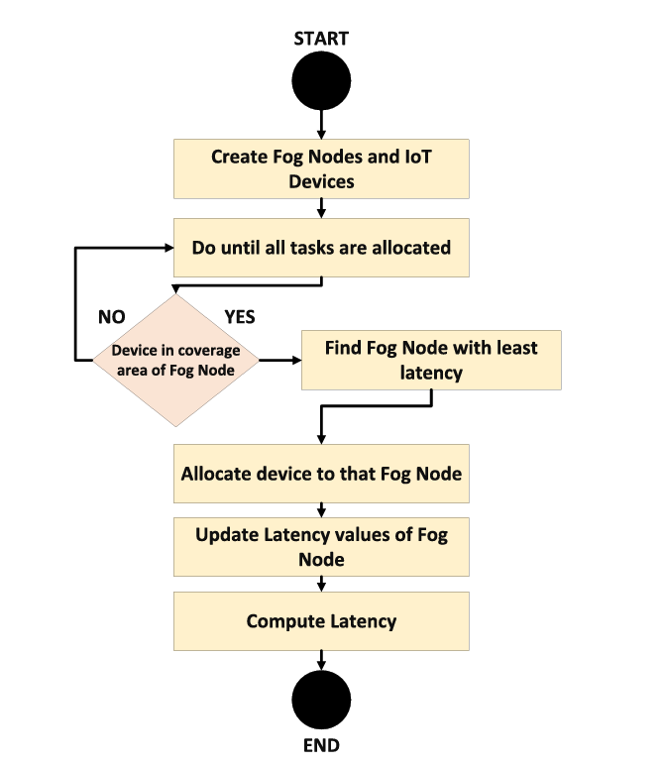

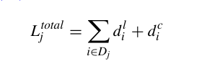
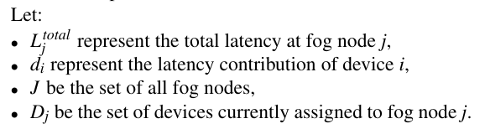
Optimized Load Balancing Algorithm

Slide 4
Review 1 Feedback
Review 2 Updates / Improvements
Architecture diagram not finalized | Diagram updated and finalized, showing clear IoT, fog, and cloud layers, along with connections
Actuator placement unclear | Actuators (insulin pumps, alarms) explicitly placed in IoT layer for clarity and realistic modeling
Anomaly detection approach not finalized | Planned ML model for anomaly detection at fog layer to detect anomalies in real-time

Slide 5
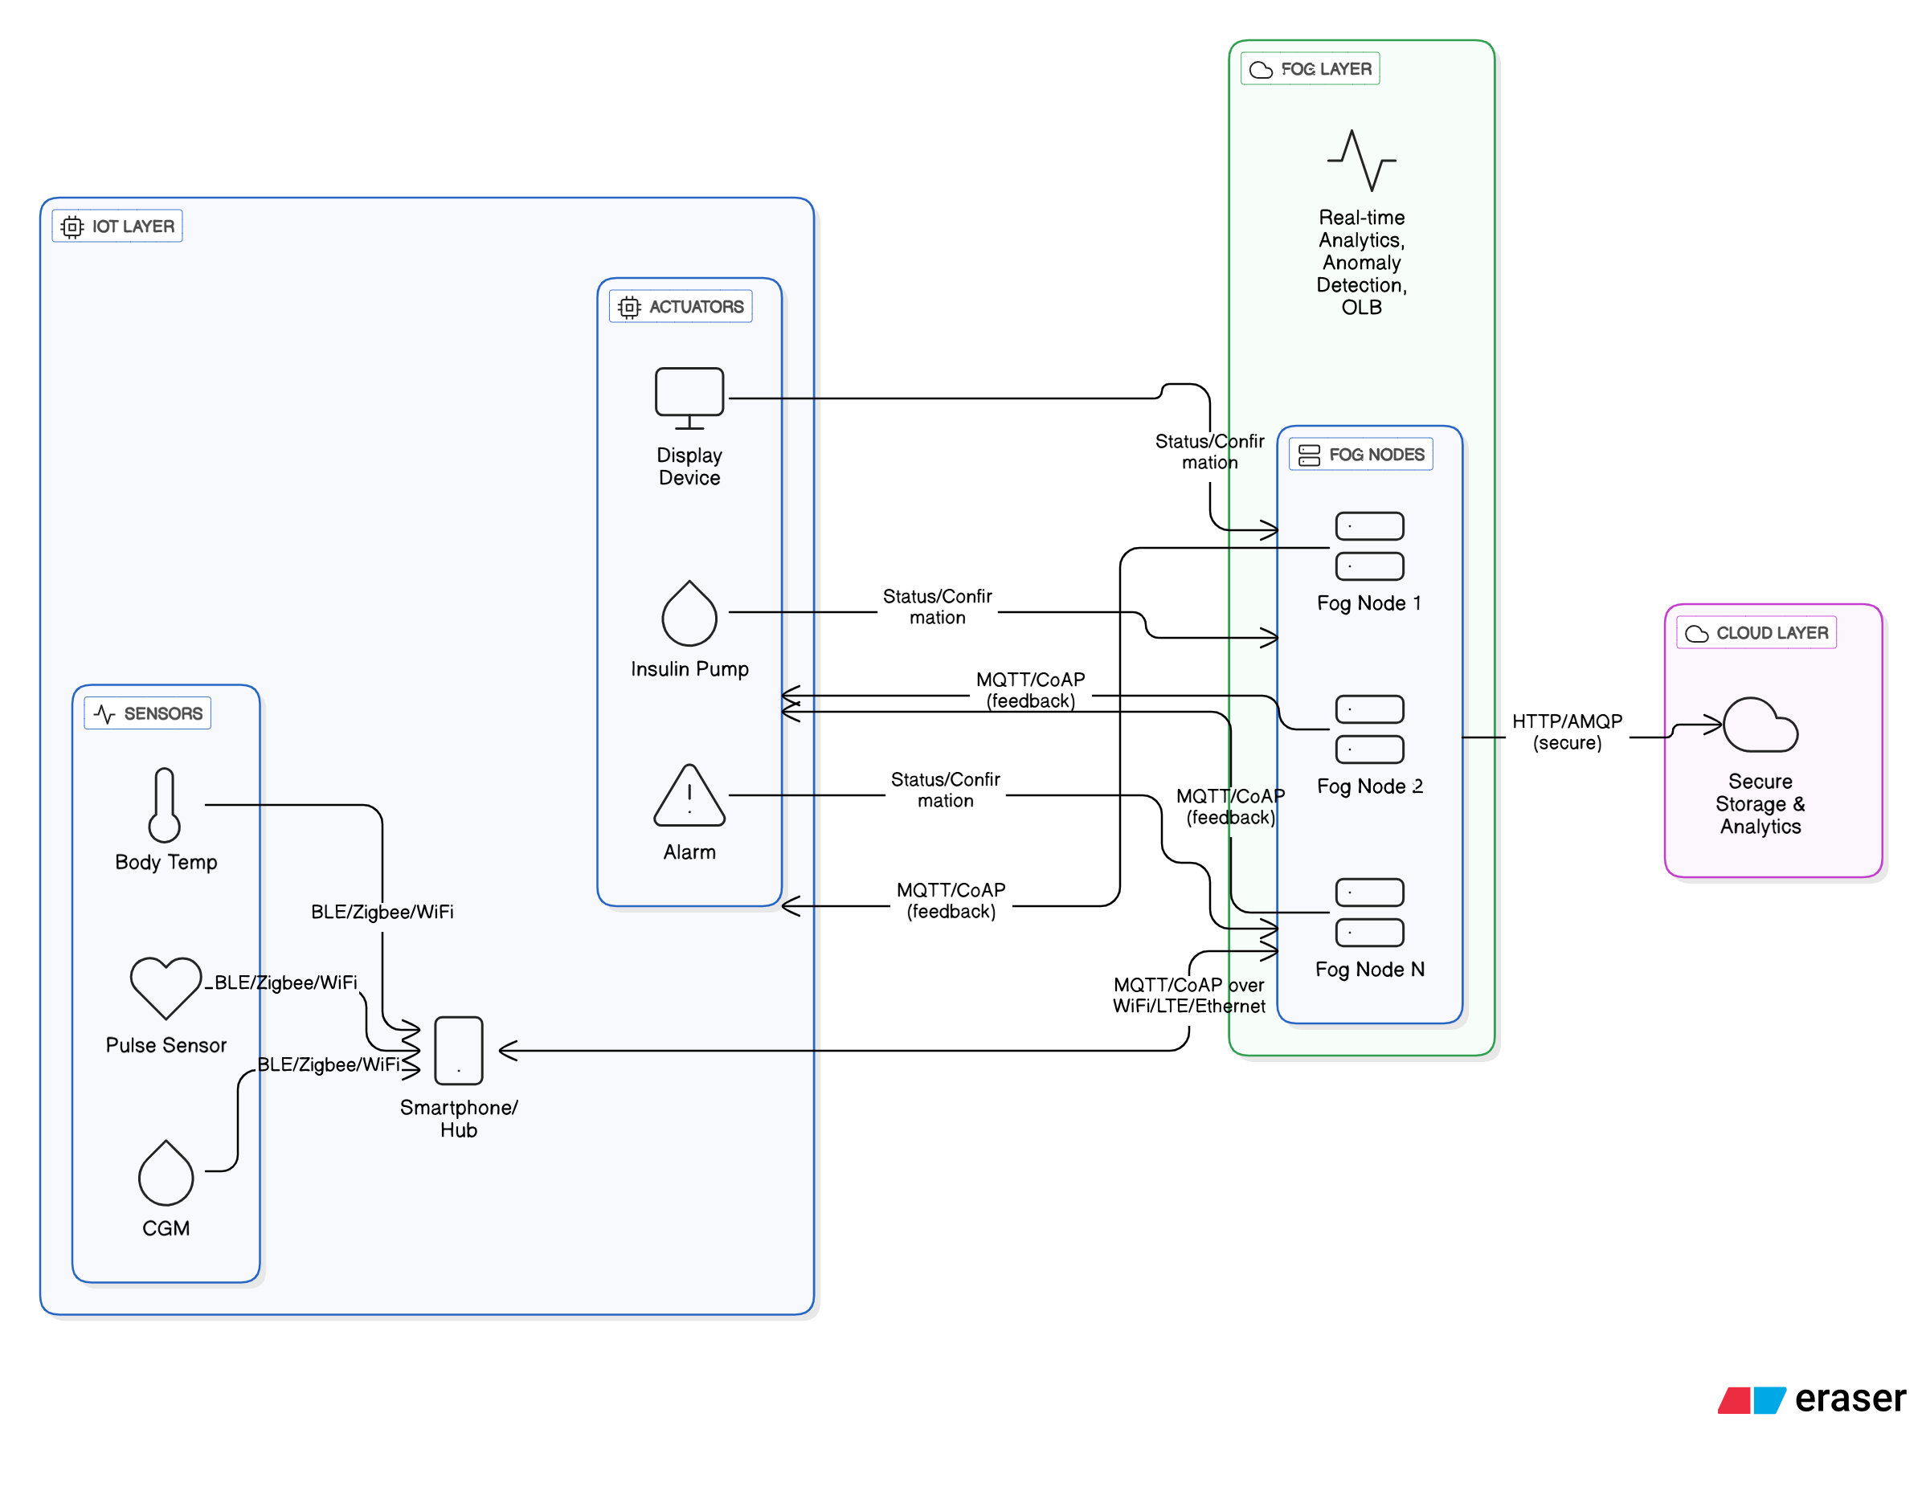
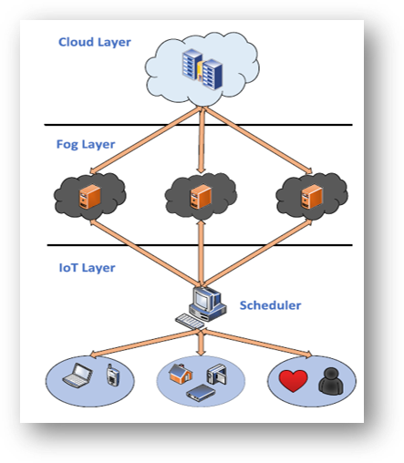
Architecture Design
Initial Architecture
Refined Architecture

Slide 6
Simulation Setup & Environment​
Objective:
Create a realistic digital twin environment and evaluate placement policies (Random, Distance, Load Balanced, OLB, FNPA) for healthcare IoT.
Components Configured :
Digital Twin Environment(Maps physical devices into simulation topology)
IoT Sensors: Generate healthcare data (location, transmission power, flow rate, workload).
Fog Nodes: Provide processing power, bandwidth, and storage capacity.
Cloud Node: High-capacity storage and computation for backup processing.
Application Architecture (YAFS Integration)
Client Modules (Source) → receive sensor data.
Processing Modules (Fog Layer) → execute tasks with OLB.
Storage Module → store results.
SIMULATION TOOL : YAFS​

Slide 7
Placement Policies tested :
Random | Distance-based | Load Balanced | OLB | FNPA.
Configuration Parameters
Number of sensors: 10
Number of fog nodes: 6
Simulation time: 1000 units
Execution Flow
Initialize digital twin environment.
Build YAFS topology (IoT → Fog → Cloud).
Deploy modules and apply placement policy.
Run YAFS simulation.
Collect performance metrics (latency, load balance, energy, execution cost).
Compare results across policies.
Environment Setup
Algorithm Execution
Results
Visualization Generation
Metrics Collection

Slide 8
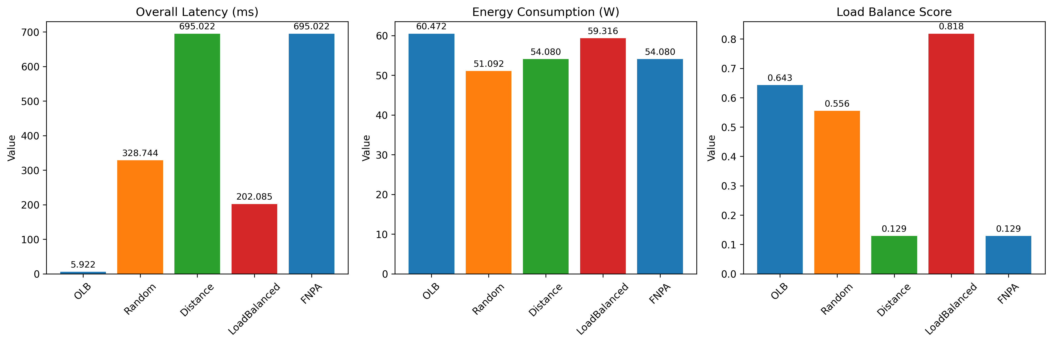
Simulation Results and Metrics

Slide 9
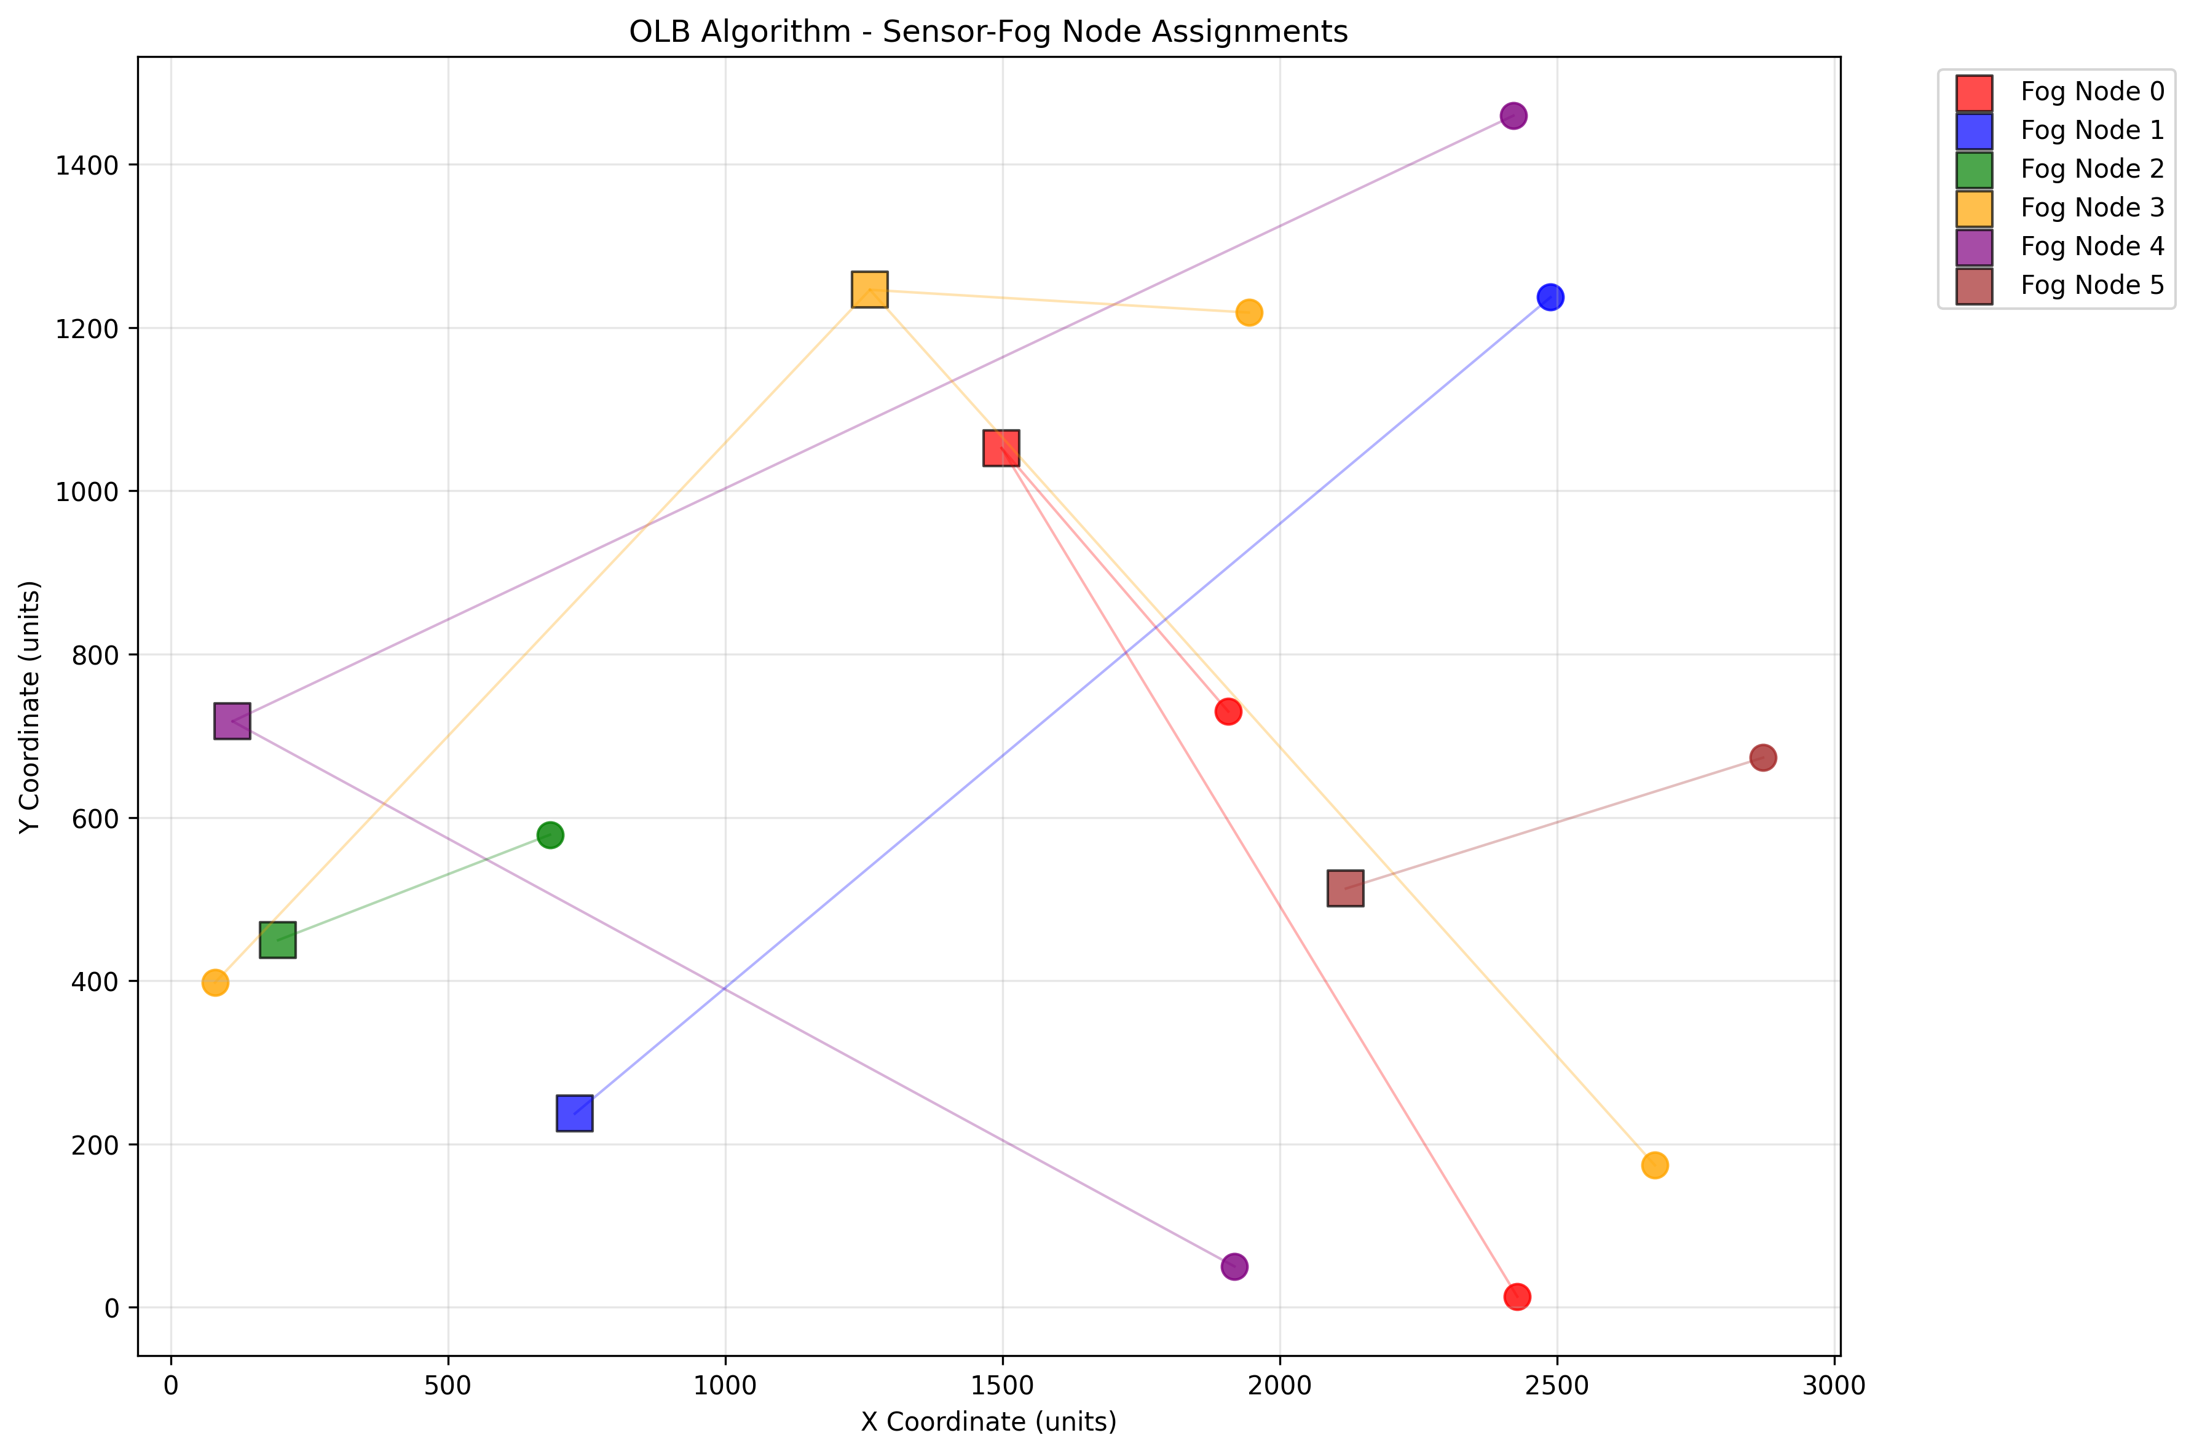
OLB Placement: Sensor Assignments to Fog Nodes

Slide 10
CGM (Continuous Glucose Monitoring)
The aim is to predict the risk Hypoglycemia of values of the patients using simple Logistic Regression with the help of MiniRocket for extracting and featuring the time series data.
Input Parameters (Features)
From the CGM (Continuous Glucose Monitoring) data, we derive features like:
Recent Glucose Values
Last n readings before prediction window (e.g., past 30–60 minutes).
Captures immediate trend.
Glucose Variability
Standard deviation or variance of recent values.
High fluctuations → higher hypoglycemia risk.
Glucose Slope / Trend
Rate of change of glucose (upward/downward).
Rapid downward slope indicates possible hypoglycemia.
Time-based Features
Time of day (meals, sleep cycles influence glucose).
Day of week (weekend vs weekday routines).
Event-based Context (optional)
Insulin intake, meals, exercise (if available).
Output
Prediction Label:
0 → Low Risk (safe)
1 → High Risk (likely hypoglycemia event)
Prediction Horizon: Next 2–4 hours risk estimation.

Slide 11
CGM (Continuous Glucose Monitoring)
Why Logistic Regression
Binary Outcome Match → Task is to classify patients into High Risk (1) or Low Risk (0) for hypoglycemia. Logistic regression is naturally designed for binary classification.
Interpretability → Coefficients show how each feature (trend, variability, time) affects risk. Easy for doctors/clinicians to understand and trust.
Probabilistic Output → Provides not just a label, but also a probability score (e.g., 70% chance of hypoglycemia). Useful for medical decision support.
Lightweight & Fast → Very efficient to train and run in real-time monitoring systems (wearables, hospital dashboards).
Good with Limited Data → Works well even when dataset size is smaller, unlike deep learning models which need huge datasets.
Strong Baseline → Establishes a reliable baseline before moving to more complex models (Random Forests, LSTMs, etc.).

Slide 12
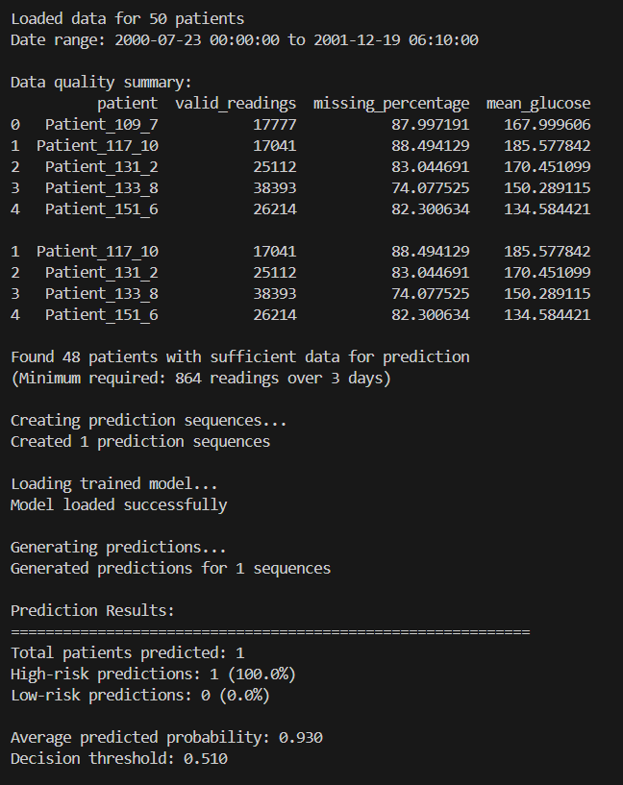
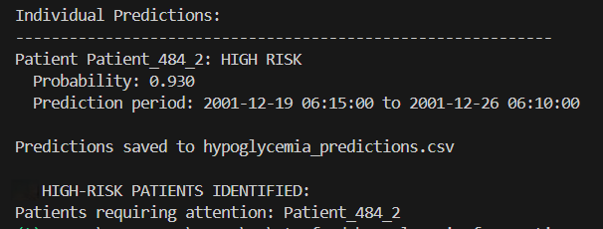
CGM
Output(PREDICTION) - Predicted for 50 Patients
(Continuous Glucose Monitoring )

Slide 13
Workload Prediction
The Aim is to Predict the future Fog node traffic to optimally assign workload to nodes based on their past behavior (learned using LSTM)
Inputs to the Model
Historical data features (per node):
•Load Average
•CPU User Usage
•CPU System Usage
•Available Memory
Sequence length: Number of past time steps used (e.g., 50)
Scaler: Normalized feature values using MinMaxScaler
Outputs from the Model
Predicted future workload for "n" future
steps
Statistics:
•Average of last historical points
•Predicted average
•Predicted min & max

Slide 14
Workload Prediction
The Aim is to Predict the future Fog node traffic to optimally assign workload to nodes based on their past behavior (learned using LSTM)
Why LSTM is Best for Workload Prediction
Handles Time Series Data Naturally
Remembers Long-Term Dependencies
Avoids Vanishing/Exploding Gradient Problems
Flexible Sequence Length Input
Accurate Future Forecasting

Slide 15

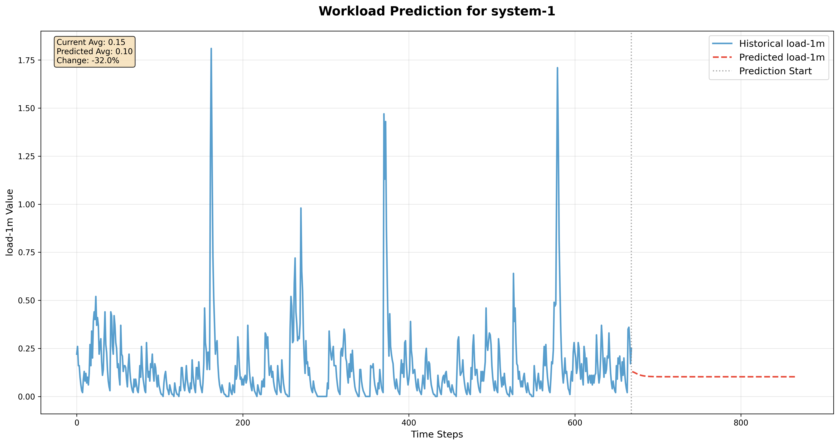
Workload Prediction
Predicted for 6 Nodes

Slide 16
Follow Up Tasks (Review– 3) Implement connectivity protocols in simulation:
Device → Gateway: Bluetooth Low Energy (BLE), Zigbee, WiFi.
Gateway → Fog: WiFi or LTE/4G.
Implement data protocols for secure, efficient transmission:
MQTT or CoAP for IoT-to-Fog communication (lightweight, low-latency).
HTTP/AMQP for Fog-to-Cloud uploads (secure, high-volume).
Add feedback/control loop simulation:
Fog detects anomalies in real-time.
Immediate actuation via MQTT/CoAP (e.g., insulin pump).
Confirmation/status returned from actuator → fog.
CI Integration :
CGM anomaly detection: Logistic Regression + MiniRocket.
Workload prediction: LSTM for fog node load forecasting.

