Slide 1
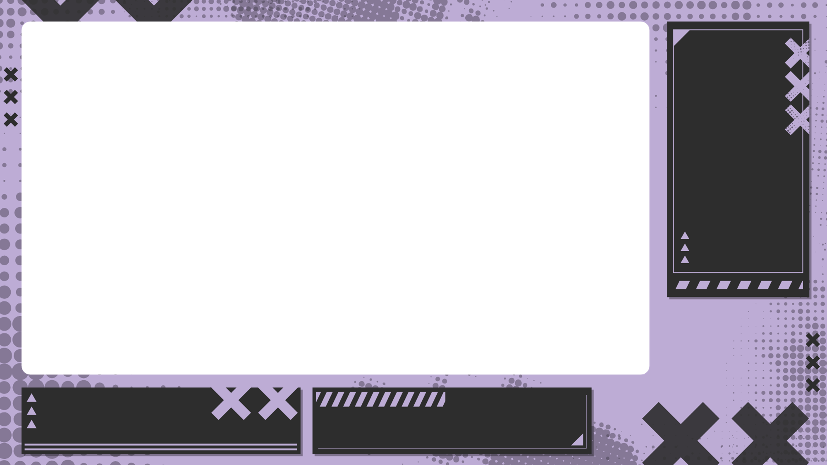
自我介紹

Slide 2
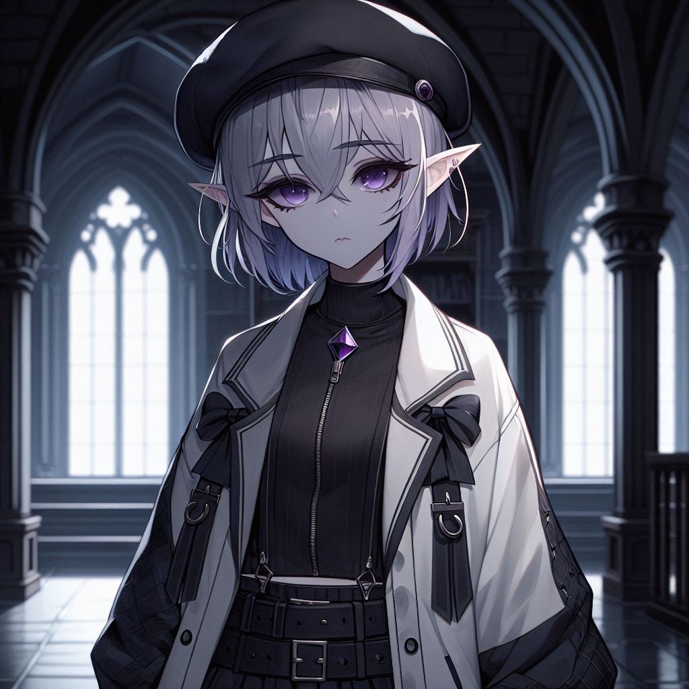
目標
Notes:
A young anime-style girl with gray skin and short silver-gray hair, with two longer strands of hair hanging down to her chest. Her bangs partially cover one of her deep purple eyes, with no light spots in the pupils, creating an intense and mysterious gaze. She has elf-like ears. There is a purple gem on her chest. Her overall appearance exudes a melancholic and mysterious aura. She is wearing black Gothic-style clothes, with an oversized white sports coat, the zipper of the coat is only half-zipped, and she is wearing a black beret with ribbon decorations. She stands quietly in a dark corner of a grand and luxurious mansion, surrounded by Gothic architecture. The style should be more like a comic character, not too realistic, and the art style should be darker.

Slide 3
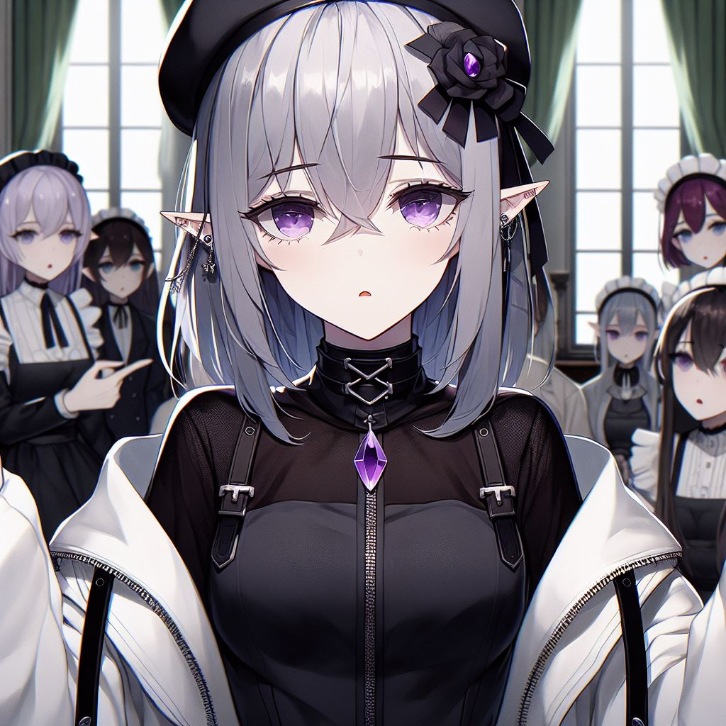
阻礙
Notes:
A young anime-style girl with gray skin and short silver-gray hair, with two longer strands of hair hanging down to her chest. Her bangs partially cover one of her deep purple eyes, with no light spots in the pupils, creating an intense and mysterious gaze. Her entire skin is gray, with no flesh color. She has elf-like ears. There is a purple gem on her chest. Her overall appearance exudes a melancholic and mysterious aura. She is wearing black Gothic-style clothes, with an oversized white sports coat, the zipper of the coat is only half-zipped, and she is wearing a black beret with ribbon decorations. She looks very sad. There are a few people who look like maids next to her, pointing at her and discussing something, and the background is in a Gothic-style mansion. The camera is zoomed out a bit, and the main character should be drawn at least to the waist. The style should be more like a comic character, not too realistic, and the art style should be darker.

Slide 4
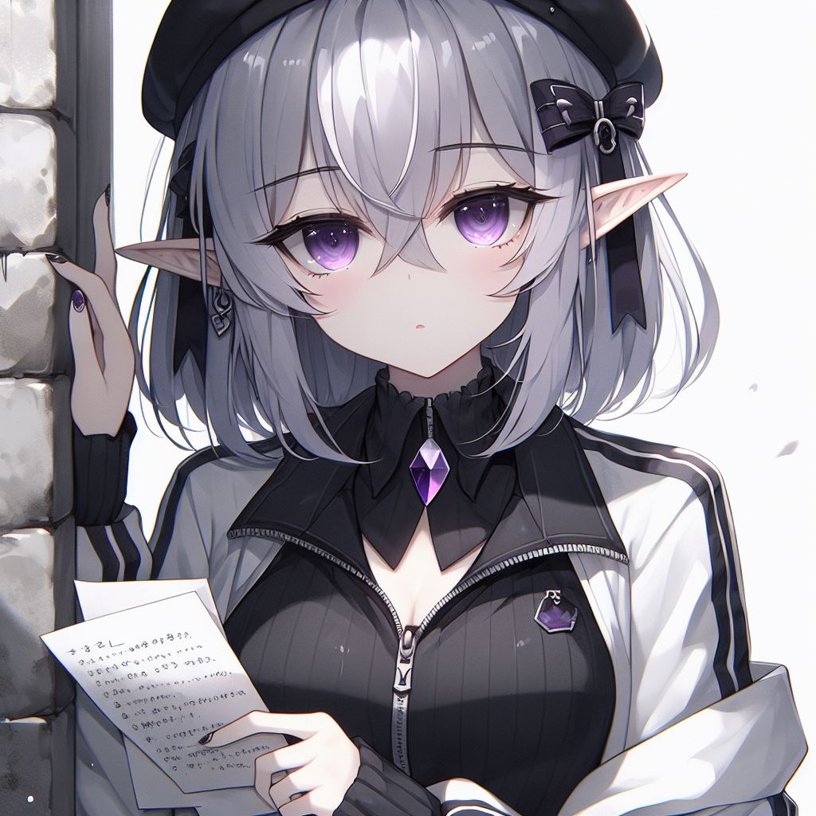
努力
Notes:
A young anime-style girl with gray skin and short silver-gray hair, with two longer strands of hair hanging down to her chest. Her bangs partially cover one of her deep purple eyes, with no light spots in the pupils, creating an intense and mysterious gaze. Her entire skin is gray, with no flesh color. She has elf-like ears. There is a purple gem on her chest. Her overall appearance exudes a melancholic and mysterious aura. She is wearing black Gothic-style clothes, with an oversized white sports coat, the zipper of the coat is only half-zipped, and she is wearing a black beret with ribbon decorations. She is hiding behind a stone wall, holding a paper and pen, looking like she is recording something, with many papers in her hand. The style should be more like a comic character, not too realistic, and the art style should be darker.

Slide 5
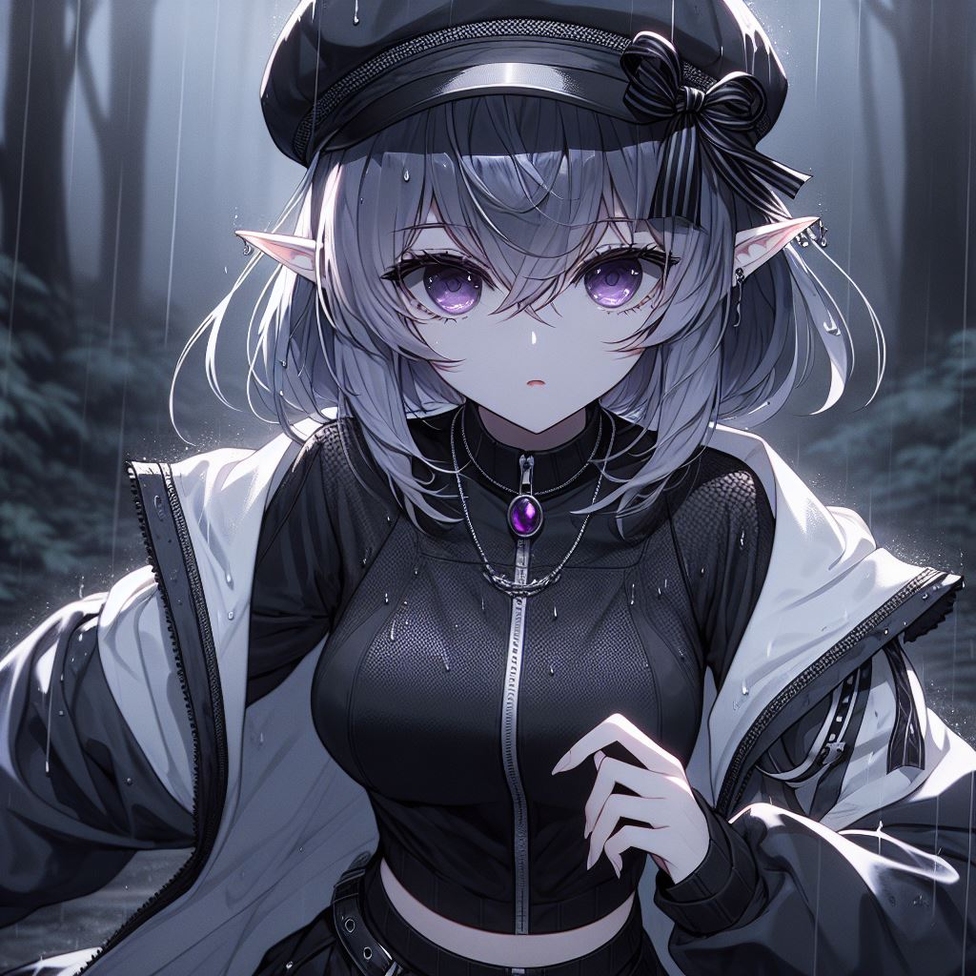
結果
Notes:
A young anime-style girl with a dark theme, gray skin, and silver-gray hair. The hair at the back of her head is short, with two strands much longer than the rest, hanging down to her chest. Her bangs cover one of her deep purple eyes, with no light spots in the pupils, creating an intense and mysterious gaze. Her entire skin is gray, with no flesh color. She has elf-like ears. There is a purple gem on her chest. Her overall appearance exudes a melancholic and mysterious aura. She is wearing black Gothic-style clothes and an oversized white sports jacket, with the zipper only halfway up, and a black beret with ribbon decorations. The background is a nighttime forest with rain, and the girl is running at full speed. The full body should be drawn, not just the upper body. Emphasize that she is wet and running. The style should not be too realistic, more like a manga character.

Slide 6
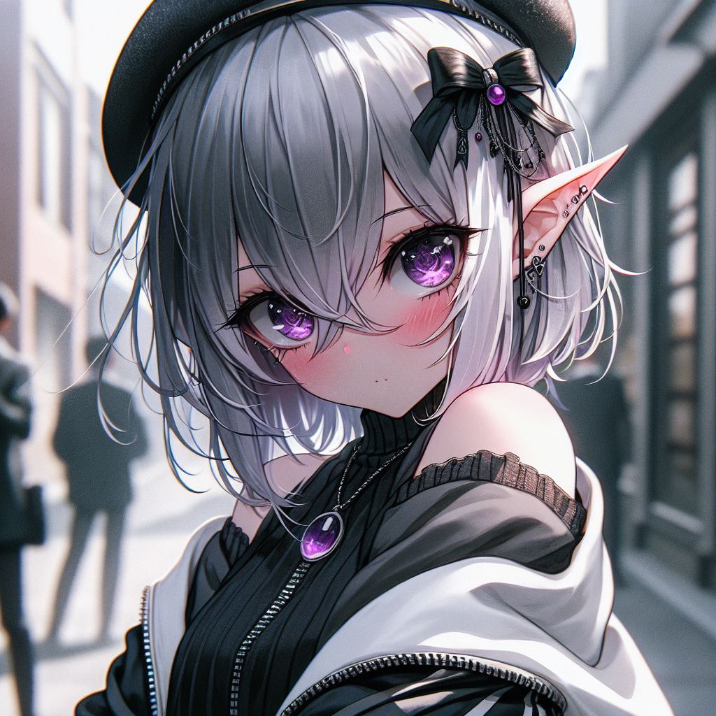
意外
Notes:
A young girl in a dark-themed Japanese anime style, with gray skin and silver-gray hair. The hair at the back of her head is short, with two strands much longer than the rest, hanging down to her chest. Her bangs cover one of her deep purple eyes, with no light spots in the pupils, creating an intense and mysterious gaze. Her entire skin is gray, with no flesh color. She has elf-like ears. There is a purple gem on her chest. Her overall appearance exudes a melancholic and mysterious aura. She is wearing black Gothic clothing and an oversized white sports jacket, with the zipper only halfway up, and a black beret with ribbon decorations. The background is on the street, showing the protagonist hiding from people, nervously turning her head to look back. The style should not be too realistic, more like a manga character.

Slide 7
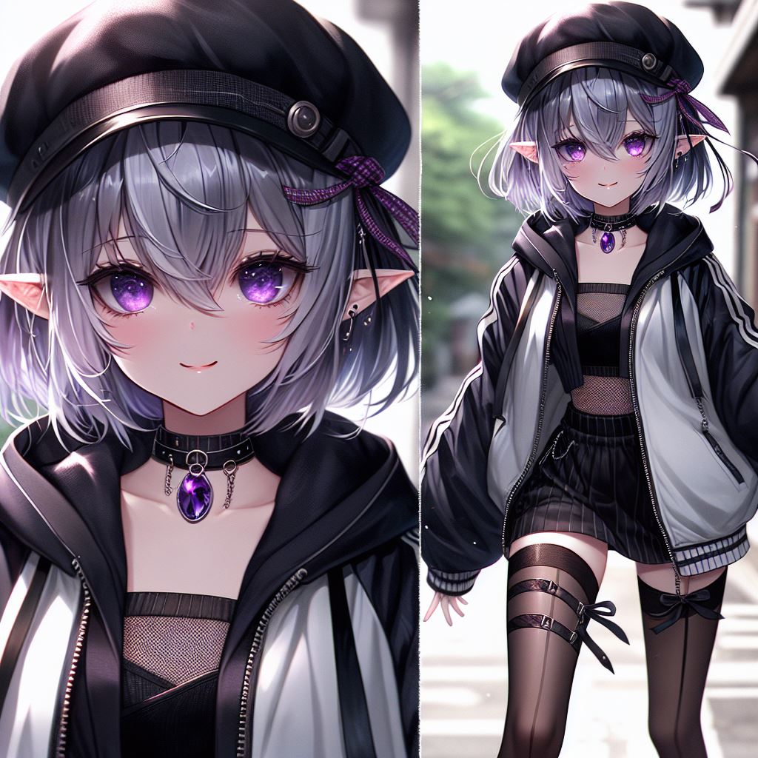
轉彎
Notes:
A young girl in a dark-themed Japanese anime style, with gray skin and silver-gray hair. The hair at the back of her head is short, with two strands much longer than the rest, hanging down to her chest. Her bangs cover one of her deep purple eyes, with no light spots in the pupils, creating an intense and mysterious gaze. Her entire skin is gray, with no flesh color. She has elf-like ears. There is a purple gem on her chest. Her overall appearance exudes a melancholic and mysterious aura. She is wearing black Gothic clothing and an oversized white sports jacket, with the zipper only halfway up, and a black beret with ribbon decorations. The background is on the street, showing the protagonist running with a smug expression. Emphasize the running on the street, draw a full-body picture, and show the feet running. The style should not be too realistic, more like a manga character.

Slide 8

結局
Notes:
A young girl in a dark-themed Japanese anime style, with gray skin and silver-gray hair. The hair at the back of her head is short, with two strands much longer than the rest, hanging down to her chest. Her bangs cover one of her deep purple eyes, with no light spots in the pupils, creating an intense and mysterious gaze. Her entire skin is gray, with no flesh color. She has elf-like ears. There is a purple gem on her chest. Her overall appearance exudes a melancholic and mysterious aura. She is wearing black Gothic clothing and a white oversized sports jacket, with the zipper only halfway up, and a black beret with ribbon decorations. The background is in a dark-themed room, with the protagonist's hands on the table (in a pose like an interviewer thinking, with both elbows on the table and fingers interlocked), smiling at the camera. The drawing should not be too realistic, more like a comic character.

