Slide 1

追尋自由

Slide 2
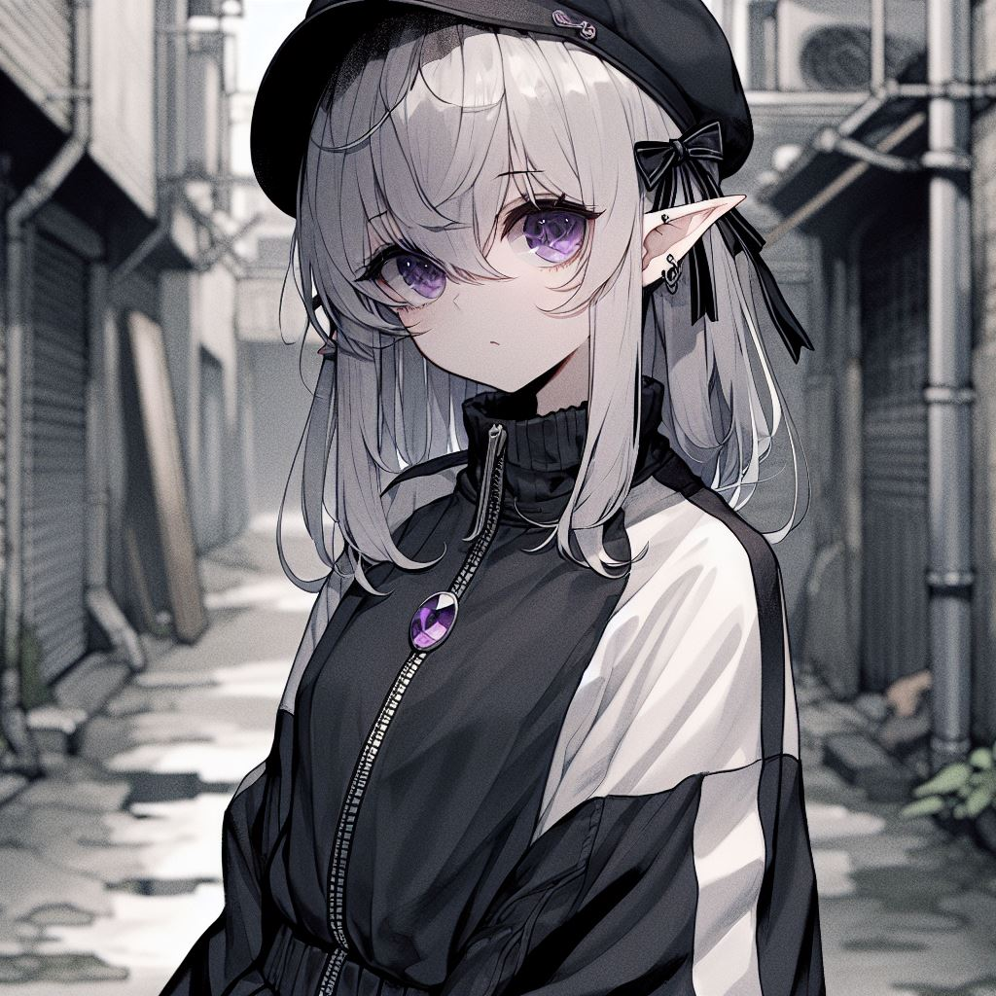
目標
Notes:
A young anime-style girl with a darker art style, gray skin, and silver-gray hair. The hair on the back of her head is short, with two strands much longer than the rest, hanging down to her chest. Her bangs cover one of her deep purple eyes, with no light spots in the pupils, creating an intense and mysterious gaze. Her entire skin is gray, with no flesh color. She has elf-like ears. She wears a purple gemstone on her chest. Her overall look exudes a melancholic and mysterious aura. She is dressed in black Gothic clothing with an oversized white sports jacket, half-zipped, and wears a black beret with ribbon decorations. The background is an alley, and she is looking back. The drawing should not be too realistic, more like a manga character.

Slide 3
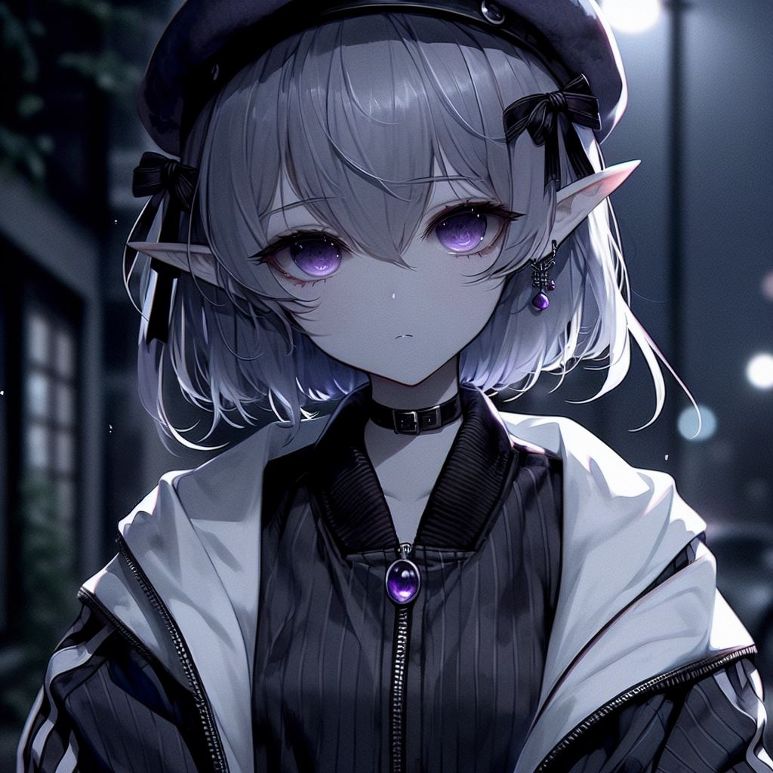
阻礙
Notes:
A young girl in Japanese anime style with a dark theme, gray skin, and silver-gray hair. The hair at the back of her head is short, with two strands much longer than the rest, hanging down to her chest. Her bangs cover one of her deep purple eyes, with no light in the pupils, creating an intense and mysterious gaze. Her entire skin is gray, with no flesh color. She has elf-like ears. There is a purple gem on her chest. Her overall appearance exudes a melancholic and mysterious aura. She is wearing black Gothic clothing and a white oversized sports jacket, with the zipper only halfway up, and a black beret with ribbon decorations. The background is nighttime, showing the girl's side face, meaning not to show the front of her face, with her looking to the left, walking on the street. The style should not be too realistic, more like a comic character.

Slide 4
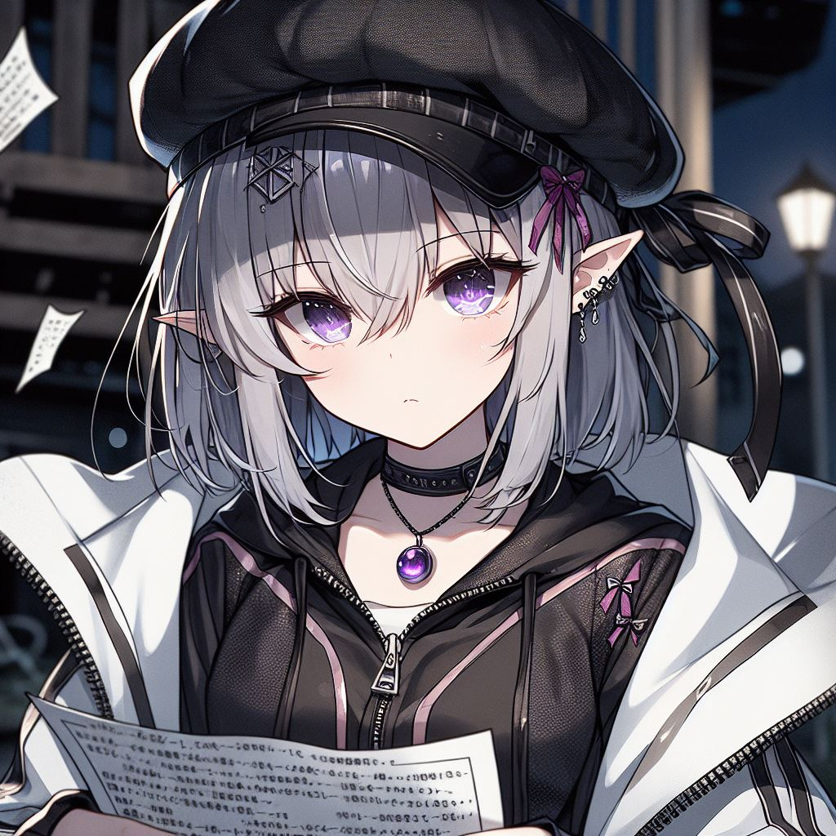
努力
Notes:
A young girl in Japanese anime style with a dark theme, gray skin, and silver-gray hair. The hair at the back of her head is short, with two strands much longer than the rest, hanging down to her chest. Her bangs cover one of her deep purple eyes, with no light in the pupils, creating an intense and mysterious gaze. Her entire skin is gray, with no flesh color. She has elf-like ears. There is a purple gem on her chest. Her overall appearance exudes a melancholic and mysterious aura. She is wearing black Gothic clothing and a white oversized sports jacket, with the zipper only halfway up, and a black beret with ribbon decorations. The background is a nighttime street, she is holding many papers with words on them, like a plan, and she is looking at the things in her hands seriously, emphasizing that she is looking at the papers in her hands. The style should not be too realistic, more like a comic character.

Slide 5
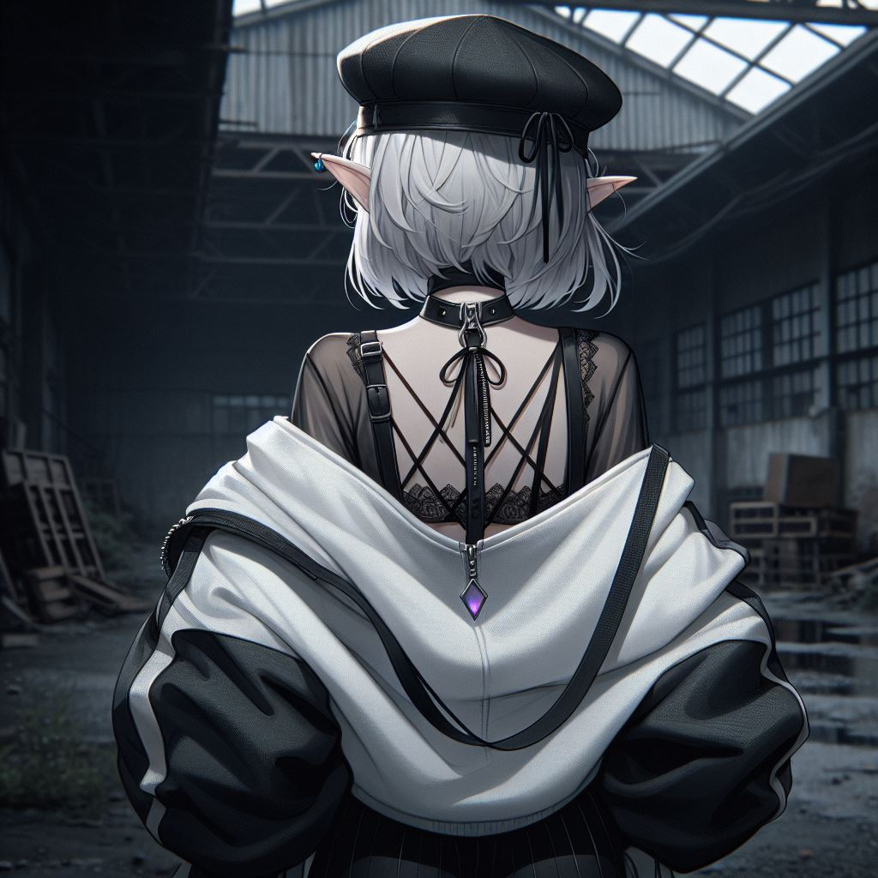
結果
Notes:
A young girl in Japanese anime style with a dark theme, gray skin, and silver-gray hair. The hair at the back of her head is short. Her entire skin is gray, with no flesh color. She has elf-like ears. There is a purple gem on her chest. Her overall appearance exudes a melancholic and mysterious aura. She is wearing black Gothic clothing and a white oversized sports jacket, with the zipper only halfway up, and a black beret with ribbon decorations. The background is an abandoned warehouse in the middle of the scene, and the girl is looking at the warehouse. The style should not be too realistic, more like a comic character. Only show the back of the girl, no front view, and she does not need to turn her head, no face should be visible.

Slide 6
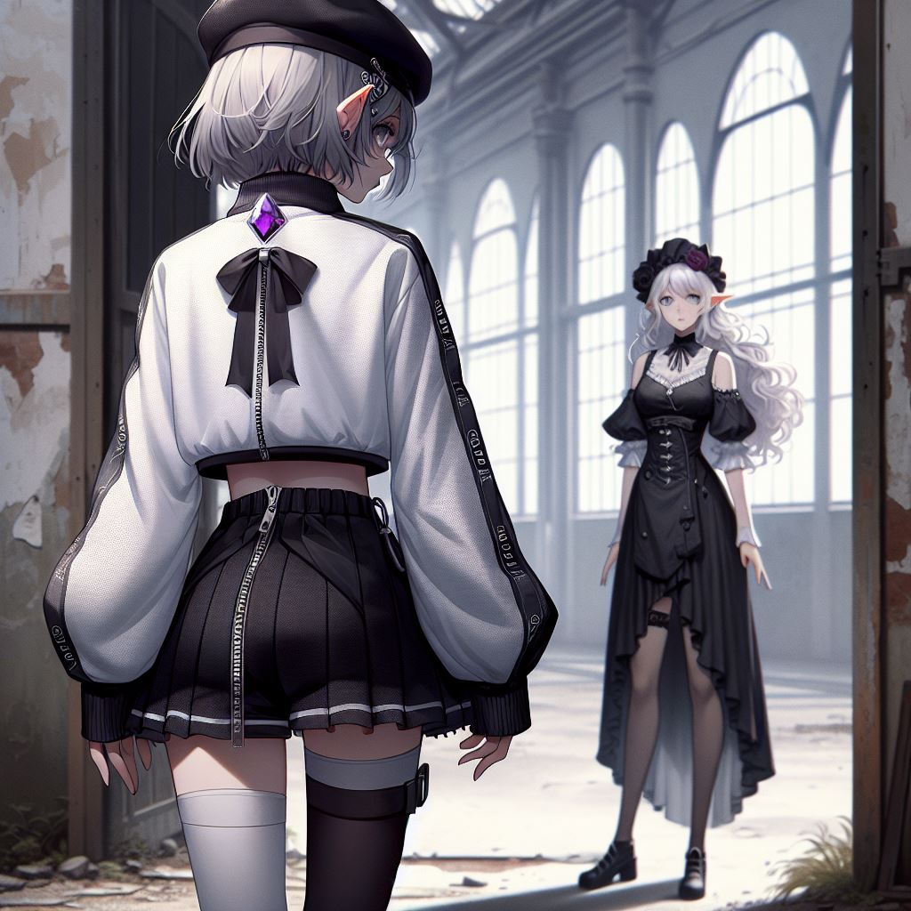
意外
Notes:
In an abandoned warehouse, there are two characters. One is a young girl with a dark theme, gray skin, and silver-gray hair. The hair at the back of her head is short. Her entire skin is gray, with no flesh color. She has elf-like ears. There is a purple gem on her chest. Her overall appearance exudes a melancholic and mysterious aura. She is wearing black Gothic clothing and a white oversized sports jacket, with the zipper only halfway up, and a black beret with ribbon decorations. She is facing away from us, showing only her back. Outside the warehouse stands a mature beautiful human woman with long white curly hair, wearing a modern black dress with a high-low hemline that reveals her legs, long socks, and a big black hat with red rose decorations, looking at the young girl. The style should not be too realistic, more like a comic character.

Slide 7
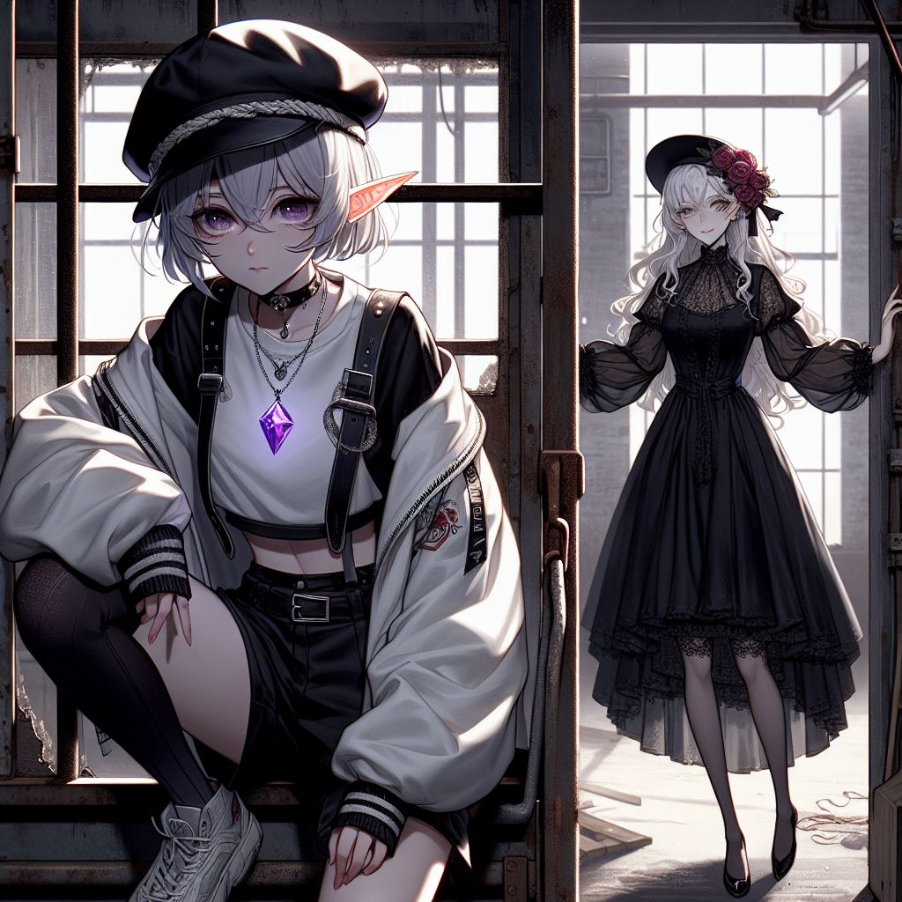
轉彎
Notes:
In an abandoned warehouse, there are two characters. One is a young girl with a dark theme, gray skin, and silver-gray hair. The hair at the back of her head is short. Her entire skin is gray, with no flesh color. She has elf-like ears. There is a purple gem on her chest. Her overall appearance exudes a melancholic and mysterious aura. She is wearing black Gothic clothing and a white oversized sports jacket, with the zipper only halfway up, and a black beret with ribbon decorations. She is climbing out of the warehouse window, facing forward, but turning her head to look at the long-haired woman. Outside the warehouse stands a mature beautiful human woman with long white curly hair, wearing a modern black dress with a high-low hemline that reveals her legs, long socks, and a big black hat with red rose decorations, standing at the main entrance, looking at the young girl. The style should not be too realistic, more like a Japanese comic character, and the distance between the two girls should be greater.

Slide 8
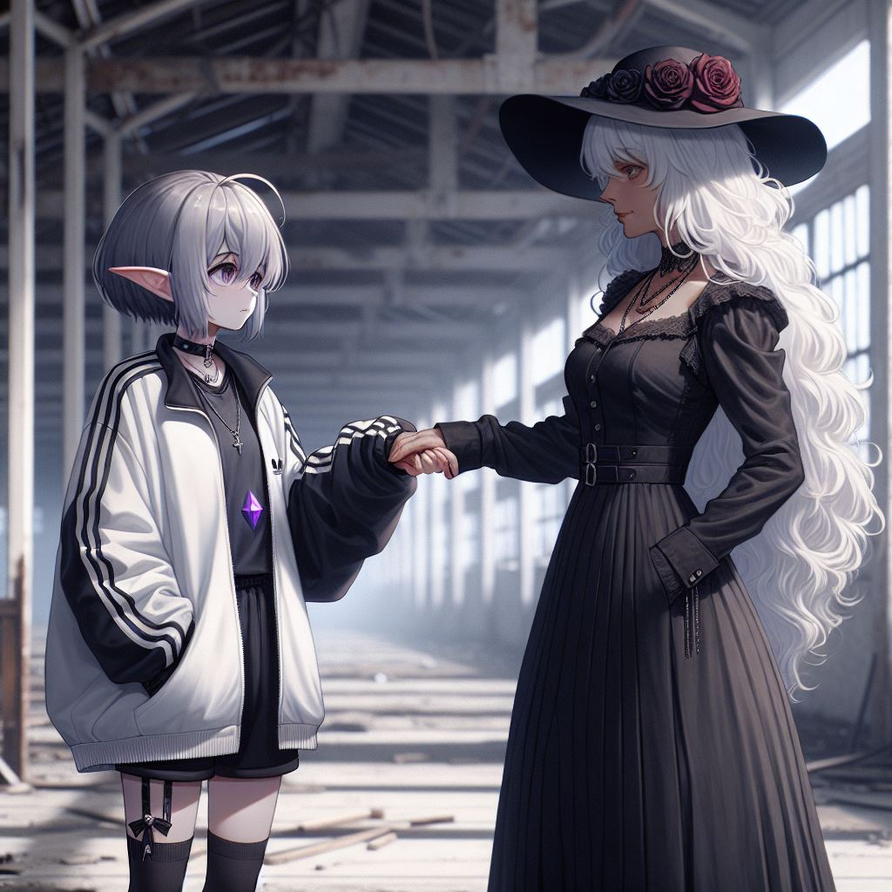
結局
Notes:
In an abandoned warehouse, there are two characters. One is a young girl with a dark theme, gray skin, and silver-gray hair. The hair at the back of her head is short. Her entire skin is gray, with no flesh color. She has elf-like ears. There is a purple gem on her chest. Her overall appearance exudes a melancholic and mysterious aura. She is wearing black Gothic clothing and a white oversized sports jacket, with the zipper only halfway up, and a black beret with ribbon decorations. She is shaking hands with the long-haired woman, and the angle of the image should be from their side. The young girl is shorter and younger than the long-haired woman. Outside the warehouse stands a mature beautiful human woman with long white curly hair, wearing a modern black dress with a high-low hemline that reveals her legs, long socks, and a big black hat with red rose decorations, looking at the young girl. The style should be more like a Japanese comic character, and the distance between the two girls should be greater. The long-haired woman should be taller and more mature, and the short-haired girl should have a black beret, while the long-haired woman should have a big hat.

