Slide 1


SALES
PROJECT
Example
Tetiana Kyrychenko

Slide 2





GOALS AND OBJECT
Object
GOAL n° 1
GOAL n° 2
IT product sales
Calculate sales dynamics by city and project type. Calculate project ranks, create an infographic by city with the possibility of highlighting specific indicators.
Calculate the share of profit from each project, taking into account the work of managers and motivation.

Slide 3

Metrics and input data
01
PRODUCT DATA
02
CUSTOMER DATA
03
PROJECT DATA (TIMELINE, BUDGET)
04
MANAGER DATA

Slide 4
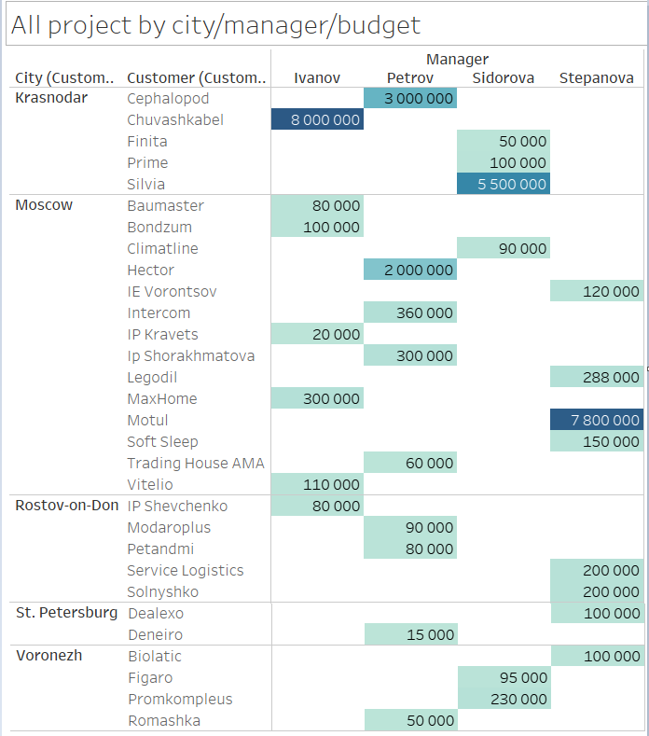
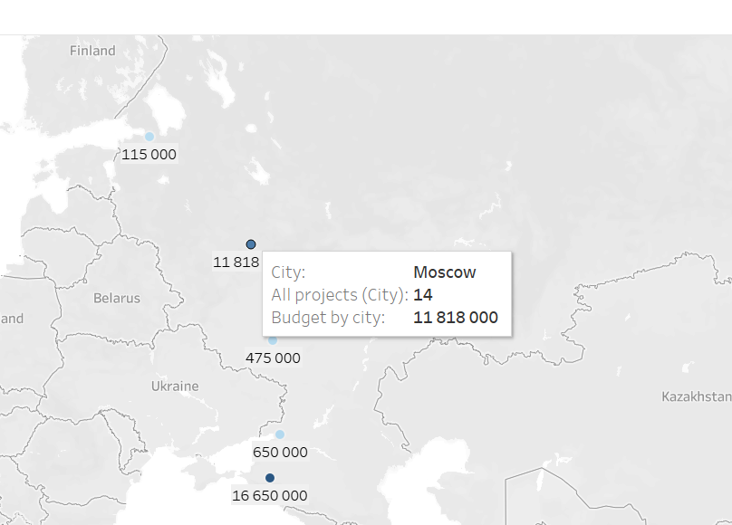
Result and infographics

Slide 5
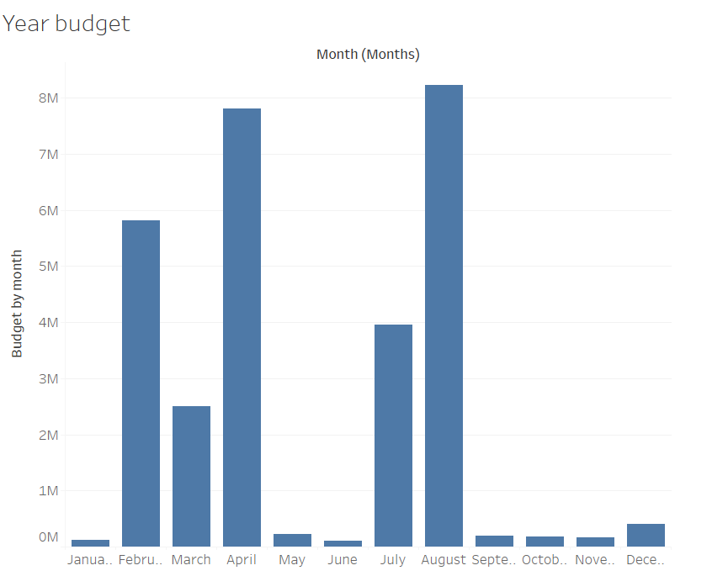
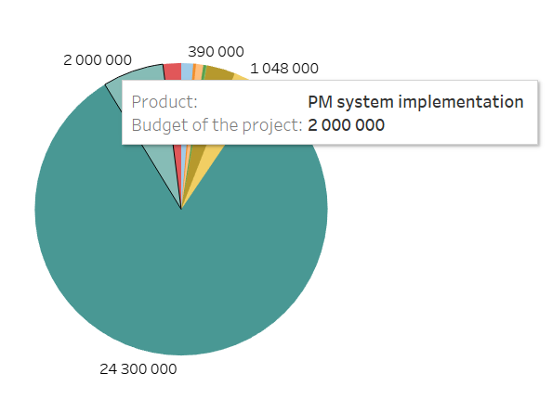
Result and infographics

Slide 6
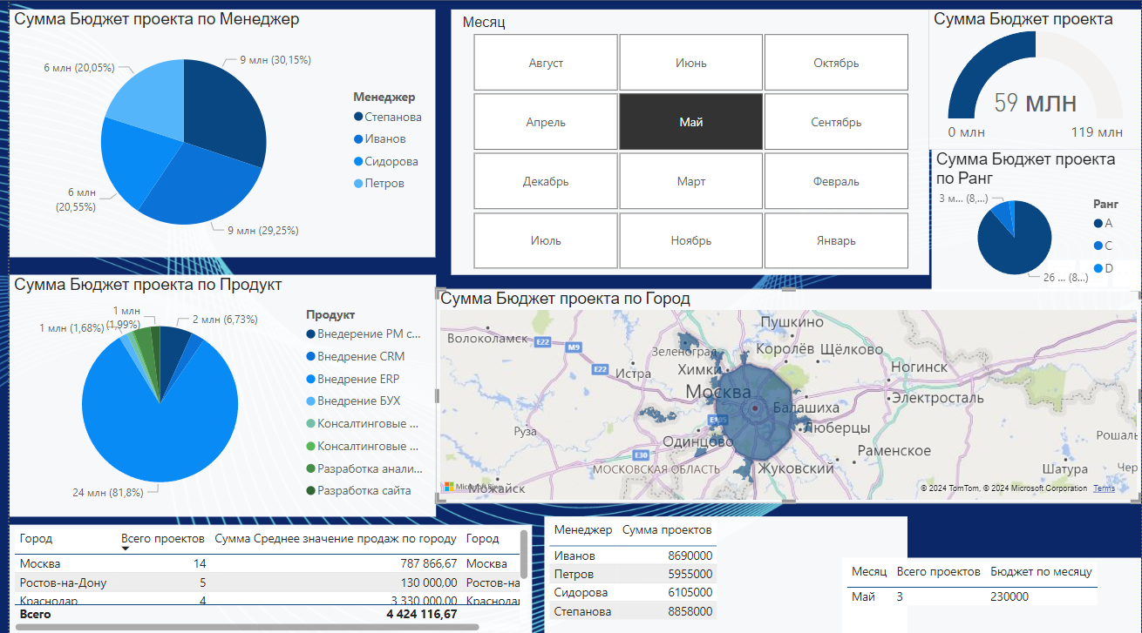
Result and infographics
Budget and managers
Project type ranking
Cartography and selection by city and month

Slide 7
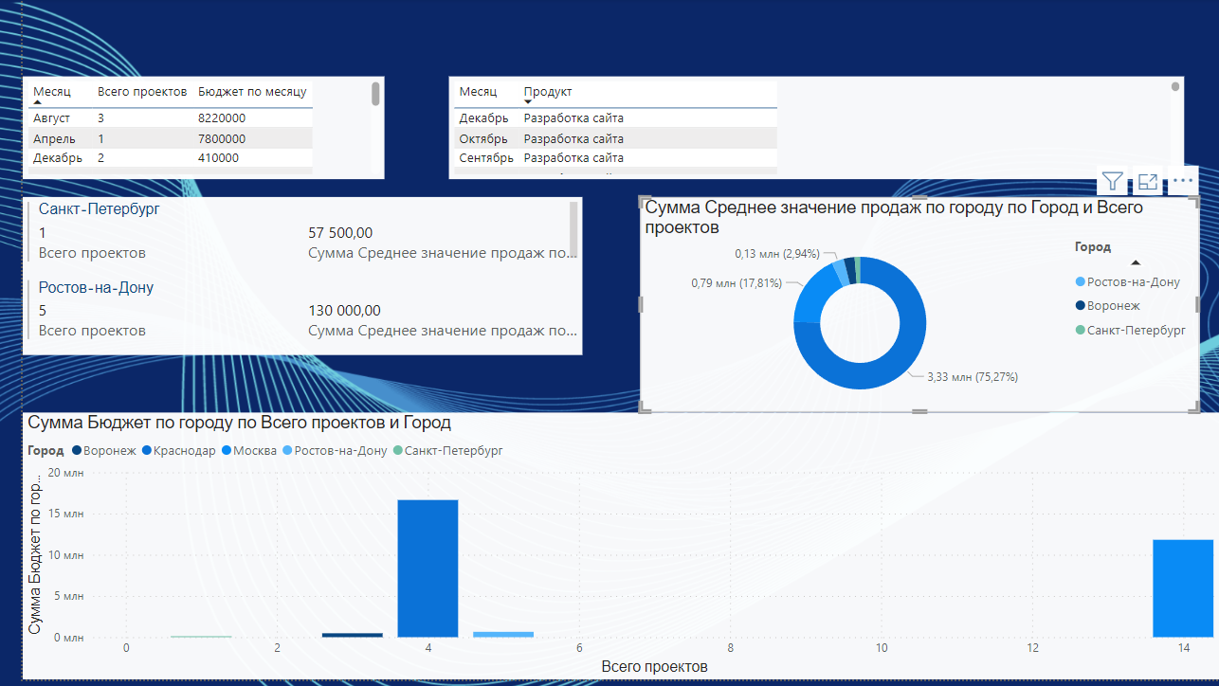
Result and infographics
Selection about the work of offices in cities: number of projects, type of project, project budget, calendar and percentage contribution to income

