Slide 1


IT project management
PROJECT
Example
Tetiana Kyrychenko

Slide 2





GOALS AND OBJECT
Object
GOAL n° 1
GOAL n° 2
Digital project management processes
Calculate the budget of the project, and the costs for each phase. Highlight real data, not planned, but actual hours spent on the project.
Analyze the share of participants' involvement both in the project and in specific steps. To provide the ability to track KPIs in real time.

Slide 3

Metrics and input data
01
PROJECT DATA (Gantt chart + testing)
02
TEAM PROJECT DATA (hour estimate, roles, responsible persons, deadlines )
03
PROJECT TEAM MAN-HOUR DATA
04
PROJECT RESULTS AND HIGHLIGHTS
05
KEY INDICATORS

Slide 4
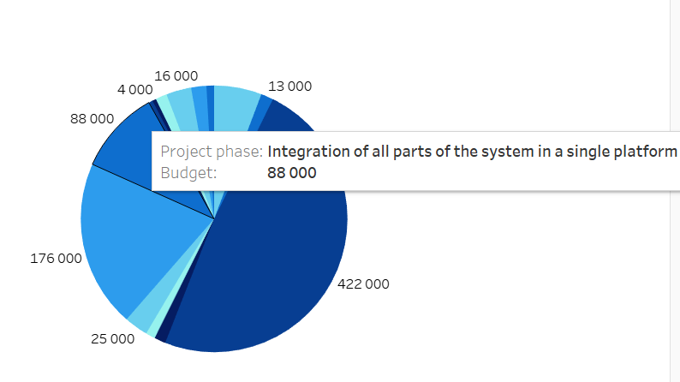
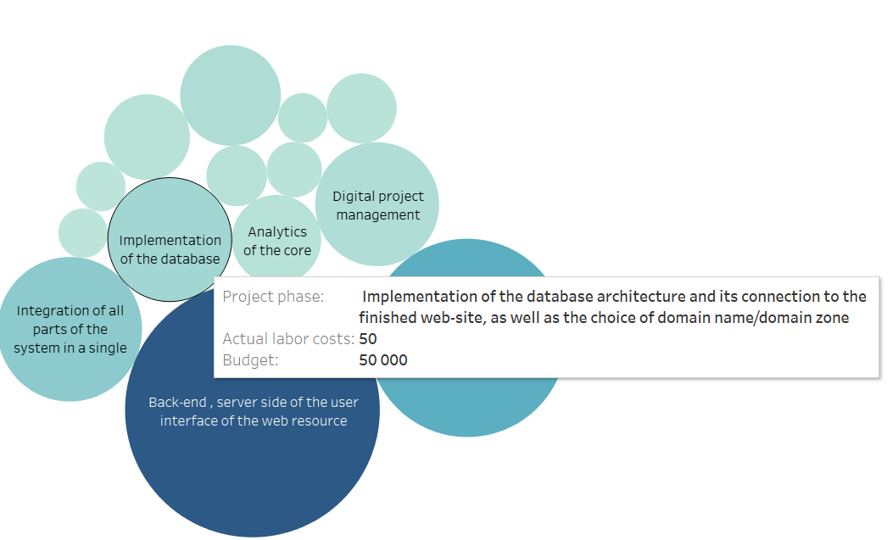
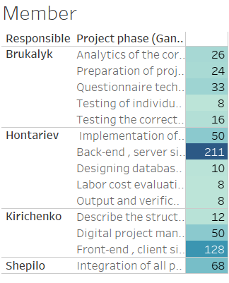
Result and infographics

Slide 5
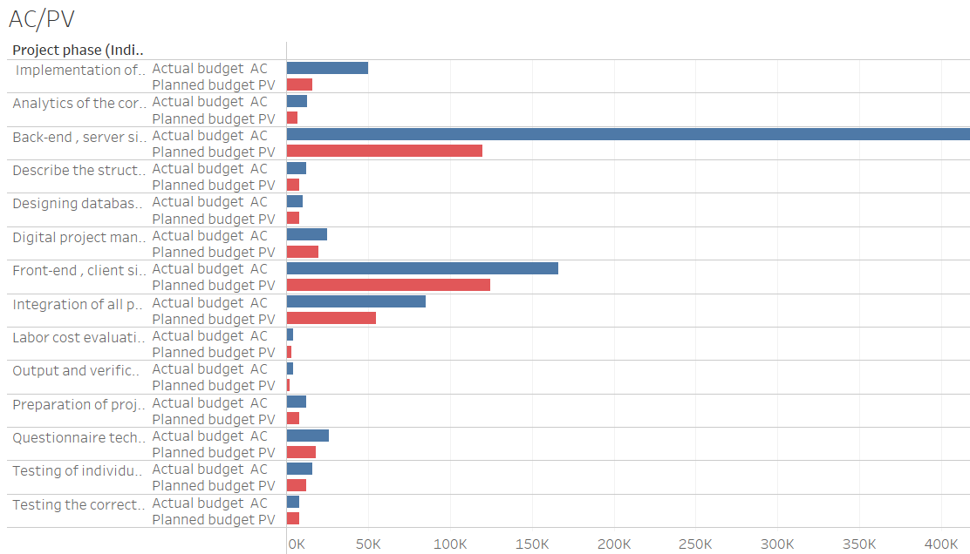
Result and infographics

Slide 6
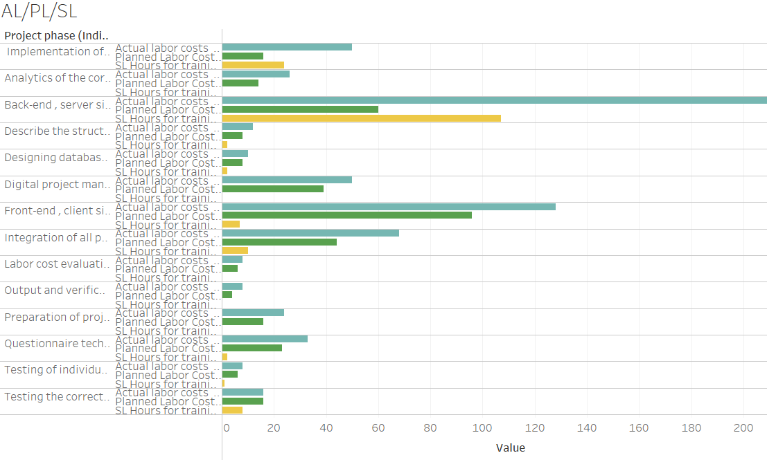
Result and infographics

Slide 7
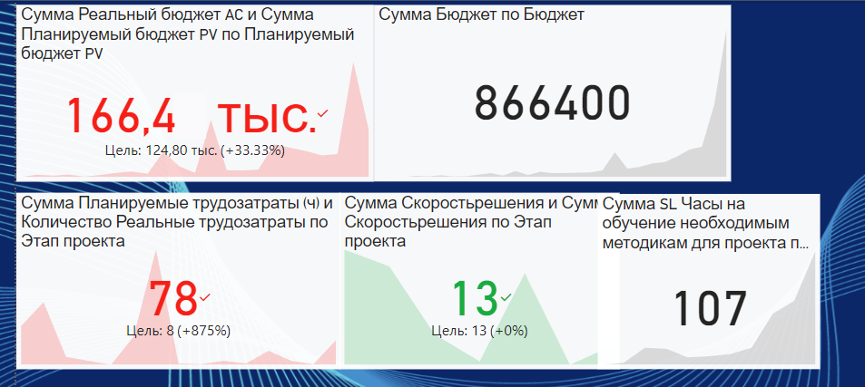
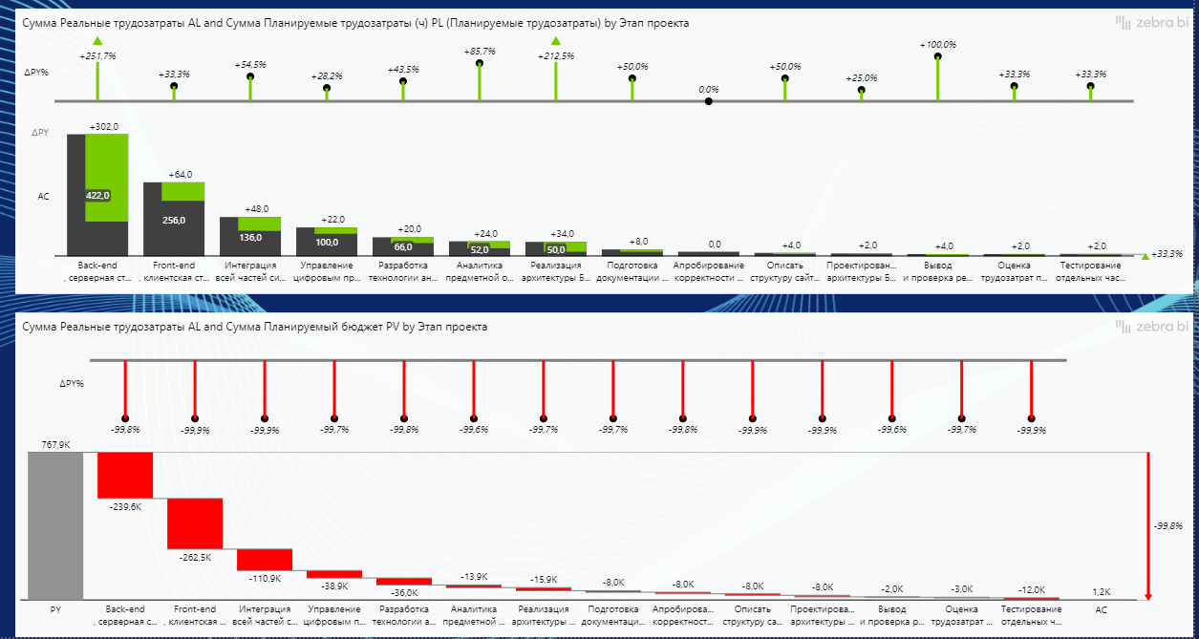
Result and infographics
Tracking deviations in budget, timelines, hours per project

Slide 8
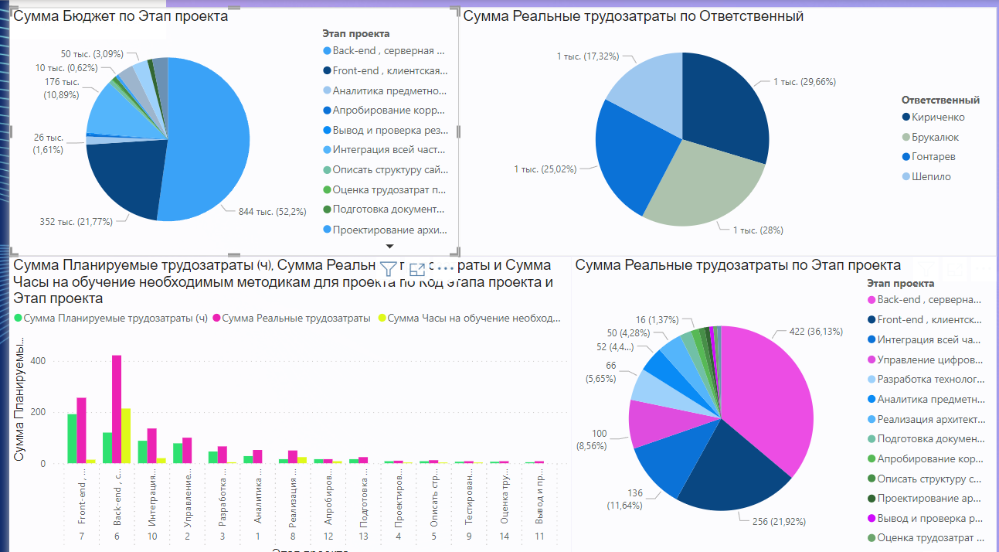
Result and infographics
Budget and project phases
Team labor costs
Labor costs for project phases

Slide 9
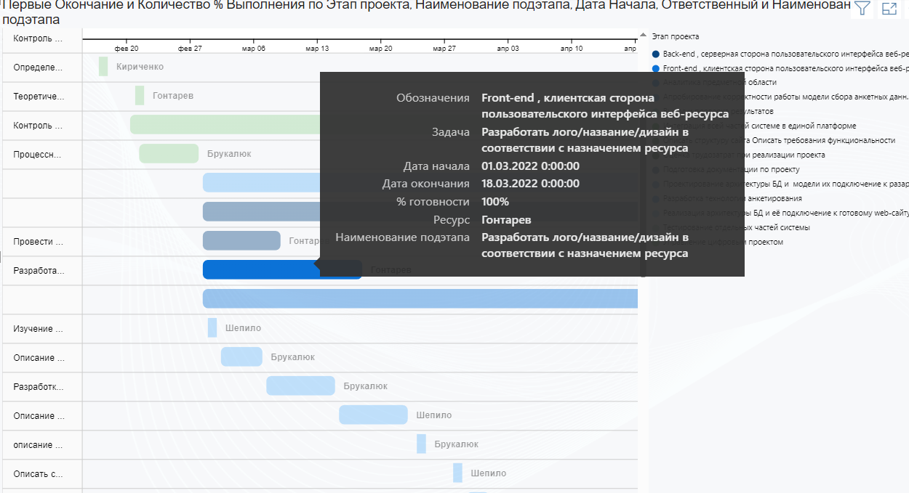
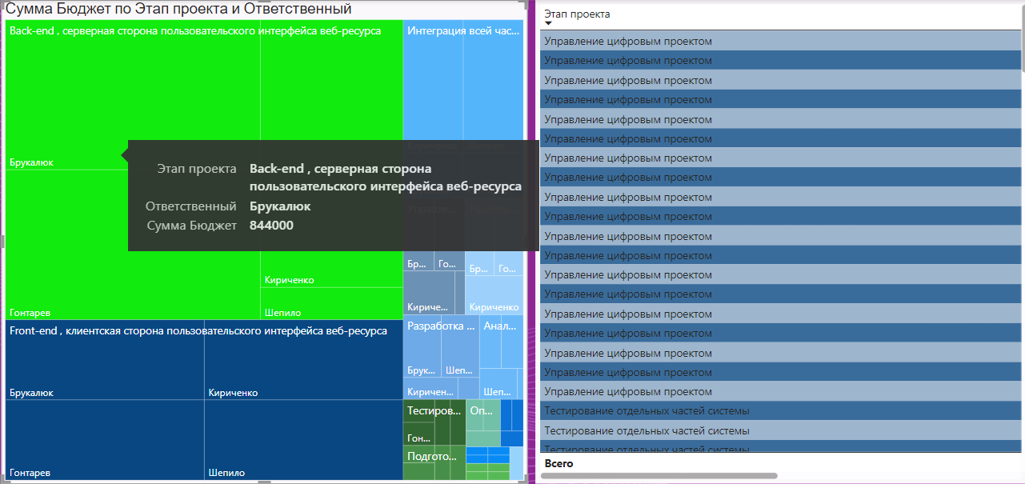
Result and infographics
Tracking of the employee, tasks and budget spent

Slide 10
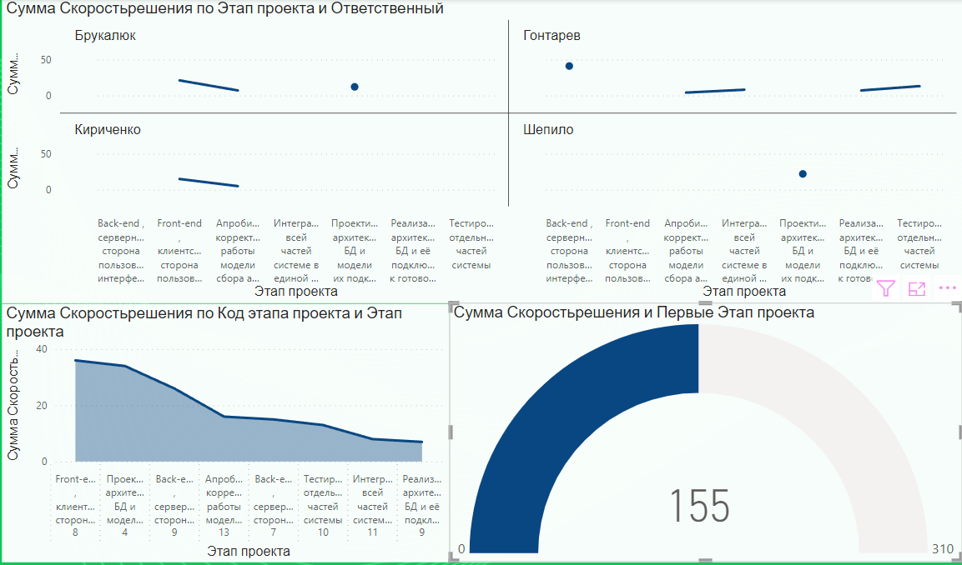
Result and infographics
Testing and speed of error fixing

Slide 11
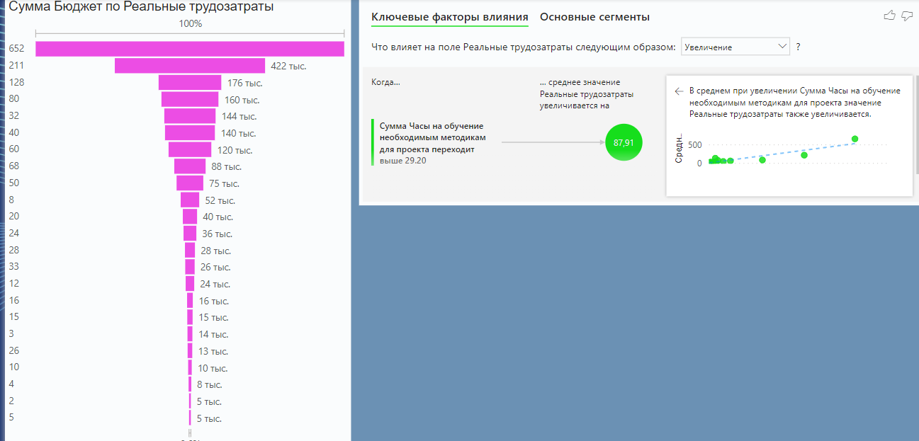
Result and infographics
Tracking the impact of kpi on the required indexes

