Slide 1
Smart Machine
Vision Lab
Managing a Machine Vision Laboratory
SKIL2 · Stef Van Wolputte
Thomas More University of Applied Sciences
Notes:
Source: SVW.mp4, 00:00. Original slides by Stef Van Wolputte, Thomas More University of Applied Sciences.

Slide 2

The Author and Coordinator’s Role
Stef Van Wolputte
Teacher and Coordinator
Machine Vision Lab
Responsibilities
Internal and external training programs.
Supporting students and project teams.
Managing resources and investments.
02
Notes:
Source: SVW.mp4, 00:20. Original slides by Stef Van Wolputte, Thomas More University of Applied Sciences.

Slide 3
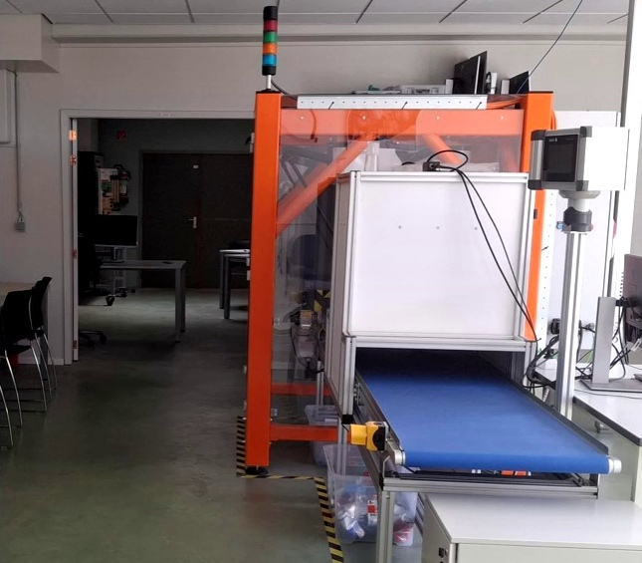
A Growing Laboratory
Growth
The Machine Vision course is growing.
New equipment arrives regularly
from different sources.
Future needs are difficult to estimate.
Constraints
Equipment is expensive, and some devices
are available in limited quantities.
Students, teams and training programs
share the same resources.
03
Notes:
Source: SVW.mp4, 00:40–01:40. Original slides by Stef Van Wolputte, Thomas More University of Applied Sciences.

Slide 4
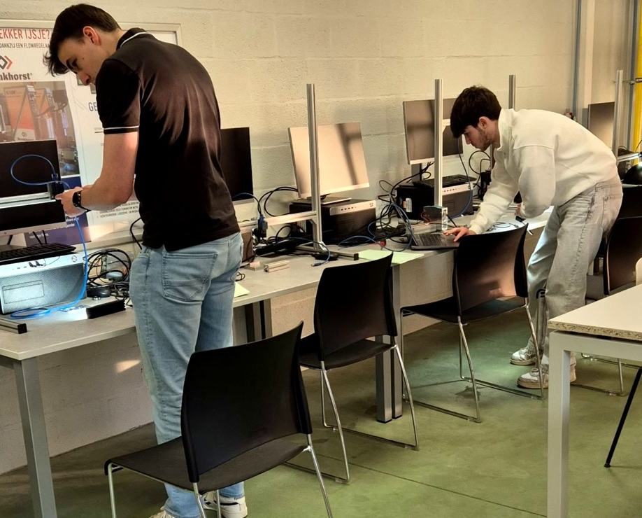
The Lab as a Learning Library
Shared access to equipment,
technology and learning resources
Students work beyond
scheduled classes.
The lab encourages initiative
and independent use
of the available facilities.
04
Notes:
Source: SVW.mp4, 02:00–02:20. Original slides by Stef Van Wolputte, Thomas More University of Applied Sciences.

Slide 5
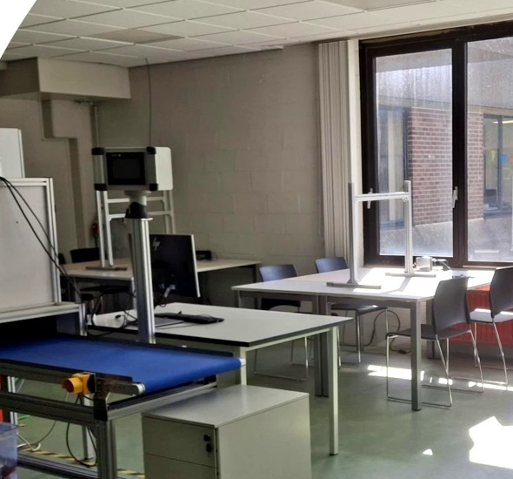
Why Canvas Alone Is Not Enough
Different Users
Students from different programs.
Members of project teams.
External trainees and partners.
Access Beyond a Single Course
Several courses and organizations
use the same laboratory.
User management needs to be independent
of educational platforms.
05
Notes:
Source: SVW.mp4, 02:40–03:20. Original slides by Stef Van Wolputte, Thomas More University of Applied Sciences.

Slide 6
Student Progress
Current Situation
Limited Visibility
Students use different technologies
individually and in teams.
They track their own progress.
Information is scattered across systems
and documents.
Which technologies a student has used.
How progress develops across courses
and projects.
Goal: every student gains experience
with all relevant technologies.
06
Notes:
Source: SVW.mp4, 03:40–04:40. Original slides by Stef Van Wolputte, Thomas More University of Applied Sciences.

Slide 7
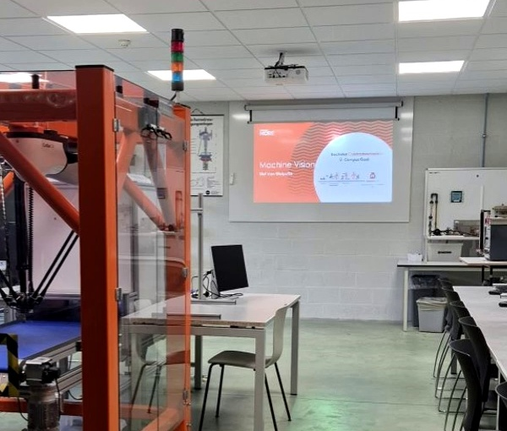
Equipment and Resources
Hardware, lab setups,
images, videos and datasets
Current Tracking Problems
Inventory is maintained in Excel.
Resource availability is not always clear.
Usage history is difficult to track.
Responsibility is not always clear.
Faults are documented inconsistently.
07
Notes:
Source: SVW.mp4, 05:00–06:20. Original slides by Stef Van Wolputte, Thomas More University of Applied Sciences.

Slide 8
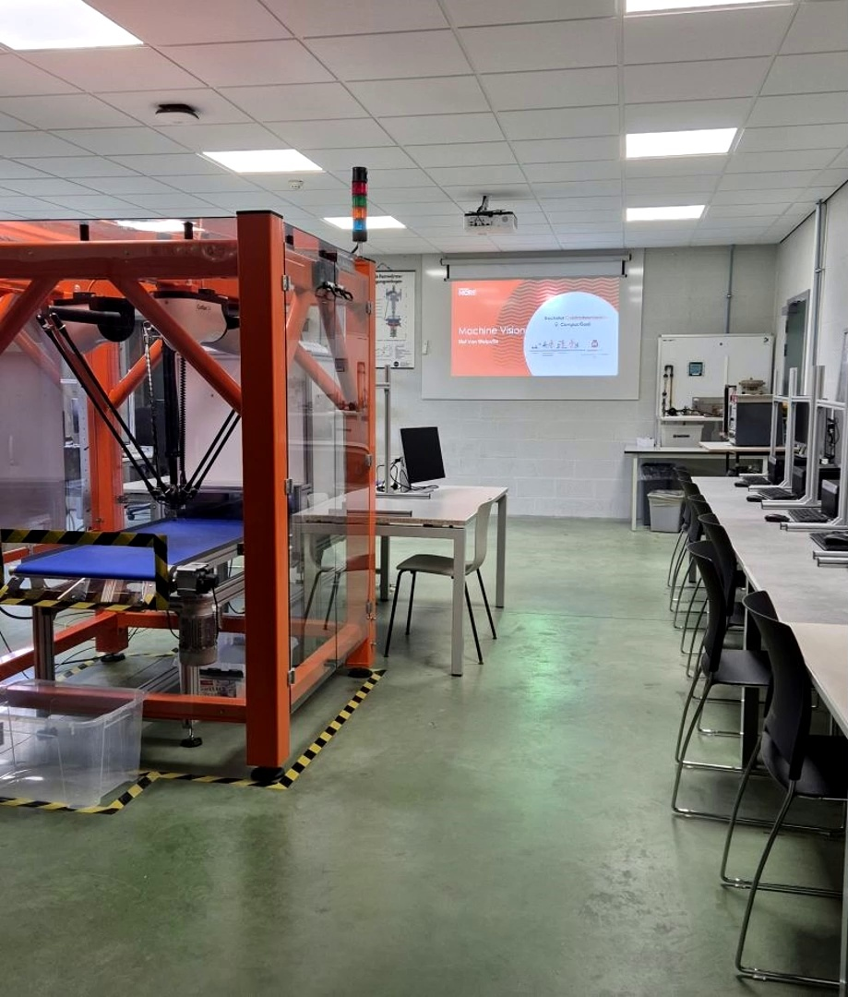
Reservations and Lending
Current Situation
Requests are often handled verbally.
Information is spread across channels.
Reservation conflicts are difficult to detect.
Information Needed
Who is using each resource.
Which project each resource supports.
What is available and what is reserved.
08
Notes:
Source: SVW.mp4, 06:40–07:20. Original slides by Stef Van Wolputte, Thomas More University of Applied Sciences.

Slide 9
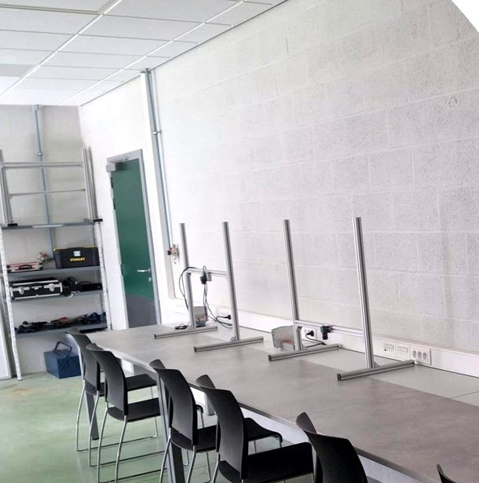
Purchasing and Budget
Manual Processes
Purchase requests and budget tracking
are handled largely manually.
Quotations are scattered.
Visibility across other labs is limited.
Questions for Decision-Making
What should we buy next?
Do we already own similar equipment?
Can another lab provide the resource?
What data supports the investment?
09
Notes:
Source: SVW.mp4, 07:40–08:20. Original slides by Stef Van Wolputte, Thomas More University of Applied Sciences.

Slide 10
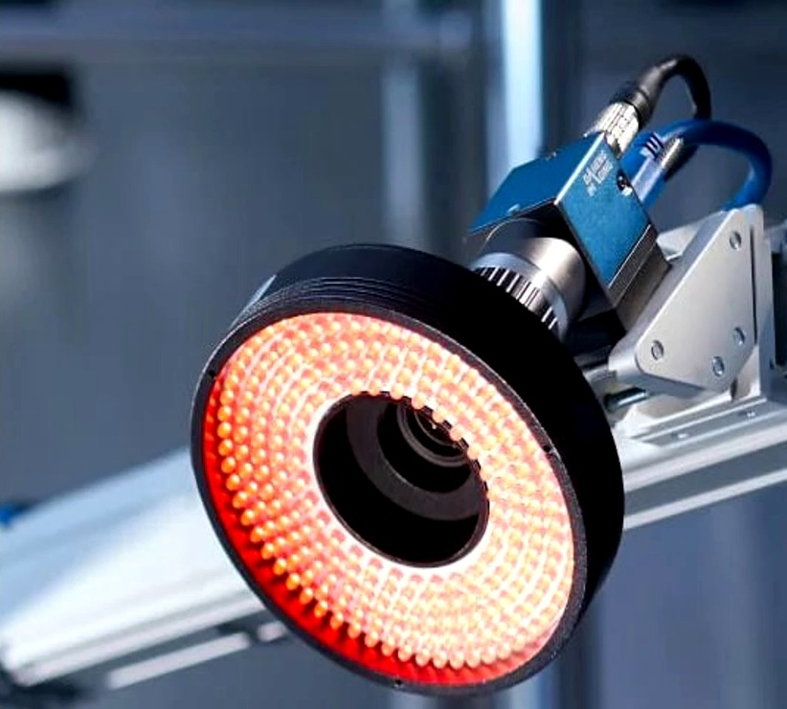
Expected Outcome
Less Time on Administration
More time for education, innovation
and student support.
A Clear Overview
Available resources and their usage.
Student progress and project activity.
Reservations, budget status
and future investments.
10
Notes:
Source: SVW.mp4, 08:40–09:00. Original slides by Stef Van Wolputte, Thomas More University of Applied Sciences.

Slide 11
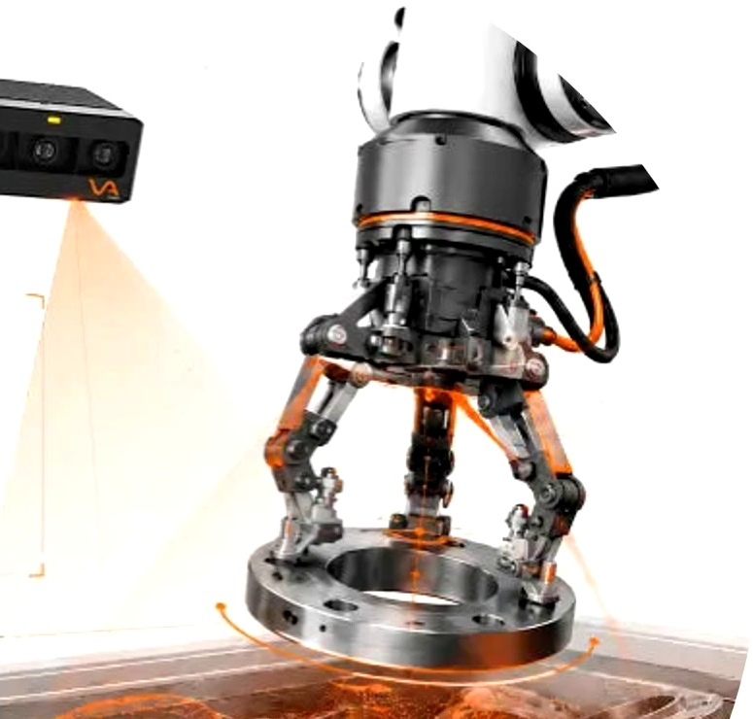
One Platform for the Entire Lab
Desired Capabilities
User and resource management.
Reservations and collaboration.
Student and project team progress.
Purchasing and budgeting support.
Analytics and reports.
The Author’s Additional Wishes
An AI assistant, automated insights,
purchasing recommendations
and a Machine Vision knowledge hub.
11
Notes:
Source: SVW.mp4, 09:20–10:07. Original slides by Stef Van Wolputte, Thomas More University of Applied Sciences.

