Slide 1
Folder Structure
2019_01
2019_02
…
PatientsID
p1
p2
…
StudyInstanceUID
st1
st2
…
DOC
MR
SeriesInstanceUID
se1
se2
…
dcm1
dcm2
…
SOPInstanceUID

Slide 2
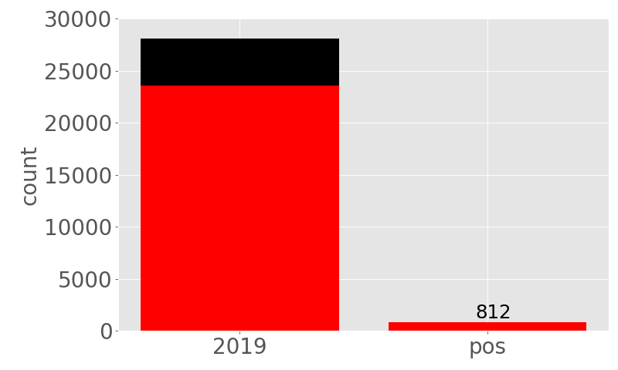
#Patients
Notes:
Around 100 patients who are in both folders

Slide 3
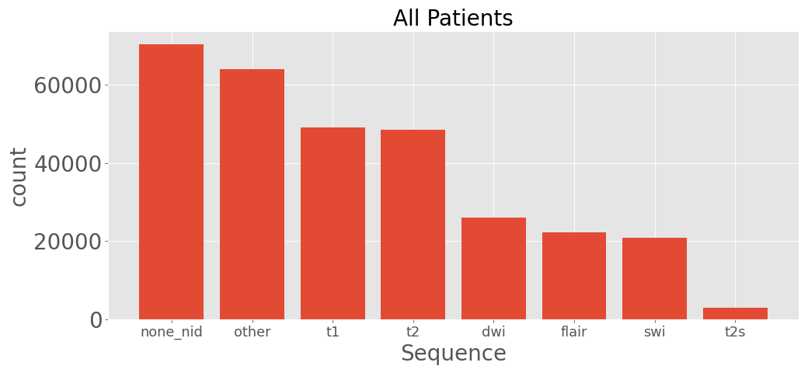
#Series

Slide 4
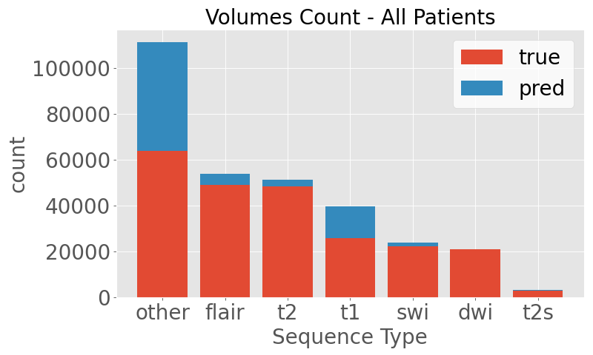
Prediction

Slide 5
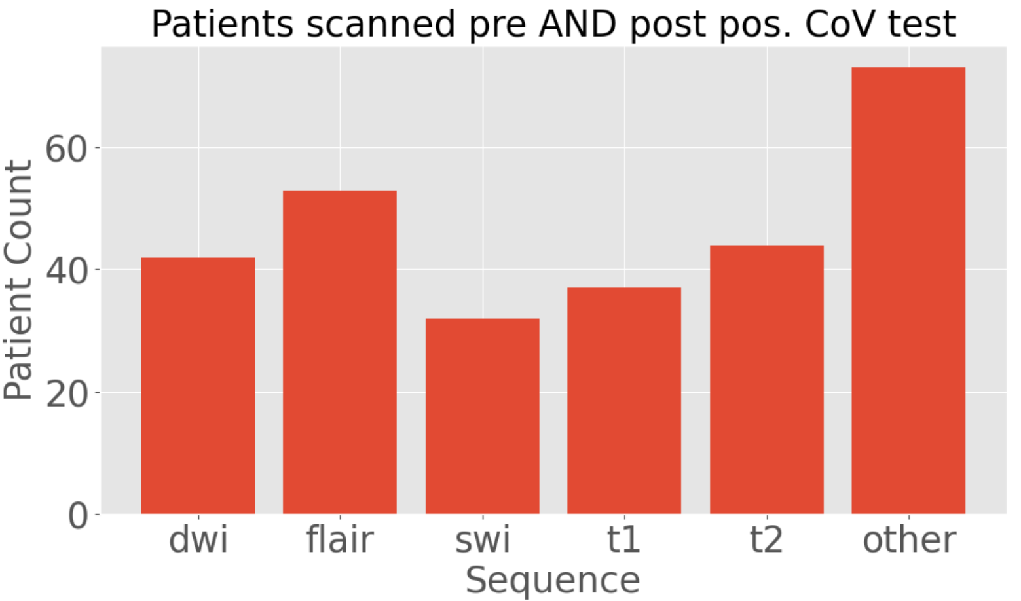
Prediction

