Slide 1
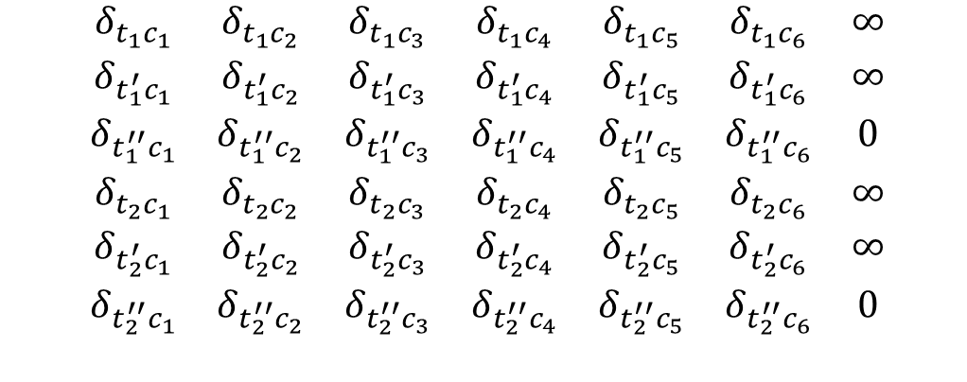

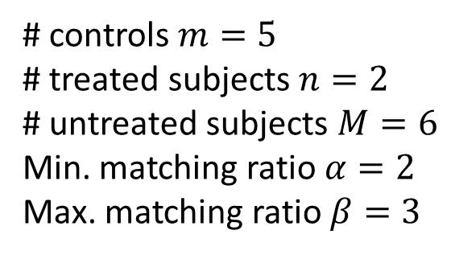



Variable-ratio matching
$$M$$
$$K=nβ−m$$
# controls $m=5$
# treated subjects $n=2$
# untreated subjects $M=6$
Min. matching ratio $α=2$
Max. matching ratio $β=3$
$$\begin{matrix}δ_{t_{1}c_{1}} & δ_{t_{1}c_{2}} & δ_{t_{1}c_{3}} & δ_{t_{1}c_{4}} & δ_{t_{1}c_{5}} & δ_{t_{1}c_{6}} & ∞ \\ δ_{t_{1}^{′}c_{1}} & δ_{t_{1}^{′}c_{2}} & δ_{t_{1}^{′}c_{3}} & δ_{t_{1}^{′}c_{4}} & δ_{t_{1}^{′}c_{5}} & δ_{t_{1}^{′}c_{6}} & ∞ \\ δ_{t_{1}^{′′}c_{1}} & δ_{t_{1}^{′′}c_{2}} & δ_{t_{1}^{′′}c_{3}} & δ_{t_{1}^{′′}c_{4}} & δ_{t_{1}^{′′}c_{5}} & δ_{t_{1}^{′′}c_{6}} & 0 \\ δ_{t_{2}c_{1}} & δ_{t_{2}c_{2}} & δ_{t_{2}c_{3}} & δ_{t_{2}c_{4}} & δ_{t_{2}c_{5}} & δ_{t_{2}c_{6}} & ∞ \\ δ_{t_{2}^{′}c_{1}} & δ_{t_{2}^{′}c_{2}} & δ_{t_{2}^{′}c_{3}} & δ_{t_{2}^{′}c_{4}} & δ_{t_{2}^{′}c_{5}} & δ_{t_{2}^{′}c_{6}} & ∞ \\ δ_{t_{2}^{′′}c_{1}} & δ_{t_{2}^{′′}c_{2}} & δ_{t_{2}^{′′}c_{3}} & δ_{t_{2}^{′′}c_{4}} & δ_{t_{2}^{′′}c_{5}} & δ_{t_{2}^{′′}c_{6}} & 0\end{matrix}$$
$$α$$
$$β$$

