Slide 1
T2w scans for brain vol. segmentation?
6400 3D T2+3D T1 MRIs
Only 4 patients with 3D T2 pre and post covid, only 1 new
Notes:
Abs instead of **2
Threshold for

Slide 2
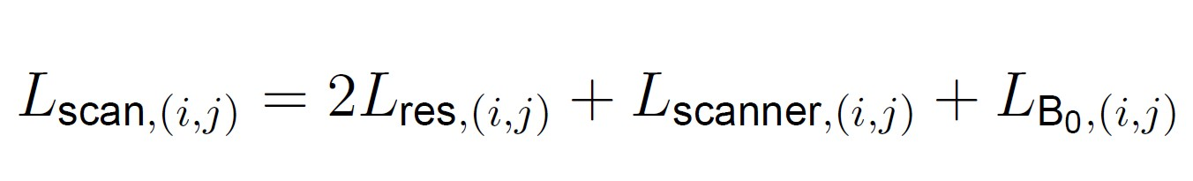
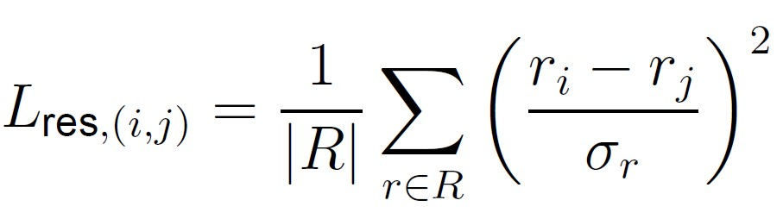
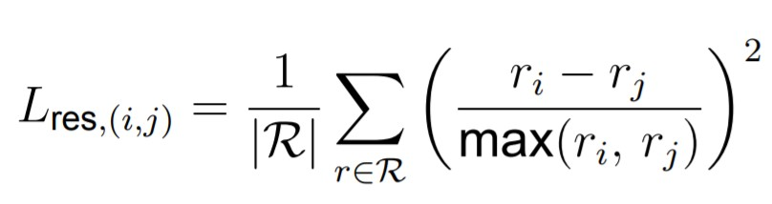
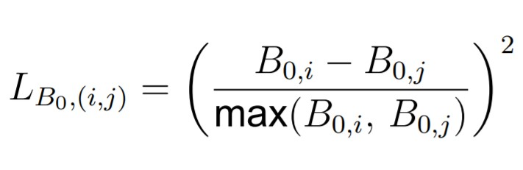
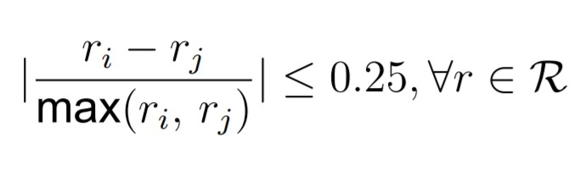
Scan distances
Notes:
Abs instead of **2

Slide 3
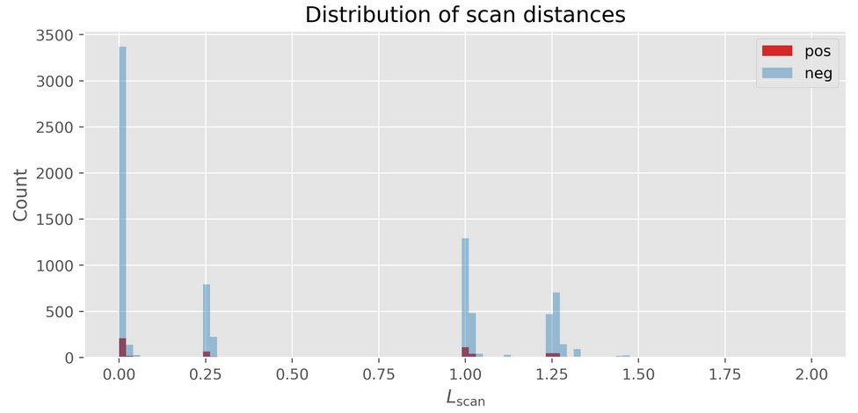

Slide 4
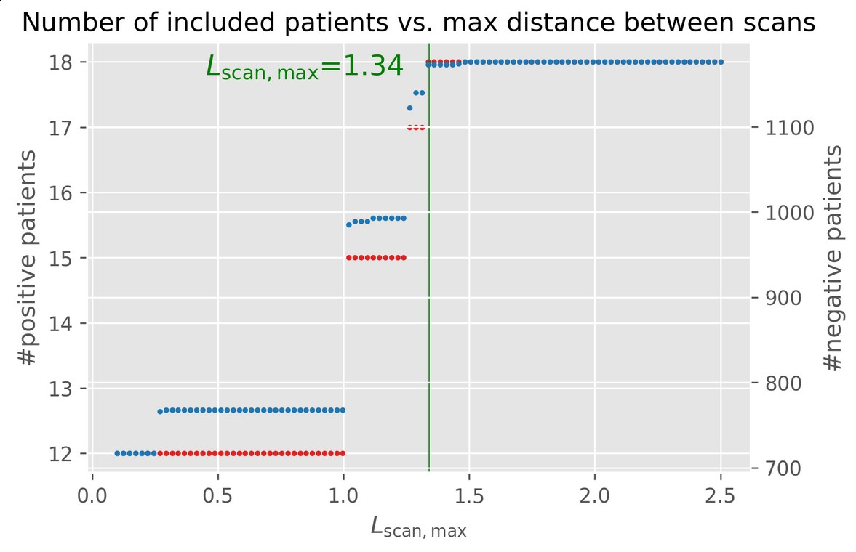

Slide 5
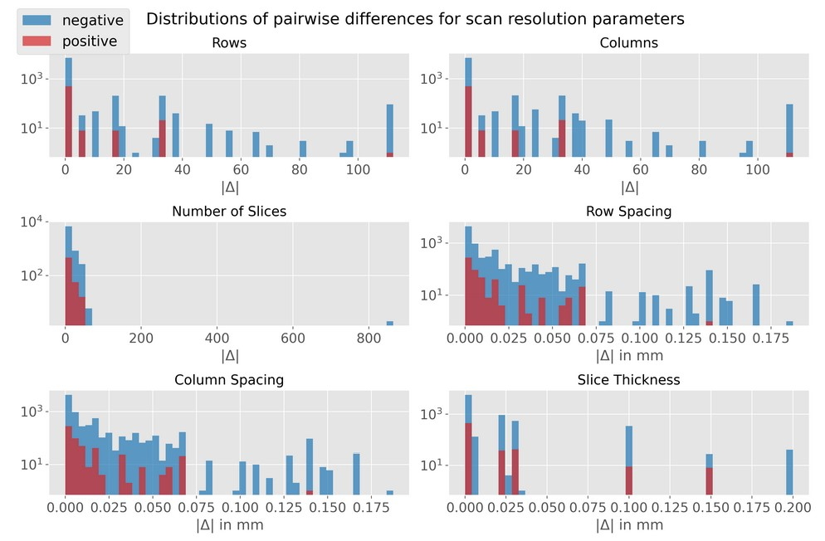

Slide 6
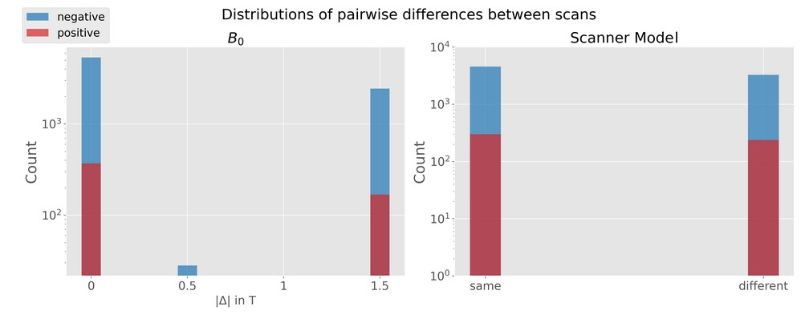

Slide 7
Goal
Match k controls to every positive without double assignment
Minimize sum of distances

Slide 8
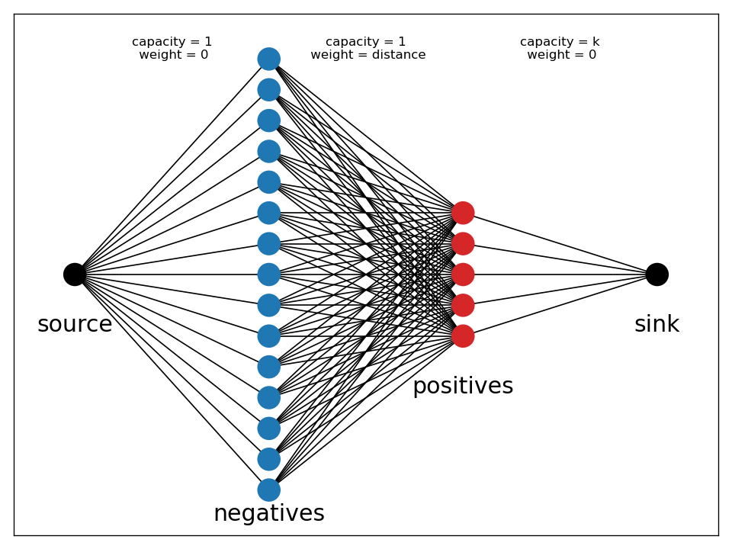
Max flow min cost

Slide 9
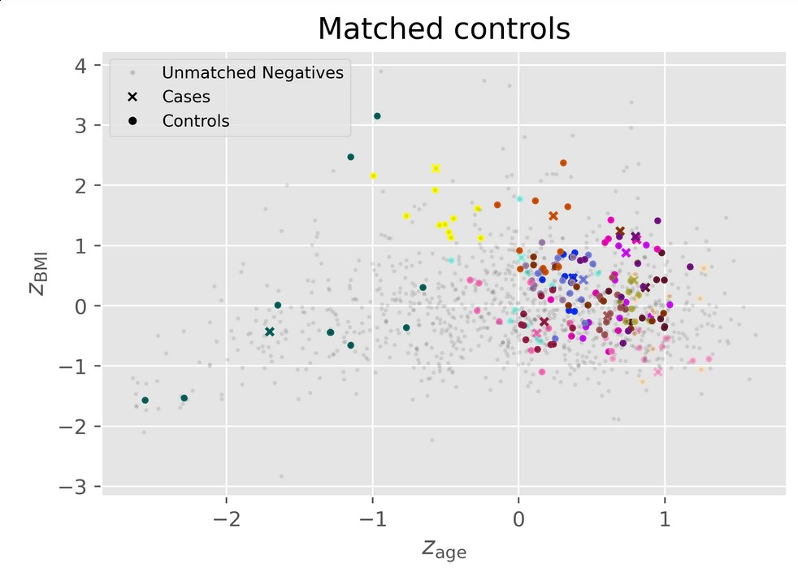
Notes:
Reduce number of controls and look only at population differences
18 positives

Slide 10
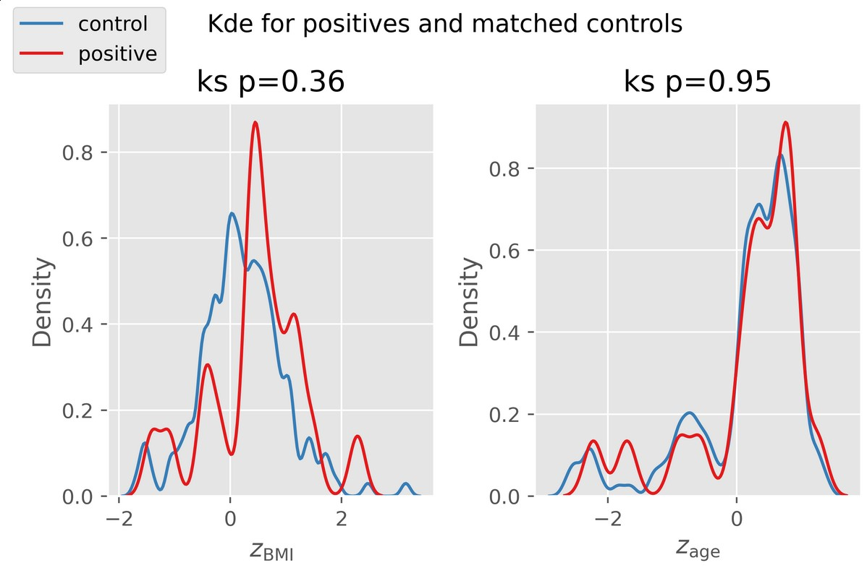

Slide 11
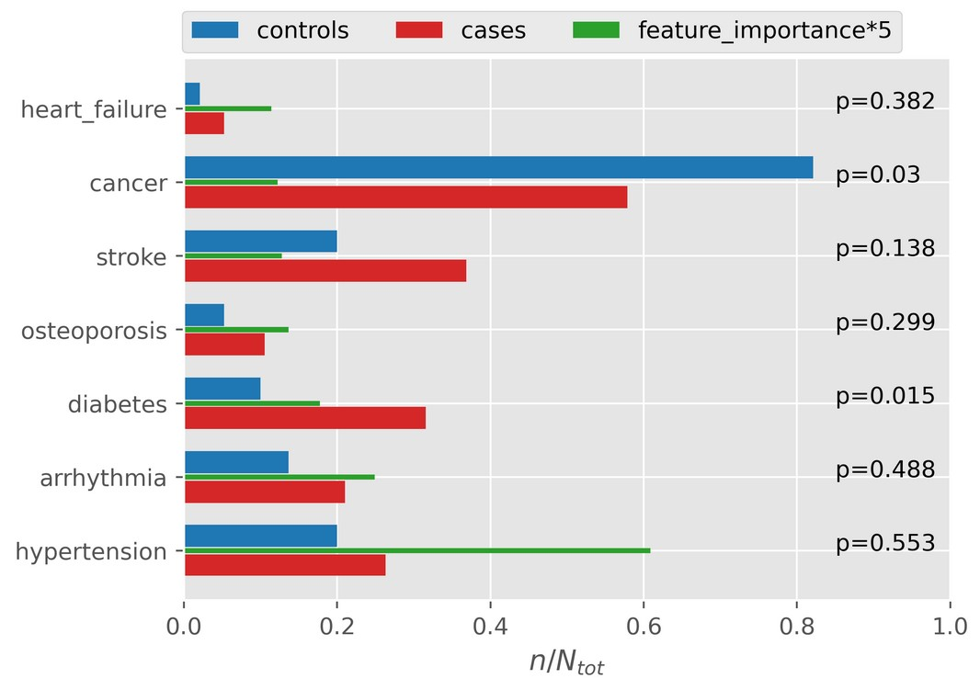
Notes:
New feature importances include new dump, rf importances and permutation importances
1 brain tumor patient in positives
61 brain tumor patients in controls

Slide 12
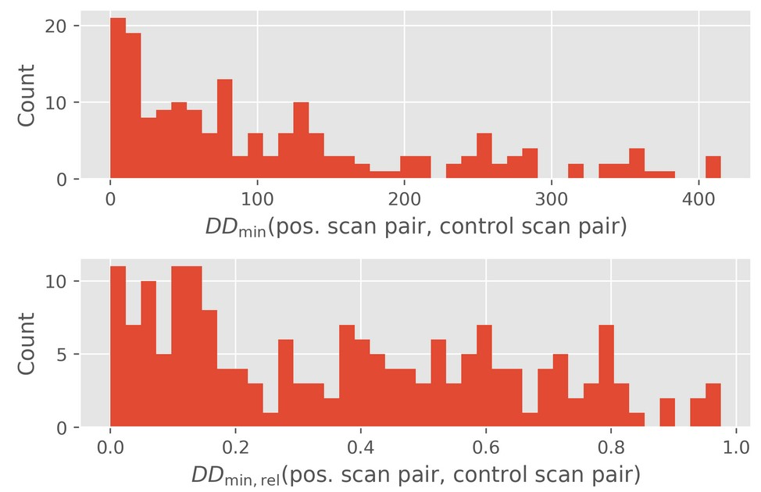
Less important
We’ll normalize over the period

