Slide 1
Overview
Longitudinal study
Patient/Scan selection
Matching results
Cross sectional Study scan selection
Comparison of optimal PS matching techniques - A Monte Carlo Study

Slide 2
Patients with scans: 24261
Remove scans without date
22434
Select 3D (min. 64 slices) T1 MRI scans
14005
Case: min. 1 scan before the pos. Test (date_scan<=date_test-30days)
AND min. 1 scan after pos. Test (date_scan>=date_test-3days)
Control: No pos. Test or min. 2 scans before pos. test
24 cases
1685 controls

Slide 3
24 cases
1685 controls
Drop missing BMI or BirthDate
If more than 2 scans per patient:
take most similar, if multiple with same score:
take the ones with highest temporal dist. (largest effect)
Also tried: taking earliest second scan,(reduce number of excluded patients)->no sign. effect on patient numbers
23 cases
1570 controls
Min. 7 days between scans
23 cases
1494 controls

Slide 4
Include ICD10/ATC codes up to the time of second scan
Remove patients with brain tumor
21 cases
1084 controls
Remove patients with stroke??
15 cases
874 controls
Compute age by the time of first scan
Remove patients younger than 20
13 cases
811 controls
Optimal matching on PS 10 controls per case
13 cases
130 controls

Slide 5
1b. Matching Results

Slide 6
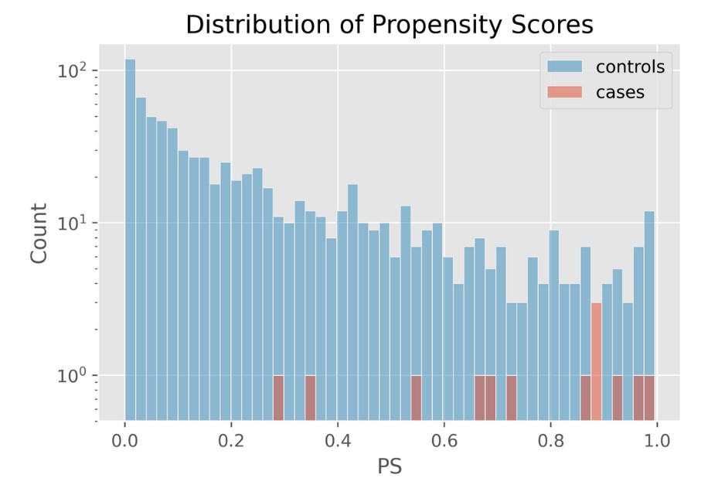

Slide 7
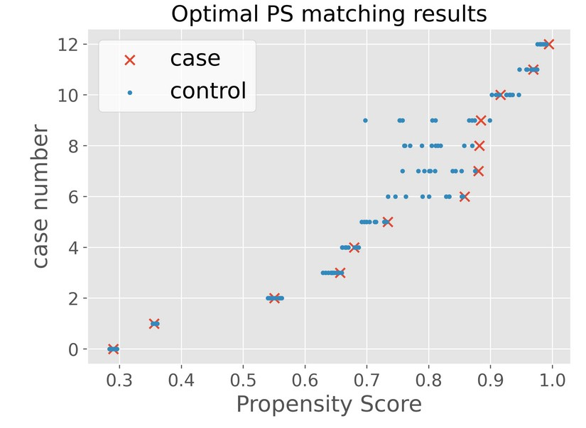

Slide 8
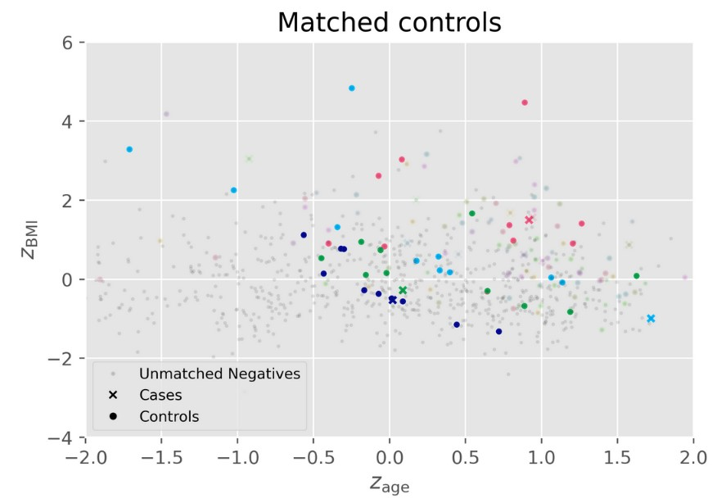

Slide 9
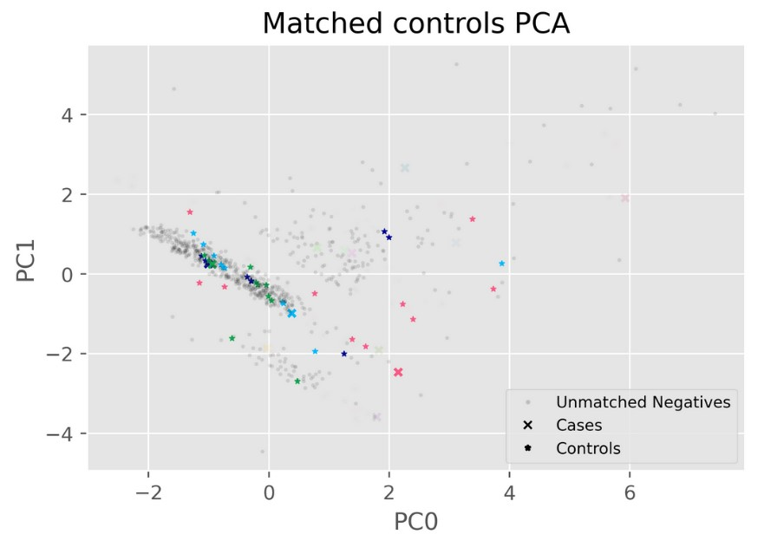

Slide 10
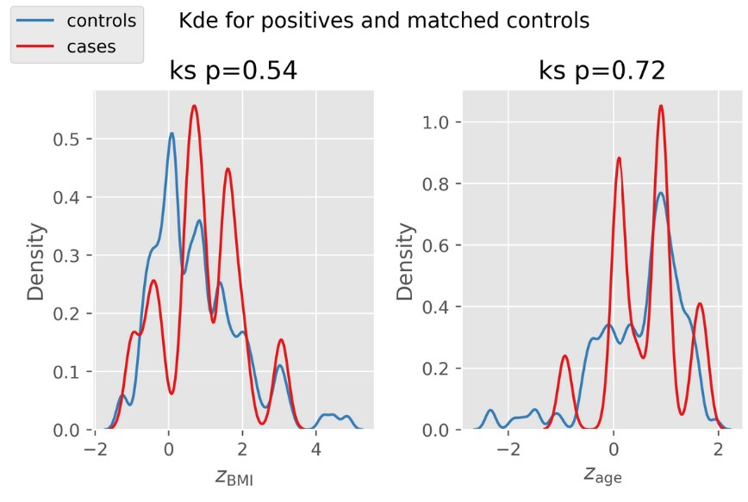

Slide 11
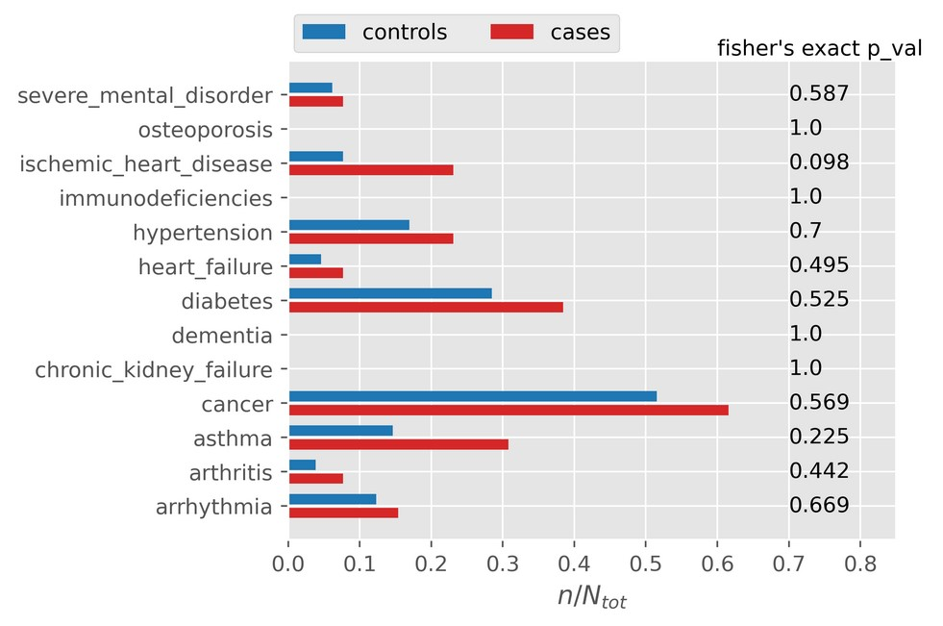

Slide 12
2. Cross Sectional Study Scan Selection

Slide 13
Patients with scans: 24261
Remove scans without date
22434
Select 3D (min. 64 slices) T1 MRI scans
14005
Control: No pos. test or min. 1 scans before pos. test (date_scan<=date_test-30days)
Case: min. 1 scan before the pos. test (date_scan<=date_test-30days)
179 cases
13826 controls

Slide 14
Select one scan for every patient
Goal: Select most similar scans
Problem: Given the scan similarity metric we can only compute pair-wise distances

Slide 15
Distances->Points
Embedding of pairwise distances in Euclidean space
Computing pairwise distances of n scans and embedding in a m<=n-1 dimensional space (Young, Householder 1938) can be reduced to matrix factorization problem
Construct matrix B_i with elements: b_jk = ½(d_ij**2+d_ik**2-d_jk**2)
Factor matrix: B_i = A_i A_i^T
While at least 1 patient has multiple scans:
Find average of all points
Compute distances of all scans to the average point
Exclude scan with max distance for a patient with multiple scans

Slide 16
Approach 1: Gradient Descent
Minimize sum of distances
Very expensive function evaluation (35000^2 distances)

Slide 17
3. Optimal Matching Methods

Slide 18
Optimal matching methods
Many-to-one with constant matching raito
Pair matching (special case of the first method)
Full matching: Either 1 treated and at least 1 untreated OR 1 untreated and at least 1 treated (Rosenbaum 1991)
Variable-ratio matching (Ming, Rosenbaum 2001):
Reduction in Bias compared to constant matching

Slide 19
Optimal matching methods
Fine Balance, not always feasible (Rosenbaum, Silber 2007)
Exact balance of a nominal covariate
Entire number=floor((1-PS)/PS) (Yoon 2009)
Near fine balance: minimizes the total covariate distance within matched pairs while coming ‘as close as possible to fine balance.’ (Rosenbaum 2011)
Entire number + near fine balance constraint (Keele 2015)
Most methods above can be performed with and without caliper

