Slide 1
Web Development Crash Course
Code: https://github.com/KirilBourakov/CS-Square-webdev
Kiril Bourakov

Slide 2

What is a Web Bowser?
How does it let us view websites?
- Essentially an arbitrary code executing machine. - It executes code it gets from a webserver.
Image credit: Wikipedia

Slide 3
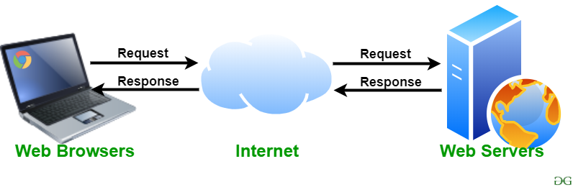
What is a webserver?
A webserver is a computer that receives requests and returns responses.
HTTP is a protocol for fetching resources. These resources could be any type of file.
When fetching a website, you are fetching 3 types of files: HTML, CSS, and Javascript. The URL in the browser is the file path on the server*
Image credit: geeksForGeeks

Slide 4
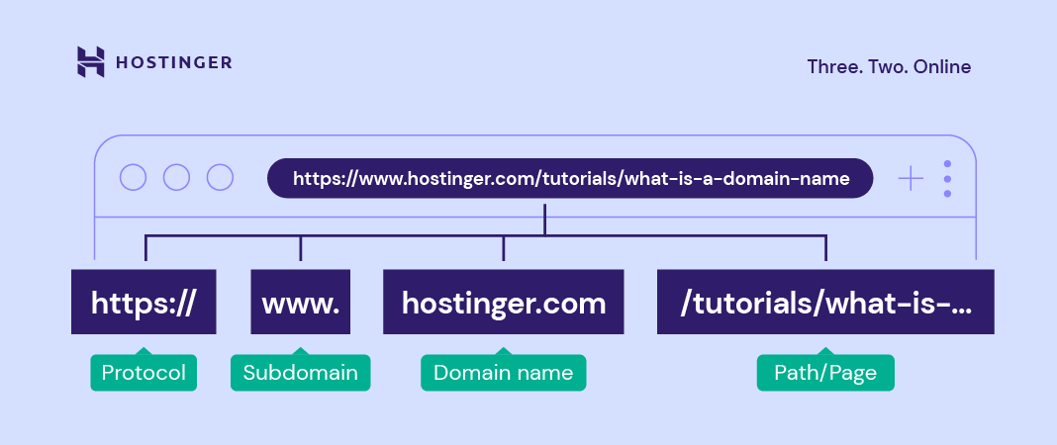
URL Parts

Slide 5
What is HTML, CSS, Javascript
HTML is the bones of the webpage
CSS is the skin and other superficial elements
Javascript is the brain
Has nothing to do with Java
We’ll start with HTML

Slide 6
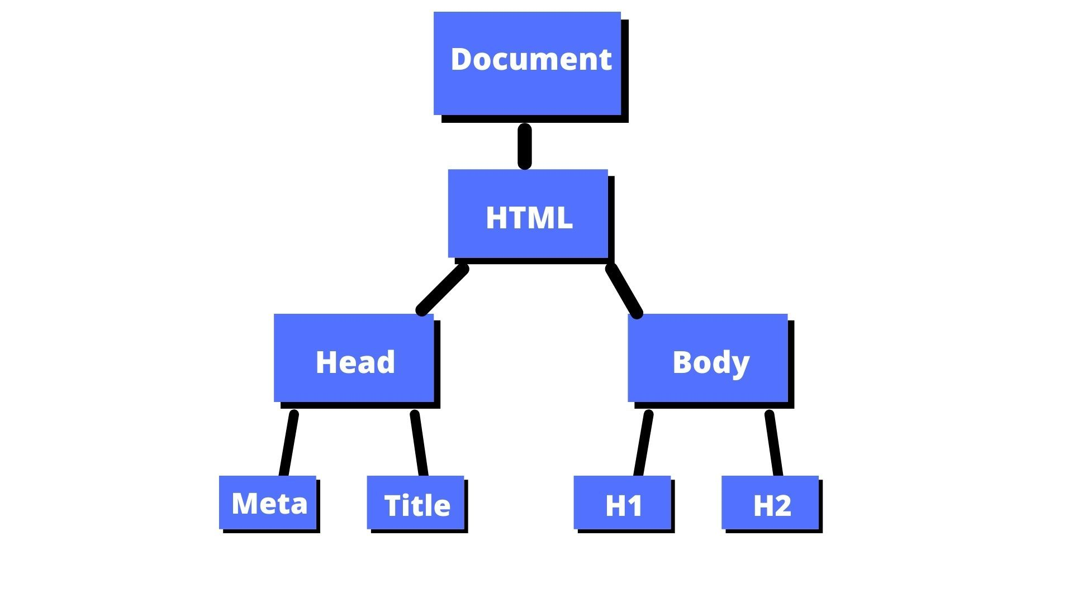
HTML Structure
Composed of elements that looks opened with:
<Element>
And closed with:
</Element>
Where Element is replaced with the name of the element.
There can be content between the opening and closing statements, such as text or other elements.
Components can be viewed as tree called the document object model (DOM)
Image credit: freeCodeCamp

Slide 7
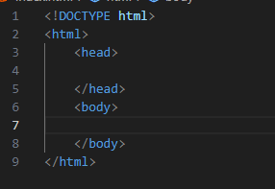
HTML Structure Continued
<!DOCTYPE html>
Tell the browser this is an HTML5 document
<html>
This is the root element of the webpage.
Ended by </html>
<head>
Defines Meta information about the html webpage
<body>
Visible contents go here

Slide 8

The <head> tag
Defines meta information about the website.
<title> [title here] </title>
Defines the title of the webpage (what shows up in the tab listing.
<meta>
Defines meta information about the website.
Not closed with </meta> instead, self contained. For example:
<meta name="description" content=“This is the description of a webpage">
Gives the webpage a description
<meta name="viewport" content="width=device-width, initial-scale=1.0">
Tells the browser how to scale the webpage.
width=device-width sets width to be screen size of the device
initial-scale=1.0 sets the initial zoom of the webpage

Slide 9

The <Body> tag
Defines the visual parts of the website.
Structure of the visual parts defined by other HTML tags within the body.
We’ll be looking at 3 tags:
<div /> - simply defines a section of the webpage
<p /> - defines a paragraph
<h1…6> - 6 elements, define levels of heading

Slide 10
Example 1

Slide 11
Our website looks boring
This can be fixed with CSS!
CSS defines the webpage’s appearance; it can control colour, appearance, and much more.

Slide 12
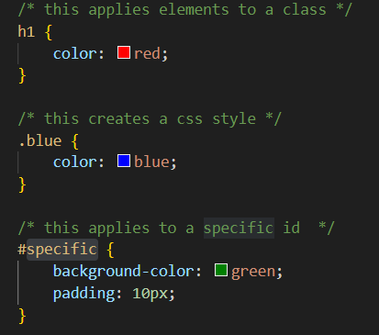
CSS syntax
Written in its own file
Can be applied
direct to the element
Via an id
Via a class
Inherited from a parent element
Specificity:
If a css style has the same property several times, the most specific applies.
What is padding?

Slide 13
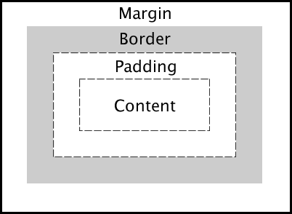
CSS Box model
In CSS, all HTML elements have a box that wraps around them. This box has 4 layers:
Content – what is contained inside the component (images, text, other elements)
Padding – an area around the content.
Border – a border that goes around padding and content
Margin – an area outside of the border.
Image Credit: University of Washington

Slide 14
Dev tools
Modern web browsers have many tools used to debug html and CSS. Inspect element is the most common.
Inspect element example 2.

Slide 15

Example 2

Slide 16
Putting this together; site V1

Slide 17
Adding the ability to post
First thing we will need is a webserver. There are many libraries and frameworks. For this example, we will be using flask, a python library because it’s easy to understand.

Slide 18
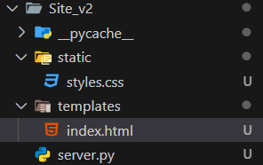
Flask file structure
Flask uses a specific file structure:
HTML goes in a folder called ‘templates’.
They are called templates are preprocessed;
flask dynamically changes the contents of the webpage based on outside factors
CSS goes in a folder called static. The static folder also contains any files that are not preprocessed, such as Javascript, images, videos and so on.

Slide 19
Site v2 example

Slide 20
Request Methods
Not all requests to the same url are the same. There are different request methods, which tell the server different things. We will use 2:
GET method. You are getting something from the server. This is the method we use when Flask gave us the website in the previous example.
POST method. This is the method for giving information to the server. For example, tweeting likely uses a POST method as you are posting something.

Slide 21
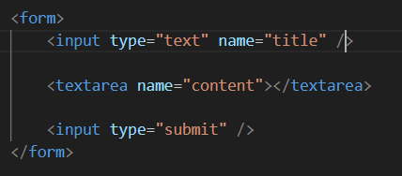
HTML forms
There are many ways to send requests, but we will be using HTML forms.
HTML forms represents sections where the user inputs data, such as login pages, or post locations.
A form starts with a <form> tag and contains several inputs.
Name attribute must be included. Tells the server what data it is looking at.

Slide 22
Site V3 example
You will notice we will get an error

Slide 23
Response codes
When a webserver receives a request, it can respond in different ways:
2xx means successful
3xx means redirection
4xx means client error
418 is a joke
- 5xx means server error
More here:
https://developer.mozilla.org/en-US/docs/Web/HTTP/Status/405

Slide 24
Handling POST request
The site cannot handle POST requests
Adding support is simple.
If the request is of type POST, simply store the form data in our database.
Database is a list
A ‘real’ app would use an SQL or noSQL database like Postgres or MongoDB.

Slide 25
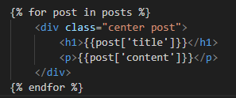
Jinja
Jinja is used to customize templates
{{ }} for instance’s (IE, variables)
{%..%} for statements without a direct output
loops, assignments

Slide 26

Site V4 example
Will also be exposed to the network.

Slide 27
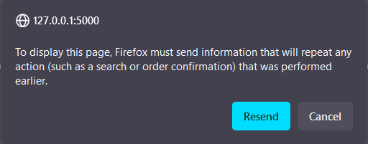
Form resubmission
After submitting a post, when reloading, we get this ->
Reloading a page after posting a form makes the post request again
Several ways to prevent this
Here, we use javascript

Slide 28
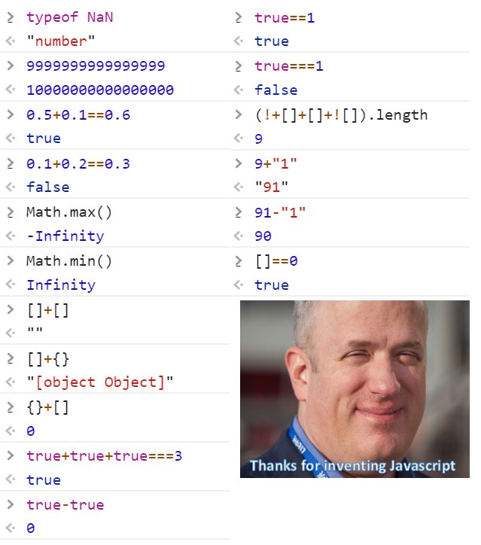
Javascript
- Is weird due to implicit type conversion.
Variables declared with var, let, and const
=== is used for equality, not ==; == does implicit type conversion
“2” == 2 -> True
“2” === 2 -> False
Function declared with:
Function example(){}
let example = () => {}
Functions are first class objects
C like syntax
Image source: dlabs.ai

Slide 29

Example 3

Slide 30
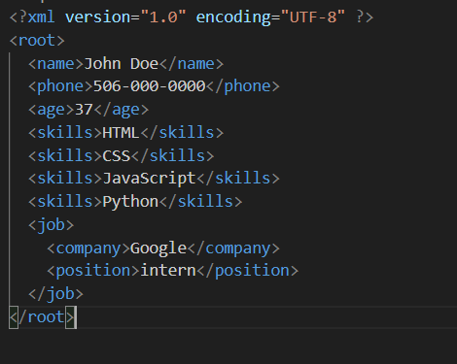
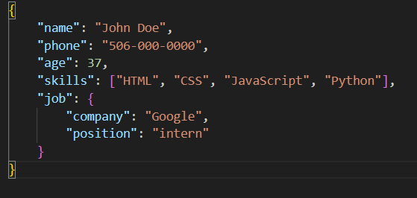
JSON
XML
JSON
Modern day replacement to XML

Slide 31
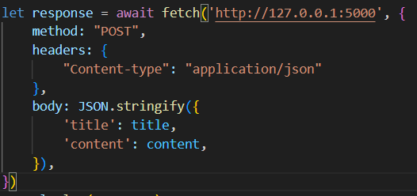
Sending requests with fetch
Fetch()
Function comes with Javascript, used to make requests
Takes in a url, as a string
Can also take in an object
Represents information about the request
Returns a promise, which becomes a value after some time

Slide 32
Site V5 Example

Slide 33

DOM manipulation
Document = the HTML file itself
document.createElement() – Create an element
document.getElementById() – Get an element by it’s id
element = any html element
element.classList.add() – Add one or more classes to an HTML element
element.appendChild() – Append a node to another node
element.innerHTML – represents the innerHTML of a node (it’s children)
Image source: w3schools

Slide 34
Site V6

