Slide 1
Computational Statistics
Midterm presentation
From
Group 8
Loris Junod, Kyrylo Kublytskyi

Slide 2
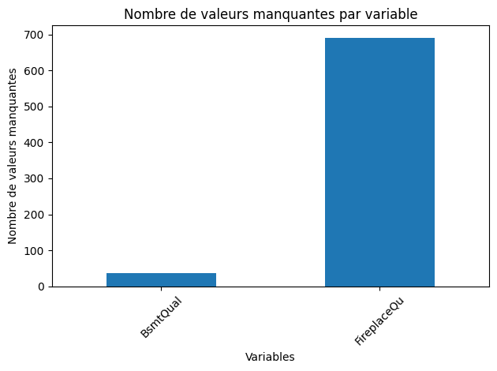
Exploratory Analysis and Classical Statistical Inference
Starting point : knowing the data
What kind of Data
Categorical Data
Ordinal variables (Bad – Very Good, ie GarageQual)
Descriptive variables (ie. LotShape, Neighborhood location)
Boolean Variables (ie CentralAir)
Numerical Variables
Times variables (ie MoSold, YrSold)
Size variables (ie. GarageArea)
Missing Data ? Type of Data ?
In the Features Variables
Issue : How to to deal with NA Values in training phase
Two training Set

Slide 3
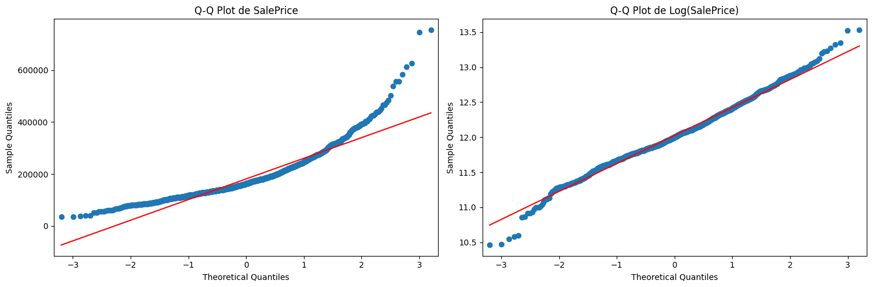
Classical Statistical Inference
On SalePrice
On LogSalePrice

Slide 4
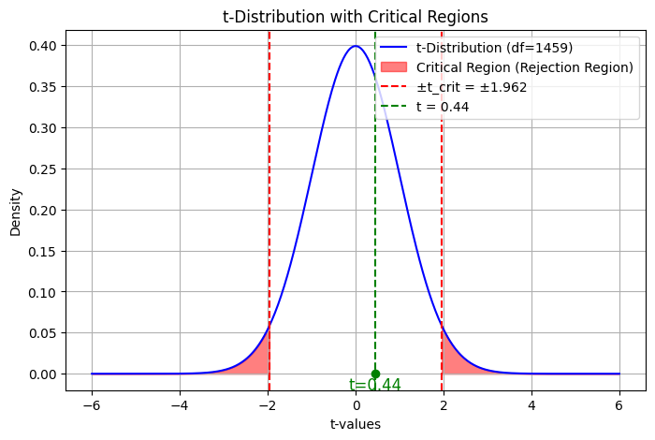
Classical Statistical Inference

Slide 5
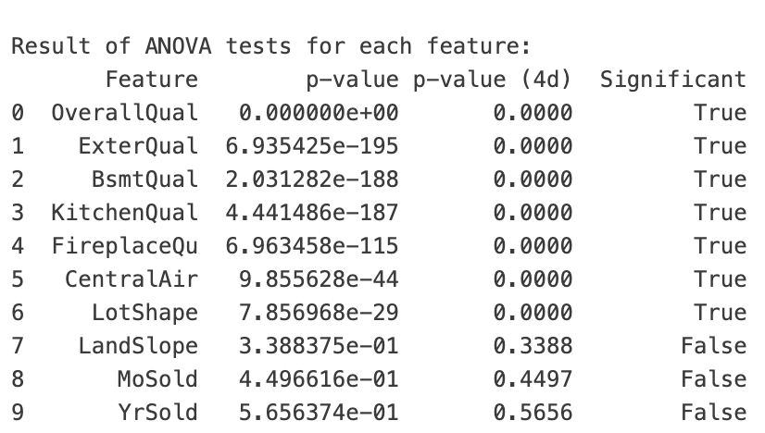
Part 2 : ANOVA – significant features
One-way ANOVA
Significant features
OverallQual
ExterQual
BsmtQual
KitchenQual
FireplaceQu
CentralAir
LotShape

Slide 6
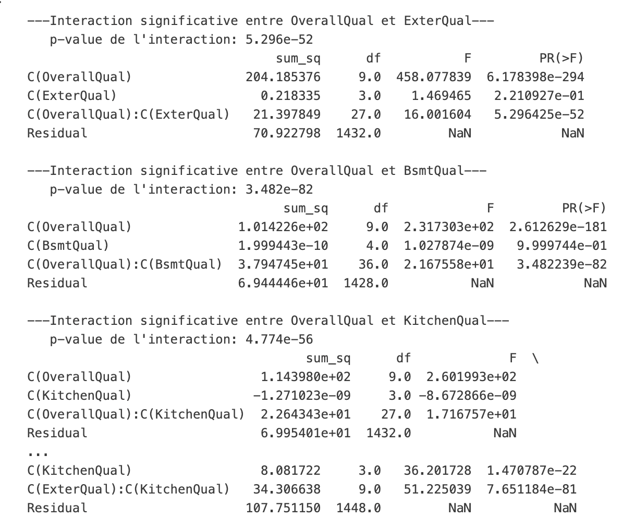
Part 2 : ANOVA – significant features

