Slide 1
OOP PRINCIPLES IN JAVASCRIPT
Kyrylo Abramov

Slide 2
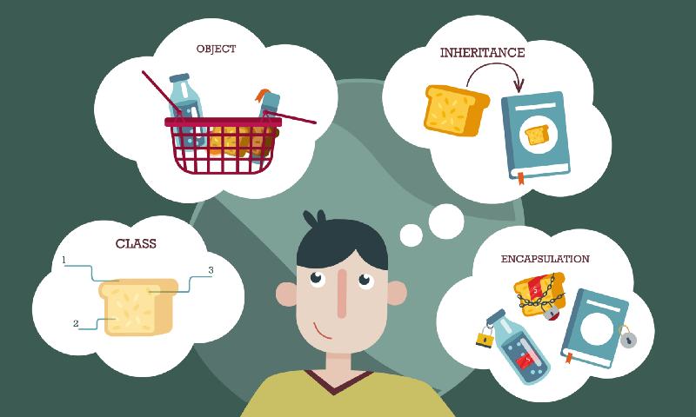
OOP IN JAVASCRIPT
WHAT IS OOP?
OOP PRINCIPLES

Slide 3
OBJECT ORIENTED PARADIGM
Object Oriented Programming is one of the most widely used programming paradigms.
From the OOP perspective, an application is a collection of “objects” that communicate with each other. We base these objects on things in the real world, like products in inventory or employee records.
Objects contain data and perform some logic based on their data. As a result, OOP code is very easy to understand.
OOP based on real-world objects lets anyone read your code and understand what’s going on.

Slide 4
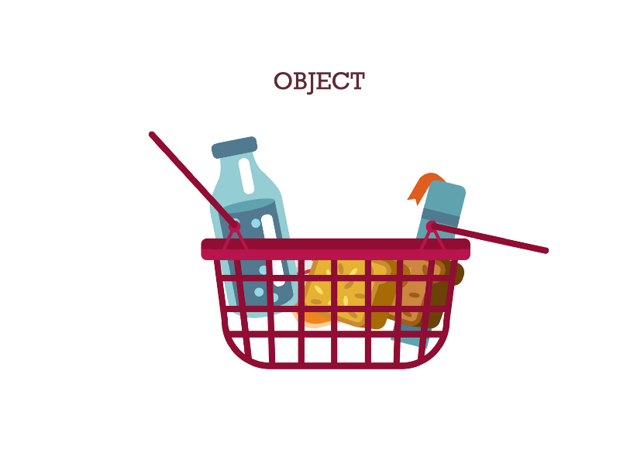
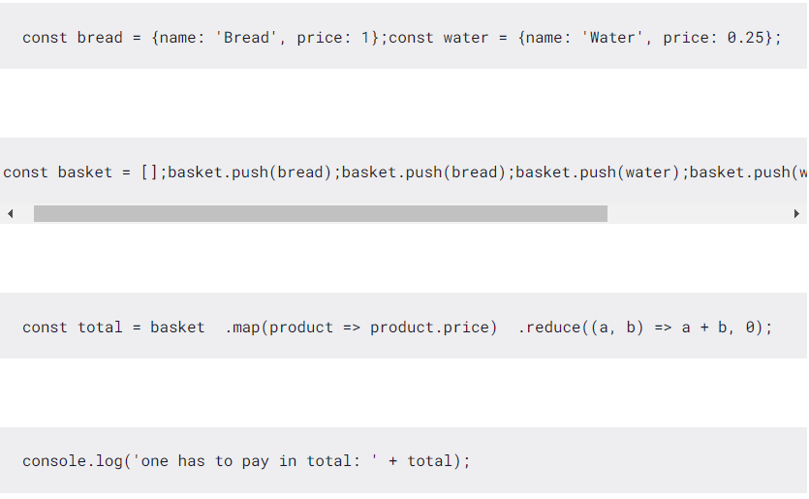
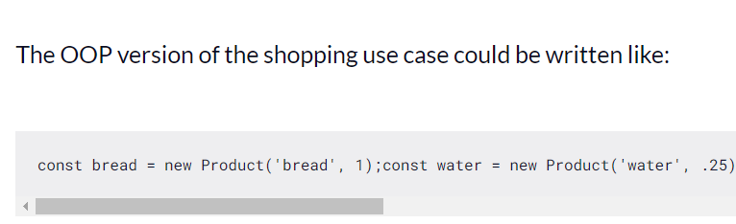
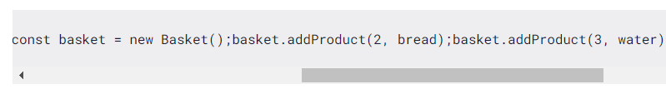

OBJECT AS CENTERPIECE
An object modeled on real-world things consists of data and functions

Slide 5
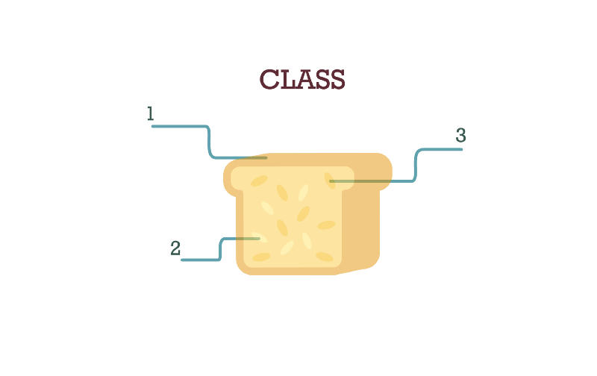
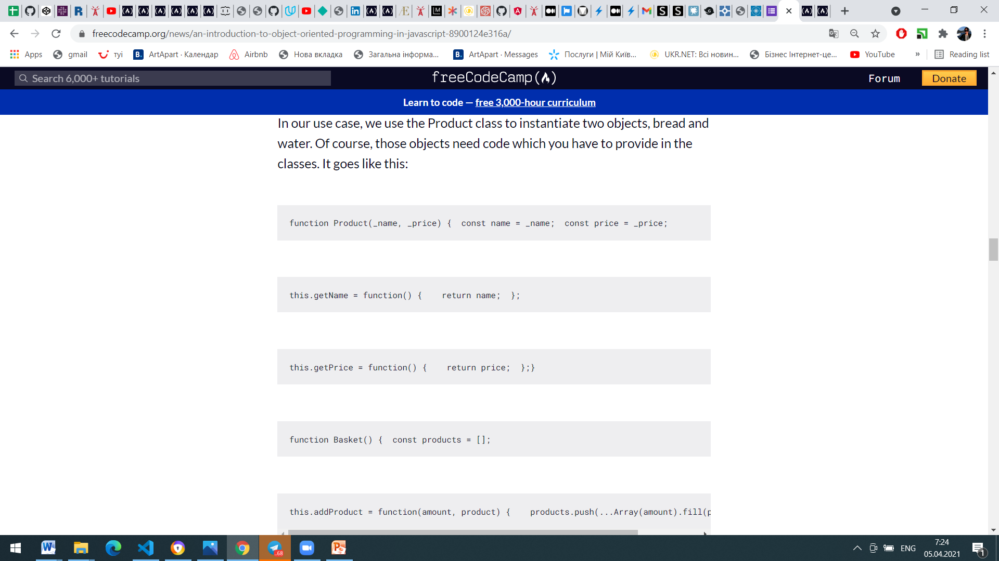
CLASS AS A TEMPLATE
We use classes in OOP as templates for creating objects. An object is an “instance of a class” and “instantiation” is the creation of an object based on a class. The code is defined in the class but can’t execute unless it is in a live object.

Slide 6
OOP
A class in JavaScript looks like a function, but you use it differently. The name of the function is the class’s name and is capitalized.
Since it doesn’t return anything, we don’t call the function in the usual way like const basket = Product('bread', 1);
Instead, we add the keyword new like
const basket = new Product('bread', 1);
The code inside the function is the constructor. This code executes each time an object is instantiated. Product has the parameters _name and _price. Each new object stores these values inside it.

Slide 7

ENCAPSULATION
Encapsulation is achieved when each object keeps its state private, inside a class. Other objects don’t have direct access to this state. Instead, they can only call a list of public functions — called methods.
So, the object manages its own state via methods — and no other class can touch it unless explicitly allowed. If you want to communicate with the object, you should use the methods provided. But (by default), you can’t change the state.

Slide 8
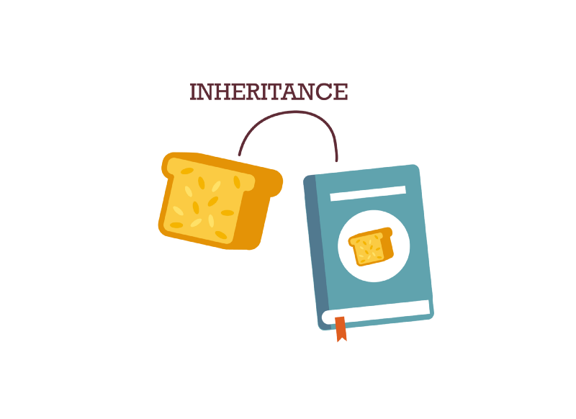
INHERITANCE
Inheritance lets one object acquire the properties and methods of another object.
Inheritance lets you create a new class by extending an existing class with additional properties and functions.
The new class “inherits” all of the features of its parent, avoiding the creation of new code from scratch.
Furthermore, any changes made to the parent class will automatically be available to the child class. This makes updates much easier.

Slide 9
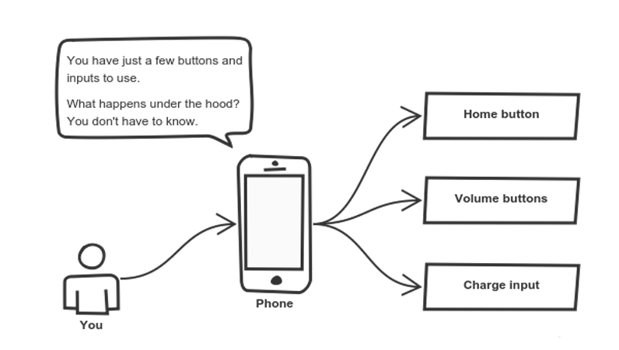
ABSTRACTION
Abstraction can be thought of as a natural extension of encapsulation.
Applying abstraction means that each object should only expose a high-level mechanism for using it.
This mechanism should hide internal implementation details. It should only reveal operations relevant for the other objects.

Slide 10
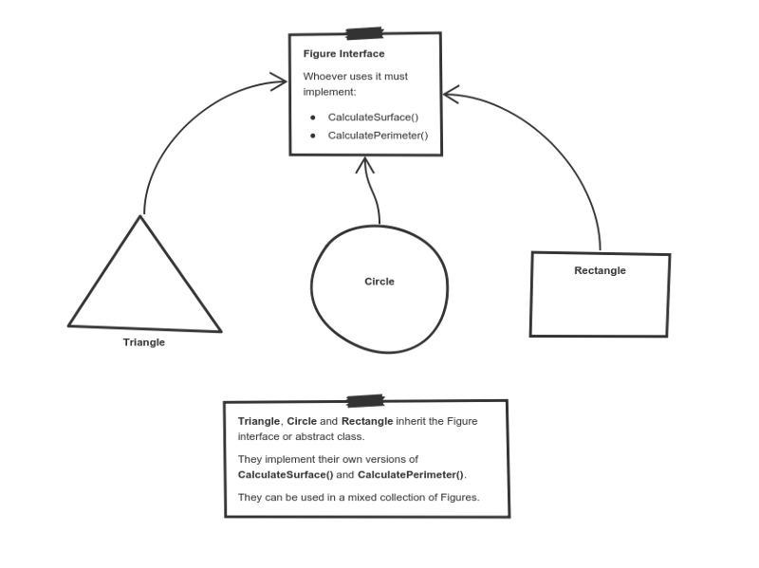
POLYMORPHYSM
Polymorphism gives a way to use a class exactly like its parent so there’s no confusion with mixing types. But each child class keeps its own methods as they are.

Slide 11
SUMMARY
Objects modeled on real-world things are the centerpiece of any OOP-based application.
Encapsulation protects data from uncontrolled access.
Objects have functions that operate on the data the objects contain.
Classes are the templates used to instantiate objects.
Inheritance is a powerful tool for avoiding redundancy.
OOP is more verbose but easier to read than other coding paradigms.
Since OOP came later in JavaScript’s development, you may come across older code that uses prototype or functional programming techniques.

Slide 12


