Slide 1
ANGULAR FORMS
Kyrylo Abramov

Slide 2
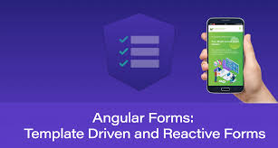
ANGULAR FORMS
Template driven
forms
Reactive forms

Slide 3
ANGULAR FORMS
Angular forms are used to handle user's input. We can use Angular form in our application to enable users to log in, to update profile, to enter information, and to perform many other data-entry tasks.
In Angular, there are 2 approaches to handle user's input through forms:
Reactive forms
Template-driven forms
Both approaches are used to collect user input events from the view, validate the user input, create a form model and data model to update, and provide a way to track changes.

Slide 4
REACTIVE FORMS
Reactive forms are more robust.
Reactive forms are more scalable, reusable, and testable.
They are most preferred to use if forms are a key part of your application, or your application is already built using reactive patterns. In both cases, reactive forms are best to use.

Slide 5
TEMPLATE DRIVEN FORMS
Template-driven forms are best if you want to add a simple form to your application. For example: email list signup form.
Template-driven forms are easy to use in the application but they are not as scalable as Reactive forms.
Template-driven forms are mainly used if your application's requires a very basic form and logic. It can easily be managed in a template.

Slide 6
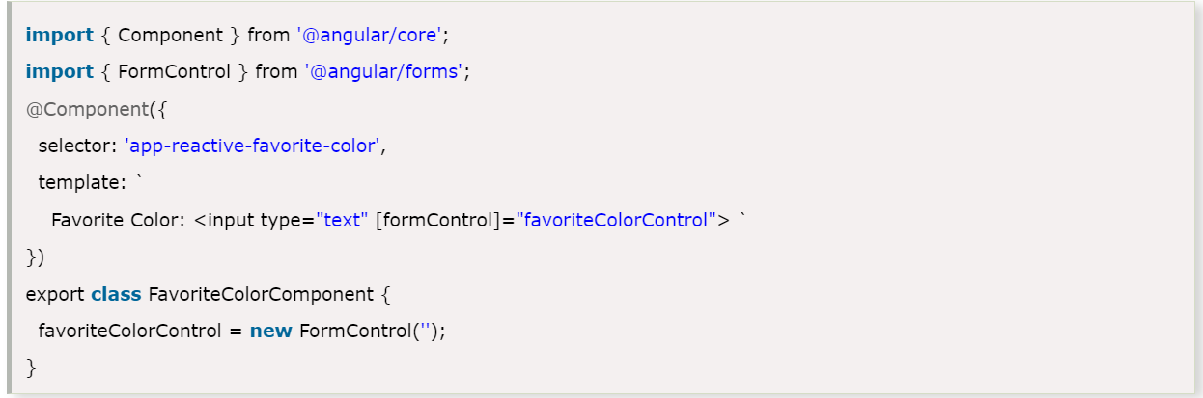
FORM MODEL SETUP REACTIVE
Form model setup is used to track value changes between Angular forms and form input elements. Let's take an example to see how the form model is defined and created.
In reactive forms, the form model is the source of truth. The source of truth provides the value and status of the form element at a given point in time.

Slide 7
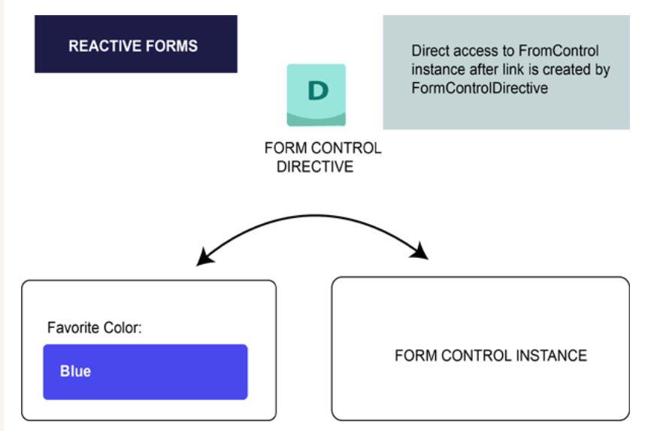
REACTIVE MODEL
In reactive forms, the form model is explicitly defined in component class. After that the reactive form directive (here, it is: FormControlDirective) links the existing FormControl instance to a specific form element in the view using a value accessor (ControlValueAccessor instance).

Slide 8
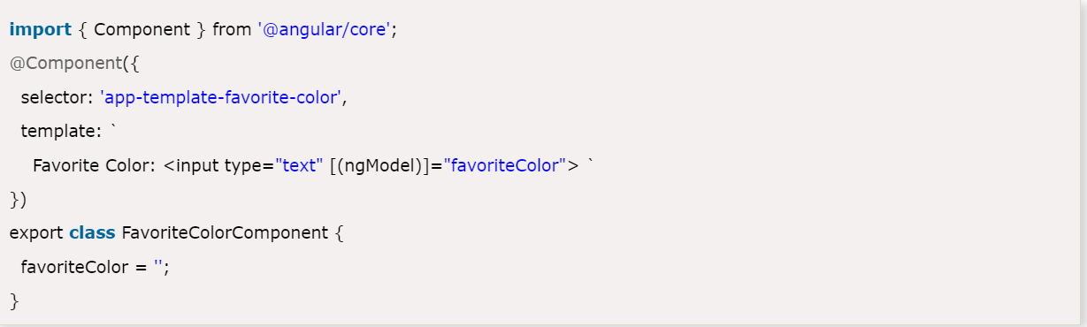
FORM MODEL SETUP TEMPLATE
In template-driven forms, the source of truth is template itself.

Slide 9
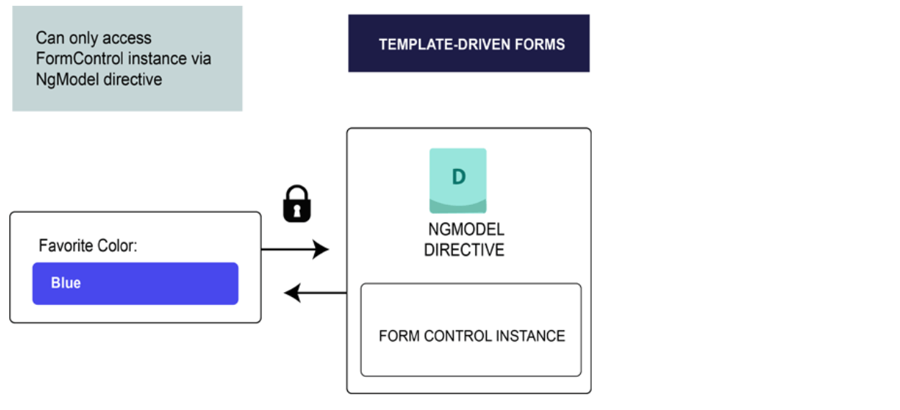
TEMPLATE MODEL
The form model abstraction promotes simplicity over structure. The template-driven form directive NgModel creates and manages the FormControl instance for a given form element. It's less explicit, but it removes the direct control over the form model.

Slide 10
SUMMARY
Reactive forms are more robust: they’re more scalable, reusable, and testable. If forms are a key part of your application, or you’re already using reactive patterns for building your application, use reactive forms.
Template-driven forms are useful for adding a simple form to an app, such as an email list signup form. They’re easy to add to an app, but they don’t scale as well as reactive forms. If you have very basic form requirements and logic that can be managed solely in the template, use template-driven forms.

Slide 11


