Slide 1
ANGULAR COMPONENT & DATA BINDING
Kyrylo Abramov

Slide 2

AGENDA
Angular component
Data binding

Slide 3
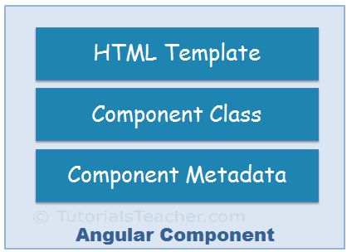
ANGULAR COMPONENT
Angular Component = HTML Template + Component Class + Component Metadata

Slide 4
ANGULAR COMPONENT
HTML template is a regular HTML code with additional Angular specific syntax to communicate with the component class.
Class is a TypeScript class that includes properties and methods. Properties store data and methods include the logic for the component. Eventually, this class will be compiled into JavaScript.
Metadata is some extra data for a component used by Angular API to execute the component, such as the location of HTML and CSS files of the component, selector, providers, etc.

Slide 5
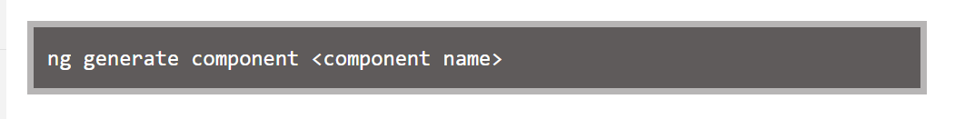
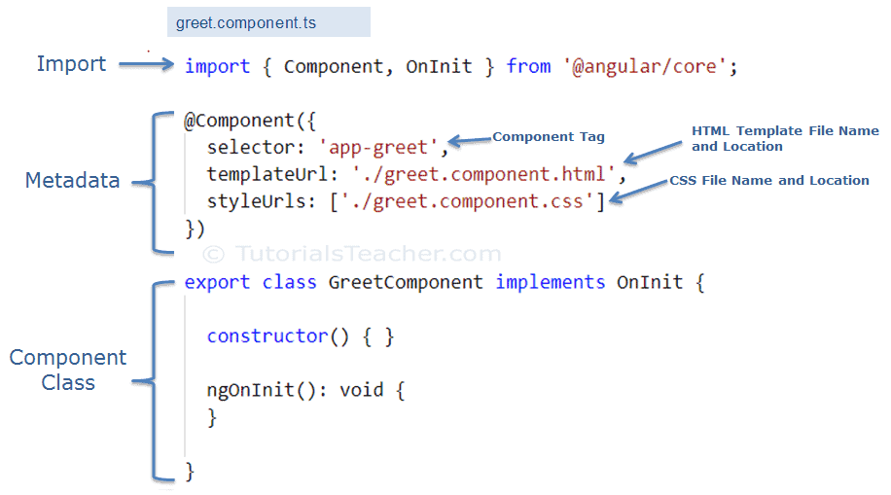
ANGULAR COMPONENT
Generate Angular Component using Angular CLI

Slide 6
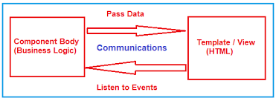
ANGULAR DATA BINDING
Data binding is one of the most important concepts in a JS framework.
Data binding is the reflection of logic or variable in a model to the view of an app.
Whenever the variable changes the view must update the DOM to reflect the new changes.

Slide 7
ANGULAR DATA BINDING
Data binding involves the concept of defining the communication between a component and its respective views.
There are about four types of data binding available in Angular:
Event binding: This data binding type is when information flows from the view to the component when an event is triggered.
Two-way data binding: is a mechanism where data flows both ways from the component to the view and back.
Interpolation: text representing variables in components are placed in between double curly braces in the template.
Property binding: Property binding is a one-way mechanism that lets you set the property of a view element.

Slide 8
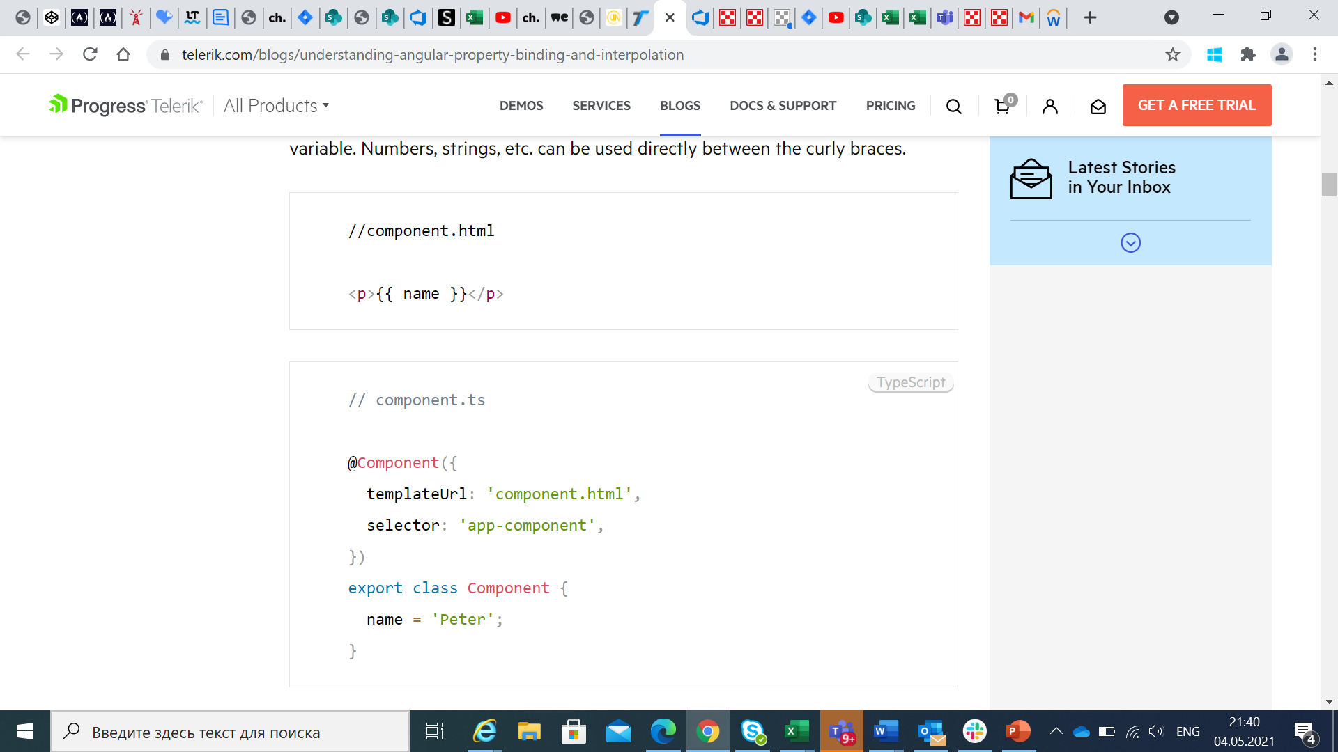
INTERPOLATION
In the technique, text representing variables in components are placed in between double curly braces in the template. Angular finds the variable matching the text in the component and replaces the text with the value assigned to the variable. Numbers, strings, etc. can be used directly between the curly braces.

Slide 9
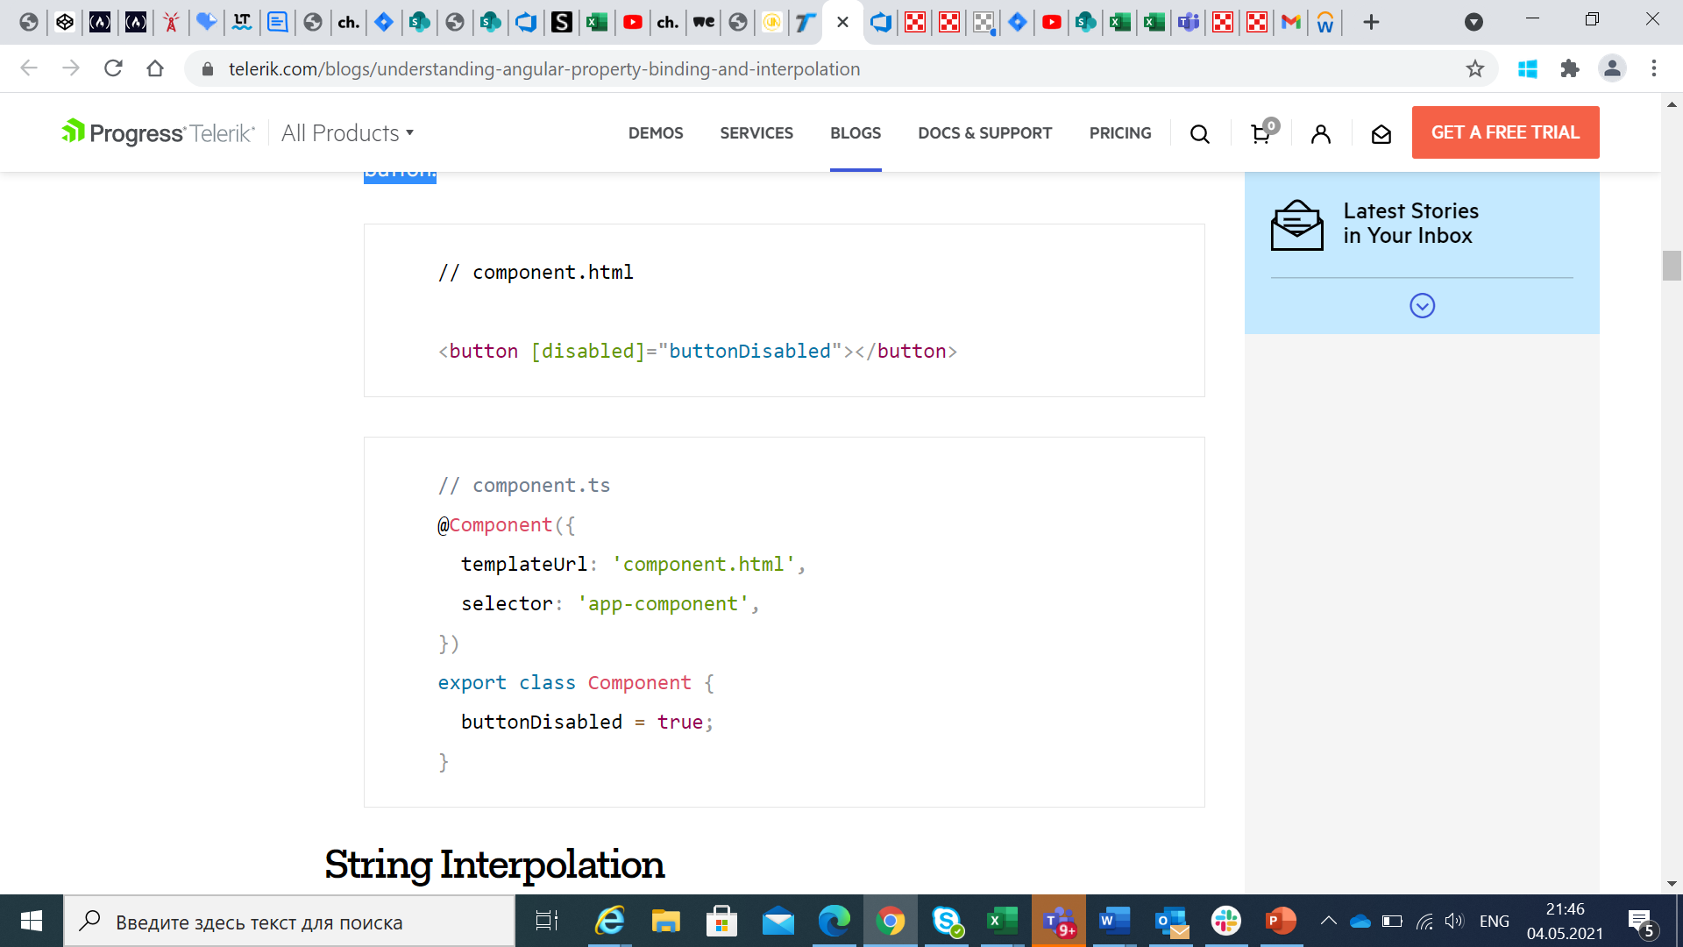
PROPERTY BINDING
Property binding is a one-way mechanism that lets you set the property of a view element. It involves updating the value of a property in the component and binding it to an element in the view template. Property binding uses the [ ] syntax for data binding. An example is setting the disabled state of a button.

Slide 10
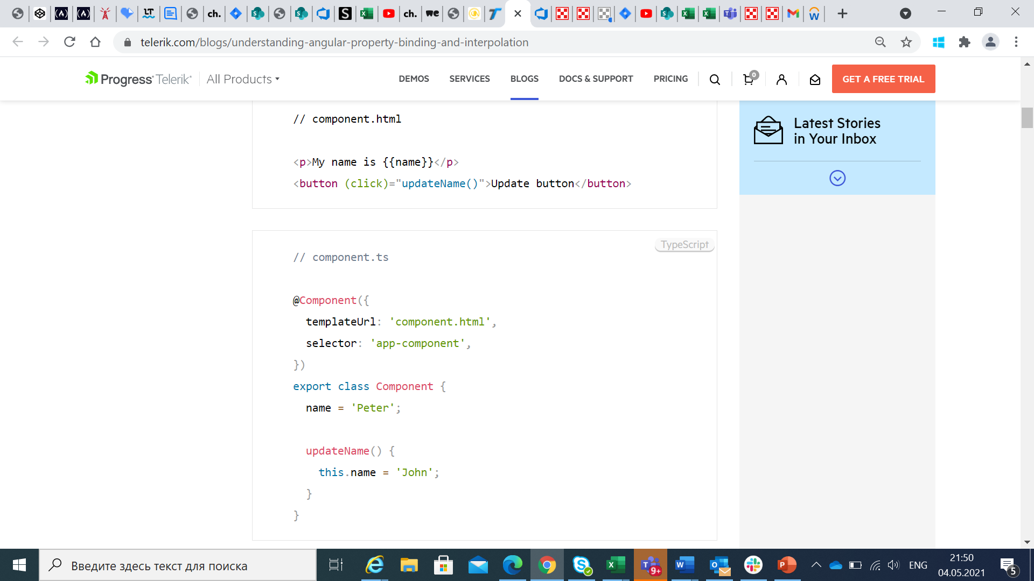
EVENT BINDING
This data binding type is when information flows from the view to the component when an event is triggered. The view sends the data from an event like the click of a button to be used to update the component. It is the exact opposite of property binding, where the data goes from the component to the view.

Slide 11
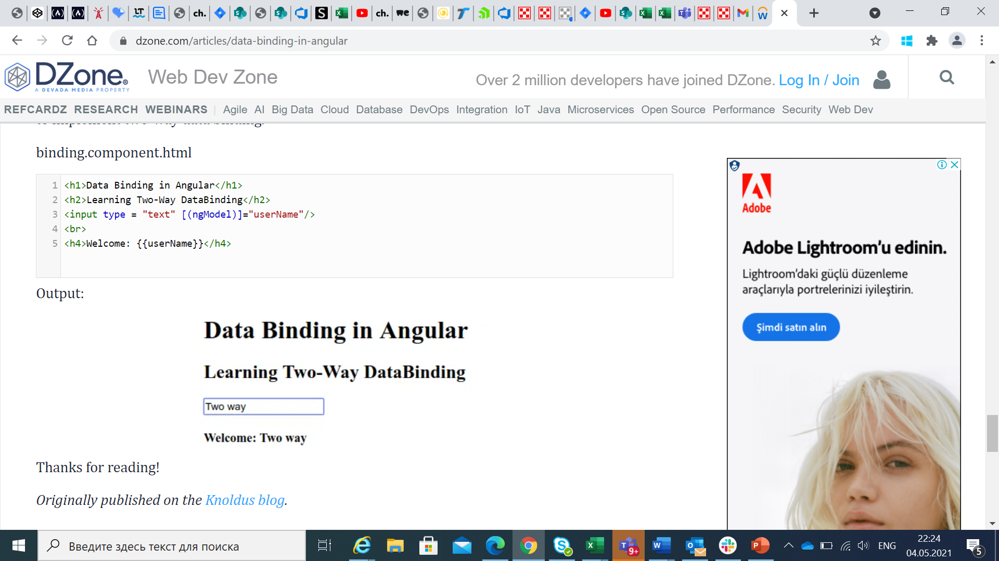
TWO-WAY BINDING
Two-way binding is a mechanism where data flows both ways from the component to the view and back. The component and view are always in sync, and changes made on either end are immediately updated both ways. Two-way binding is commonly used when dealing with forms where the user input is used to update the component’s state and vice versa.
Angular uses the combination of Property binding and event binding to implement two-way data binding with the help of the ngModel directive.

Slide 12


