Slide 1
WEB APPLICATION ARCHITECTURE HTTP PROTOCOL
Kyrylo Abramov

Slide 2
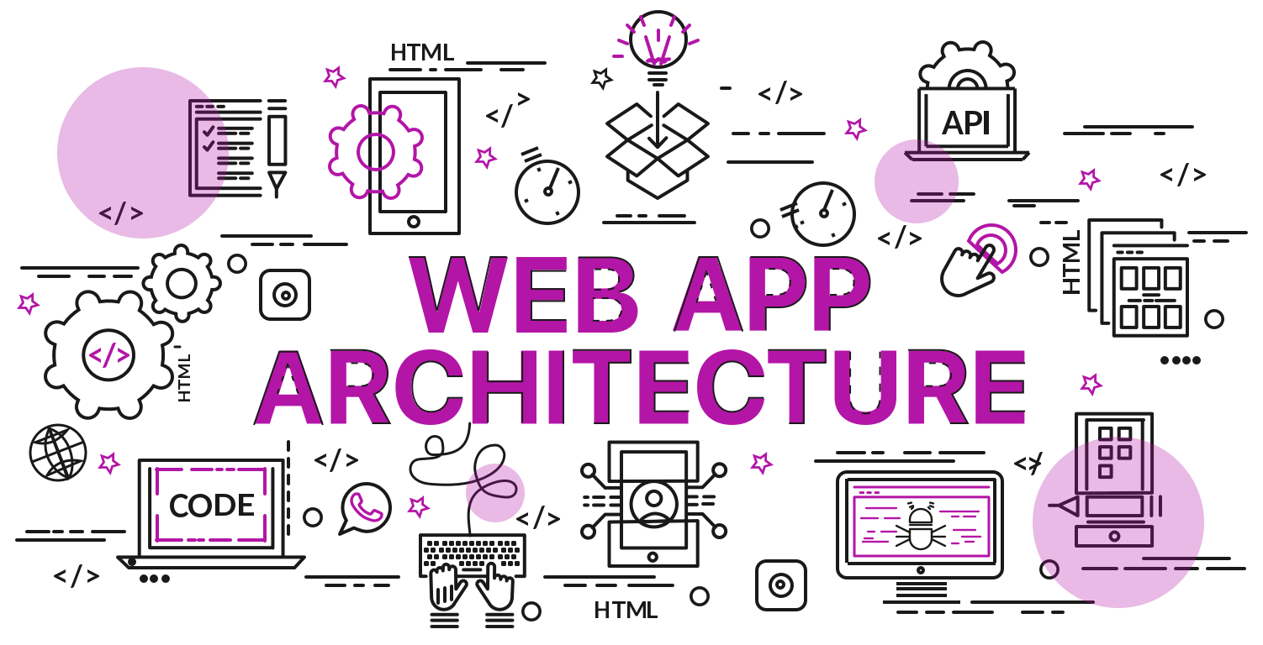
WEB APP ARCHITECTURE
What is WAA
How it works
Models, Components,
Types

Slide 3
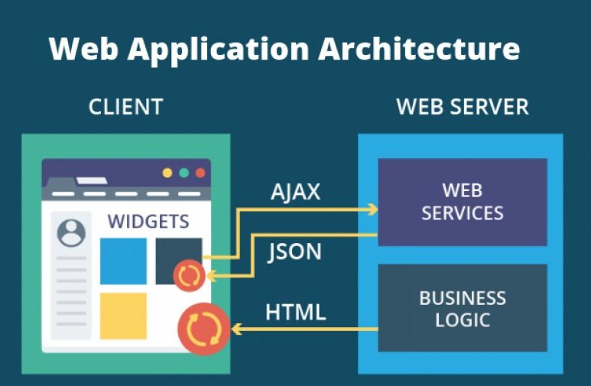
WHAT IS WAA
Web application is a system that runs on a web server that hosts a series of pages or documents which are linked and accessible to users through a web browser that is the web client.
The web application architecture describes the interactions between applications, databases, and middleware systems on the web. It ensures that multiple applications work simultaneously.

Slide 4
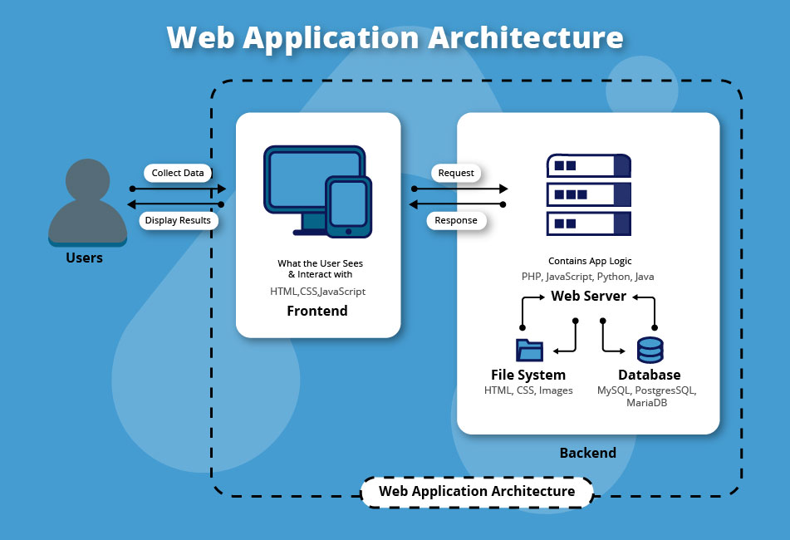
HOW IT WORKS?
As soon as the user hits the go button after typing a URL in the address bar of a web browser, it requests for that particular web address.
The server sends files to the browser as a response to the request made.
The browser then executes those files to show the requested page.
Finally, the user is able to interact with the website. The most important thing to note here is the code parsed by the web browser.

Slide 5
HOW IT WORKS?
Client-side Code - The code that is in the browser and responds to some user input.
A combination of CSS, HTML, and JavaScript is used for writing the client-side code. This code is parsed by the web browser. Unlike the server-side code, client-side code can be seen as well as modified by the user. It reacts to user input.
The client-side code communicates only via HTTP requests and is not able to read files off a server directly.
Server-side Code - The code that is on the server and responds to the HTTP requests.
The server-side code is responsible for creating the page that the user requested as well as storing different types of data, including user profiles and user input. It is never seen by the end-user.
For writing server-side code: C#, Java, JavaScript, Python, PHP, Ruby, etc. are used.

Slide 6
WEB APPLICATION COMPONENTS
UI/UX Web Application Components – This includes activity logs, dashboards, notifications, settings, statistics, etc. These components have nothing to do with the operation of a web application architecture. Instead, they are part of the interface layout plan of a web app.
Structural Components – The two major structural components of a web app are client and server sides.
Client Component - The client component is developed in CSS, HTML, and JS. As it exists within the user’s web browser, there is no need for operating system or device-related adjustments. The client component is a representation of a web application’s functionality that the end-user interacts with.
Server Component - The server component can be build using one or a combination of several programming languages and frameworks, including Java, .Net, NodeJS, PHP, Python, and Ruby on Rails. The server component has at least two parts; app logic and database. The former is the main control center of the web application while the latter is where all the persistent data is stored.

Slide 7
MODELS OF WEB APPLICATION COMPONENTS
1. One Web Server, One Database
It is the most simple as well as the least reliable web app component model. Such a model uses a single server as well as a single database. A web app builds on such a model will go down as soon as the server goes down. Is not typically used for real web applications. It is mostly used for running test projects as well as with the intent of learning and understanding the fundamentals of the web application.
2. Multiple Web Servers, One Database (At a Machine Rather than the Web server)
The idea with this type of web application component model is that the webserver doesn’t store any data. When the webserver gets information from a client, it processes the same and then writes it to the database, which is managed outside of the server. This is sometimes also referred to as a stateless architecture.
3. Multiple Web Server, Multiple Databases
It is the most efficient web application component model because neither the webservers nor the databases have a single point of failure. There are two options for this type of model. Either to store identical data in all the employed databases or distribute it evenly among them.

Slide 8
Types of Web Application Architecture
Single-Page Applications (SPAs) – Instead of loading completely new pages from the server each time for a user action, single page web applications allows for a dynamic interaction by means of providing updated content to the current page.
Microservices – These are small and lightweight services that execute a single functionality. The Microservices Architecture framework has a number of advantages that allows developers to not only enhance productivity but also speed up the entire deployment process. The components using the Microservices Architecture aren’t directly dependent on each other. As such, they don’t necessitate to be built using the same programming language.
Serverless Architectures – In this type of web application architecture, an application developer consults a third-party cloud infrastructure services provider for outsourcing server as well as infrastructure management.

Slide 9
WEB APP MUST:
Avoid frequent crashes
Be able to scale up or down easily
Be simple to use
Have a faster response time
Have automated deployments
Log errors
Not have a single point of failure
Solve the query in a consistent and uniform manner
Support the latest standards and technologies
Utilize strengthened security measures to lessen the chance of malicious intrusions

Slide 10
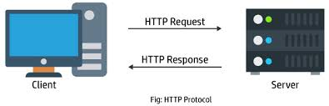
HTTP PROTOCOL
What is HTTP
How it works
Versions & Methods

Slide 11
HTTP PROTOCOL
HTTP is a protocol which allows the fetching of resources, such as HTML documents.
It is the foundation of any data exchange on the Web and it is a client-server protocol, which means requests are initiated by the recipient, usually the Web browser.
A complete document is reconstructed from the different sub-documents fetched, for instance text, layout description, images, videos, scripts, and more.
Every HTTP interaction includes a request and a response.

Slide 12
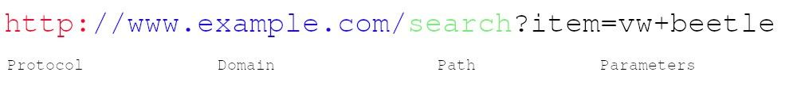
URL
The URL (Uniform Resource Locator) is probably the most known concept of the Web. A URL is a web address used to identify resources on the Web.
Protocol — Most often they are HTTP (or HTTPS for a secure version of HTTP).
Domain — Name that is used to identify one or more IP addresses where the resource is located.
Path —Specifies the resource location on the server.
Parameters — Additional data used to identify or filter the resource on the server.

Slide 13
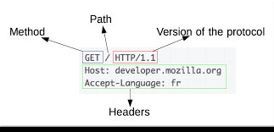
HTTP REQUEST
Example: GET /adds/search-result?item=vw+beetle HTTP/1.1
The first part is a method which tells which HTTP method is used. Most commonly used is the GET method. GET method retrieves a resource from the web server and since GET doesn’t have a message body nothing after the header is needed.
The second part is a requested URL.
The third part is a HTTP version being used. Version 1.1. is the most common version for most browsers, however, version 2.0 is taking over.

Slide 14
HTTP RESPONSE
Example:
HTTP/1.1 200 OK
The first part is the HTTP version being used.
The second part is the numeric code of the result for the request.
The third part is a textual description of the second part.

Slide 15
HTTP METHODS
GET
PUT
POST
DELETE
READ
UPDATE
CREATE
DELETE
actions

Slide 16
HTTP METHODS
GET - method to request data from a specified resource where data is not modified it in any way
PUT - method to update the existing resource on a server
POST - method to send data to a server to create a resource
DELETE - method to delete the specified resource
HEAD - You use the HEAD method to check whether the resource is present
TRACE - method for diagnostic purposes
PATCH - method to apply partial modifications to a resource

Slide 17
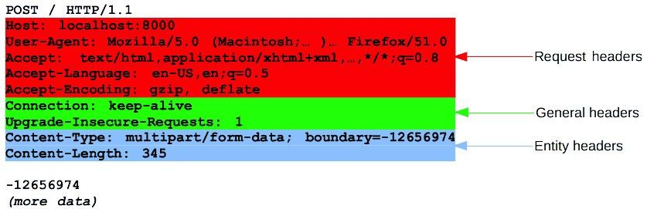
HTTP HEADERS
General header — Headers that can be used in both requests and response messages and that are independent of the data being exchanged.
Request header — These headers define parameters for the data requested or parameters that give important information about the client making the request.
Response header — These headers contain information about the incoming response.
Entity header — The entity headers describe the content that makes up the body of the message.

Slide 18
HTTP STATUS CODES
1xx — Informational.
2xx — The request was successful.
3xx — The client is redirected to a different resource.
4xx — The request contains an error of some kind.
5xx — The server encountered an error fulfilling the request.

Slide 19
HTTPS (secure)
HTTPS provides encrypted communication between a browser (client) and the website (server).
In HTTPS, the communication protocol is encrypted using Transport Layer Security (TLS) or Secure Sockets Layer (SSL).
Benefits HTTPS:
Customer information, like credit card numbers and other sensitive information, is encrypted and cannot be intercepted.
Visitors can verify you are a registered business and that you own the domain.
Customers know they are not suppose to visit sites without HTTPS, and therefore, they are more likely to trust and complete purchases from sites that use HTTPS.

Slide 20


