Slide 1



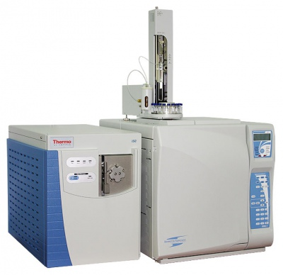
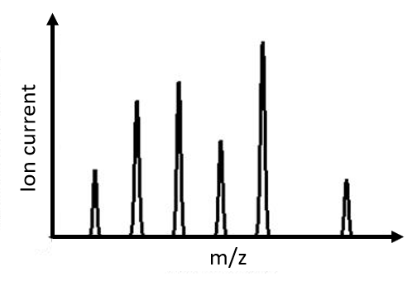


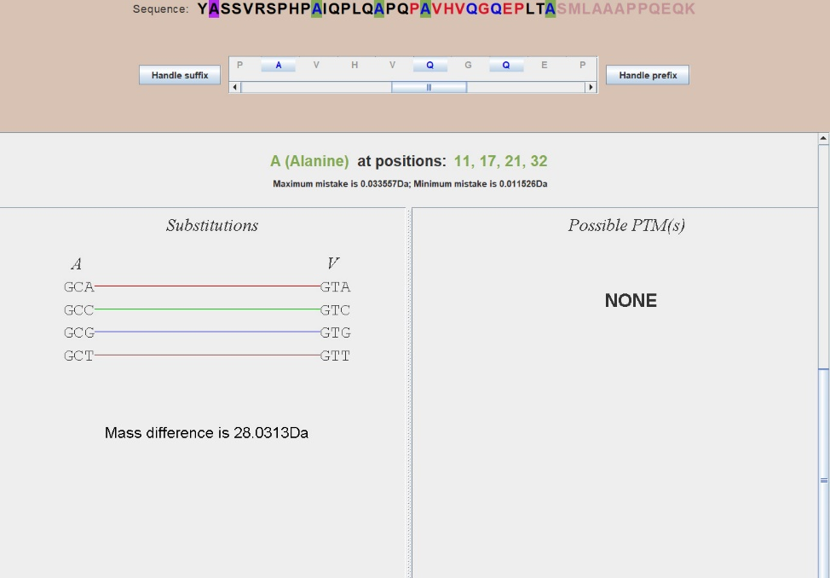
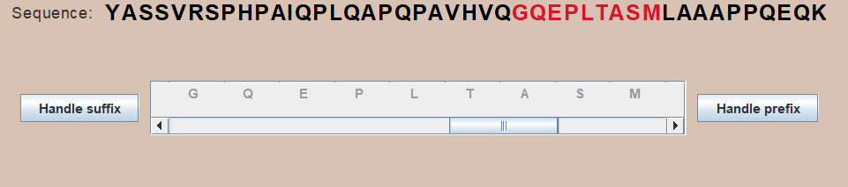
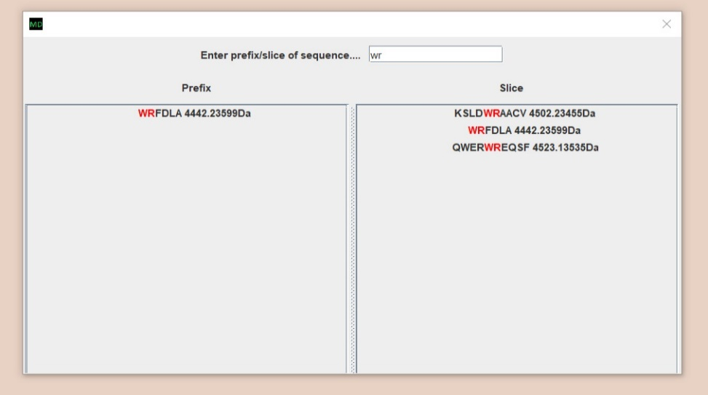
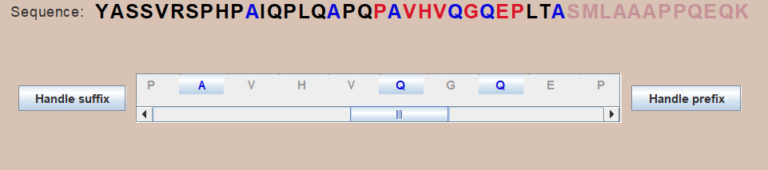
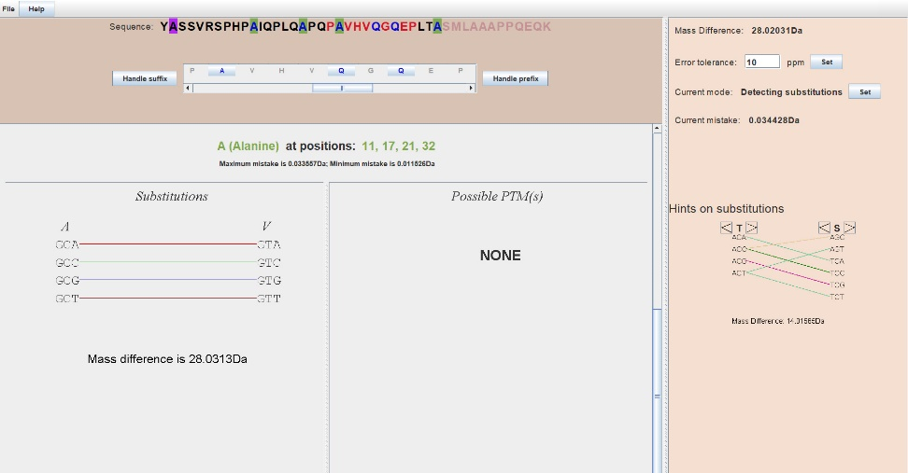





MutationDetector ®.
Software tool for detecting amino acid substitutions
Student: Brilliantov K., St. Petersburg Academic Lyceum Physical Technical High School, Russia
Supervisor: Vyatkina K., St. Petersburg Academic University, Russia
Introduction
Proteins and Peptides
Single nucleotide polymorphism (SNP)
Post translational modifications (PTMs)
Ser
V
N
N
N
A
 | Wild type | Variant type (A->T)
DNA strand | ACC AAA CCG AGT | ACC ATA CCG AGT
mRNA | UGG UUU GGC UCA | UGG UAU GGC UCA
Protein | -Trp-Phe-Gly-Ser- | -Trp-Tyr-Gly-Ser-
Ser
Ser
$$CH_{3}$$
V
Gly
A
S
V
S
G
G
Gly
Gly
A
S
Cys
Cys
Cys
G
C
C
Cys
C
$$CH_{3}Cl$$
$$HCl$$
Proteins
Peptides
Amino acids
$${{∆M= M}_{variant type} −M}_{wild type}= M_{Tyr} − M_{Phe}$$
$$∆M= M_{radical}$$
Possible modifications
Problem statement
The Goal
Gly
Ser
Lys
Cys
To develop a software tool for analysing data, obtained from modified peptide
Ser
peptide
Cys
The investigated
peptide
Mass - spectrometer
Mass spectrum
$$CH_{3}$$
The sub-tasks
Read file .pep
The allocation of positions in peptide, where any modifications could happen
Lys
Ser
Lys
Cys
Ser
Gly
Cys
quantity
Ser
substitution
PTM
Interface
File .pep
m
Mass spectrum
Methodology
Programming tools
Interface
SWING
1. “File” tab
3. Sequence and scrollable panel
5. Information about substitutions
Input and Output
A C C A A A C C G A G T
2. Searching for peptides
4. Highlighted positions
and
File .pep
YASSVRSPHPAIQPLQAPQPAVHVQ
Prefix selected
Possible modifications:
at position 16: A->V
at position 20: A->V
at position 24: Q->R
File .pepout
Results and conclusions
References
General view of an application
Testing
First peptide YASSVRSPHPAIQPLQAPQPAVHVQGQEPLTASMLAAAPPQEQK
In this peptide A>>V and Q>>R occurred (in the prefix).
Second peptide
EAATQEDPEQVPELAAHEVSASEAEERPVAEEEILL
In this peptide A>>V occurred (in the suffix)
B. Lewin. Cells. БИНОМ Russia, 2011. 951 с.
S. Nie, H. Yin, Z. Tan, M. A. Anderson, M. T. Ruffin, D. M. Simeone, D. M. Lubman. Quantitative Analysis of Single Amino Acid Variant Peptides Associated with Pancreatic Cancer in Serum by an Isobaric Labeling Quantitative Method. J Proteome Res. 2014, 13(12):6058–6066.
K. Vyatkina, S. Wu, L. J. M. Dekker, M. M. VanDuijn, X. Liu, N. Tolic, M. Dvorkin, S. Alexandrova, T. M. Luider, L. Pasa-Tolic, P. A. Pevzner. De Novo Sequencing of Peptides from Top-Down Tandem Mass Spectra. J Proteome Res. 2015, 14(11):4450-4462.
Qisheng Peng, Zijian Wang, Donglin Wu, Xiaoou Li, Xiaofeng Liu, Wanchun Sun, Ning Liu. Identification of single amino acid substitutions (SAAS) in neuraminidase from influenza a virus (H1N1) via mass spectrometry analysis coupled with de novo peptide sequencing.
Rapid Commun. Mass Spectrom. 2016
Conclusion
During this work, the software tool for analyzing data obtained from modified peptide has been developed. It has been tested, it works correctly.
In the future, we intend to extend the functionality of MutationDetector in various ways thereby adapting it to solving special problems.
Additional functionality
Tab help
Hot keys
Hints on substitutions

