Slide 1



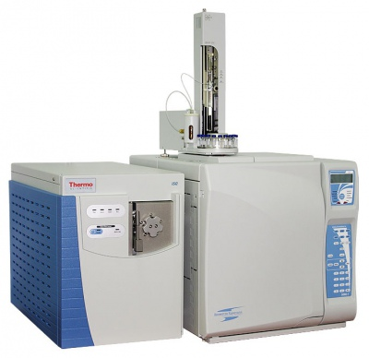
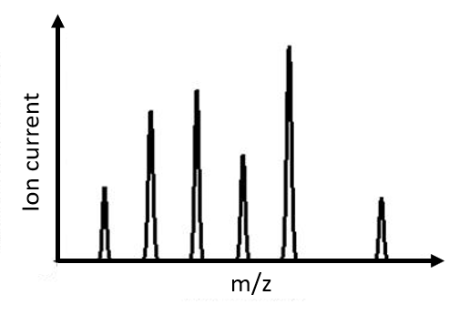

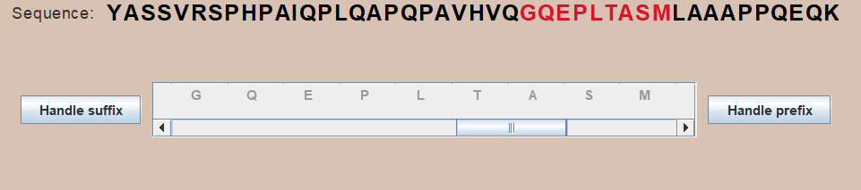
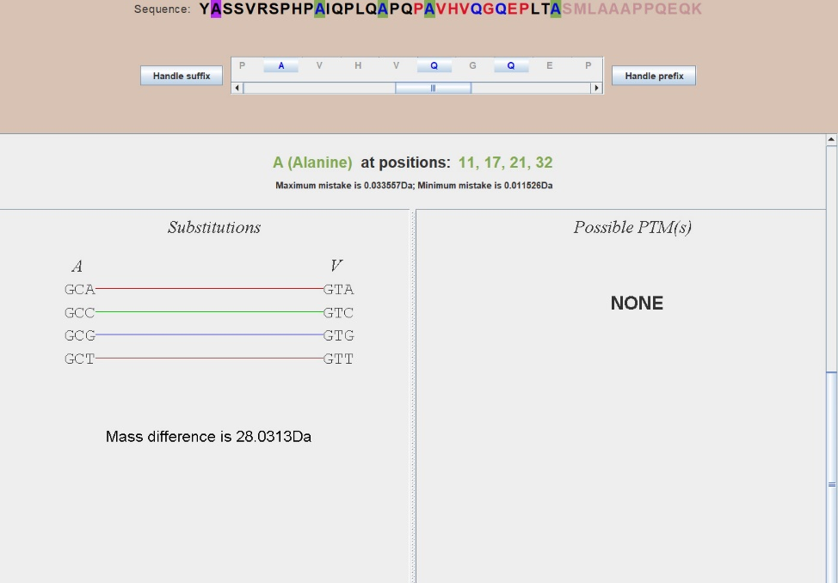
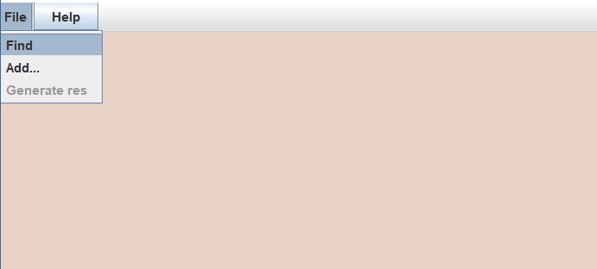
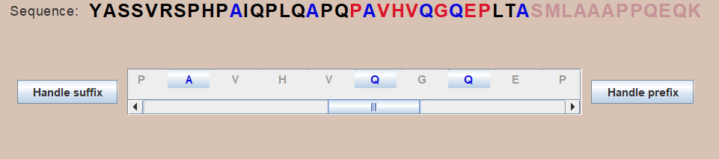
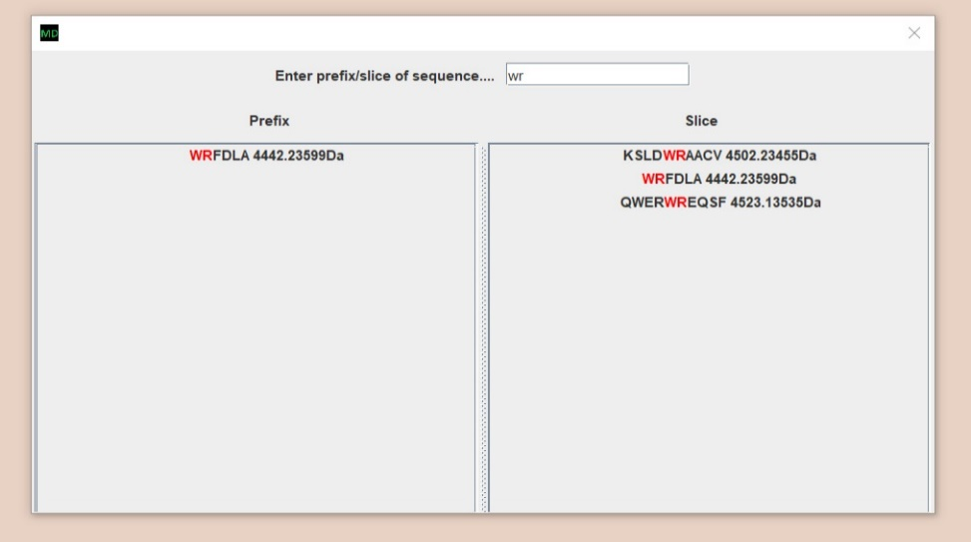
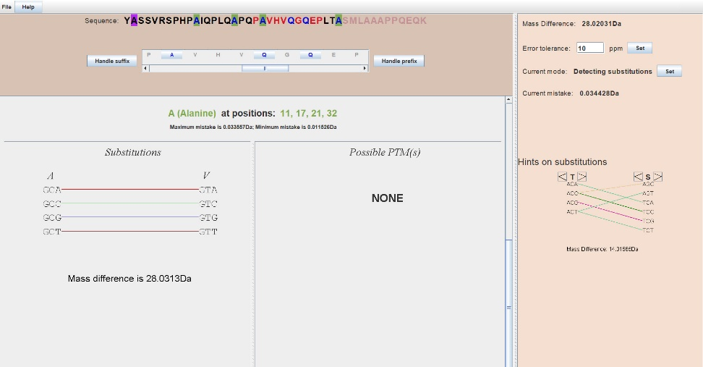

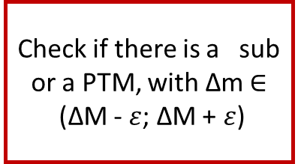


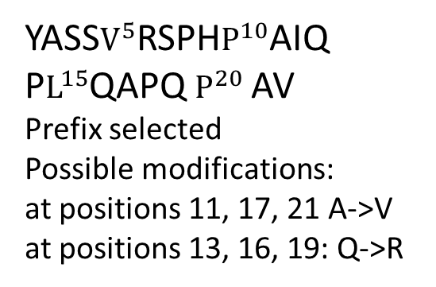



MutationDetector ®.
Software tool for detecting amino acid substitutions
Student: Brilliantov K., St. Petersburg Academic Lyceum Physical Technical High School, Russia
Supervisor: Vyatkina K., St. Petersburg Academic University, Russia
Introduction
Proteins and Peptides
Single nucleotide polymorphism (SNP)
Post translational modifications (PTMs)
Ser
V
N
N
N
A
 | Wild type | Variant type (A->T)
DNA strand | ACC AAA CCG AGT | ACC ATA CCG AGT
mRNA | UGG UUU GGC UCA | UGG UAU GGC UCA
Protein | -Trp-Phe-Gly-Ser- | -Trp-Tyr-Gly-Ser-
Since three consequent nucleotides in a DNA strand, together forming a codon, encode an amino acid, SNP can lead to an
amino acid substitution, thereby implying a change of the mass of the protein.
Ser
Ser
$$CH_{3}$$
V
Gly
A
S
V
S
G
G
Gly
Gly
A
S
Cys
Cys
Cys
G
C
C
Cys
C
$${{∆M= M}_{variant type} −M}_{wild type}= M_{Tyr} − M_{Phe}$$
$$CH_{3}∙$$
$$H∙$$
Proteins
Peptides
Amino acids
$$∆M= M_{radical}$$
>50
amino acids
2 – 50
amino acids
Possible modifications
Problem statement
The Goal
Gly
Ser
Lys
Cys
To develop a software tool for analysing data, obtained from modified peptide
Ser
peptide
Cys
The investigated
peptide
Mass - spectrometer
Mass spectrum
$$CH_{3}$$
The sub-tasks
Learn how to read file .pep
Learn how to find positions in the peptide where a substitution or a PTM could occur
Lys
Ser
Lys
Cys
Ser
Gly
Cys
quantity
Ser
substitution
PTM
Interface
File .pep
m
Mass spectrum
Methodology
the peptides which just contain this fragment appears on the right part.
6. Information about substitutions
Programming tools
Interface
3. Sequence and scrollable panel
1. “File” tab
SWING
Input
When user clicks on some of the peptides which were in that window, the main frame appears. In the top there is a chosen sequence of amino acids. Just below there is a scrollable panel. There are buttons symbolizing amino acids.
The developed interface as an input takes a .pep file. You can see an example of such file.
YASSVRSPHPAIQPLQAPQPAVHVQGQEPLTASMLAAAPP SMLA prefix 4653.40152Da
In the top right corner there is a pull-down menu. There are three items: Find, Add, Generate res. Item “Find” allows user to search for peptides. Add allows user to add .pep files. “Generate res” allows user to generate .pepout files
File .pep
4. Highlighted positions
When a user clicks on one of the “A”s in the top sequence, first of these “A”s appears on the purple background since the remaining appear on pale green background, because first “A” does not fit the conditions since the mistake is not enough big (mass of prefix is not big enough).
The substitution which could occur in those positions is A >> V some of the codons (encoding these amino acids) are connected with colorful lines. They are connected because the only difference between them is one nucleotide. For example, codon GCA encode A, GTA encode V, the difference between them is that on the second position there are different nucleotides. If SNP in which nucleotide C substitutes with nucleotide T occurs, a substitution A>>V occurs.
Output
2. Searching for peptides
The developed program gives to user as an output: first, the peptide with a highlighted positions, secondly, a .pepout file. You can see an example of this file.
V Q S S S A R C V N G N
Also there are buttons “Handle prefix” and “Handle suffix”. When a user clicks on some of these buttons, user can then click on one of the amino acids (buttons in the scrollable panel). After that the algorithm begins.
- PTM
- both
- substitution
YASS$V^{5}$RSPH$P^{10}$AIQ
P$L^{15}$QAPQ $P^{20}$AV
Prefix selected
Possible modifications:
at positions 11, 17, 21 A->V
at positions 13, 16, 19: Q->R
If a user clicks a “find” item, the dialog window appears. Then when user inputs Some sequence of the amino acids, the peptides where this fragment is a suffix appears on the left part of this window and,
5. The algorithm
For each position in the suffix or in the prefix
File .pepout
Count the error
If prefix: $ε= \frac{M_{i}∗ppm}{{10}^{6}}$
if suffix $ε$ $=M_{0}+ \frac{M_{i}∗ppm}{{10}^{6}}$
Check if there is a sub or a PTM, with ∆m $∈$
(∆M - $ε$; ∆M + $ε$)
Results and conclusions
References
General view of an application
Testing
B. Lewin. Cells. БИНОМ Russia, 2011. 951 с.
S. Nie, H. Yin, Z. Tan, M. A. Anderson, M. T. Ruffin, D. M. Simeone, D. M. Lubman. Quantitative Analysis of Single Amino Acid Variant Peptides Associated with Pancreatic Cancer in Serum by an Isobaric Labeling Quantitative Method. J Proteome Res. 2014, 13(12):6058–6066.
K. Vyatkina, S. Wu, L. J. M. Dekker, M. M. VanDuijn, X. Liu, N. Tolic, M. Dvorkin, S. Alexandrova, T. M. Luider, L. Pasa-Tolic, P. A. Pevzner. De Novo Sequencing of Peptides from Top-Down Tandem Mass Spectra. J Proteome Res. 2015, 14(11):4450-4462.
Qisheng Peng, Zijian Wang, Donglin Wu, Xiaoou Li, Xiaofeng Liu, Wanchun Sun, Ning Liu. Identification of single amino acid substitutions (SAAS) in neuraminidase from influenza a virus (H1N1) via mass spectrometry analysis coupled with de novo peptide sequencing.
Rapid Commun. Mass Spectrom. 2016
First peptide YASSVRSPHPAIQPLQAPQPAVHVQGQEPLTASMLAAAPPQEQK
In this peptide A>>V and Q>>R occurred (in the prefix).
Second peptide
EAATQEDPEQVPELAAHEVSASEAEERPVAEEEILL
In this peptide A>>V occurred (in the suffix)
Conclusion
Additional functionality
During this work, the software tool for analyzing data obtained from modified peptide has been developed. It has been tested, it works correctly.
In the future, we intend to extend the functionality of MutationDetector in various ways thereby adapting it to solving special problems.
Tab help
Hot keys
Hints on substitutions

