Slide 1


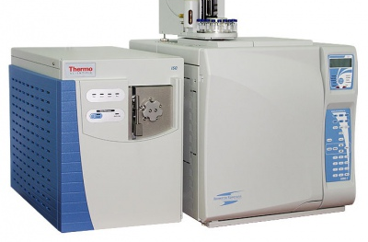
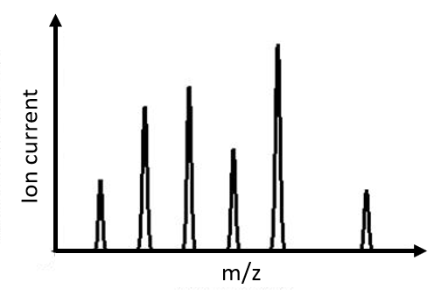
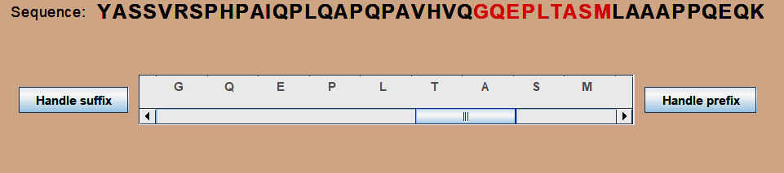
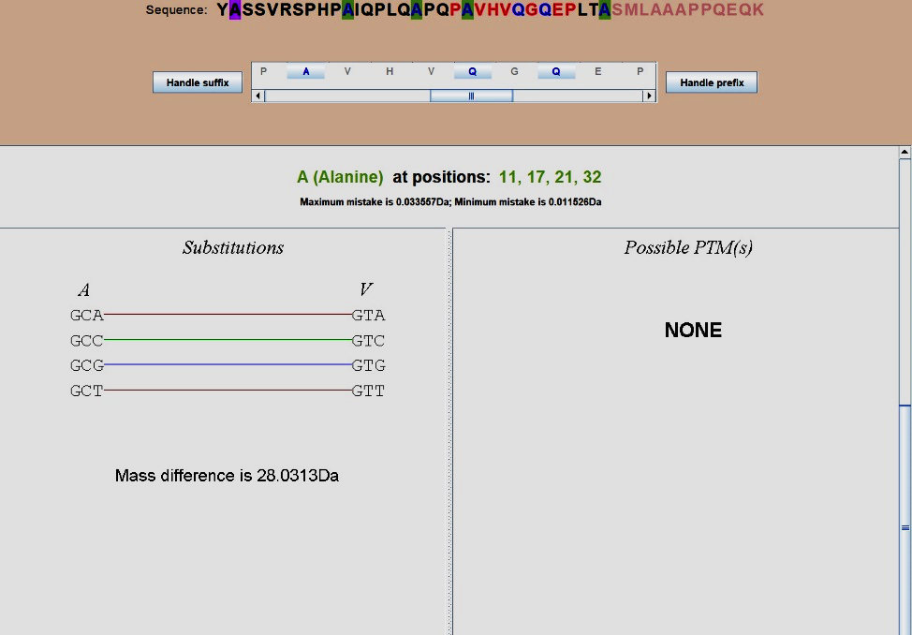
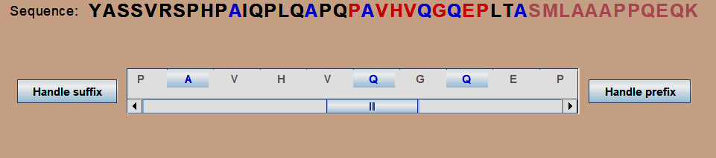
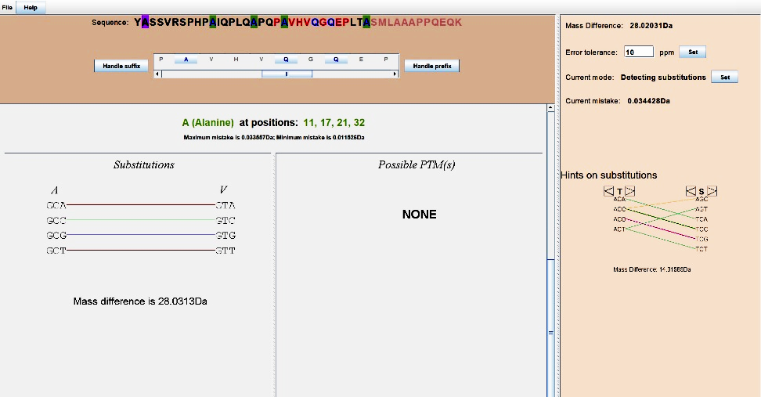









MutationDetector ®.
Software tool for detecting amino acid substitutions
Student: Brilliantov K., St. Petersburg Academic Lyceum Physical Technical High School, Russia
Supervisor: Vyatkina K., St. Petersburg Academic University, Russia
Introduction
Motivation
Proteins play an essential role in our lives, because they are regulating sub-cellar . If any disruption occurs, a protein will cease acting properly and may cause severe diseases. Many factors can result in such disruptions. We consider the most important of those – a single nucleotide polymorphism (SNP). Having learned to find positions in a protein sequence where the substitution might occur, we would get a possibility to identify the so-called variant proteins, which can be biomarkers for a variety of serious .
Single nucleotide polymorphism (SNP)
Post translational modifications (PTMs)
Possible modifications
Ser
Ser
$$CH_{3}$$
Ser
SNP is a substitution of a nucleotide in a DNA strand. Since codons encode amino acids, a SNP can lead to a substitution of an amino acid
 | Wild type | Variant type (A->T)
DNA strand | ACC AAA CCG AGT | ACC ATA CCG AGT
mRNA | UGG UUU GGC UCA | UGG UAU GGC UCA
Protein | -Trp-Phe-Gly-Ser- | -Trp-Tyr-Gly-Ser-
PTM is a change of
amino acid’s chemical composition through adherence of some
chemical radicals.
(ex. the mass of methionine increases by approximately 14Da upon methylation)
Gly
$$CH_{3}$$
Gly
Cys
Gly
Cys
$$CH_{3}∙$$
Cys
Ser
Peptide
Ser
$$H∙$$
$$CH_{3}$$
$${{∆M= M}_{variant type} −M}_{wild type}= M_{Tyr} − M_{Phe}$$
$$∆M= M_{radical}$$
Lys
Gly
Cys
Cys
Substitution
PTM
Problem statement
Two different methods are used to analyse such peptides. The first one is qualitative and the second one is quantitative. Our work was concentrated on qualitative analyses. Here is the scheme of such analyses
Ser
Lys
quantity
The Goal
Cys
Mass - spectrometer
Mass spectrum
m
To develop a software tool for analyses of the data, obtained from modified peptide
The peptide
File .pep
Interface
The sub-tasks
Learn how to read file .pep
Learn how to find positions in the peptide where a substitution or a PTM could occur
Learn how to generate a result file
The dissolved peptide is being bombarded with charged particles, so ideally each molecule divides in two parts.
After that, these fragments go through a mass - spectrometer and this device gives us the mass spectrum.
Mass spectrum is a histogram, where X – axis is a mass of an ionized fragment, Y-axis is the ion current. Accordingly, this graph is a set of peaks. Based on this set we can establish the amino acid’s sequence of the investigated peptide. Then we can generate a file with the help of an algorithm called Twister.
The file contains information about the investigated peptide:
the amino acid sequence, the fragment which was not modified and
the mass difference
Analyzing it manually is inconvenient. So, the idea to develop a software tool for the analyses of such data arises.
Methodology
The algorithm scheme
The software tool
Input
The proposed algorithm was implemented in a software tool MutationDetector, in the Java programming language using the Swing library. MutationDetector takes as input a file containing a mass spectrum acquired from a putative variant peptide, and the respective wild-type sequence.
Structure of .pep file
General | Example
<peptide> | …LTASMLAA…
<fragment which has not been modified> | SMLA
<Prefix/Suffix> | Prefix
<experimental mass of this peptide> | 4653.40152 Da
1. Scrollable panel and sequence
the smaller the error. So, in the beginning the error is not big enough.
4. Output
1
2
3. Information about substitutions
The developed program gives the user the following output:
the peptide with highlighted positions and a .pepout file.
3.1
3.2
V Q S S S A R C V N G N
The algorithm
When a user clicks on some of the peptides, the main frame appears.
1 – the chosen amino acid sequence
2 – scrollable panel with zoomed amino acids
3.1 – button “handle suffix”
3.2 – button “handle prefix”
These buttons allow to choose the prefix or the suffix, where the algorithm will search for PTMs and substitutions.
1
- PTM
For each position:
- both
2
3
- substitution
Count the error
Structure of .pepout file
Prefix
Suffix
2. Highlighted positions
General | Example
<peptide> | YASSRSPHAIQPQAP...
<Prefix/Suffix> Selected | Prefix selected
at position(s) <numbers>: <sub/PTM> | at positions 11, 17: A>>V
… | at positions 13, 16: Q>>R
$$ε=\frac{M_{i}ppm}{{10}^{6}}$$
$$ε=M_{0}+\frac{M_{i}ppm}{{10}^{6}}$$
When a user clicks on some of the enabled buttons, the information about subs and PTMs appears.
1 – name of the amino acid under observation
2 – information about substitutions
3 – information about PTMs
Some of the codons are connected with colorful lines because they can get into each other by SNP.
Find a PTM or a sub with
∆m $∈ (\text{∆}$M – ε; $\text{∆}$M + ε)
After this operation some of the positions are highlighted. But not all of “A”s (and “Q”s) are highlighted with blue color, because the closer is the position to the beginning of the sequence,
Results and conclusions
References
General view of the application
Testing
B. Lewin. Cells. BINOM Russia, 2011. 951 с.
S. Nie, H. Yin, Z. Tan, M. A. Anderson, M. T. Ruffin, D. M. Simeone, D. M. Lubman. Quantitative Analysis of Single Amino Acid Variant Peptides Associated with Pancreatic Cancer in Serum by an Isobaric Labeling Quantitative Method. J Proteome Res. 2014, 13(12):6058–6066.
X. Liu, Y. Inbar, P. C. Dorrestein, C. Wynne, N. Edwards, P. Souda, J. P. Whitelegge, V. Bafna, P. A. Pevzner. Deconvolution and database search of complex tandem mass spectra of intact proteins: a combinatorial approach. Molecular and Cellular Proteomics, 9:2772-2782, 2010.
K. Vyatkina, S. Wu, L. J. M. Dekker, M. M. VanDuijn, X. Liu, N. Tolic, M. Dvorkin, S. Alexandrova, T. M. Luider, L. Pasa-Tolic, P. A. Pevzner. De Novo Sequencing of Peptides from Top-Down Tandem Mass Spectra. J Proteome Res. 2015, 14(11):4450-4462.
K.V. Vyatkina, A.A. Lobas, L.I. Levitsky, M.V. Ivanov, E.M. Solovyeva, S.A. Moshkovskii, M.V. Gorshkov. Automated detection and validation of variant peptides in cancer cell lines via de novo sequencing assisted database search. Proc. 5th International Conference “POSTGENOME’2018” “In Search of Models for Personalized Medicine”, Kazan, Russia, October 29- November 2, 2018, pp. 41-42.
We tested MutationDetector on the mass spectrometry data acquired from the melanoma cell line (see above). Below we provide two examples illustrating its behavior.
.pep file: YASSVRSPHPAIQPLQAPQPAVHVQGQEPLTASMLAAAPPQEQK SMLA prefix 4653.40152
The correct result is
At positions 11, 17, 24: A>>V
At positions 13, 16, 22, 28, 30: Q>>R
Conclusion
Additional functionality
We have developed a software tool MutationDetector for identifying variant peptides. It was tested on a melanoma cancer cell line, and demonstrated correct behavior
In the future, we plan to extend the functionality of MutationDetector, thereby adjusting it for solving a number of particular problems.
Tab “Help”
Hot keys
Hints about the substitutions

