Slide 1


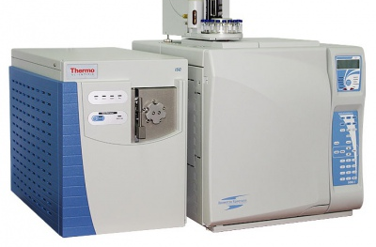
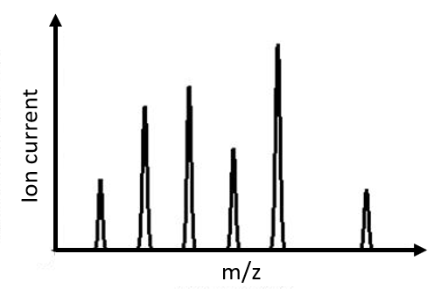

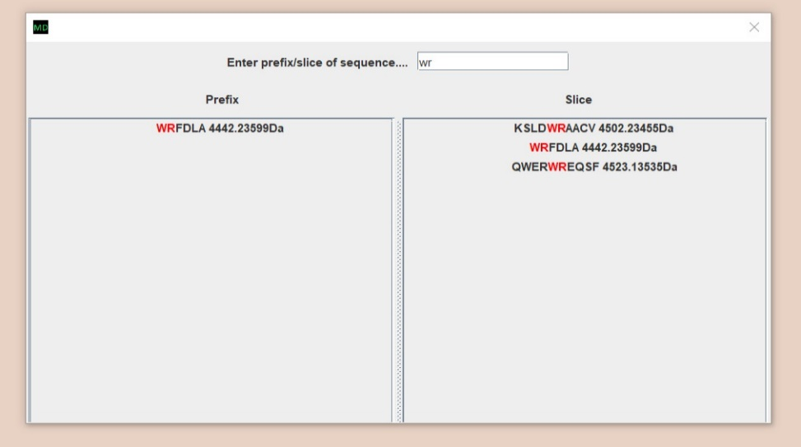
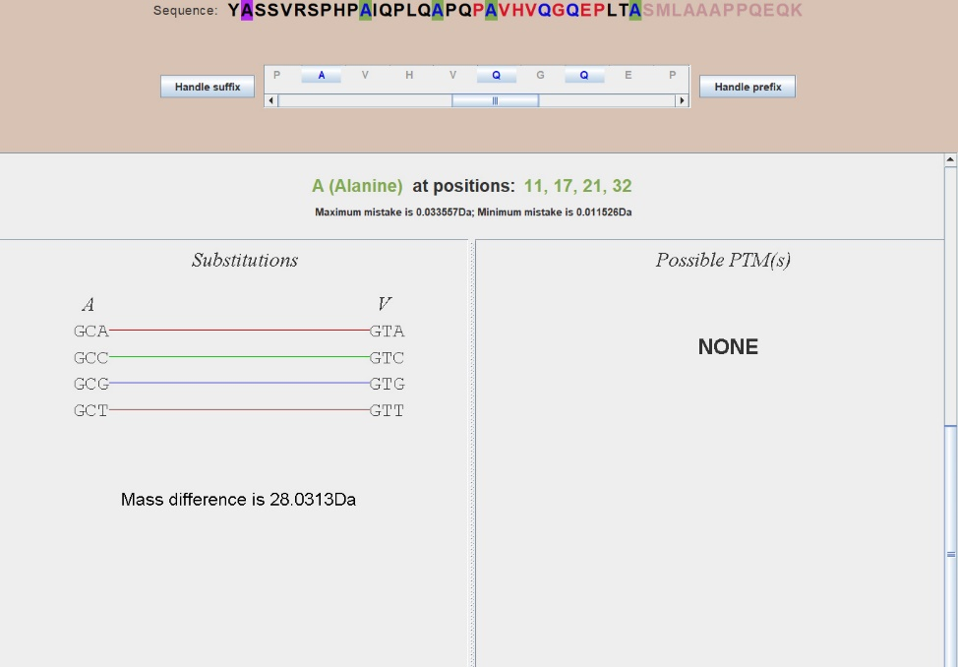
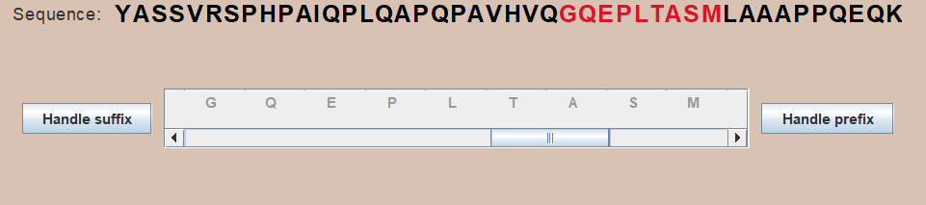
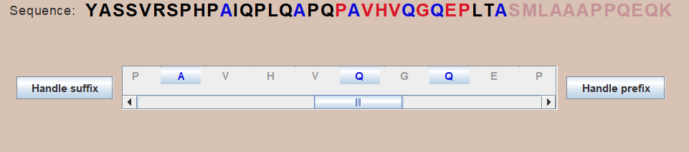
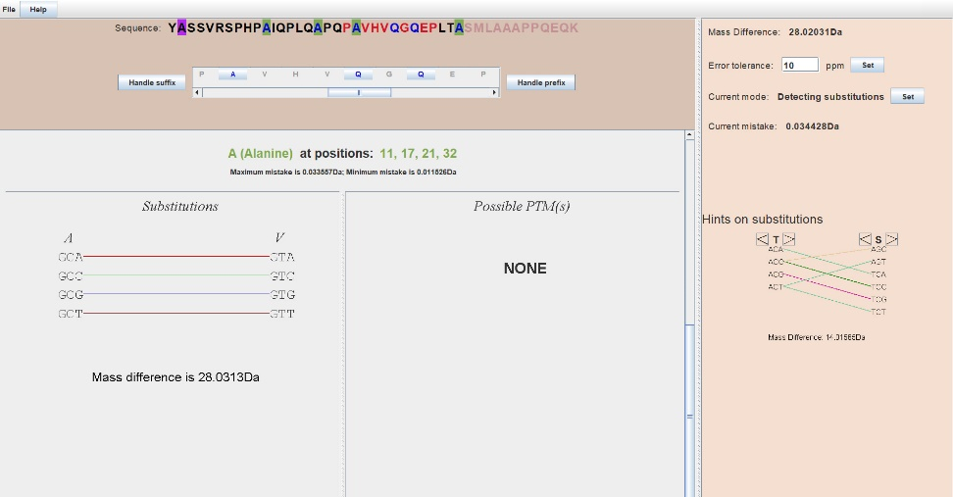





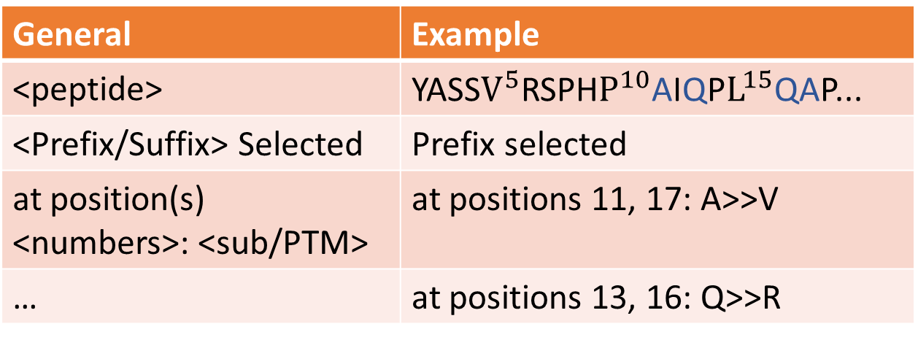





MutationDetector ®.
Software tool for detecting amino acid substitutions
Student: Brilliantov K., St. Petersburg Academic Lyceum Physical Technical High School, Russia
Supervisor: Vyatkina K., St. Petersburg Academic University, Russia
Introduction
Motivation
Proteins play an essential role in our lives, because they are regulating sub-cellar ${processes}^{[1]}$. If any disruption occurs, a protein will cease acting properly and may cause severe diseases. Many factors can result in such disruptions. We consider the most important of those – a single nucleotide polymorphism (SNP). Having learned to find positions in protein sequence where the substitution might occur, we would get a possibility to identify the so-called variant proteins, which can be biomarkers for a variety of hard ${diseases}^{[2]}$.
Single nucleotide polymorphism (SNP)
Post translational modifications (PTMs)
Possible modifications
Ser
Ser
$$CH_{3}$$
Ser
SNP – is a substitution of nucleotide in a DNA strand. Since codons encode amino acid, SNP can lead to substitution of amino acid
 | Wild type | Variant type (A->T)
DNA strand | ACC AAA CCG AGT | ACC ATA CCG AGT
mRNA | UGG UUU GGC UCA | UGG UAU GGC UCA
Protein | -Trp-Phe-Gly-Ser- | -Trp-Tyr-Gly-Ser-
PTM – is a change of
amino acid’s chemical composition through adherence of some
chemical radicals.
(ex. the mass of methionine increases by approximately 14Da upon methylation)
Gly
$$CH_{3}$$
Gly
Cys
Gly
Cys
$$CH_{3}∙$$
Cys
Ser
Ser
$$H∙$$
$$CH_{3}$$
$${{∆M= M}_{variant type} −M}_{wild type}= M_{Tyr} − M_{Phe}$$
$$∆M= M_{radical}$$
Lys
Gly
Cys
Cys
Substitution
PTM
Problem statement
There are two different methods for analyzing such peptides. First is qualitive and second is quantitative. Our work was concentrated on qualitive analyze. Here is the scheme of such analyze
Ser
Lys
quantity
The Goal
Cys
Mass - spectrometer
m
File .pep
To develop a software tool for analysing data, obtained from modified peptide
The peptide
Mass spectrum
Interface
The sub-tasks
Learn how to read file .pep
Learn how to find positions in the peptide where a substitution or a PTM could occur
Learn how to generate a result file
The dissolved peptide is being bombarded with charged particles, so ideally each molecule divides in two parts.
After that, these fragments go through mass - spectrometer and this device gives us the mass spectrum.
Mass spectrum is a histogram, where X – axis is a mass of an ionized fragment, Y-axis is the ion current. Accordingly, this graph is a set of peaks. Based on this set we can establish amino acid’s sequence of the investigated peptide. The with usage of algorithm Twister, we can generate a file.
File has an information about the investigated peptide: amino acid sequence, fragment which was not modified and mass difference
To analyze it manually is uncomfortable. So, the idea about developing a software tool for analyzing such data arises.
Methodology
Programming tools
Interface
For developing this interface I used Java for a basic programming language. And an additional library for creating graphical interfaces, named, Swing
1. Searching for peptides
3. The algorithm
because closer is position to the beginning of sequence smaller the error. So, in the beginning the error is not big enough.
Input
For each position:
6. Information about substitutions
Structure of .pep file
Count the error
General | Example
<peptide> | …LTASMLAA…
<fragment which has not been modified> | SMLA
<Prefix/Suffix> | Prefix
<experimental mass of this peptide> | 4653.40152 Da
Prefix
Suffix
A user can search through the program’s database with help of this dialog window to find peptides which are interest him
$$ε=\frac{M_{i}ppm}{{10}^{6}}$$
$$ε=M_{0}+\frac{M_{i}ppm}{{10}^{6}}$$
1
2. Sequence and scrollable panel
2
3
Output
Find a PTM or a sub with
∆m $∈ (\text{∆}$M – ε; $\text{∆}$M + ε)
The developed program gives to user as an output: the peptide with highlighted positions and a .pepout file.
V Q S S S A R C V N G N
1
2
- PTM
3.1
3.2
- both
- substitution
When a user clicks on some of the peptides, the main frame appears.
1 – the chosen amino acid sequence
2 – scrollable panel with zoomed amino acids
3.1 – button “handle suffix”
3.2 – button “handle prefix”
These buttons allows to choose the prefix or suffix, where the algorithm will search for PTMs and substitutions.
4. Highlighted positions
When a user clicks on some of the enabled buttons, the information about subs and PTMs appears.
1 – name of the amino acid under observation
2 – information about substitutions
3 – information about PTMs
Some of the codons are connected with colorful lines because they can to get into each other by SNP.
Structure of .pepout file
General | Example
<peptide> | YASS$V^{5}$RSPH$P^{10}$AIQP$L^{15}$QAP...
<Prefix/Suffix> Selected | Prefix selected
at position(s) <numbers>: <sub/PTM> | at positions 11, 17: A>>V
… | at positions 13, 16: Q>>R
After this operation some of the positions appears highlighted. But not all of “A”s (and “Q”s) appears highlighted with blue color,
Results and conclusions
References
General view of an application
Testing
B. Lewin. Cells. BINOM Russia, 2011. 951 с.
S. Nie, H. Yin, Z. Tan, M. A. Anderson, M. T. Ruffin, D. M. Simeone, D. M. Lubman. Quantitative Analysis of Single Amino Acid Variant Peptides Associated with Pancreatic Cancer in Serum by an Isobaric Labeling Quantitative Method. J Proteome Res. 2014, 13(12):6058–6066.
K. Vyatkina, S. Wu, L. J. M. Dekker, M. M. VanDuijn, X. Liu, N. Tolic, M. Dvorkin, S. Alexandrova, T. M. Luider, L. Pasa-Tolic, P. A. Pevzner. De Novo Sequencing of Peptides from Top-Down Tandem Mass Spectra. J Proteome Res. 2015, 14(11):4450-4462.
Qisheng Peng, Zijian Wang, Donglin Wu, Xiaoou Li, Xiaofeng Liu, Wanchun Sun, Ning Liu. Identification of single amino acid substitutions (SAAS) in neuraminidase from influenza a virus (H1N1) via mass spectrometry analysis coupled with de novo peptide sequencing.
Rapid Commun. Mass Spectrom. 2016
To test our software tool we took some peptides, which were analyzed earlier.
.pep file: YASSVRSPHPAIQPLQAPQPAVHVQGQEPLTASMLAAAPPQEQK SMLA prefix 4653.40152
Right result is
At positions 11, 17, 24: A>>V
At positions 13, 16, 22, 28, 30: Q>>R
Conclusion
Additional functionality
The developed interface deals with high-resolution data, the algorithm which gives such data is ${new }^{[3]}$, so there is no a lot of applications that using such data.
Also, there is no a lot of graphical applications concerned with this subject
Tab help
Hot keys
Hints on substitutions

