Slide 1
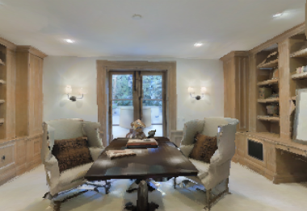
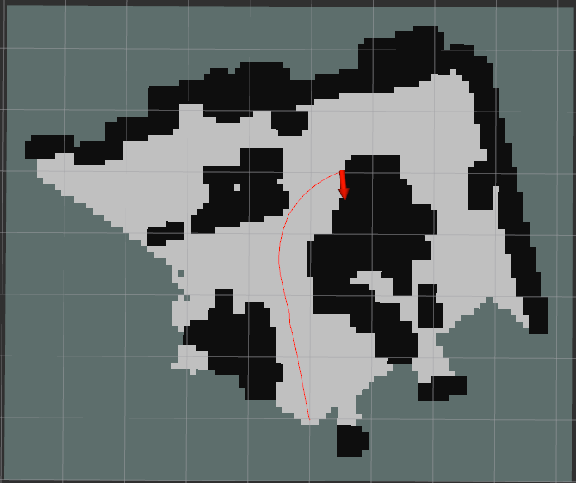
Exploration
Observation (I_{t})
Map of explored part (M_{t})
Action (a_{t})

