Slide 1
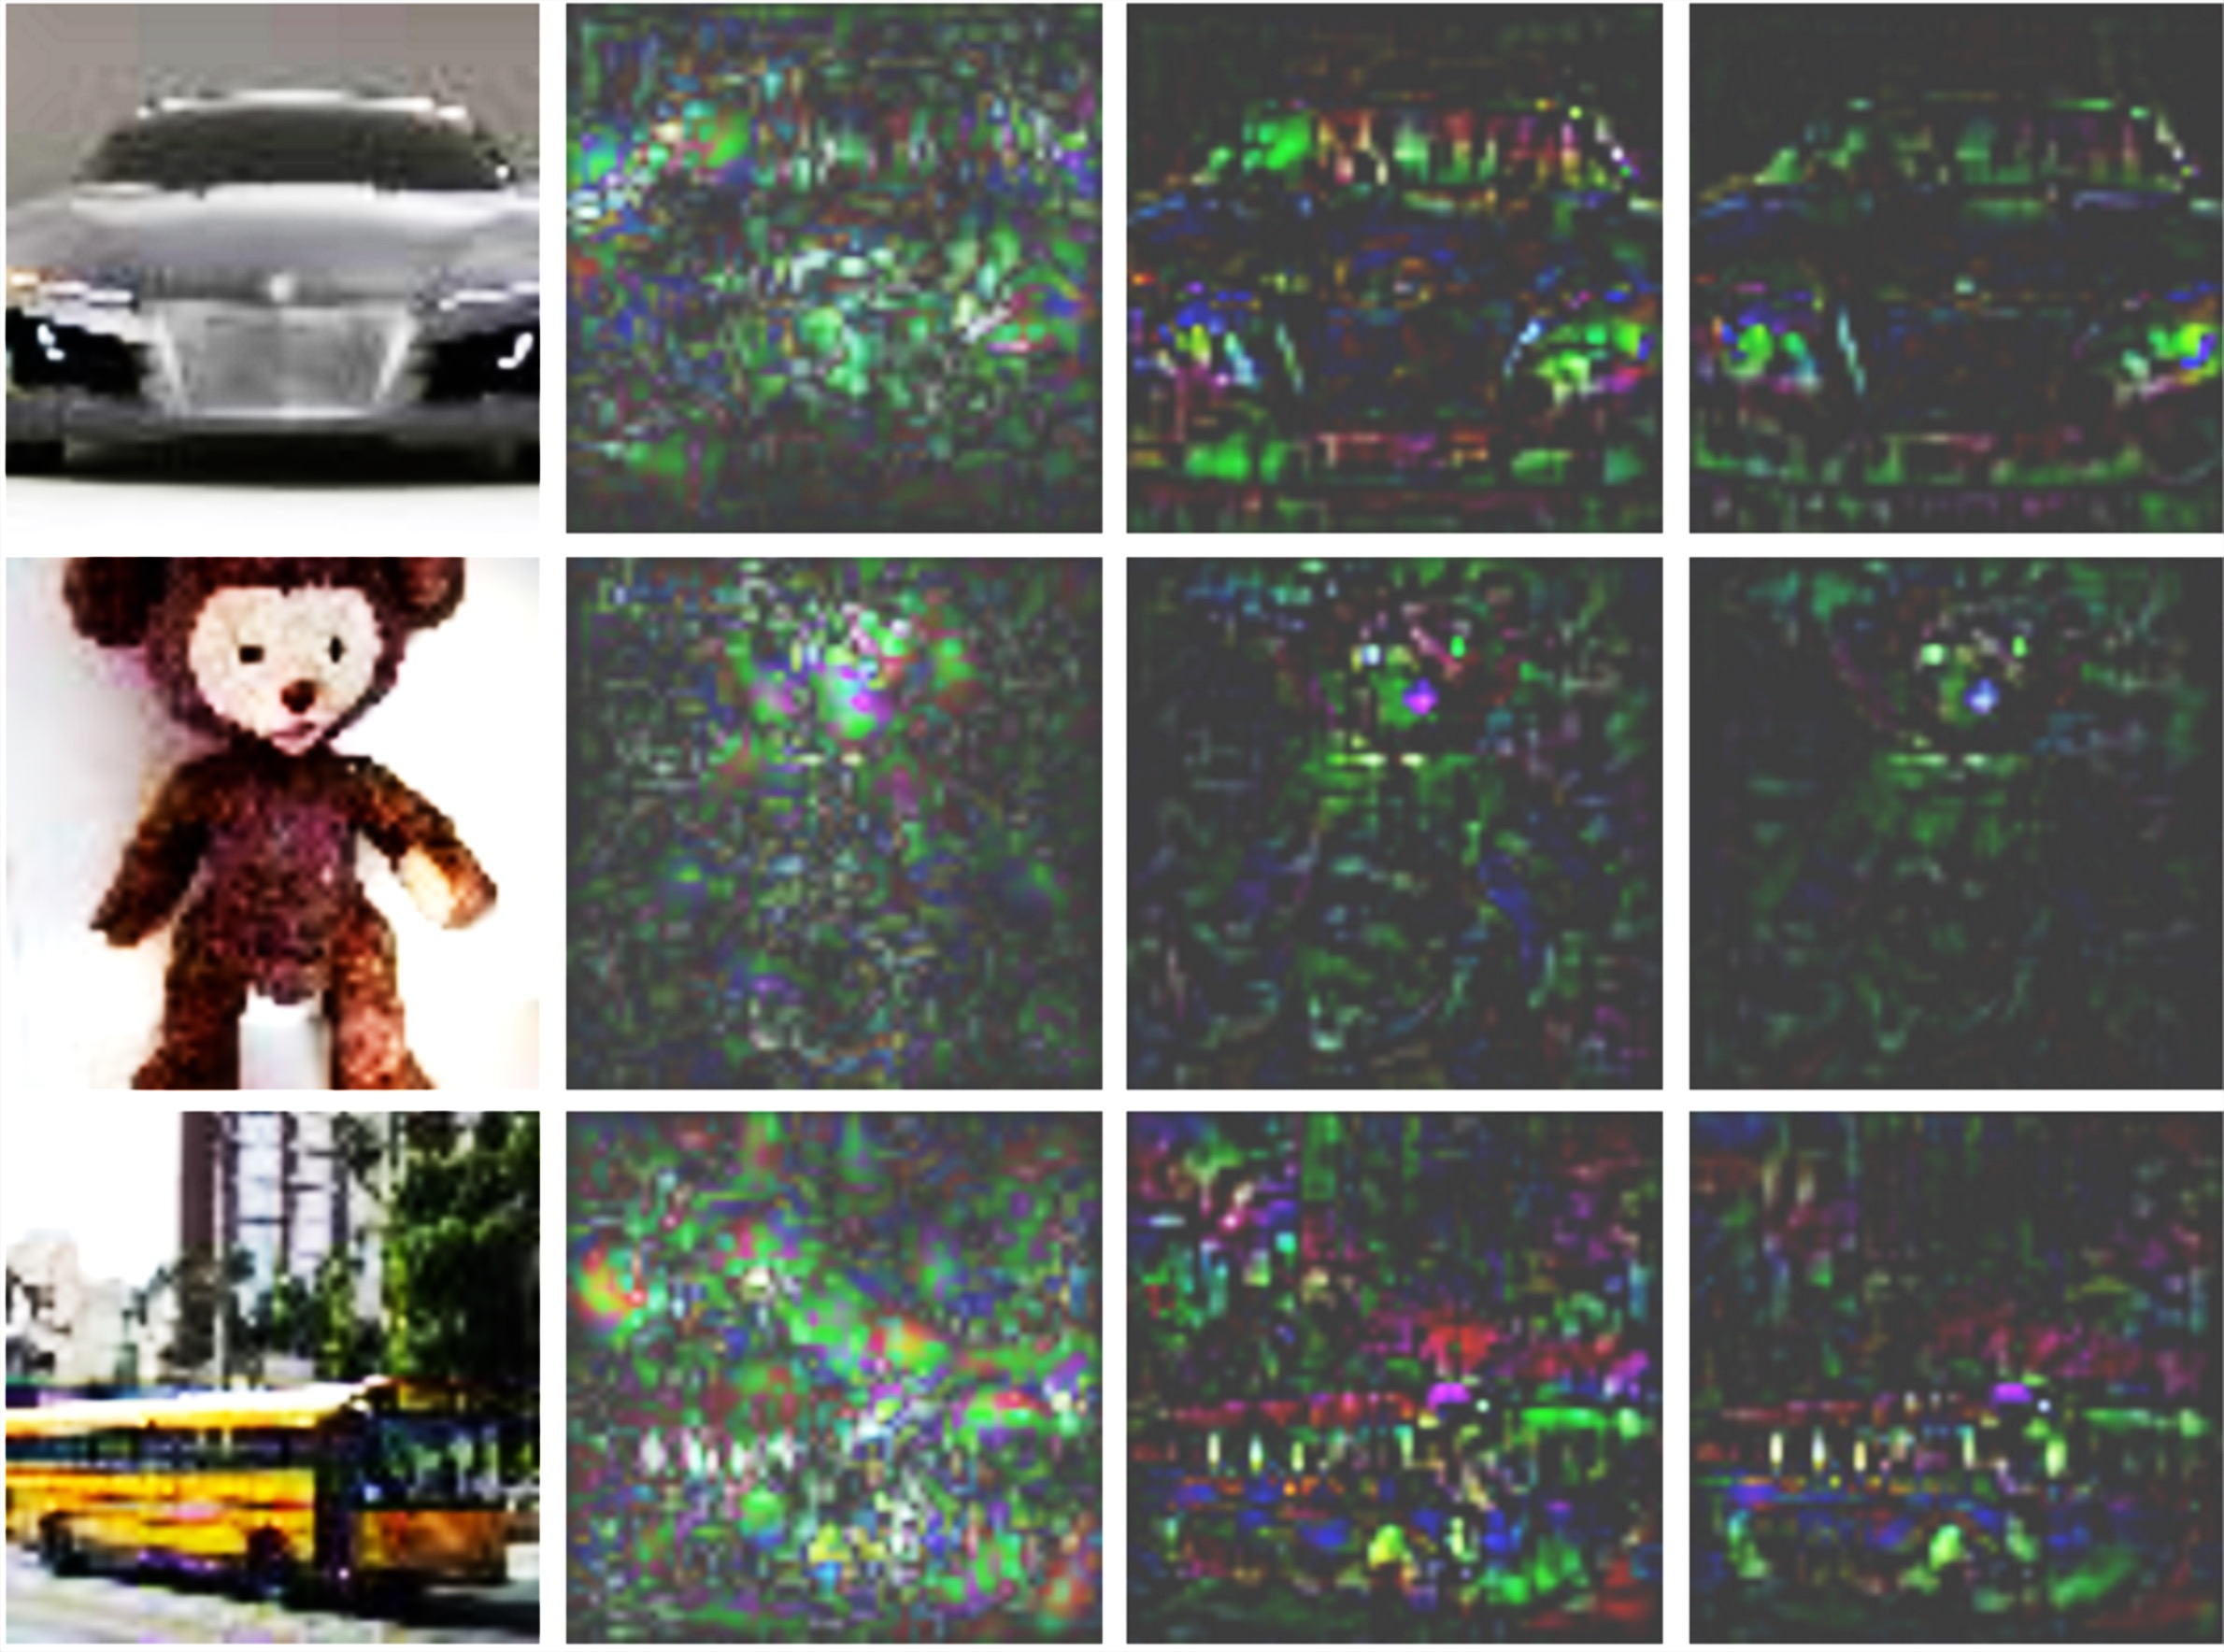
Original
Absolute Gradients
Positive grad*inp
Positive LIFTPAD

Slide 2
sigmoid(y-2)
y = ReLU(x₁ + 2x₂ + 2) = 0
x₁=-1; ref=0
x₂=-1; ref=0

