Slide 1
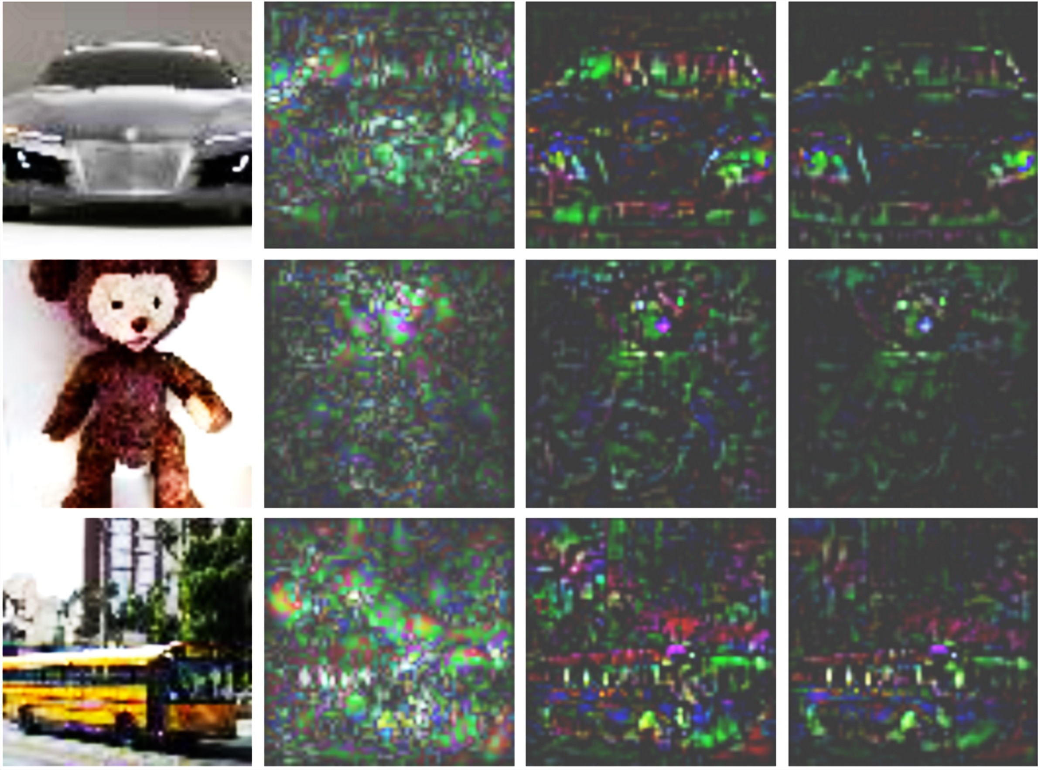
Original
Absolute Gradients
Positive grad*inp
Positive LIFTPAD

