Slide 1
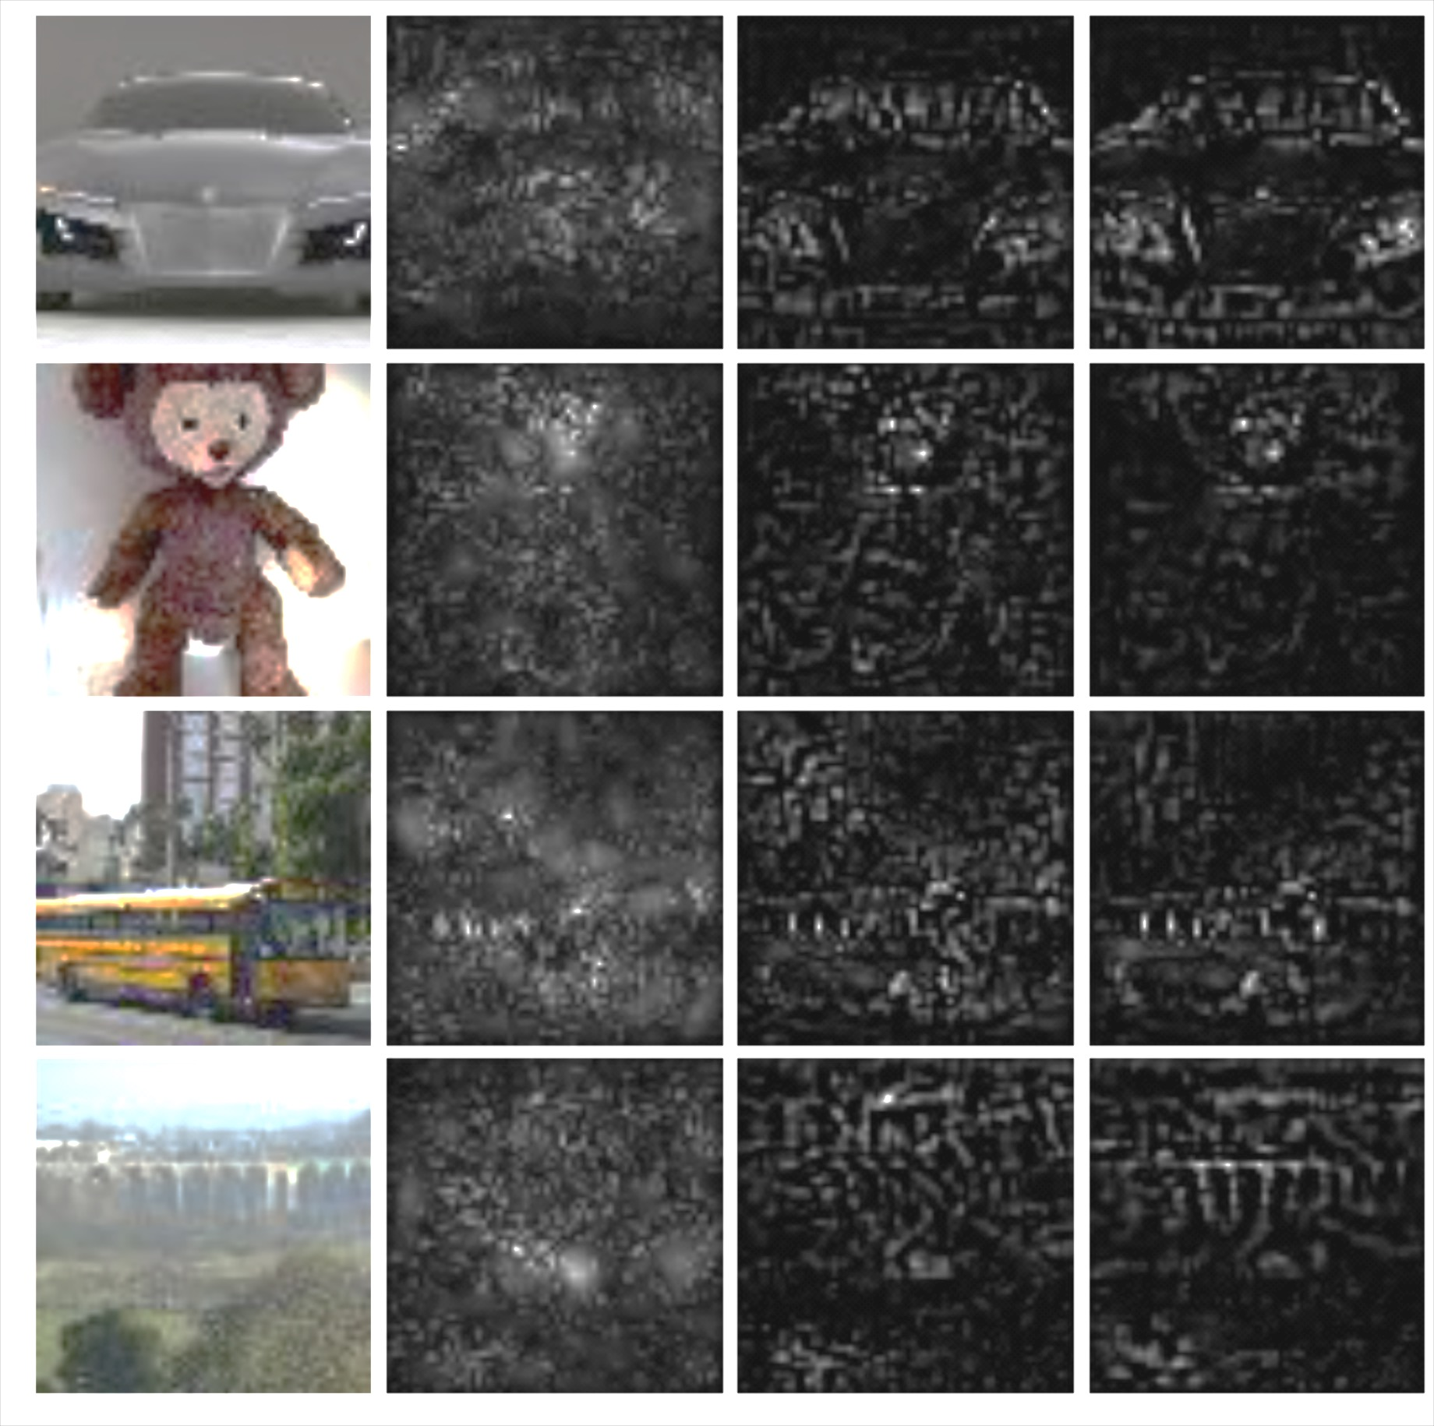
Original
Absolute Gradients
Positive grad*inp
Positive DeepLIFT

Slide 2
x₁=-1; ref=0
y = ReLU(x₁ + 2x₂ + 2)
= 0; ref=2
sigmoid(y-2) = 0.1; ref=0.5
x₂=-1; ref=0

