Slide 1
AI Crypto Hedge Fund
INTEGRATING CRYPTO AND AI-DRIVEN TRADING

Slide 2
The Hedge Fund Model A Multi-Model Approach
SMA, ARIMA and AI outperform basic Buy-and-Hold model, providing predictive, risk-adjusted and data-driven approach
Goal – build and compare strategies of increasing sofistication
1. The Baseline – SMA Crossover
simple, rule-based strategy that reacts to past price trends by tracking moving averages.
2. The Enhancement – ARIMA Model
known statistical model that forecasts the next price point based on recent historical data.
3. The Advanced Model – LightGBM AI Agent
machine learning model that predicts future price direction by learning complex patterns from multiple features (RSI, MACD, Volatility).
“
“
 | Buy and Hold | SMA | ARIMA | AI (LightGBM)
ROI (%) | 36.75 | 16.41 | 21.40 | 40.57
Volatility (%) | 45.98 | 31.08 | 31.39 | 36.54

Slide 3
Future Enhancements Model Sofistication
1. Specialized Models
Train a Model per Asset
Move beyond a single, generalized model by training a unique AI Agent for each cryptocurrency. This allows the model to learn the specific patterns and dynamics of each asset.
2. Ensemble Methods
Combine Models
Instead of relying on one prediction, we can combine the signals from multiple models (e.g., ARIMA and LightGBM). This creates a more robust signal that is less prone to the errors of a single approach.
3. Advanced Architectures
Explore Deep Learning
Instead of relying on one prediction, we can combine the signals from multiple models (e.g., ARIMA and LightGBM). This creates a more robust signal that is less prone to the errors of a single approach.
Key Impact: More robust, accurate, reliable signal generation

Slide 4
Risk Management Active Risk Control
1. Volatility
Measures the intensity of price swings. A lower value means a smoother journey.
3. The ATR Volatility Filter
Our system uses the Average True Range (ATR) to measure real-time volatility. If the market becomes too "choppy" (e.g., ATR > 4% of the price), the strategy is programmed to stay in cash, avoiding potential losses.
Controlling Risk
Quantifying Risk
2. Max Drawdown
The worst-case loss from a peak to a trough. A smaller value shows better capital protection.
 | Buy and Hold | Static Portfolio | Dynamic AI Portfolio
Max Drawdown (%) | -37.20 | -30.62 | -22.69
Volatility (%) | 45.98 | 47.38 | 35.88

Slide 5
Future Enhancements Advanced Risk Control
1. Position Risk
Dynamic Stop-Loss
Implement a dynamic stop-loss for each trade based on real-time volatility (e.g., a 1.5x ATR trailing stop). This actively protects profits and further limits the downside of individual positions.
2. Portfolio Risk
Risk-Based Position Sizing
Adjust position sizes based on risk. For example, allocate less capital to assets with higher recent volatility, ensuring no single asset can overly impact the portfolio's performance.
3. Fund Risk
Tail Risk Monitoring
Introduce fund-level metrics like Value-at-Risk (VaR) and Conditional Value-at-Risk (CVaR). These measures estimate the maximum potential loss, helping to manage and prevent catastrophic "tail risk" events.
Key Impact: More resilient, institution-quality trading systems

Slide 6
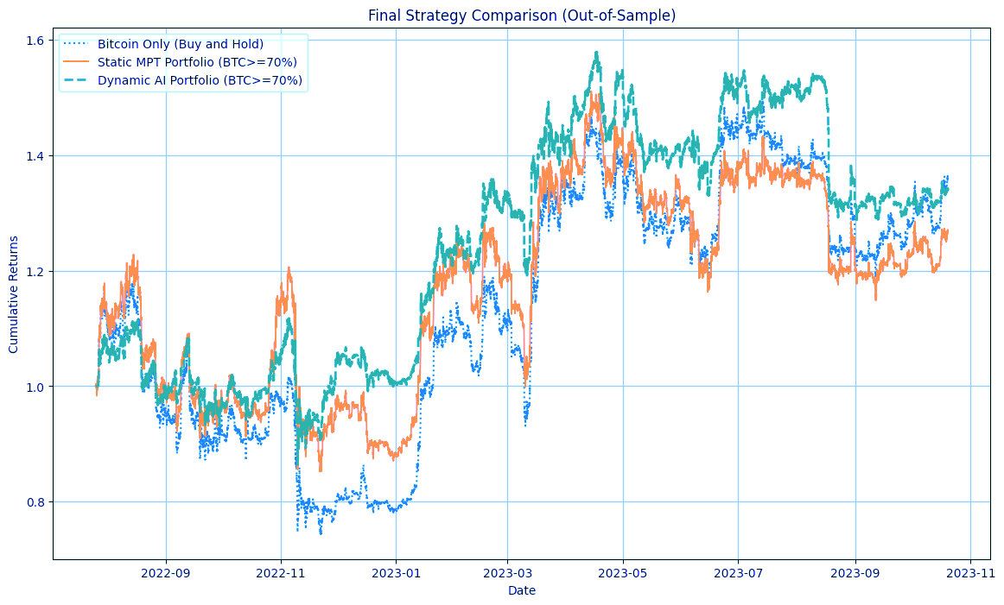
Portfolio Management From static to dynamic
1. Static Baseline Portfolio
We first used Modern Portfolio Theory (MPT) to find the optimal static (fixed-weight) allocation based on historical training data. A Monte Carlo simulation identified the portfolio with the highest Sharpe Ratio, subject to a >=70% Bitcoin constraint.
2. Dynamic AI Portfolio
We then enhanced this portfolio by using our AI Agent as a dynamic overlay on the static MPT weights. The AI's hourly buy/sell signals act as a tactical "on/off" switch for each asset, actively managing the portfolio's exposure.

Slide 7
Future Enhancements Advanced Portfolio Management
Strategic Rebalancing
Periodic MPT Re-Optimization
Our current "base" weights are calculated once on the training data. A more adaptive approach is to re-run the MPT optimization periodically (e.g., every month). This would adjust the strategic, long-term allocation to reflect the most recent market returns and risk profiles.
2. Tactical Rebalancing
Signal-Based Weighting
Move beyond a simple on/off signal. The AI model's output (a probability from 0.0 to 1.0) can be used to directly influence the portfolio weights. A high-confidence "buy" signal could increase an asset's allocation, while a low-confidence signal could reduce it.
3. Add Sentiment Analysis
News, Hype and Fear
Add a score based on the general mood (positive, negative, neutral) from platforms like X/Telegram, perform analysis of headlines of major financial newspapers
Key Impact: Adjust long-term outlook and short-term positioning

Slide 8
System Architecture As-Is Status
1. Data Preparation
Loads crypto_all.csv, cleans the data (handles duplicates, missing values), sorts it chronologically, and splits it into an 80% Training Set and a 20% Test Set.
2. AI Model Training
Uses the Training Set (BTC data) to perform feature engineering (RSI, MACD, etc.) and train the LightGBM model to predict future price direction. The output is a Trained Model.
3. MPT Optimization
Uses the Training Set (multi-asset data) to run a Monte Carlo simulation and find the optimal static portfolio weights based on the highest Sharpe Ratio, subject to any constraints (e.g., BTC >= 70%). The output is the Optimal Weights.
4. Strategy Backtesting
Uses the Test Set along with the Trained Model and Optimal Weights from the previous steps. It simulates the performance of all strategies (Bitcoin-Only, Static MPT, Dynamic AI Portfolio).
5. Analytics & Visualization
Takes the backtest results and calculates all key performance metrics (ROI, Sharpe Ratio, Volatility, Max Drawdown). It generates the final comparison tables and charts (Equity Curves, Radar Chart).

Slide 9
Future Enhancements Production-Ready Architecture
1. Live Data & Execution
API Integration
Replace the static CSV file with a real-time data feed by connecting to exchange APIs (e.g., Binance, Hyperliquid). Implement an execution module to automatically place orders based on the AI's signals.
2. Robust Data Management
Dedicated Database
Incorporate a database (e.g., PostgreSQL) to store all historical data, model signals, executed trades, and performance metrics. This ensures data integrity and allows for more advanced, long-term analysis.
3. Real-Time Monitoring
Live Dashboard & Control
Develop a monitoring dashboard or a Telegram bot to provide real-time updates on the fund's performance and system health. This would also allow for manual overrides or a "kill switch" for safety.
Key Impact: Fully-fledged, automated, user-friendly systems

Slide 10

Summary of Key Achievements Done so far
1. Proven Predictive Power
Successfully demonstrated that predictive models (ARIMA and our AI Agent) deliver a significant performance edge over both passive buy-and-hold and simple rule-based (SMA) strategies in out-of-sample testing.
2. End-to-End Framework
Constructed a complete, reproducible Python-based pipeline for data preparation, model training, multi-strategy backtesting, and performance analytics, which serves as a solid foundation for future development.
3. Dynamic Portfolio Outperformance
The final Dynamic AI Portfolio was the best overall performer, achieving the highest Sharpe Ratio and the lowest Max Drawdown. This proves the value of combining strategic allocation (MPT) with a tactical, AI-driven overlay.

Slide 11
Conclusion & Project Roadmap To Be Done
Refine Strategy
Improve Core Trading Logic
Train a specialized AI model for each asset
Implement advanced risk controls like dynamic stop-losses and risk-based position sizing.
2. Transition to Production
Build a Live Automated System
Integrate live data exchange via API
Develop an automated trade execution module
Build a database and dashboard for real-time monitoring
3. Fund Expansion
Scale the Project into a diversified, multi-strat Fund
Research and deploy new, uncorrelated trading strategies (e.g., market-neutral arbitrage, options strategies).Develop an automated trade execution module
Apply the quantitative framework to other markets, such as equities, forex, or commodities.

