Slide 1
Operating Systems Introduction
Hua Huang, Ph.D.
Spring 2019

Slide 2

About me
PhD in SP, Beijing Jiaotong University
Research interest: Computer Vision, Machine Learning
Enjoy programming, Algorithm design & analysis
Industry experiences:
Beijing JYD Digital Technology Co., Ltd.
Ofﬁce hours:
N515, 9# Building, Make appointment first by email or text, Please
• Questions and feedbacks are highly encouraged

Slide 3

Job hunting
Reference
(Not reference letters)
Online coding (maybe)
Onsite Interviews:
Several Coding interviews
Behavioral Interview
System Design interview
Phone interview:
mainly coding

Slide 4
Tips for job hunting
Contact schoolmates and friends to get internal references
Coding: acm.bjtu, leetcode, topcoder, codeforces...
Stay in Beijing during job hunting; you may get onsite interviews directly (without going through online and phone interviews)
Learn this course well
Notes:
Oracle数据库系统为何独占鳌头？

Slide 5
Course prerequisites
Data Structure
Computer Hardware Foundations or Computer Architecture
C or C++ Programming is a must

Slide 6
Course website
http://citel.bjtu.edu.cn/moodle/course/view.php?id=152
Please check this website frequently for updates of assignments, readings, and slides
Readings ahead of classes are required

Slide 7
Textbooks
Required
“Operating System Concepts”, 9th edition, Silberschatz, Galvin, and Gagne. Wiley, 2012. // There is a free online version
计算机操作系统(第4版), 汤小丹等, 西安电子科技大学出版社，2014
Optional
“Computer Systems - a Programmer’s Perspective”, 3rd edition, Bryant & O’Hallaron, Pearson, 2016. // 2nd edition is OK
“The Linux Programming Interface: A Linux and UNIX System Programming Handbook”, Michael Kerrisk, No Starch Press, 2011. // You can ﬁnd it online
Modern Operating Systems, 4th edition, Andrew S. Tanenbaum，Herbert Bos, Pearson, 2014
操作系统之哲学原理(第2版), 邹恒明, 机械工业出版社, 2012

Slide 8
Textbooks (Cont')
Other reference books
30天自制操作系统，川合秀实，周自恒等译，人民邮电出版社，2014
操作系统实用教程：螺旋方法，Ramez Elmasri et al，机械工业出版社，2018
现代操作系统(4ed)，Tanenbaum，陈向群等译，机械工业出版社，2017
Windows操作系统原理(2nd)，陈向群等，机械工业出版社，2004
操作系统－精髓与设计原理(8ed)，William Stallings，电子工业出版社，2017
操作系统概念(9ed)，Abrahan Silberschatz，机械工业出版社，2018
自己动手写操作系统，于渊，电子工业出版社，2005

Slide 9
Grading
Attendence, quizzes, labs etc: 40%.
Lab projects, Late submission will lead to a grade of 0 for that project
Quizzes, Note that quizzes will generally NOT be announced in advance. There is no makeup for missed quizzes and the grade for a missed quiz is 0.
The lowest quiz grade will be dropped
Final: 60%. Closed-book; covers the whole course

Slide 10
Policies
No cheating
Do not share your solutions; do not copy solutions online. These will lead to a course grade of F for both sides
No late submission
Late submissions will be rejected
Submission via course website as required
No make-up projects/quizzes/exams

Slide 11
Course goals
What are the subsystems of an OS?
The functions and purpose of each subsystem
Why have they built this way?
What are the trade-been offs?
Can the ideas be applied to your system design?
How to invoke important system services?
E.g., how to create threads; how to synchronize processes; how to speed up ﬁle read;

Slide 12
What is an Operating System?
A program that acts as an intermediary between a user of a computer and the computer hardware
Operating system goals:
Execute user programs and make solving user problems easier
Make the computer system convenient to use
Use the computer hardware in an efficient manner

Slide 13
Why is an operating system needed? RIPS
Resource management
– Processor, memory, disk, etc.
Inter-process communication (IPC)
– One process talks with another
Protection
– Isolation and access control
Services to user programs
– Typically, hundreds of system calls

Slide 14
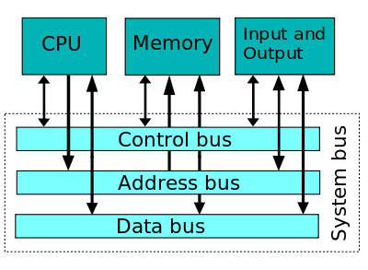
Computer system structure

Slide 15
Computer system structure(Cont.)
Computer system can be divided into four components:
Hardware – provides basic computing resources
CPU, memory, I/O devices
Operating system
Controls and coordinates use of hardware among various applications and users
Application programs – define the ways in which the system resources are used to solve the computing problems of the users
Word processors, compilers, web browsers, database systems, video games
Users
People, machines, other computers

Slide 16
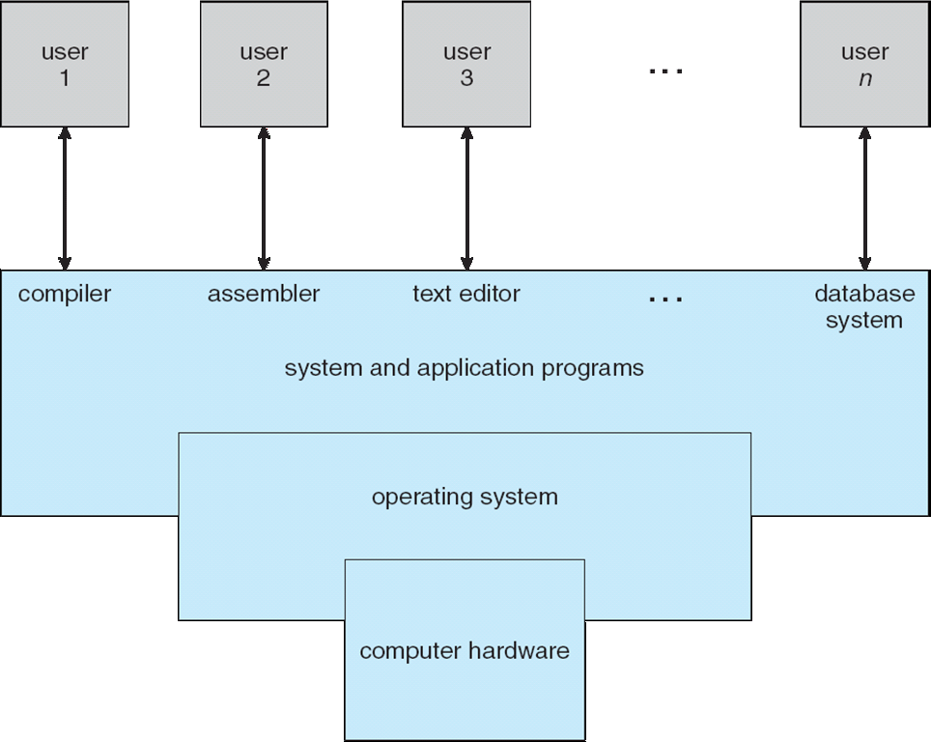
Four Components of a Computer System

Slide 17
Three major subsystems of an OS
Process management
Processes, threads, synchronization
Memory management
Physical memory, virtual memory
Device management
File systems, networks, display, keyboard, …
User Spaces
Application Libraries
Process/Memory/Device Management
Kernel
Hardware
CPU Memory Device

Slide 18
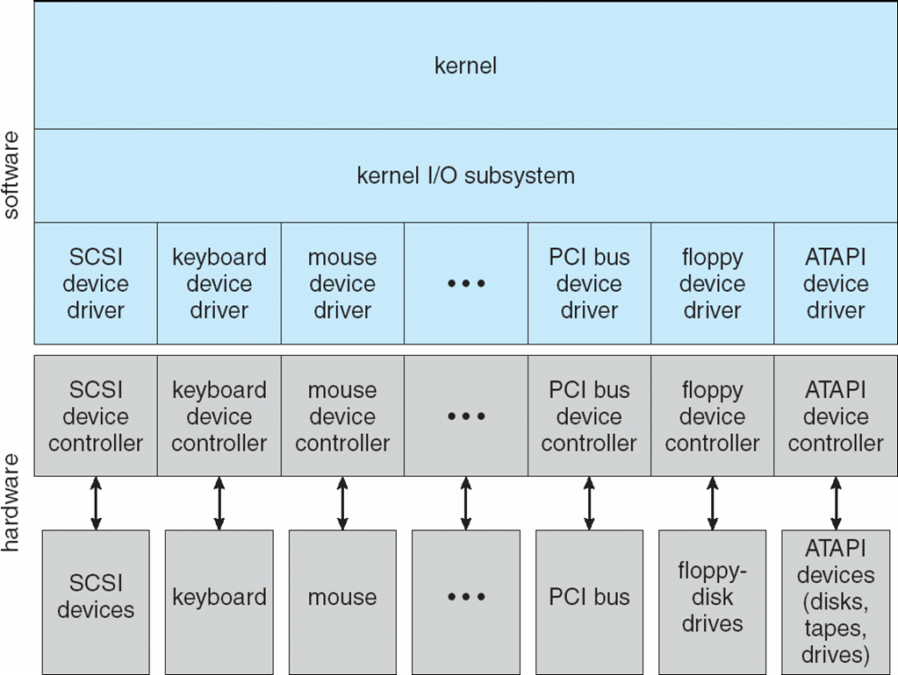
Big picture
Layered design: User program-> libs -> core kernel -> Kernel I/O subsystem -> driver
-> controller ->device
User programs
Libraries

Slide 19
What Operating Systems Do
Depends on the point of view
Users want convenience, ease of use
Don’t care about resource utilization
But shared computer such as mainframe or minicomputer must keep all users happy
Users of dedicate systems such as workstations have dedicated resources but frequently use shared resources from servers
Handheld computers are resource poor, optimized for usability and battery life
Some computers have little or no user interface, such as embedded computers in devices and automobiles

Slide 20
Operating System Definition
OS is a resource allocator
Manages all resources
Decides between conflicting requests for efficient and fair resource use
OS is a control program
Controls execution of programs to prevent errors and improper use of the computer

Slide 21
Operating System Definition(Cont.)
No universally accepted definition
“Everything a vendor ships when you order an operating system” is good approximation
But varies wildly
“The one program running at all times on the computer” is the kernel. Everything else is either a system program (ships with the operating system) or an application program.

Slide 22
Computer Startup
bootstrap program is loaded at power-up or reboot
Typically stored in ROM or EPROM, generally known as firmware
Initializes all aspects of system
Loads operating system kernel and starts execution

Slide 23
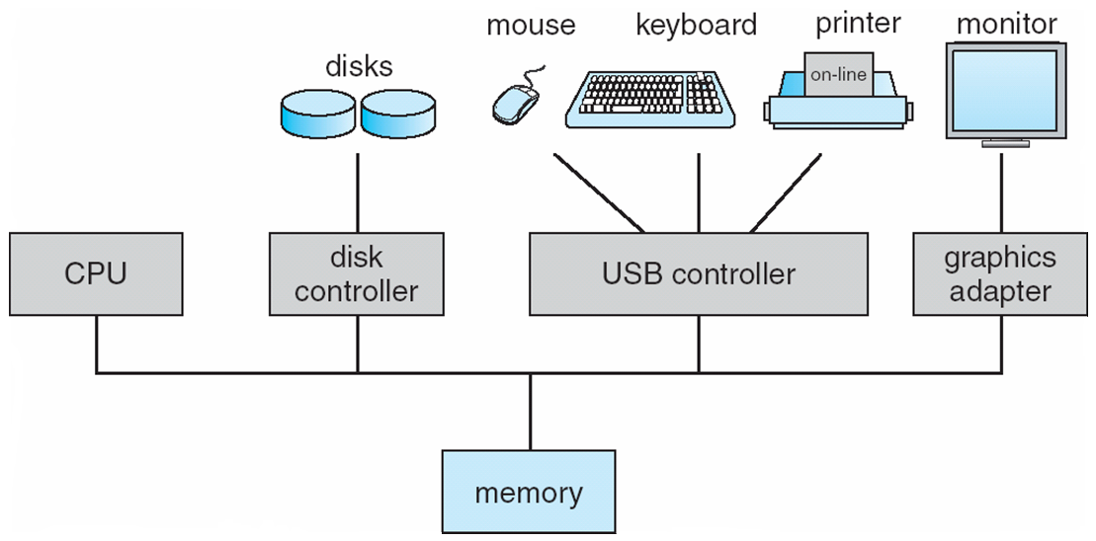
Computer System Organization
Computer-system operation
One or more CPUs, device controllers connect through common bus providing access to shared memory
Concurrent execution of CPUs and devices competing for memory cycles

Slide 24
Computer-System Operation
I/O devices and the CPU can execute concurrently
Each device controller is in charge of a particular device type
Each device controller has a local buffer
CPU moves data from/to main memory to/from local buffers
I/O is from the device to local buffer of controller
Device controller informs CPU that it has finished its operation by causing an interrupt

Slide 25
Common Functions of Interrupts
Interrupt transfers control to the interrupt service routine generally, through the interrupt vector, which contains the addresses of all the service routines
Interrupt architecture must save the address of the interrupted instruction
A trap or exception is a software-generated interrupt caused either by an error or a user request
An operating system is interrupt driven

Slide 26
Interrupt Handling
The operating system preserves the state of the CPU by storing registers and the program counter
Determines which type of interrupt has occurred:
polling
vectored interrupt system
Separate segments of code determine what action should be taken for each type of interrupt

Slide 27
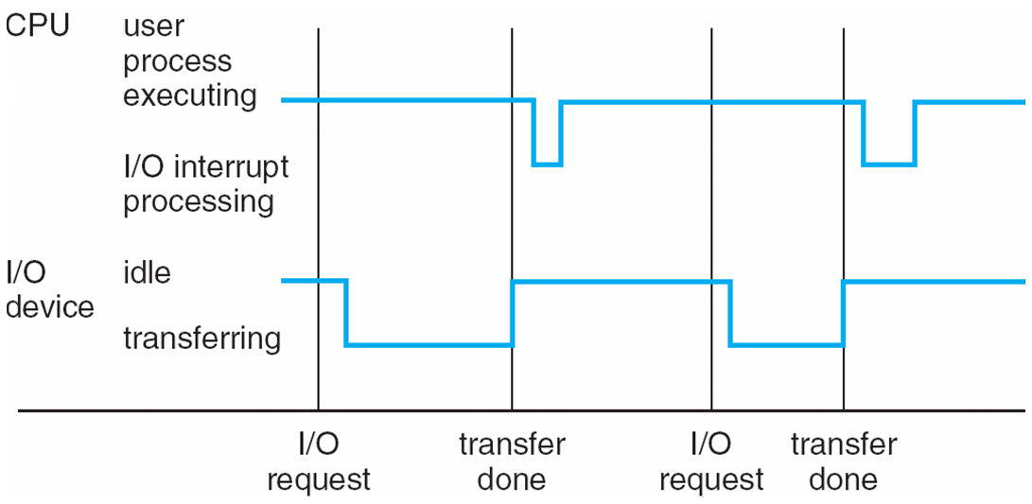
Interrupt Timeline

Slide 28
I/O Structure
After I/O starts, control returns to user program only upon I/O completion
Wait instruction idles the CPU until the next interrupt
Wait loop (contention for memory access)
At most one I/O request is outstanding at a time, no simultaneous I/O processing
After I/O starts, control returns to user program without waiting for I/O completion
System call – request to the OS to allow user to wait for I/O completion
Device-status table contains entry for each I/O device indicating its type, address, and state
OS indexes into I/O device table to determine device status and to modify table entry to include interrupt

Slide 29
Direct Memory Access Structure
Used for high-speed I/O devices able to transmit information at close to memory speeds
Device controller transfers blocks of data from buffer storage directly to main memory without CPU intervention
Only one interrupt is generated per block, rather than the one interrupt per byte

Slide 30
Storage Structure
Main memory – only large storage media that the CPU can access directly
Random access
Typically volatile
Secondary storage – extension of main memory that provides large nonvolatile storage capacity
Magnetic disks – rigid metal or glass platters covered with magnetic recording material
Disk surface is logically divided into tracks, which are subdivided into sectors
The disk controller determines the logical interaction between the device and the computer
Solid-state disks – faster than magnetic disks, nonvolatile
Various technologies
Becoming more popular

Slide 31
Storage Hierarchy
Storage systems organized in hierarchy
Speed
Cost
Volatility
Caching – copying information into faster storage system; main memory can be viewed as a cache for secondary storage
Device Driver for each device controller to manage I/O
Provides uniform interface between controller and kernel

Slide 32
Storage-Device Hierarchy

Slide 33
Caching
Important principle, performed at many levels in a computer (in hardware, operating system, software)
Information in use copied from slower to faster storage temporarily
Faster storage (cache) checked first to determine if information is there
If it is, information used directly from the cache (fast)
If not, data copied to cache and used there
Cache smaller than storage being cached
Cache management important design problem
Cache size and replacement policy

Slide 34
Computer-System Architecture
Most systems use a single general-purpose processor (PDAs through mainframes)
Most systems have special-purpose processors as well
Multiprocessors systems growing in use and importance
Also known as parallel systems, tightly-coupled systems
Advantages include:
Increased throughput
Economy of scale
Increased reliability – graceful degradation or fault tolerance
Two types:
Asymmetric Multiprocessing
Symmetric Multiprocessing

Slide 35
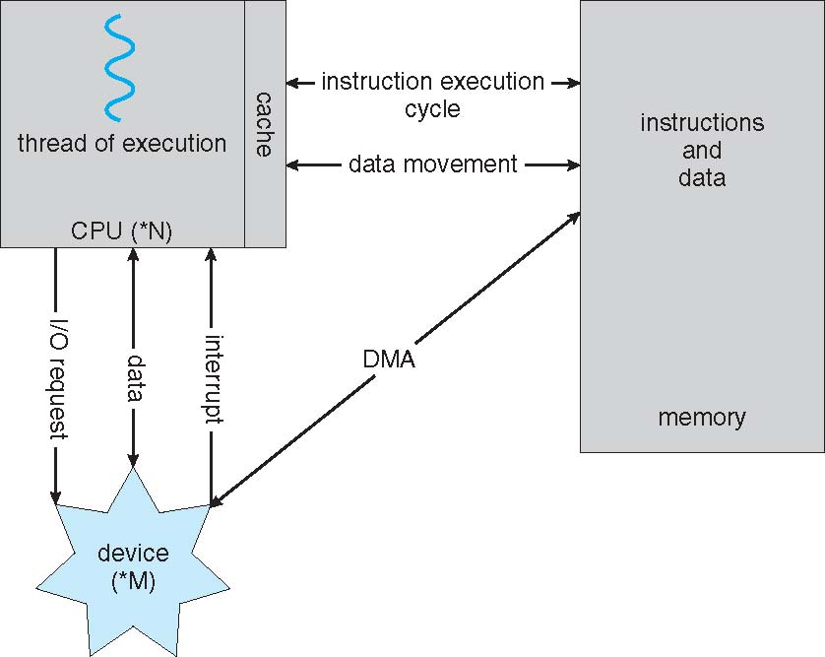
How a Modern Computer Works

Slide 36
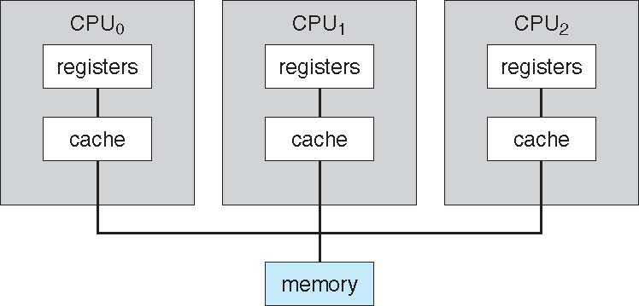
Symmetric Multiprocessing Architecture

Slide 37
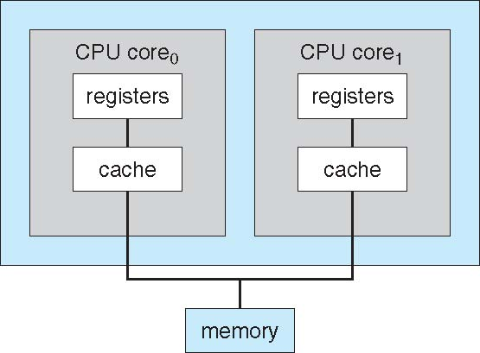
A Dual-Core Design
UMA and NUMA architecture variations
Multi-chip and multicore
Systems containing all chips vs. blade servers
Chassis containing multiple separate systems

Slide 38
Clustered Systems
Like multiprocessor systems, but multiple systems working together
Usually sharing storage via a storage-area network (SAN)
Provides a high-availability service which survives failures
Asymmetric clustering has one machine in hot-standby mode
Symmetric clustering has multiple nodes running applications, monitoring each other
Some clusters are for high-performance computing (HPC)
Applications must be written to use parallelization
Some have distributed lock manager (DLM) to avoid conflicting operations

Slide 39
Clustered Systems

Slide 40
Operating System Structure
Multiprogramming needed for efficiency
Single user cannot keep CPU and I/O devices busy at all times
Multiprogramming organizes jobs (code and data) so CPU always has one to execute
A subset of total jobs in system is kept in memory
One job selected and run via job scheduling
When it has to wait (for I/O for example), OS switches to another job
Timesharing (multitasking) is logical extension in which CPU switches jobs so frequently that users can interact with each job while it is running, creating interactive computing
Response time should be < 1 second
Each user has at least one program executing in memory process
If several jobs ready to run at the same time  CPU scheduling
If processes don’t fit in memory, swapping moves them in and out to run
Virtual memory allows execution of processes not completely in memory

Slide 41
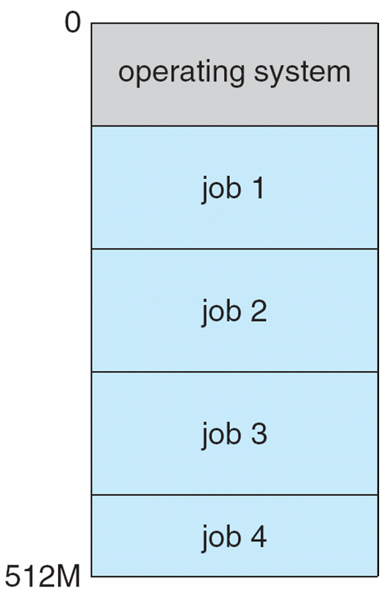
Memory Layout for Multiprogrammed System

Slide 42
Operating-System Operations
Interrupt driven by hardware
Software error or request creates exception or trap
Division by zero, request for operating system service
Other process problems include infinite loop, processes modifying each other or the operating system
Dual-mode operation allows OS to protect itself and other system components
User mode and kernel mode
Mode bit provided by hardware
Provides ability to distinguish when system is running user code or kernel code
Some instructions designated as privileged, only executable in kernel mode
System call changes mode to kernel, return from call resets it to user
Increasingly CPUs support multi-mode operations
i.e. virtual machine manager (VMM) mode for guest VMs

Slide 43
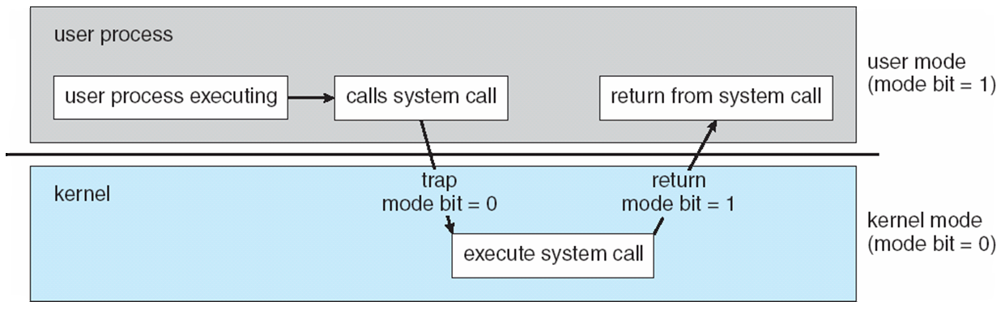
Transition from User to Kernel Mode
Timer to prevent infinite loop / process hogging resources
Set interrupt after specific period
Operating system decrements counter
When counter zero generate an interrupt
Set up before scheduling process to regain control or terminate program that exceeds allotted time

Slide 44
Process Management
A process is a program in execution. It is a unit of work within the system. Program is a passive entity, process is an active entity.
Process needs resources to accomplish its task
CPU, memory, I/O, files
Initialization data
Process termination requires reclaim of any reusable resources
Single-threaded process has one program counter specifying location of next instruction to execute
Process executes instructions sequentially, one at a time, until completion
Multi-threaded process has one program counter per thread
Typically system has many processes, some user, some operating system running concurrently on one or more CPUs
Concurrency by multiplexing the CPUs among the processes / threads

Slide 45
Process Management Activities
The operating system is responsible for the following activities in connection with process management:
Creating and deleting both user and system processes
Suspending and resuming processes
Providing mechanisms for process synchronization
Providing mechanisms for process communication
Providing mechanisms for deadlock handling

Slide 46
Memory Management
All data in memory before and after processing
All instructions in memory in order to execute
Memory management determines what is in memory when
Optimizing CPU utilization and computer response to users
Memory management activities
Keeping track of which parts of memory are currently being used and by whom
Deciding which processes (or parts thereof) and data to move into and out of memory
Allocating and deallocating memory space as needed

Slide 47
Storage Management
OS provides uniform, logical view of information storage
Abstracts physical properties to logical storage unit - file
Each medium is controlled by device (i.e., disk drive, tape drive)
Varying properties include access speed, capacity, data-transfer rate, access method (sequential or random)
File-System management
Files usually organized into directories
Access control on most systems to determine who can access what
OS activities include
Creating and deleting files and directories
Primitives to manipulate files and dirs
Mapping files onto secondary storage
Backup files onto stable (non-volatile) storage media

Slide 48
Mass-Storage Management
Usually disks used to store data that does not fit in main memory or data that must be kept for a “long” period of time, Proper management is of central importance
Entire speed of computer operation hinges on disk subsystem and its algorithms
OS activities
Free-space management
Storage allocation
Disk scheduling
Some storage need not be fast
Tertiary storage includes optical storage, magnetic tape
Still must be managed – by OS or applications
Varies between WORM (write-once, read-many-times) and RW (read-write)

Slide 49
I/O Subsystem
One purpose of OS is to hide peculiarities of hardware devices from the user
I/O subsystem responsible for
Memory management of I/O including buffering (storing data temporarily while it is being transferred), caching (storing parts of data in faster storage for performance), spooling (the overlapping of output of one job with input of other jobs)
General device-driver interface
Drivers for specific hardware devices

Slide 50
Protection and Security
Protection – any mechanism for controlling access of processes or users to resources defined by the OS
Security – defense of the system against internal and external attacks
Huge range, including denial-of-service, worms, viruses, identity theft, theft of service
Systems generally first distinguish among users, to determine who can do what
User identities (user IDs, security IDs) include name and associated number, one per user
User ID then associated with all files, processes of that user to determine access control
Group identifier (group ID) allows set of users to be defined and controls managed, then also associated with each process, file
Privilege escalation allows user to change to effective ID with more rights

Slide 51
Operating systems made available in source-code format rather than just binary closed-source
Counter to the copy protection and Digital Rights Management (DRM) movement
Started by Free Software Foundation (FSF), which has “copyleft” GNU Public License (GPL)
Examples include GNU/Linux and BSD UNIX (including core of Mac OS X), and many more
Can use VMM like VMware Player (Free on Windows), Virtualbox (open source and free on many platforms - http://www.virtualbox.com)
Use to run guest operating systems for exploration

Slide 52
What is the difference between a process and a thread?

Slide 53
How do processes share a CPU?

Slide 54
What is a segmentation fault?

Slide 55
How to share memory between processes?

Slide 56
What happens upon a keystroke?

Slide 57
How to optimize your programs?

Slide 58
Summary
What Operating Systems Do
Computer-System Organization
Computer-System Architecture
Operating-System Structure
Operating-System Operations
Process Management
Memory Management
Storage Management
Protection and Security
Open-Source Operating Systems

