Slide 1
Operating Systems CPU Mode & OS Structure
Hua Huang, Ph.D.
Spring 2019

Slide 2
CPU Modes
Two common modes
Kernel mode（也称为管态）
The CPU has to be in this mode to execute the kernel code
User mode（也称为目态）
The CPU is usually in this mode to execute the user code
User Spaces
Application Libraries
Process/Memory/Device Management
Kernel
Hardware
CPU Memory Device

Slide 3
Important questions
How are CPU modes implemented?
Why are CPU modes needed?
Difference between Kernel mode and User mode
How are system calls implemented?
Advanced topic: Virtualization
Operating Services
System calls
Operating Structure

Slide 4
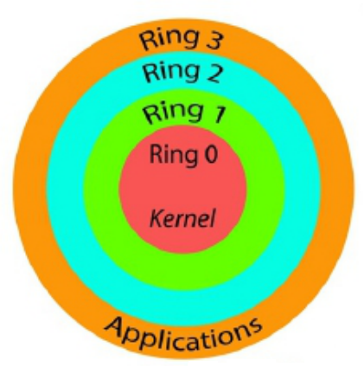
How CPU Modes are implemented
Implemented through protection rings
A modern CPU typical provides different protection rings, which represent different privilege levels
A ring with a lower number has higher privileges
Introduced by Multics in 60’s
E.g., an X86 CPU usually provides four rings, and a Linux/Unix/Windows OS uses Ring 0 for the kernel mode and Ring 3 for the user mode

Slide 5
Why are Protection Rings needed?
Fault isolation: a fault (e.g., divided by 0) in the code running in a less-privileged ring can be captured and handled by code in a more-privileged ring
Privileged instructions: certain instructions can only be issued in a privileged ring; thus an OS can implement resource management and isolation here
Privileged memory space: certain memory can only be accessed in a privileged ring
All these are demonstrated in the difference between the kernel mode and the user mode

Slide 6
Kernel Mode vs. User Mode?
A fault in the user space (e.g., divided by zero, invalid access, null pointer dereference) can be captured by the Kernel (without crashing the whole system)
Details of fault handling will be covered in later lectures
Privileged instructions can only be issued in the kernel mode
E.g., disk I/O
In X86, an attempt to execute them from ring 3 leads to GP (General Protection) exceptions
The kernel memory space can only be accessed in the kernel mode
E.g., the list of processes for scheduling

Slide 7
What are the “real mode” “protected mode” in x86 CPUs
In “real mode”, protection rings are NOT enforced, while in “protected mode”, protection rings are enforced

Slide 8
Examples of Privileged Instructions
I/O operations: inp, outp
Switch page tables of processes: load cr3
Enable/disable interrupts: sti/cli
Change processor modes from kernel to user: iret
Halt a processor to enter low-power stage: hlt
Load the Global Descriptor Table register in x86: lgdt
Ref: http://www.brokenthorn.com/Resources/OSDev23.html
Examples of non-privileged ones:
add, sub, or, etc.

Slide 9
Questions
If I/O operations rely on privileged instructions, how does a user program read/write?
System calls
When a system call is issued, the process goes from user mode (Ring 3) to kernel mode (Ring 0)
printf libc call (Ring 3) => write system call =>Kernel code (Ring 0)

Slide 10
A CPU enters user mode and kernel mode in an interleaved way
before read
before write
user context
user context
user context
kernel context
kernel context
syscall write
syscall read

Slide 11
How to interpret the output of the time command
$ time any-command
real 0m0.064s
user 0m0.006s
sys 0m0.033s
real: wall clock time
user: CPU time spent in user-mode
sys: CPU time spent in kernel-mode
Actual CPU time: user + sys
Why “real != user + sys”?

Slide 12
Myth: “root” refers to the kernel mode?
Short answer: no!
Long answer: the root user and non-root user refer to the user account types; in Linux/Unix, the root user can access any ﬁles, while a non-root user only has access to some ﬁles.
Kernel Mode and User Mode refer to the processor mode
No matter the user is a root or non-root, a CPU still enter Kernel mode and User mode in an interleaved way
Regardless of the current CPU mode, a root user is always a root user
That is, they are orthogonal concepts

Slide 13
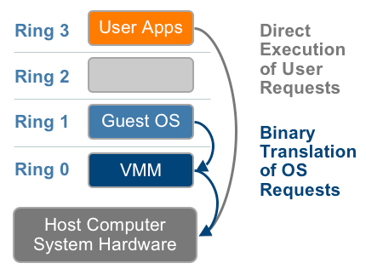
Rings and Virtualization
A Hypervisor is a Virtual Machine Monitor (VMM) that runs and manages virtual machines
A straightforward virtualization scheme
Hypervisor: Ring 0; VM Kernel: Ring 1; VM User: Ring 3
But there are instructions in X86 (sensitive but non-privileged) that cause problems when running in Ring 1; e.g., SGDT returns the host GDT info
– The hypervisor is supposed to handle them
E.g., the hypervisor can maintain a virtual GDT for each VM and returns the VM’s GDT info when SGDT is invoked from a VM
Full Virtualization using Binary Translation
Ref: https://blog.csdn.net/miller_lover/article/details/39898083
The binary translation approach for x86 virtualization
Notes:
Full Virtualization using Binary Translation
VMware can virtualize any x86 operating system using a combination of binary translation and direct execution techniques. This approach, depicted in Figure 5, translates kernel code to replace nonvirtualizable instructions with new sequences of instructions that have the intended effect on the virtual hardware. Meanwhile, user level code is directly executed on the processor for high performance virtualization. Each virtual machine monitor provides each Virtual Machine with all the services of the physical system, including a virtual BIOS, virtual devices and irtualized memory management.

Slide 14
Rings and Virtualization
How to handle those instructions?
Binary translation (e.g., full-virtualization in certain VMware versions)
Modification of the guest OS (e.g., via para-virtualization in certain Xen versions)
Notes:
Full virtualization offers the best isolation and security for virtual machines, and simplifies migration and portability as the same guest OS instance can run virtualized or on native hardware. VMware’s virtualization products and Microsoft Virtual Server are examples of full virtualization.

Slide 15
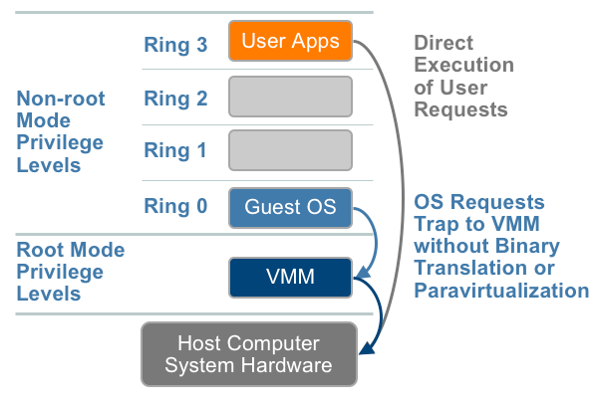
Ring -1 used by the Hypervisor
In 2005 and 2006, Intel and AMD introduced Ring-1, respectively; it is used by the Hypervisor
The VM kernel uses Ring 0, and the Hypervisor -1
The Hypervisor can configure with the CPU which instructions are of interest, so whenever they are executed, the execution traps from Ring 0 to -1
Hardware-assisted full virtualization

Slide 16
Take-away
CPU provides protection rings, while an OS use them for the kernel mode and the user mode
A fault in the user code will not crash the system
User code cannot do I/O directly, but do it through system calls
The design of system calls is beautiful, because..
they allow your program to do something powerful; in the meanwhile you cannot abuse them easily
Ring -1 is used by some hypervisors

Slide 17
Operating System Services
Operating systems provide an environment for execution of programs and services to programs and users
One set of operating-system services provides functions that are helpful to the user:
User interface - Almost all operating systems have a user interface (UI).
Varies between Command-Line (CLI), Graphics User Interface (GUI), Batch
Program execution - The system must be able to load a program into memory and to run that program, end execution, either normally or abnormally (indicating error)
I/O operations - A running program may require I/O, which may involve a file or an I/O device
File-system manipulation - The file system is of particular interest. Programs need to read and write files and directories, create and delete them, search them, list file Information, permission management.

Slide 18
Operating System Services (Cont.)
Communications – Processes may exchange information, on the same computer or between computers over a network
Communications may be via shared memory or through message passing (packets moved by the OS)
Error detection – OS needs to be constantly aware of possible errors
May occur in the CPU and memory hardware, in I/O devices, in user program
For each type of error, OS should take the appropriate action to ensure correct and consistent computing
Debugging facilities can greatly enhance the user’s and programmer’s abilities to efficiently use the system

Slide 19
Operating System Services (Cont.)
Another set of OS functions exists for ensuring the efficient operation of the system itself via resource sharing
Resource allocation - When multiple users or multiple jobs running concurrently, resources must be allocated to each of them
Many types of resources - Some (such as CPU cycles, main memory, and file storage) may have special allocation code, others (such as I/O devices) may have general request and release code
Accounting - To keep track of which users use how much and what kinds of computer resources
Protection and security - The owners of information stored in a multiuser or networked computer system may want to control use of that information, concurrent processes should not interfere with each other
Protection involves ensuring that all access to system resources is controlled
Security of the system from outsiders requires user authentication, extends to defending external I/O devices from invalid access attempts
If a system is to be protected and secure, precautions must be instituted throughout it. A chain is only as strong as its weakest link.

Slide 20
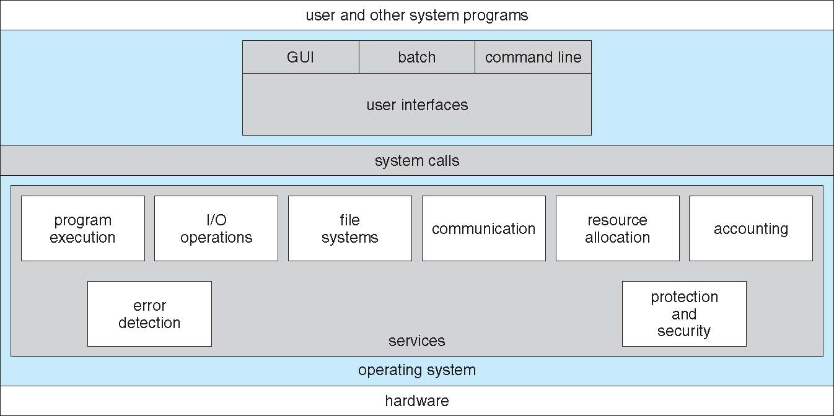
A View of Operating System Services

Slide 21
System Calls
Programming interface to the services provided by the OS
Typically written in a high-level language (C or C++)
Mostly accessed by programs via a high-level Application Programming Interface (API) rather than direct system call use
Three most common APIs are Win32 API for Windows, POSIX API for POSIX-based systems (including virtually all versions of UNIX, Linux, and Mac OS X), and Java API for the Java virtual machine (JVM)
Why use APIs rather than system calls?
(Note that the system-call names used throughout this text are generic)

Slide 22
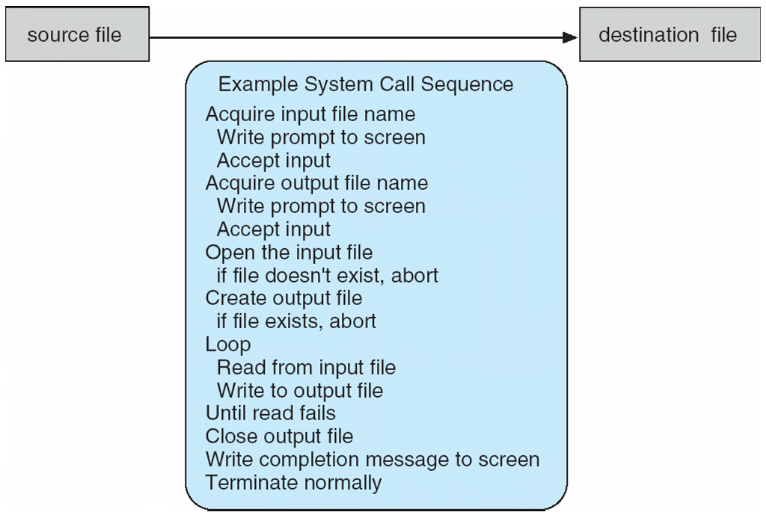
Example of System Calls
System call sequence to copy the contents of one file to another file

Slide 23
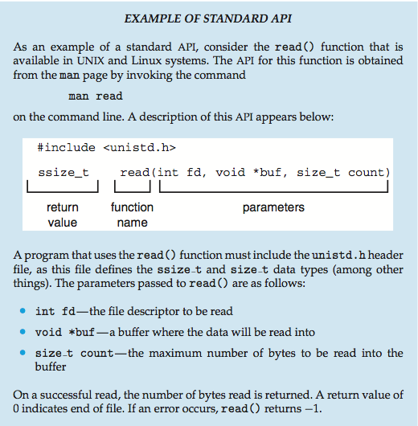
Example of Standard API

Slide 24
How will you design the mechanism of System Calls?
Given a system call, how to design the CPU and the kernel to execute it?
Background: the Program Counter (PC) register in a processor stores the address of the instruction to be executed
PC is incremented after fetching an instruction
But “jump”, “call” and “ret” instruction can set the PC value
If the user code can set the PC register arbitrarily before changing from Ring 3 to Ring 0, how will you exploit the kernel code?
This is very dangerous, as the user code can exploit the power of Ring 0 to harm the whole system

Slide 25
System Call Implementation
Typically, a number associated with each system call
System-call interface maintains a table indexed according to these numbers
The system call interface invokes intended system call in OS kernel and returns status of the system call and any return values
The caller need know nothing about how the system call is implemented
Just needs to obey API and understand what OS will do as a result call
Most details of OS interface hidden from programmer by API
Managed by run-time support library (set of functions built into libraries included with compiler)

Slide 26
System Call Table
offset | symbol | sys_call_table | system call location
0 | __NR_restart_syscall | sys_restart_syscall | ./linux/kernel/signal.c
4 | __NR-exit | sys_exit | ./linux/kernel/exit.c
8 | __NR_exit | sys_fork | ./linux/arch/.../syscall_xx.tbl
1272 | __NR_getcpu | sys_getcpu | ./linux/kernel/sys.c
1276 | __NR_epoll_pwait | sys_epoll_pwait | ./linux/kernel/sys_ni.c
 | __NR_syscalls
./linux/arch/386/kernel/syscall_table.S
./linux/include/uapi/asm-generic/unistd.h

Slide 27
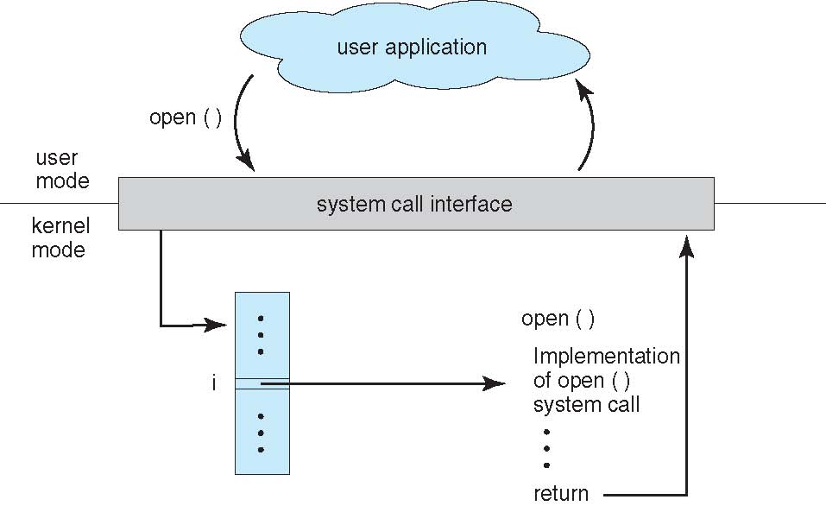
API – System Call – OS Relationship

Slide 28
System Call Parameter Passing
Often, more information is required than simply identity of desired system call
Exact type and amount of information vary according to OS and call
Three general methods used to pass parameters to the OS
Simplest: pass the parameters in registers
In some cases, may be more parameters than registers
Parameters stored in a block, or table, in memory, and address of block passed as a parameter in a register
This approach taken by Linux and Solaris
Parameters placed, or pushed, onto the stack by the program and popped off the stack by the operating system
Block and stack methods do not limit the number or length of parameters being passed

Slide 29
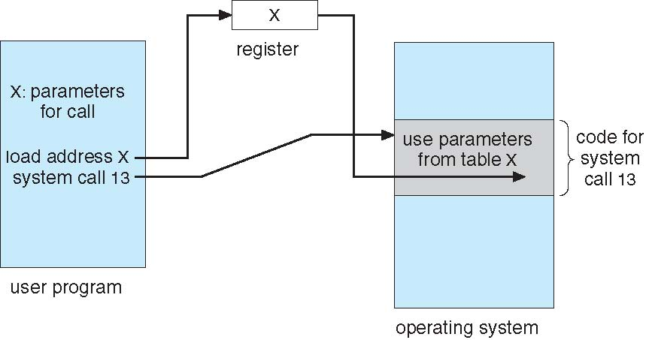
Parameter Passing via Table

Slide 30
Types of System Calls
Process control
end, abort
load, execute
create process, terminate process
get process attributes, set process attributes
wait for time
wait event, signal event
allocate and free memory
Dump memory if error
Debugger for determining bugs, single step execution
Locks for managing access to shared data between processes

Slide 31
Types of System Calls (Cont.)
File management
create file, delete file
open, close file
read, write, reposition
get and set file attributes
Device management
request device, release device
read, write, reposition
get device attributes, set device attributes
logically attach or detach devices

Slide 32
Types of System Calls (Cont.)
Information maintenance
get time or date, set time or date
get system data, set system data
get and set process, file, or device attributes
Communications
create, delete communication connection
send, receive messages if message passing model to host name or process name
From client to server
Shared-memory model create and gain access to memory regions
transfer status information
attach and detach remote devices

Slide 33
Types of System Calls (Cont.)
Protection
Control access to resources
Get and set permissions
Allow and deny user access

Slide 34
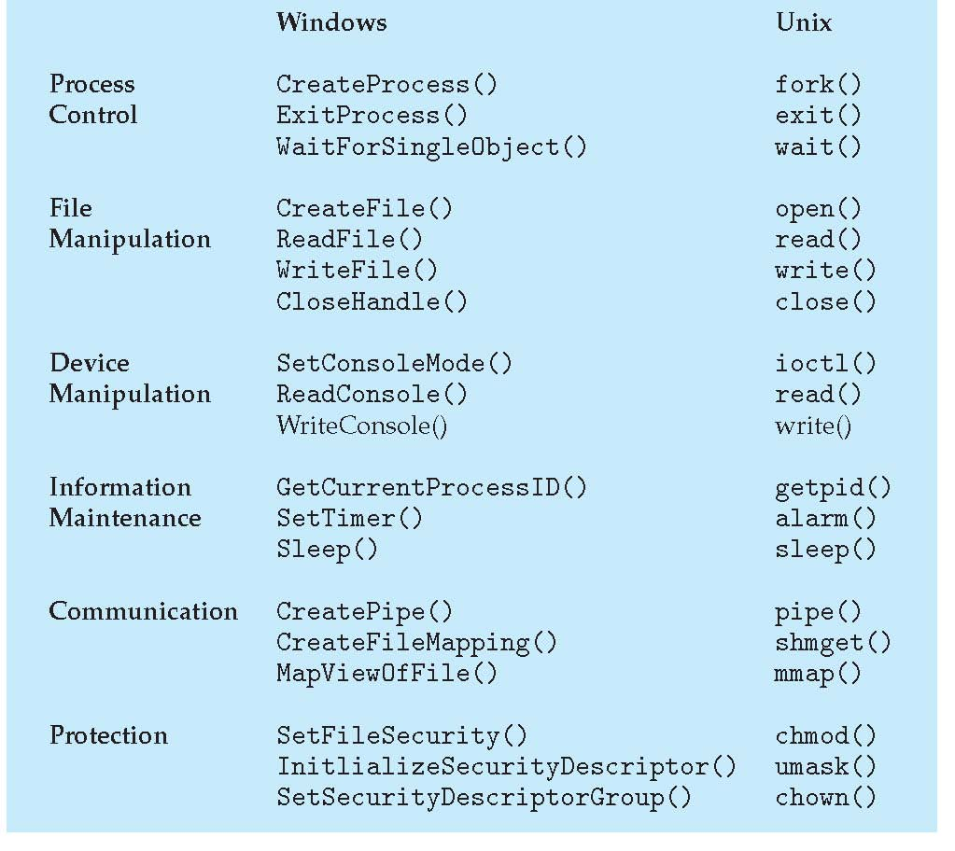
Examples of Windows and Unix System Calls

Slide 35
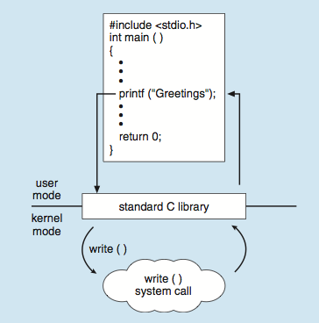
Standard C Library Example
C program invoking printf() library call, which calls write() system call

Slide 36
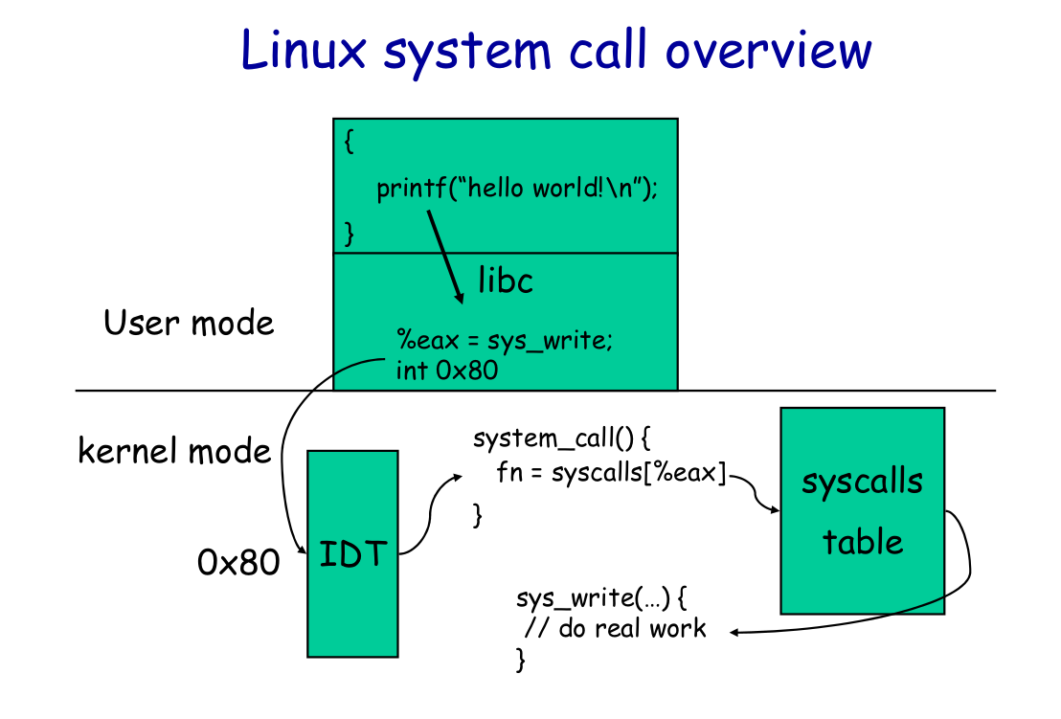

Slide 37
System calls in Linux
arck/i386/kernel/entryS
system_call()
fs/read_write.c
sys_read()
file system or network
or device code
main()
__libc_read()
...
...
push arguments
_libc_read()
pop arguments
...
...
load args to regs
EAX=__NR_read
int 0x80
check error
return
SAVE_ALL
check limit of EAX
syscall_tab[EAX]()
handle signals
possibly schedule
RESTORE_ALL
iret
file=fget(fd)
check file ops
check file locks
(file->fop->read)()
fput(file)
return
Check destination
retrieve data
copy data
return
System call dispatch
table, which is an array
of addresses of system
service functions
INT 0x80/SYSENTER
are instructions used
to issue system calls
User Mode
Kernel Mode

Slide 38
How to trace system calls in Linux/Unix
“strace” command can trace system calls (or ltrace -S)
“ltrace” command can trace library calls
$ strace ls
execve("/bin/ls", ["ls"], 0x7ffcbb5e1bd0 /* 56 vars */) = 0
brk(NULL) = 0x55ac561c8000
access("/etc/ld.so.nohwcap", F_OK) = -1 ENOENT (No such file or directory)
access("/etc/ld.so.preload", R_OK) = -1 ENOENT (No such file or directory)
openat(AT_FDCWD, "/usr/local/cuda/lib64/tls/haswell/x86_64/libselinux.so.1", O_RDONLY|O_CLOEXEC) = -1 ENOENT (No such file or directory)
stat("/usr/local/cuda/lib64/tls/haswell/x86_64", 0x7fff8b28c2d0) = -1 ENOENT (No such file or directory)
openat(AT_FDCWD, "/usr/local/cuda/lib64/tls/haswell/libselinux.so.1", O_RDONLY|O_CLOEXEC) = -1 ENOENT (No such file or directory)
stat("/usr/local/cuda/lib64/tls/haswell", 0x7fff8b28c2d0) = -1 ENOENT (No such file or directory)
openat(AT_FDCWD, "/usr/local/cuda/lib64/tls/x86_64/libselinux.so.1", O_RDONLY|O_CLOEXEC) = -1 ENOENT (No such file or directory)
stat("/usr/local/cuda/lib64/tls/x86_64", 0x7fff8b28c2d0) = -1 ENOENT (No such file or directory)
......

Slide 39
Operating System Design and Implementation
Design and Implementation of OS not “solvable”, but some approaches have proven successful
Internal structure of different Operating Systems can vary widely
Start by defining goals and specifications
Affected by choice of hardware, type of system
User goals and System goals
User goals – operating system should be convenient to use, easy to learn, reliable, safe, and fast
System goals – operating system should be easy to design, implement, and maintain, as well as flexible, reliable, error-free, and efficient

Slide 40
Operating System Design and Implementation(Cont.)
Important principle to separate
Policy: What will be done? Mechanism: How to do it?
Mechanisms determine how to do something, policies decide what will be done
The separation of policy from mechanism is a very important principle, it allows maximum flexibility if policy decisions are to be changed later
Specifying and designing OS is highly creative task of software engineering

Slide 41
Implementation
Much variation
Early OSes in assembly language
Then system programming languages like Algol, PL/1
Now C, C++
Actually usually a mix of languages
Lowest levels in assembly
Main body in C
Systems programs in C, C++, scripting languages like PERL, Python, shell scripts
More high-level language easier to port to other hardware
But slower
Emulation can allow an OS to run on non-native hardware

Slide 42
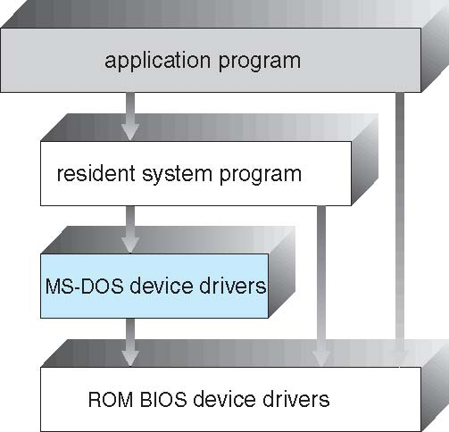
Operating System Structure
General-purpose OS is very large program
Various ways to structure one as follows
MS-DOS – written to provide the most functionality in the least space
Not divided into modules
Although MS-DOS has some structure, its interfaces and levels of functionality are not well separated

Slide 43
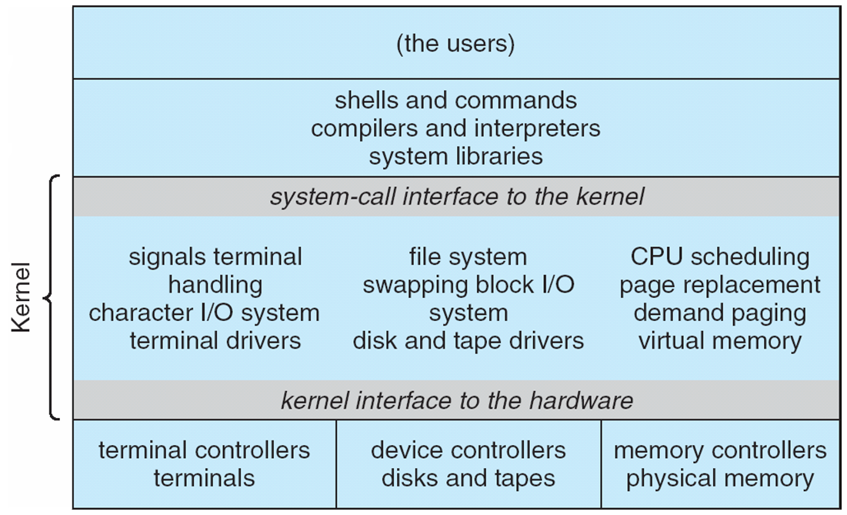
UNIX
UNIX – limited by hardware functionality, the original UNIX operating system had limited structuring. The UNIX OS consists of two separable parts
Systems programs
The kernel
Consists of everything below the system-call interface and above the physical hardware
Provides the file system, CPU scheduling, memory management, and other operating-system functions; a large number of functions for one level

Slide 44
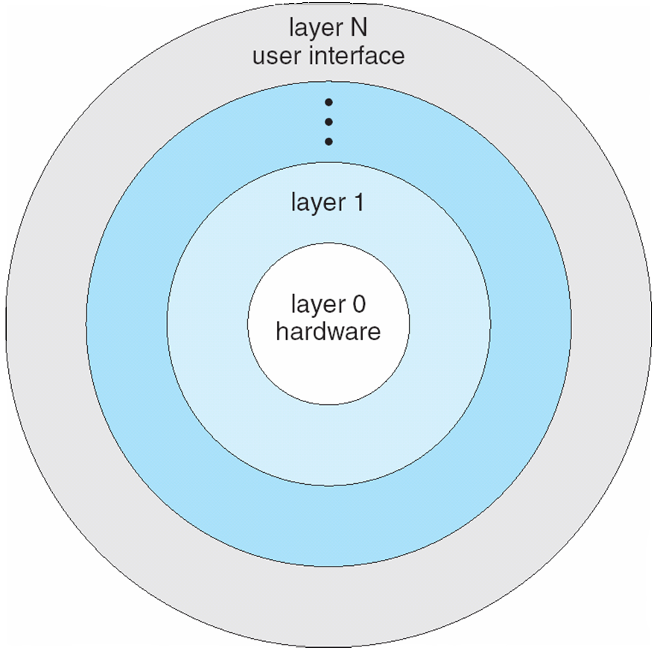
Layered Approach
The operating system is divided into a number of layers (levels), each built on top of lower layers. The bottom layer (layer 0), is the hardware; the highest (layer N) is the user interface.
With modularity, layers are selected such that each uses functions (operations) and services of only lower-level layers

Slide 45
Microkernel System Structure
Moves as much from the kernel into user space
Mach example of microkernel
Mac OS X kernel (Darwin) partly based on Mach
Communication takes place between user modules using message passing
Benefits:
Easier to extend a microkernel
Easier to port the operating system to new architectures
More reliable (less code is running in kernel mode)
More secure
Detriments:
Performance overhead of user space to kernel space communication

Slide 46
Microkernel System Structure(Cont.)

Slide 47
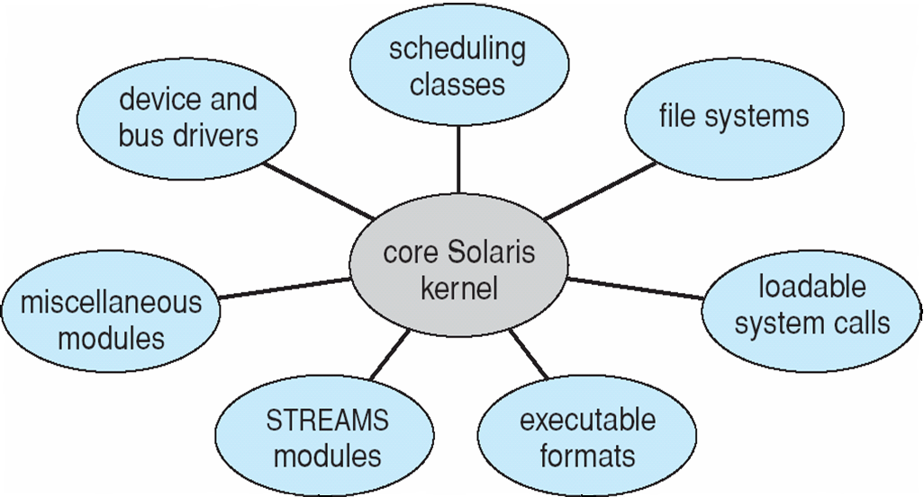
Modules
Most modern operating systems implement loadable kernel modules
Uses object-oriented approach
Each core component is separate
Each talks to the others over known interfaces
Each is loadable as needed within the kernel
Overall, similar to layers but with more flexible
Linux, Solaris, etc

Slide 48
Hybrid Systems
Most modern operating systems actually not one pure model
Hybrid combines multiple approaches to address performance, security, usability needs
Linux and Solaris kernels in kernel address space, so monolithic, plus modular for dynamic loading of functionality
Windows mostly monolithic, plus microkernel for different subsystem personalities
Apple Mac OS X hybrid, layered, Aqua UI plus Cocoa programming environment
Below is kernel consisting of Mach microkernel and BSD Unix parts, plus I/O kit and dynamically loadable modules (called kernel extensions)

Slide 49
Mac OS X Structure

Slide 50
iOS
Apple mobile OS for iPhone, iPad
Structured on Mac OS X, added functionality
Does not run OS X applications natively
Also runs on different CPU architecture (ARM vs. Intel)
Cocoa Touch Objective-C API for developing apps
Media services layer for graphics, audio, video
Core services provides cloud computing, databases
Core operating system, based on Mac OS X kernel

Slide 51
Android
Developed by Open Handset Alliance (mostly Google)
Open Source
Similar stack to IOS
Based on Linux kernel but modified
Provides process, memory, device-driver management
Adds power management
Runtime environment includes core set of libraries and Dalvik virtual machine
Apps developed in Java plus Android API
Java class files compiled to Java bytecode then translated to executable than runs in Dalvik VM
Libraries include frameworks for web browser (webkit), database (SQLite), multimedia, smaller libc

Slide 52
Android Architecture

Slide 53
System Boot
When power initialized on system, execution starts at a fixed memory location
Firmware ROM used to hold initial boot code
Operating system must be made available to hardware so hardware can start it
Small piece of code – bootstrap loader, stored in ROM or EEPROM locates the kernel, loads it into memory, and starts it
Sometimes two-step process where boot block at fixed location loaded by ROM code, which loads bootstrap loader from disk
Common bootstrap loader, GRUB, allows selection of kernel from multiple disks, versions, kernel options
Kernel loads and system is then running

Slide 54
Essential Readings
Rings
http://duartes.org/gustavo/blog/post/cpu-rings-privilege-and-protection/
System calls
https://www.ibm.com/developerworks/linux/library/l-system-calls/
https://www.cs.columbia.edu/~junfeng/10sp-w4118/lectures/l05-syscall-intr-linux.pdf
https://www.cs.princeton.edu/courses/archive/fall10/cos318/lectures/OSStructure.pdf
https://elixir.free-electrons.com/linux/v2.6.18-rc6/source/arch/i386/kernel/vsyscall-sysenter.S
Protecting Against Unexpected System Calls. Usenix Sec’05.
System call issues:
http://www.inf.ed.ac.uk/teaching/courses/os/slides/02-operations.pdf
Compatibility
http://rlc.vlinder.ca/blog/2009/08/binary-compatibility/

Slide 55
Optional Readings on Virtualization
Introduction of Xen
“Xen and the art of virtualization.” SOSP '03
Slides for the paper above: http://courses.cs.vt.edu/cs5204/fall14-butt/lectures/xen.pdf
Virtualization in Xen 3.0. Rami Rosen, Linux Journal 2006.
“The deﬁnitive guide to the xen hypervisor.” 2008
Introduction of Vmware
Virtual Machines & VMware, Part I by Jay Munro
VMware and CPU Virtualization Technology
Virtualization-optimized architectures
Marshall, David. "Understanding Full Virtualization, Paravirtualization, and Hardware Assist.”
Very good slides
https://cbw.sh/static/class/5600/slides/11_Virtual_Machines.pptx
https://www.ics.uci.edu/~aburtsev/cs5460/lectures/lecture25-virtualization/lecture25-virtualization.pdf
List of hypercalls
https://xenbits.xen.org/docs/unstable/hypercall/x86_64/include,public,xen.h.html
Survey
Hwang, Jinho, et al. "A component-based performance comparison of four hypervisors.” 2013.
A summary of virtualization techniques, Haro et al. 2012
A Comparison of Software and Hardware Techniques for x86 Virtualization, ASPLOS’06
Virtualization Basics: Understanding Techniques and Fundamentals, Lee et al., 2014

Slide 56
Sensitive but non-privileged instructions
Analysis of the Intel Pentium’s Ability to Support a Secure Virtual Machine Monitor. Usenix Security, 2000.
Intel Privileged and Sensitive Instructions: https://jeffpar.github.io/kbarchive/kb/114/Q114473/
https://stackoverﬂow.com/questions/32794361/what-are-non-virtualizable-instructions-in-x86-architecture

Slide 57
Optional Readings on x86-64
Long mode = 64-bit mode + Compatibility mode
https://en.wikipedia.org/wiki/Long_mode
Legacy mode: 64-bit programs cannot run
https://en.wikipedia.org/wiki/X86-64
Real mode (without protection rings) vs. V86 mode (virtual real mode in protected mode) vs. Protected Mode
https://stackoverﬂow.com/questions/43111970/whats-the-difference- between-virtual-8086-mode-and-real-address-mode-in-x86-pro
Why do 32-bit applications work on x86-64 CPU?
https://stackoverﬂow.com/questions/28307180/why-do-32-bit-applications-work-on-64-bit-x86-cpus
How retiring segmentation in AMD64 long mode broke Vmware
http://www.pagetable.com/?p=25

Slide 58
Ring -2: System Management Mode
https://security.stackexchange.com/questions/129098/what-is-protection-ring-1

Slide 59
CPL, DPL, RPL (RPL not used nowadays)
DPL - Descriptor Privilege Level
CPL - Current Privilege Level
The CPL bits are always consistent with the kernel/user mode
RPL - Requested Privilege Level
A logical addr = a 16-bit segment identifier/selector + offset
13-bit index + 1-bit Table indicator + 2-bit RPL
The Intel processor provides Segment Registers to hold Segment Selectors
cs (it contains CPL), ss, ds
A Segment Descriptor has 8 bytes and contains DPL
Before the processor loads a segment selector into a segment register, it performs a privilege check:
Max(CPL, RPL) <= DPL
https://software.intel.com/en-us/forums/intel-isa-extensions/topic/733754
https://iambvk.wordpress.com/2007/10/10/notes-on-cpl-dpl-and-rpl-terms/

