Slide 1
Operating Systems Processes and Threads
Hua Huang, Ph.D.
Spring 2019

Slide 2
Previous class…
What is the difference between Kernel Mode and User Mode?
1. Faults in user space can be captured by the kernel
2. Privileged instructions, e.g., I/O instructions, can only be issued (when the CPU is) in the kernel mode
3. Some memory address space (i.e., the kernel space) can only be accessed in the kernel mode; this portion of memory stores the kernel code and data

Slide 3
Previous class…
Why are Protection Rings needed?
Fault isolation: the program crash can be captured and handled by a lower ring
Privileged instructions can only be issued in a privileged ring (e.g., ring 0), which makes resource management, isolation and protection possible
“Privileged” memory address space (e.g., the kernel space) can only be accessed in a privileged ring

Slide 4
Previous class…
Given an X86 CPU, how do you tell whether the CPU is in the kernel mode or user mode
The lowest two bits in the CS (Code Segment) register indicate the Current Privilege Level of the CPU.
E.g., 00 means that the CPU is in ring 0
Index（3-15） | TI | CPL
15 | 2 | 0

Slide 5
Previous class…
What if the user mode code tries to execute privileged instructions?
Whenever a privileged instruction is executed, the CPU checks whether it is in the kernel mode; if not, an exception (e.g., in x86, a General Protection exception) is triggered to end the current process

Slide 6
Previous class…
Given that I/O instructions can only be executed in the kernel mode, how does a user program perform I/O?
System calls. When a system call is invoked, the CPU mode switches to kernel mode and CPU can thus execute privileged instructions, such as I/O instructions.

Slide 7
System calls in Linux
arck/i386/kernel/entryS
system_call()
fs/read_write.c
sys_read()
file system or network
or device code
main()
__libc_read()
...
...
push arguments
_libc_read()
pop arguments
...
...
load args to regs
EAX=__NR_read
int 0x80
check error
return
SAVE_ALL
check limit of EAX
syscall_tab[EAX]()
handle signals
possibly schedule
RESTORE_ALL
iret
file=fget(fd)
check file ops
check file locks
(file->fop->read)()
fput(file)
return
Check destination
retrieve data
copy data
return
System call dispatch
table, which is an array
of addresses of system
service functions
INT 0x80/SYSENTER
are instructions used
to issue system calls
User Space
Kernel Space

Slide 8
Outline
Process Concept
Process State Transition
Call Stack and Calling Convention
Execution Context
Process Control Block
Process Switch and Timer Interrupts
Process Creation and Termination
Thread models and libraries
Processes vs. Threads

Slide 9
Process Concept
An operating system executes a variety of programs:
Batch system – jobs
Time-shared systems – user programs or tasks
Textbook uses the terms job and process almost interchangeably
Process – a program in execution; process execution must progress in sequential fashion
Multiple parts
The program code, also called text section
Current activity including program counter, processor registers
Stack containing temporary data
Function parameters, return addresses, local variables
Data section containing global variables
Heap containing memory dynamically allocated during run time
Program is passive entity stored on disk (executable file), process is active
Program becomes process when executable file loaded into memory
Execution of program started via GUI mouse clicks, command line entry of its name, etc
One program can be several processes
Consider multiple users executing the same program

Slide 10
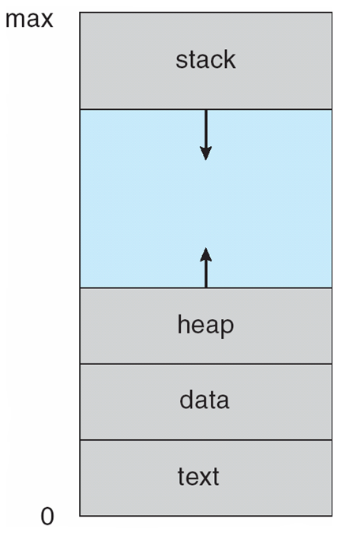
Process in Memory

Slide 11
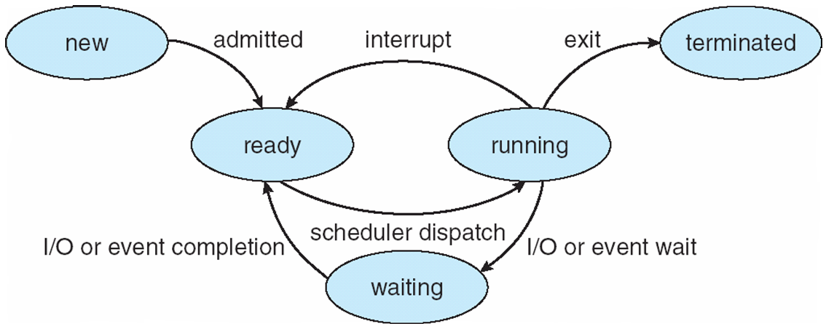
Process State and the transitions
As a process executes, it changes state
new: The process is being created
running: Instructions are being executed
waiting: The process is waiting for some event to occur
ready: The process is waiting to be assigned to a processor
terminated: The process has finished execution
Which involves context switch?

Slide 12
Call stack
A call stack is a stack data structure that store information of the active function calls
A call stack is composed of stack frames (also called activation records or activation frames). Each function call corresponds to a stack frame, which consists of
Arguments passed to the routine
The return address
Saved register values (in order to restore them at return)
Local variables
The call stack grows when a new call is issued, and shrinks when a function call returns

Slide 13
Calling Convention
A Calling Convention stipulates important information about how a function calls another, and how the call returns. It consists of
How parameters are passed (e.g., through registers or the call stack)
The order of parameters if there are multiple ones
Who (caller or callee) is to recover the environment after the call returns
How the return value is to be passed from the callee to the caller

Slide 14
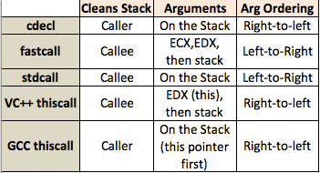
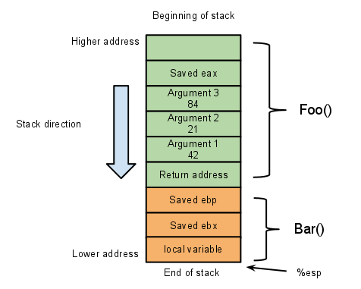
Call stack and calling convention (x86-32 as an example)
Bar(42, 21, 84) // invoked by Foo()
Calling Convention
Stack Pointer register, which stores the address of the stack top

Slide 15
Execution context
The execution context (or context; or processor state ) is the content of the CPU registers at any point of time, e.g.
Program counter: a specialized register that indicates the current program location
Call stack pointer: indicates the top of the kernel-space call stack for the process
Location of memory allocated for the process
Other register values

Slide 16
Caution: the meaning of “state” is ambiguous
Process state: Running/Blocked/Ready
Processor state, i.e., the execution context
Don’t mistake them

Slide 17
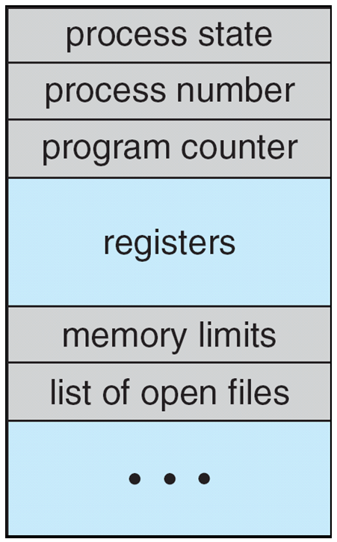
Where is the context information stored?
A Process Control Block (PCB, also called task control block) is an instance of a data structure in the kernel memory containing the information needed to manage a particular process. It includes
The stored execution context information
Process ID
Process control information, such as the scheduling state, opened file descriptors, accounting information

Slide 18
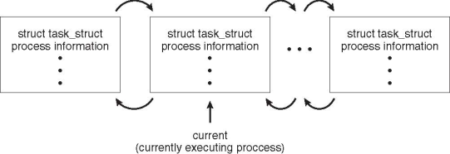
Linux’s PCB: task_struct
include/linux/sched.h
560 struct task_struct {
569 volatile long state;
577 void *stack;
701 pid_t pid; // thread id
702 pid_t tgid; // thread group id
718 task_struct __rcu *parent;
723 struct list_head children;
724 struct list_head sibling;
815 /* open file information */
816 struct files_struct *files;
821 /* signal handlers */
822 struct signal_struct *signal;
1138 struct thread_struct thread;
1147};
The execution context is stored in the thread_struct structure

Slide 19
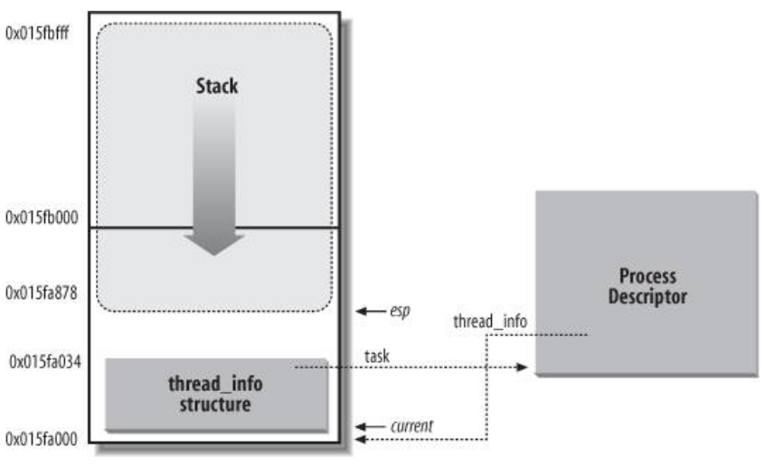
How to locate the PCB task_struct?
#define current get_current()
static inline struct task_struct * get_current(void) {
return current_thread_info()->task;
}
thread_info and the kernel stack together reside in 8k (2^13=8k) space (two pages)
static inline struct thread_info *current_thread_info(void) {
__asm( “
movl $0xffffe000, %eax
andl %esp, %eax
task_struct
”)
}
Mask off 13 bits of esp, and you can get the addr of thread_info, which has a field task pointing to task_struck

Slide 20
Process Scheduling
Maximize CPU use
Quickly switch processes onto CPU for time sharing
Process scheduler selects among available processes for next execution on CPU
Maintains scheduling queues of processes
Job queue – set of all processes in the system
Ready queue – set of all processes residing in main memory, ready and waiting to execute
Device queues – set of processes waiting for an I/O device
Processes migrate among the various queues

Slide 21
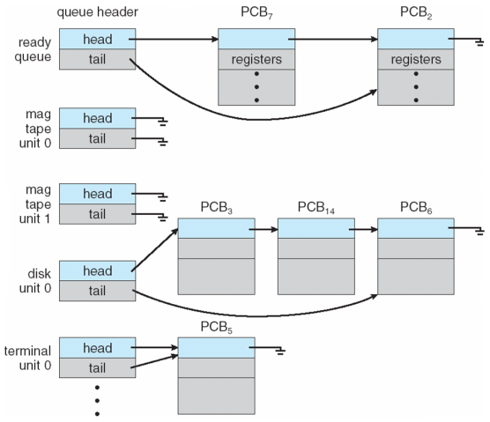
Ready Queue And Various I/O Device Queues

Slide 22
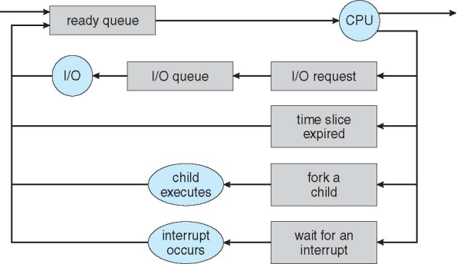
Representation of Process Scheduling
Queuing diagram represents queues, resources, flows

Slide 23
Process switch
A Process Switch (or Task Switch) occurs when the OS scheduler suspends the execution of one process on a CPU and runs another
Store the context of the current process into its PCB
The scheduler picks a process in the “ready” list
Use the PCB of the picked process to restore the contents of the CPU registers
The effect is that the first process is scheduled out and the second process is scheduled in

Slide 24
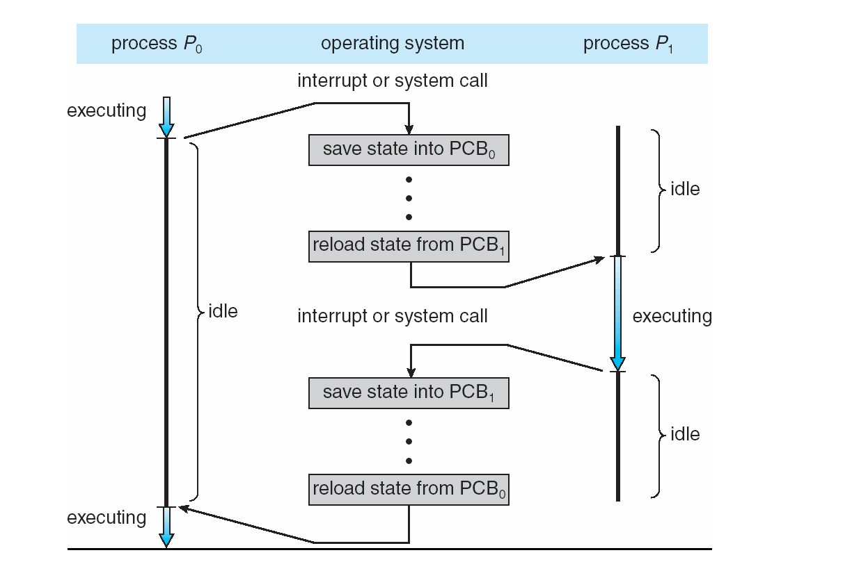
CPU Switch From Process to Process

Slide 25
When does a Process Switch occur?
A process blocks (e.g., due to I/O)
A process exits
The CPU time slice is used up

Slide 26
How does the kernel know when the CPU time slice of the current process is used up?
Assume the timer interrupt has a frequency of 1000hz, i.e., it occurs once per 1ms
Assume the CPU time slice for a process is 10ms; thus, a counter of the process is set to 10 when it is scheduled in
Each time the timer interrupt occurs, the interrupt handler (in kernel) will decrement the counter
When the counter is 0, scheduling occurs: the current process is scheduled out and another is scheduled in

Slide 27
Whenever a timer interrupt is issued, the interrupt handler in the kernel is invoked to determine whether scheduling should happen
Timer interrupts ensure that the CPU time allocation is
under the control of the kernel; i.e., no user process can occupy the CPU longer than it is supposed to

Slide 28
Question
If the CPU time slice is 10ms, why not just set the timer interrupt frequency as 100?
Timer interrupts are not only used by the scheduler, but also timing purpose (e.g., games, multimedia player)

Slide 29
Schedulers
Short-term scheduler (or CPU scheduler) – selects which process should be executed next and allocates a CPU
Sometimes the only scheduler in a system
Short-term scheduler is invoked frequently (milliseconds) ==> (must be fast)
Long-term scheduler (or job scheduler) – selects which processes should be brought into the ready queue
Long-term scheduler is invoked infrequently (seconds, minutes) ==> (may be slow)
The long-term scheduler controls the degree of multiprogramming
Processes can be described as either:
I/O-bound process – spends more time doing I/O than computations, many short CPU bursts
CPU-bound process – spends more time doing computations; few very long CPU bursts
Long-term scheduler strives for good process mix

Slide 30
Multitasking in Mobile Systems
Some mobile systems (e.g., early version of iOS) allow only one process to run, others suspended
Starting with iOS 4, it provides for a
Single foreground process – controlled via user interface
Multiple background processes – in memory, running, but not on the display, and with limits
Limits include single, short task, receiving notification of events, specific long-running tasks like audio playback
Android runs foreground and background, with fewer limits
Background process uses a service to perform tasks
Service can keep running even if background process is suspended
Service has no user interface, small memory use

Slide 31
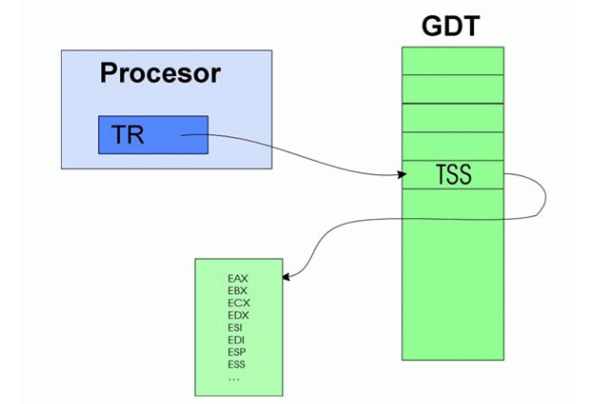
Linux/x86 – How to locate kernel stack during mode switch?
The x86 CPU has a Task Register (TR), that points to he Task State Segment (TSS) descriptor
Linux kernel creates a Task State Segment (TSS) for each CPU, which contains
Kernel stack address (TSS.esp0)
TSS is updated during context switch

Slide 32

Hardware vs. Software context switch
Intel makes Task State Segment (TSS) complex to support h/w context switch; it is supposed to work as PCB
Linux, however, uses s/w context switch, because it is easier to port for other CPUs, and has more opportunities for optimizations.
Linux only uses TSS for saving the kernel stack address and IO permission checking. Other registers are saved in the kernel stack and task_struct, which is the PCB in linux

Slide 33
Linux/x86 – Task switch
Switch from process prev to next
Switch the page table (using task_struct.mm_struct.pgd)
Save ebp, eflags, and general purpose registers at prev’s stack
Save eip onto the stack of prev
Save and restore esp (using thread_struct of prev & next)
Current CPU’s TSS is updated (using next’s thread_struct)
Restore eip using the value saved for next // through “ret” instruction
eflags register
CF: carry flag (unsigned arithmetic)
OF: overflow flag (signed arithmetic)
ZF: zero flag
TF: trap flag (for debugging)
IF: interrupt enable flag (cli: turn off interrupts)

Slide 34
Operations on Processes
System must provide mechanisms for:
process creation,
process termination,
and so on as detailed next

Slide 35
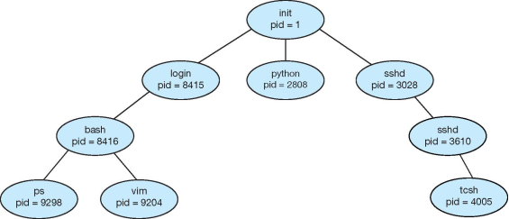
Process Creation
A process may create other processes.
Parent process create children processes, which, in turn create other processes, forming a tree of processes
Generally, a process is identified and managed via a process identifier (pid)
A Tree of Processes in UNIX

Slide 36
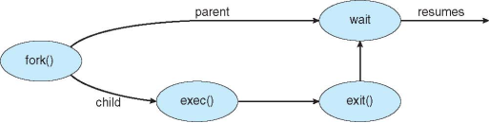
Process Creation (Cont.)
Resource sharing among parents and children options
Parent and children share all resources
Children share subset of parent’s resources
Parent and child share no resources
Execution options
Parent and children execute concurrently
Parent waits until children terminate
Address space
A child is a duplicate of the parent address space.
A child loads a program into the address space.
UNIX examples
fork() system call creates new process
exec() system call used after a fork()replaces the process’ memory space with a new program

Slide 37
C program to create a separate process in UNIX
#include <stdio.h>
#include <sys/wait.h> #include <sys/types.h>
#include <unistd.h> int main() { pit.t pid; pid = fork(); /*fork a child process */ if (pid < 0) { /* error occurred */ fprintf(stderr, "Fork Failed"); return 1; } else if (pid == 0) { /*child process */ execlp("/bin/ls","ls",NULL); } else { /* parent process */ /* parent will wait for the child to complete */ wait(NULL); printf("Child Complete"); } return 0; }

Slide 38
C Program Forking Separate Process
The C program illustrates how to create a new process UNIX.
After fork() there are two different processes running copies of the same program. The only difference is that the value of pid for the child process is zero, while that for the parent is an integer value greater than zero
The child process inherits privileges and scheduling attributes from the parent, as well certain resources, such as open files.
The child process then overlays its address space with the UNIX command “ls” (used to get a directory listing) using the execlp() (a version of the exec() system call).
The parent waits for the child process to complete with the wait() system call.
When the child process completes the parent process resumes from the call to wait(), where it completes using the exit() system call.

Slide 39
Creating a Separate Process via Windows API
int main(VOID) { STARTUPINFO si; PROCESS_INFORMATION pi; ZeroMemory(&si, sizeof(si)); /* allocate memory */ si.cb = sizeof(si); ZeroMemory(&pi, sizeof(pi)); /* create child process */ if (!CreateProcess(NULL, /* use command line */ "C:\\WINDOWS\\system32\\mspaint.exe",/* command */ NULL, /* don’t inherit process handle */ NULL, /* don’t inherit threat handle */ FALSE, /* disable handle inheritance */ 0, /* no creation flags */ NULL, /* use parent’s environment block */ NULL, /* use parent’s existing directory */ &si, &pi)) { fprintf{stderr, “Create Process Failed”}; return -1; } /* parent will wait for the child to complete */ WaitForSingleObject(pi.hProcess, INFINITE); printf(“Child Complete”); /* close handles */ CloseHandle(pi.hProcess); CloseHandle(pi.hThread); }

Slide 40
Process Termination
A process terminates when it finishes executing its final statement and it asks the operating system to delete it by using the exit() system call.
At that point, the process may return a status value (typically an integer) to its parent process (via the wait() system call.
All the resources of the process are deallocated by the operating system.
A parent may terminate the execution of children processes using the abort() system call. Some reasons for doing so:
Child has exceeded allocated resources
Task assigned to child is no longer required
The parent is exiting and the operating systems does not allow a child to continue if its parent terminates

Slide 41
Process Termination (Cont.)
Some operating systems do not allow a child process to exists if its parent has terminated. If a process terminates, then all its children must also be terminated.
cascading termination. All children, grandchildren, etc. are terminated.
The termination is initiated by the operating system.
The parent process may wait for termination of a child process by using the wait()system call. The call returns status information and the pid of the terminated process
pid = wait(&status);
If no parent waiting (did not invoke wait()) process is zombie
If parent terminated without invoking wait, process is orphan

Slide 42
Threads
So far, process has a single thread of execution
Consider having multiple program counters per process
Multiple locations can execute at once
Multiple threads of control -> threads
Must then have storage for thread details, multiple program counters in PCB

Slide 43
Motivation
Most modern applications are multithreaded
Threads run within application
Multiple tasks with the application can be implemented by separate threads
Update display
Fetch data
Spell checking
Answer a network request
Process creation is heavy-weight while thread creation is light-weight
Can simplify code, increase efficiency
Kernels are generally multithreaded

Slide 44
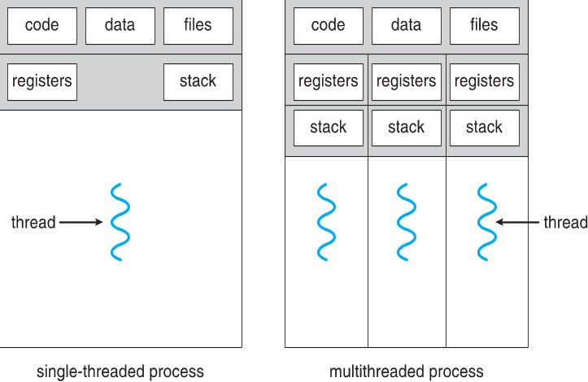
Single and Multithreaded Processes

Slide 45
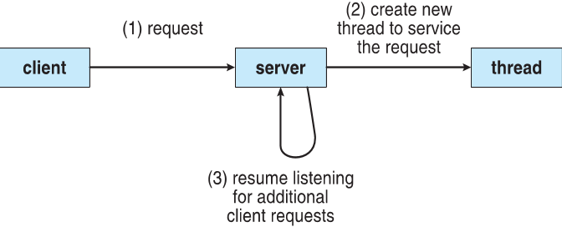
Multithreaded Server Architecture

Slide 46
Benefits
Responsiveness – may allow continued execution if part of process is blocked, especially important for user interfaces
Resource Sharing – threads share resources of process, easier than shared memory or message passing
Economy – cheaper than process creation, thread switching lower overhead than context switching
Scalability – process can take advantage of multiprocessor architectures

Slide 47
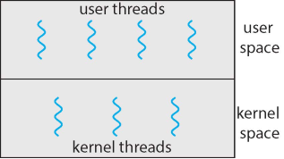
User and Kernel Threads
Support for threads may be provided at two different levels:
User threads - are supported above the kernel and are managed without kernel support, primarily by user-level threads library.
Kernel threads - are supported by and managed directly by the operating system.
Virtually all contemporary systems support kernel threads:
Windows, Linux, and Mac OS X

Slide 48
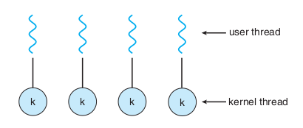
Relationship between user and Kernel threads
Three common ways of establishing relationship between user and kernel threads:
Many-to-One
One-to-One
Many-to-Many
One-to-One Model
Each user-level thread maps to a single kernel thread
Creating a user-level thread creates a kernel thread
More concurrency than many-to-one
Number of threads per process sometimes restricted due to overhead
Examples
Windows
Linux

Slide 49
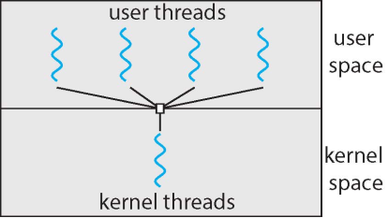
Many-to-One Model
Many user-level threads mapped to single kernel thread
One thread blocking causes all to block
Multiple threads may not run in parallel on multicore system because only one may be in kernel at a time
Few systems currently use this model
Examples:
Solaris Green Threads
GNU Portable Threads

Slide 50
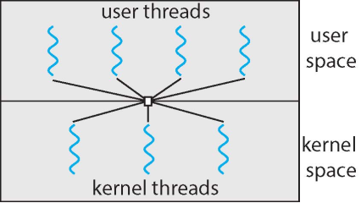
Many-to-Many Model
Allows many user level threads to be mapped to many kernel threads
Allows the operating system to create a sufficient number of kernel threads
Solaris prior to version 9
Windows with the ThreadFiber package

Slide 51
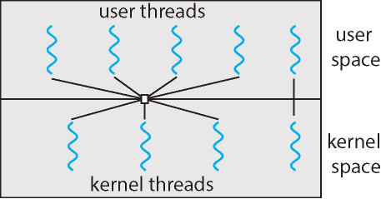
Two-level Model
Similar to many-to-many, except that it allows a user thread to be bound to kernel thread
Examples
IRIX
HP-UX
Tru64 UNIX
Solaris 8 and earlier

Slide 52
Thread Libraries
Thread library provides programmer with API for creating and managing threads
Two primary ways of implementing
Library entirely in user space
Kernel-level library supported by the OS
Three primary thread libraries:
POSIX Pthreads
Windows threads
Java threads

Slide 53
Process vs. Thread
Process
Thread
A process is an executing instance of a program
Different processes have different memory address spaces
Resource-heavyweight: signiﬁcant resources are consumed when creating a new process
A thread is the entity within a process that can be scheduled for code execution
A process has at least one thread
Threads of a process share a lot of information, such as memory address space, opened ﬁles, etc.
Thus, resource-lightweight to create a new thread

Slide 54
Using Threads over Processes
Pros
Cons
Cheaper to create a new thread
Cheaper task switch:
when you switch the threads of the same process, you only need to update part of the context (e.g., esp)
Cheaper data sharing between threads of a process
one bug in one thread may render the whole process unstable
Once one thread is attacked (more precisely, compromised), the whole process is in danger
The main reason why one-process-per-tab browsers become so popular

Slide 55
Summary
Process state transition
Ready, blocked, running
Call Stack and Calling Convention
Execution Context
Process switch
CPU time slice is used up
Process is blocked (e.g., waiting for user input)
Process has exited
Process creation and termination
Threads and models
Process vs. Thread

Slide 56
Interesting Readings
Threads vs. Processes:
http://blogs.datalogics.com/2013/09/25/threads-vs-processes-for-program-parallelization/
Timer interrupt frequency
https://lwn.net/Articles/145973/
Assembly using RDTSC; faster than clock_gettime()
https://stackoverﬂow.com/questions/14017894/time-calculation-with-tsc-time-stamp-counter/14019158#14019158
Constant TSC rate is one every CPU now:
https://stackoverﬂow.com/questions/7935518/is-clock-gettime-adequate-for-submicrosecond-timing
http://oliveryang.net/2015/09/pitfalls-of-TSC-usage/
https://stackoverﬂow.com/questions/88/is-gettimeofday-guaranteed-to-be-of-microsecond-resolution/367#367
clock_gettime: portable method for time measurement
https://stackoverﬂow.com/questions/15623343/using-cpu-counters-versus-gettimeofday/15623833#15623833

