Slide 1
Welcome to the world of Computer Architecture
计算机体系结构
董 岚

Slide 2
教学目的
计算机（系统）是可以由您来设计的！
本课程将告诉您：
计算机设计的原则和技术

Slide 3
本课程在专业教学中的地位
计算机基础 操作系统 编译
计算机应用需要什么？
操作系统需要哪些功能支持？
优化编译可以利用和实现哪些功能？
计算机系统性能如何优化？
我们能够建造什么样的机器？
今后的计算机将会怎样？
数据结构
应用基础
C语言编程
存储管理
调度
并发
代码生成
优化
计算机组成
原理
计算机系统
结构
基本逻辑单元处
理器基本知识
如何实现
具体细节
－－知其然
1.分析＋评测－知其所以然
2.设计新型的计算机系统
数字逻辑

Slide 4
教学安排
上课
答疑
联系方法 donglan@bjtu.edu.cn

Slide 5
学习计算机设计技术的必要性
  一些人将设计计算机，制造计算机
  每个人都将使用计算机
    越了解计算机，使用就越有效！
有益的收获
  如何使程序运行的更快
  了解计算机技术、结构发展的内在规律
以用户为中心的计算机系统
    本课程将使你能够更好地启迪用户
    考虑整个计算机系统：处理器、存储器、I/O、存储系统、网络

Slide 6
学习计算机设计技术的必要性（续）
  放弃微处理器的设计与OS的研究和开发曾是我们的国策。
  现在已开始反省这一国策，提出开发自己的微处理器和OS。
  在今天后PC时代更有必要。因为在后PC时代，计算机的主要作用不再是独立使用的机器，而是一个应用系统或设备的组件（如马达一样），处理器技术是高性能智能设备的核心。

Slide 7
CPU是国家大宗战略产品
通用CPU芯片是信息产业的基础部件，是武器装备的核心器件
  我国由于缺少自主的CPU技术和产业，不仅信息产业严重受制于人，国家安全也面临威胁
目前美国对通用CPU技术和产业进行严格控制，连其盟国（欧盟和日本）都不允许拥有该技术和产业
  试想一个国家需要完全依靠从一个与之有着战事冲突或经济不稳定的国家进口某种珍贵商品，而且没有这种商品，其整个社会将被迫停顿。再试想这个国家是中国，而与之有着战事冲突的国家是美国，而该商品是 CPU－－－美国《连线》杂志
Notes:
Intel与苹果重要性；习大大访美

Slide 8
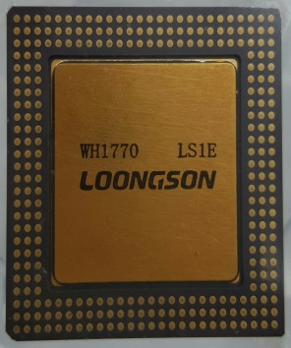
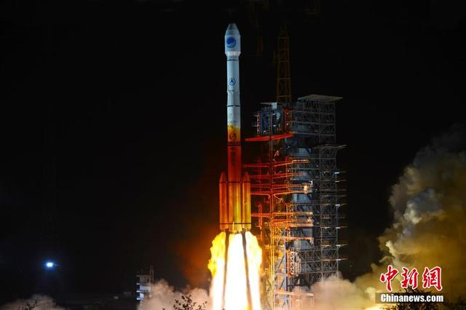
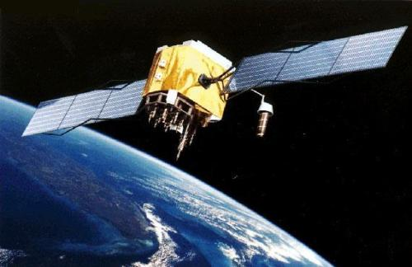
北斗卫星搭载龙芯
2015年3月31日，中科院负责研制的新一代导航卫星发射升空，也是中国北斗卫星导航系统的第17颗北斗卫星，该卫星首次使用国内制造的“龙芯”中央处理器（CPU）
  宇航级芯片
  要求很高的抗辐照能力

Slide 9
CPU是信息产业的基础部件
2011年中国电子信息百强企业利润总额（138亿美元）为苹果公司的四成
2012年我国手机芯片出货上亿片，联想、华为、中兴、小米等多家手机企业进入全球前十，但苹果和三星占全球手机企业利润的97%
我国每年用于进口集成电路的外汇达到2000亿美元，超过石油成为第一大进口商品

Slide 10
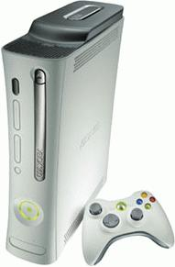
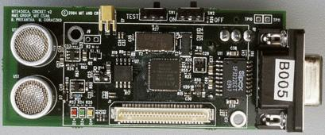
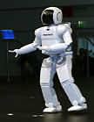

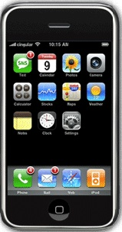

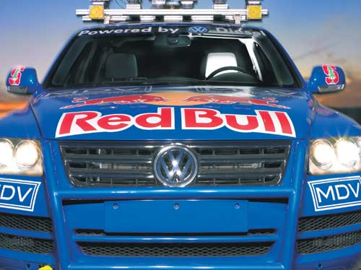
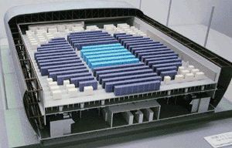
Computing Devices Now
Sensor Nets
Games
Servers
Robots
Routers
Smart phones
Automobiles
Supercomputers
Notes:
100多亿美元

Slide 11
CPU是信息安全的核心保障
伊朗核离心装置的“震网”病毒
  2012年3月23日，布什尔核电站遭到震网病毒攻击，20%离心机报废
  监控录像被篡改，监控人员看到正常画面；遭攻击电脑是物理隔离的
叙利亚雷达案例
  IEEE Spectrum：2007年9月，以色列轰炸了叙利亚东北部一个潜在的核设施，在此之前，叙利亚预警雷达刚好出现故障，刚开始以为是正常的随机故障。事后发现是雷达中的通用（Off-the-shelf）处理器后门引起
我国也有类似情况
  ……
Notes:
电厂、奥迪

Slide 12
CPU市场分类及我国基础
每年亿片量级
传统电脑还有市场
云计算的影响
水平整合，Wintel平台垄断
研发向市场转型
龙芯、申威、飞腾
安全、党政、行业
云服务器/云终端
电脑类
（个人电脑、服务器/HPC）
每年10亿片量级
不断提高性能，与PC融合
Android等平台竞争激烈
垂直整合的趋势
SOC发展快
数字电视：海信、海尔
移动终端：华为、展讯、全志
部分用自主CPU
消费类
（手持移动终端、数字电视/机顶盒、车载娱乐电子）
每年100亿片量级
从低端（8/16位）向高端发展
物联网化
垂直整合，没有平台化
产业链短易突破
珠三角需求量大
结合行业需求进行垂直整合
龙芯、君正等有一定基础
控制（MCU）类
（工业控制、数据采集、仪器仪表、物联网、……）

Slide 13
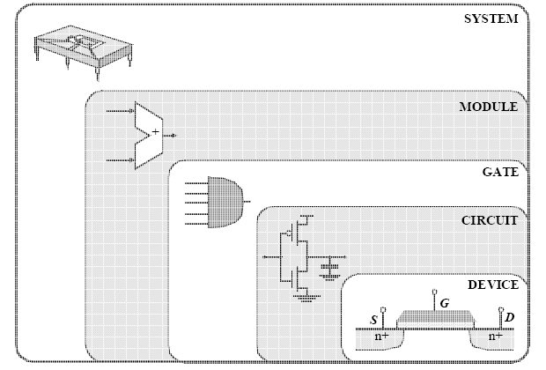
CPU的设计层次(流程)
系统设计师结构设计师
物理设计师
芯片生产厂
验证测试工程师
Notes:
就像设计汽车，先由外观结构设计师画好外观图，物理设计师设计好每个零部件，芯片生产厂把汽车组装起来，一个汽车是否合格，还要经过层层检验，最后验证安全无误才能出厂。

Slide 14
1.1 计算机系统的多层次结构
计算机系统的多层次结构的一个极端就是：单层次计算机——高级语言机器。
Principle of Equivalence of Hardware and Software:
  Anything that can be done with software can also be done with hardware, and anything that can be done with hardware can also be done with software.*
* Assuming speed is not a concern.

Slide 15
不可编程
的计算机
问题：
若计算机只能有一条指令，请设计这条唯一的指令？
软件
功能分配
比例%
只有一条指令的计算机
硬件
常见的计算机系统
图1.1计算机系统的软、硬件功能分配

Slide 16
1.2 计算机系统结构、组成与实现
“计算机体系结构” （Computer Architecture）是计算机科学与技术学科中最重要的概念之一。但这一概念并不是同计算机或计算机科学与技术学科一起与生俱来的，它是在第一台电子计算机诞生近20年后，由G.M.Amdahl等人于1964年在设计IBM System/360时提出的。

Slide 17
Amdahl的定义
…the attributes of a [computer] system as seen by the programmer, i.e. the conceptual structure and function behaviour, as distinct from the organization of the data flows and controls ，the logic design, and the physical implementation.
  Amdahl, Blaaw and Brooks (1964)
--可编程存贮系统的组成
-- 数据类型& 数据结构:
--编码& 表示
-- 指令格式
-- 指令(或操作码) 集合
-- 对数据项和指令进行寻址和访问的模式
-- 意外情况

Slide 18
计算机系统结构、组成与实现
  计算机体系结构是指程序员所看到的机器的属性，即机器的概念性结构和功能表现。这里，程序员主要是指汇编、编译程序员。
  计算机组成是计算机体系结构的逻辑实现。一种计算机体系结构可以有多种不同的计算机组成。
  计算机实现是计算机组成的物理实现。一种计算机组成也可以有多种不同的计算机实现。

Slide 19
计算机组成
主要功能部件的实际能力和性能特性 例如, 寄存器, ALU, 移位器,逻辑部件, 等等
部件之间的互联方式
部件之间信息的流动
控制这些信息流动的逻辑和方法
为实现指令系统体系结构, 功能部件协作、运行的情况
寄存器传输级别(RTL)的规范！

Slide 20
计算机系统结构、组成与实现
  计算机体系结构的核心是指令集( Instruction Set )。指令集就是软、硬件功能划分的界面。
  指令对程序员是不透明的，但是指令的实现对程序员是透明的
  计算机指令集的设计不是孤立的，它必须考虑体系结构的逻辑实现。

Slide 21
What is “Computer Architecture”
Computer Architecture =
Instruction Set Architecture +
Machine Organization+…

Slide 22
The Instruction Set: a Critical Interface
software
instruction set
hardware
Properties of a good abstraction
  Lasts through many generations (portability)
  Used in many different ways (generality)
  Provides convenient functionality to higher levels
  Permits an efficient implementation at lower levels

Slide 23
1.2 计算机系统结构、组成与实现
  计算机系统结构研究的是软、硬件功能分配以及如何最佳、最合理地实现分配给硬件的功能。
  计算机组成技术的改进会推动计算机体系结构的发展。
  但是计算机组成的设计向上受限于体系结构的设计结果，向下受限于所能采用的实现技术。

Slide 24
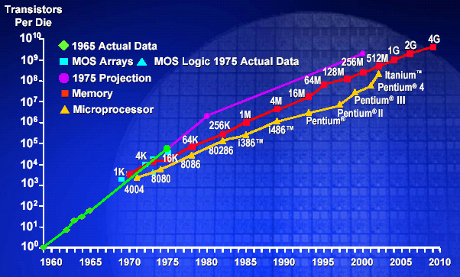
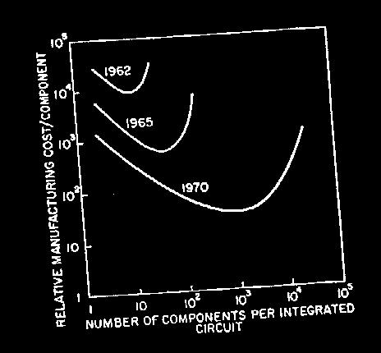
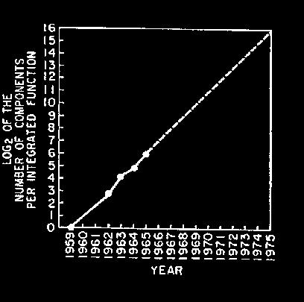
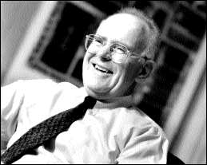
Moore’s Law
“Cramming More Components onto Integrated Circuits”
  Gordon Moore, Electronics, 1965
# on transistors on cost-effective integrated circuit double every 18 months

Slide 25
Notes:
结合公司的名字tsmc, cyle 30亿美元。

Slide 26
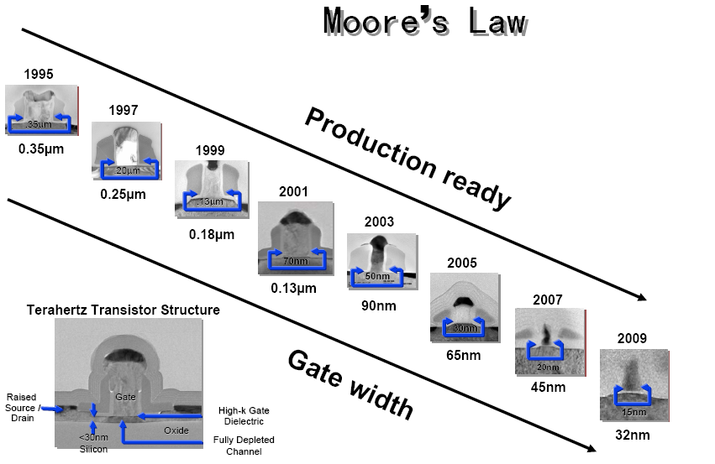
Notes:
30亿美金 ，tsmc, ti ，umc

Slide 27
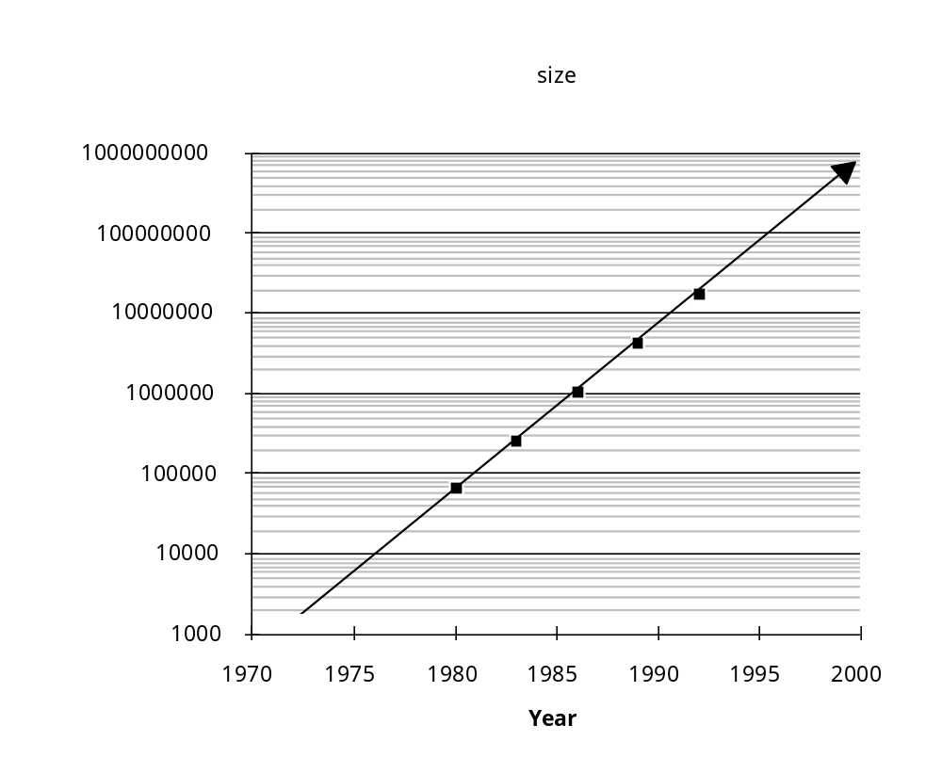
Memory Capacity
(Single Chip DRAM)
year size(Mb) cyc time
1980 0.0625 250 ns
1983 0.25 220 ns
1986 1 190 ns
1989 4 165 ns
1992 16 145 ns
1996 64 120 ns
2000 256 100 ns
2003 1024 60 ns
• 1985年左右, 出现了单片处理器(32位)和单板机
=> 推动了工作站、个人计算机、多处理器
• 2002年左右，出现大型机级别的单片计算机（IBM
POWER4）

Slide 28
Technology Trends
(Summary)
Capacity Speed (latency)
Logic 2x in 3 years 2x in 3 years
DRAM 4x in 3 years 2x in 10 years
Disk 4x in 3 years 2x in 10 years

Slide 29
Technology Trends
Clock Rate: ~30% per year
Transistor Density: ~35%
Chip Area: ~15%
Transistors per chip: ~55%
Total Performance Capability: ~100%
32x disk density (60% per year)
Network bandwidth, …

Slide 30
软件、应用、器件对系统结构的影响
应用对系统结构的影响
用户的分类 | 对系统结构的要求
高端用户 | 追求性能高
中端用户 | 追求性能价格比高
低端用户 | 追求低价格

Slide 31
软件、应用、器件对系统结构的影响
应用、用户不同对系统结构影响的结果
计算机系统结构不同、性能或价格不同而出现了：
    巨型计算机 Supercomputer
    大型计算机 Mainframe
    小型计算机 Minicomputer
    微型计算机 Microcomputer
Notes:
Main 国家战略地位 mini中小型企业

Slide 32
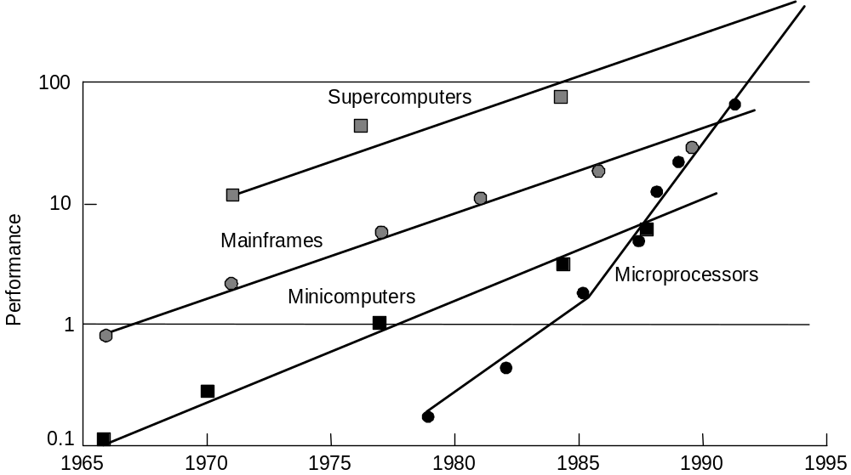
Performance Trends

Slide 33
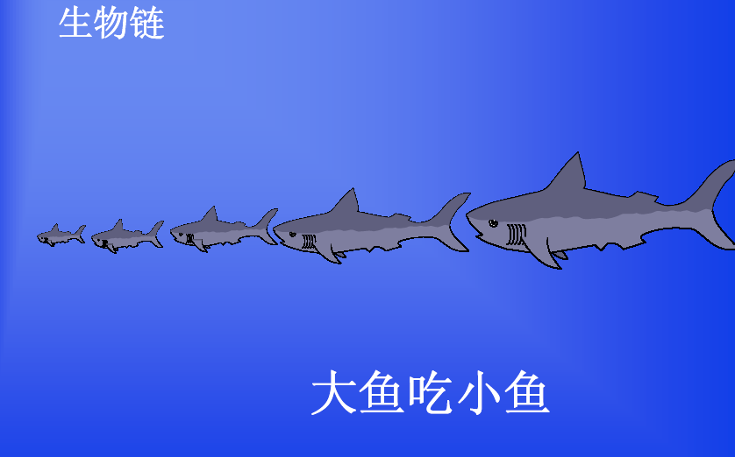

Slide 34
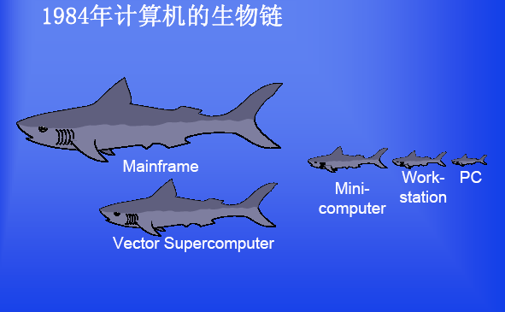
Notes:
Main 全球订票系统，国家银行

Slide 35
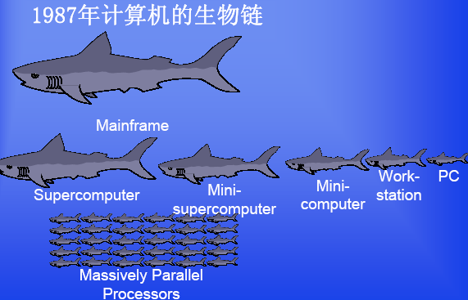

Slide 36
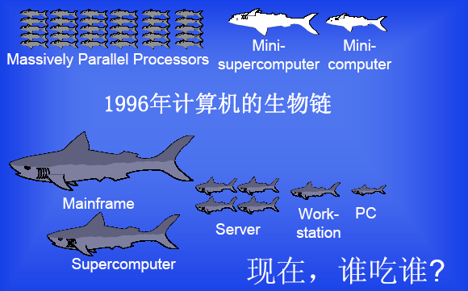
Notes:
Thinking machine

Slide 37
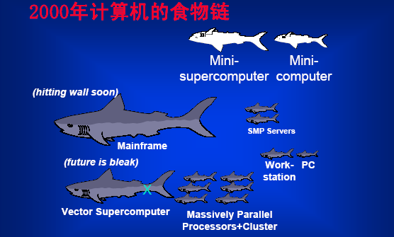

Slide 38
Why Such Change in 10 years?
Performance
  Technology Advances
    CMOS VLSI dominates older technologies (TTL, ECL) in cost AND performance
  Computer architecture advances improves low-end
    RISC, superscalar, RAID, …
Price: Lower costs due to …
  Simpler development
    CMOS VLSI: smaller systems, fewer components
  Higher volumes
    CMOS VLSI : same dev. cost 10,000 vs. 10,000,000 units
  Lower margins by class of computer, due to fewer services
Function
  Rise of networking/local interconnection technology

Slide 39
Measurement and Evaluation
Architecture is an iterative process
-- searching the space of possible designs
-- at all levels of computer systems
-- constraints of energy, cost (=area) and
performance
Design
Analysis
Creativity
Cost /
Performance
Analysis
Good Ideas
Mediocre Ideas
Bad Ideas

Slide 40
Computer Architecture
Instruction Set Design Computer Organization
Interfaces Hardware Components
Compiler/System View Logic Designer’s View
­“Building Architect” ­“Construction Engineer”

Slide 41
What is “Computer Architecture”?
Applications
Operating
System
Compiler
Firmware
Instruction Set
Architecture
Instr. Set Proc.
I/O system
Datapath & Control
Digital Design
Circuit Design
Layout & fab
Semiconductor Materials
Coordination of many levels of abstraction
Under a rapidly changing set of forces
Design, Measurement, and Evaluation

Slide 42
Forces on Computer Architecture
Technology
Programming
Languages
Applications
Computer
Architecture
Constraints
e.g. cost, energy
Operating
Systems
History

Slide 43
Computer Engineering Methodology
Evaluate Existing
Systems for
Bottlenecks
Implementation
Complexity
Benchmarks
Technology
Trends
Implement Next
Generation System
Simulate New
Designs and
Organizations
Workloads
Notes:
How hard to build
Importance of simplicity (wearing a seat belt); avoiding a personal disaster
Theory vs. practice

Slide 44
Performance (and Cost)
Plane
DC to Paris
Speed
Passengers
Throughput (pmph)
Boeing 747
6.5 hours
610 mph
470
286,700
BAD/Sud Concodre
3 hours
1350 mph
132
178,200
Time to run the task (ExTime)
  Execution time, response time
Tasks per day, hour, week, sec, ns … (Performance)
  Throughput
Notes:
Fastest for 1 person?
Which takes less time to transport 470 passengers?
人英里/小时
英里/小时

Slide 45
Example
Replace the processor in a computer with a faster version
Adding additional processors to a system that uses multiple processors for separate tasks

Slide 46
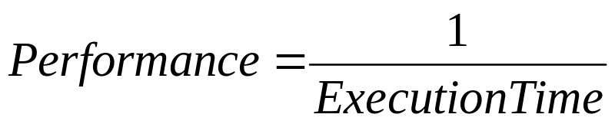

Slide 47
Performance (and Cost)
"X is n times faster than Y" means
ExTime(Y) Performance(X)
--------- = --------------- =n
ExTime(X) Performance(Y)
improve excution time Decrease
improve performance Increase
Notes:
1350 / 610 = 2.2X
286,700/ 178,200 1.6X

Slide 48
Measuring and Reporting Performance
How to evaluate a computer?
  Analysis
    Queuing theory
  Simulation
    Software model of many levels
  Measurement
    Workload
    the mixture of programs and operating system commands that users run on a machine

Slide 49
Measuring and Reporting Performance
response time, elapsed time, wall-clock time
  the time between the start and the completion of an event
  execution time including disk accesses, memory accesses, input/output activities, operating system overhead, etc.
Throughput
  the total amount of work done in a given time
Etc. Cost, Area, Power requirement
Notes:
交互的
X is faster than Y

Slide 50
Measuring and Reporting Performance
Measuring Performance
  CPU time
    User CPU time
    System CPU time
  IO time
  system performance
    elapsed time on an unloaded system
  CPU performance
    user CPU time on an unloaded system.

Slide 51
Measuring and Reporting Performance
Choosing Programs (workload) to Evaluate Performance
  Real applications
    often encounter portability problems
  Modified (or scripted) applications
    Enhance portability or focus on one particular aspect
  Kernels
    Livermore Loops and Linpack
  Toy benchmarks
    typically between 10 and 100 lines of code
    Sieve of Eratosthenes(generate prime numbers), Puzzle, and Quicksort
  Synthetic benchmarks
    Whetstone and Dhrystone
    created artificially to match an average execution profile.

Slide 52
Measuring and Reporting Performance
Benchmark Suites
  SPEC (Standard Performance Evaluation Corporation)
    WWW.SPEC.ORG
    real program modified for portability and to minimize the role of I/O in overall benchmark performance.
  Desktop benchmarks
    SPEC CPU2000
    SPECviewperf (OpenGL graphics)
    SPECapc (graphics)
  Server benchmarks
    SPECSFS (file server)
    SPECWeb (web server)
    Transaction processing(TP) benchmarks
      Database accesses (www.tpc.org)
  Embedded benchmarks
    EDN Embedded Microprocessor Benchmark Consortium (EEMBC)

Slide 53
Reporting Performance Results
The guiding principle of reporting performance measurements
  reproducibility
  list everything another experimenter would need to duplicate the results.
    System configuration
    Optimization, source code modification
baseline performance
  Performance measurement without optimization

Slide 54

Measuring and Reporting Performance
Comparing and Summarizing Performance
  Different workload can result different measurement results
    A is 10 times faster than B for program P1.
    B is 10 times faster than A for program P2.
    A is 20 times faster than C for program P1.
    …

Slide 55


Measuring and Reporting Performance
Arithmetic mean
weighted arithmetic mean
  proper mixture of programs for the workload

Slide 56


Measuring and Reporting Performance
geometric mean
  Normalize execution times to a reference machine
    Relative performance
  used by the SPEC benchmarks
Nice property of geometric mean

Slide 57
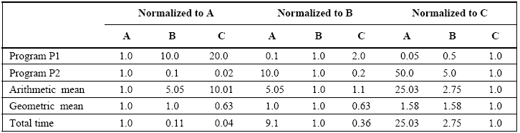
Measuring and Reporting Performance
Example
  it doesn’t matter which machine is used to normalize.
  But it do not predict execution time.

Slide 58
Quantitative Principles of Computer Design
Make the Common Case Fast
  In making a design trade-off, favor the frequent case over the infrequent case
Amdahl’s Law
  the performance improvement to be gained from using some faster mode of execution is limited by the fraction of the time the faster mode can be used.

Slide 59
Amdahl’s Law
ExTime_{new} = ExTime_{old} x (1 - Fraction_{enhanced}) + Fraction_{enhanced}
Speedup_{enhanced}

Slide 60

Quantitative Principles of Computer Design
Franction_{enhanced}
1 - Franction_{enhanced}
Fraction/Speedup
1 - Franction_{enhanced}

Slide 61
Example
If Add is improved to 10 time the speed
And Add is used half the CPU time
what’s the CPU time Speed up?
0.5
0.5
0.05
0.5

Slide 62
Quantitative Principles of Computer Design
The CPU Performance Equation
  Instruction count
    Instruction set architecture and compiler technology
  clock cycles per instruction (CPI)
    Organization and instruction set architecture
  Clock cycle time
    Hardware technology and organization

Slide 63


Quantitative Principles of Computer Design
The CPU Performance Equation

Slide 64
Example
Suppose the following:
  Frequency of FP operations (other than FPSQR) = 25%
  Average CPI of FP operations = 4.0
  Average CPI of other instructions = 1.33
  Frequency of FPSQR= 2%
  CPI of FPSQR = 20
Assume that the two design alternatives are to decrease the CPI of FPSQR to 2 or to decrease the average CPI of all FP operations to 2.5. Compare these two design alternatives using the CPU performance equation.

Slide 65
Concluding Remarks
Make the common case fast
  Will be a guiding light in the next chapters
CPU performance equations
  Will be our major tools
CPU cost and price equations

Slide 66
主要参考教材
Computer Architecture: A Quantitative Approach 3Ed. Patterson D A, Hennessy J L
Computer Organization and Design: The Hardware/Software Interface, Patterson and Hennessy
主要参考书：
计算机体系结构 张晨曦、王志英等 高等教育出版社

