Slide 1
Cryptocurrency Prediction System Using Deep Learning
- Hasmeet singh makhija(18ec043)
Ishan gupta(18ec031)
Sambit Biswal(18ec012)

Slide 2
Abstract
In last decade, cryptocurrency has emerged in financial area as a key factor in businesses and financial market opportunities. Accurate predictions can assist cryptocurrency investors towards right investing decisions and lead to potential increased profits. Additionally, they can also support policy makers and financial researchers in studying cryptocurrency markets behavior. Nevertheless, cryptocurrency price prediction is considered a very challenging task, due to its chaotic and very complex nature.

Slide 3
Introduction
Cryptocurrency price prediction can provide a lending hand to cryptocurrency investors for making proper investment decisions in order to acquire higher profits while it can also support policy decision-making and financial researchers for studying cryptocurrency markets behavior. Cryptocurrency price prediction can be considered as a common type of time series problems, like the stock price prediction.
Deep Learning (DL) refers to powerful machine learning algorithms which specialize in solving nonlinear and complex problems exploiting most of the times big amounts of data in order to become efficient predictor models.

Slide 4
Libraries Loaded
import json import requests from keras.models import Sequential from keras.layers import Activation, Dense, Dropout, LSTM import matplotlib.pyplot as plt import numpy as np import pandas as pd import seaborn as sns from sklearn.metrics import mean_absolute_error %matplotlib inline

Slide 5
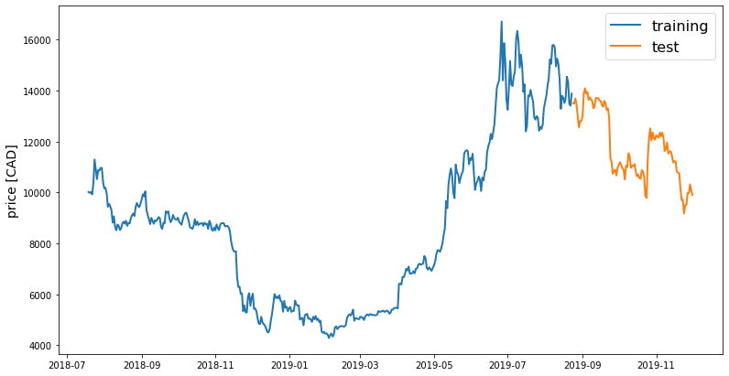
Plotting Crypto Price in CAD

Slide 6
Observation
We can observe that there is a clear dip in prices between December 2018 and April 2019. The prices keep on increasing from April 2019 to August 2019 with fluctuations happening in the months of July and August. From September 2019 onward prices are constantly decreasing. The interesting thing to be noted from this price fluctuation is that the prices are low in winter and it increases in the summer.
Made a couple of functions to normalize the values. Normalization is a technique often applied as part of data preparation for machine learning. The goal of normalization is to change the values of numeric columns in the dataset to a common scale, without distorting differences in the ranges of values.

Slide 7
Long Short-Term Memory (LSTM)
Long Short-Term Memory (LSTM) constitute a special type of deep neural networks, which are able to learn long-term dependencies by utilizing feedback connections in order to “remember” past network cell states. More specifically, LSTM networks are composed by a memory cell, an input, output and forget gate. The input gate controls the new stored information into the memory cell, while the forget gate controls the information which must be vanished.

Slide 8
Implementation of LSTM
def build_lstm_model(input_data, output_size, neurons=100, activ_func='linear', dropout=0.2, loss='mse', optimizer='adam'): model = Sequential() model.add(LSTM(neurons, input_shape=(input_data.shape[1], input_data.shape[2]))) model.add(Dropout(dropout)) model.add(Dense(units=output_size)) model.add(Activation(activ_func)) model.compile(loss=loss, optimizer=optimizer) return model

Slide 9

Mean Absolute Error
It measures the average magnitude of the errors in a set of predictions, without considering their direction. It’s the average over the test sample of the absolute differences between actual and predicted observations where all individual differences have equal weight.

Slide 10
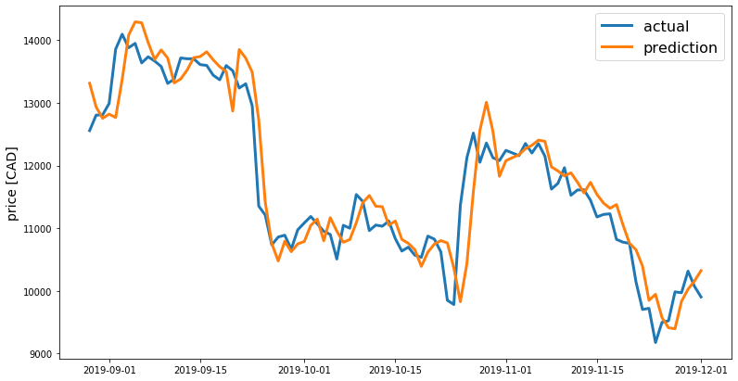
Actual Vs Predicted Value

Slide 11
Conclusion
I demonstrated how to predict cryptocurrency prices in real time using LSTM neural network. I went through a four step process of getting real-time crypto-currency data, preparing data for training and testing, predicting the prices using LSTM neural network and visualizing the prediction results. Feel free to play with the hyper-parameters or try out different neural network architectures for better results.

Slide 12
Thank You

