Slide 1

Analysis Of The Stack Overflow Survey Data (2024)
Shang-Ian Tan
7th September 2025

Slide 2



OUTLINE
Executive Summary
Introduction
Methodology
Results
Programming Languages Trends
Database Trends
Dashboards
Discussion
Insights
Overall Findings and Implications
Conclusion
Appendix

Slide 3

EXECUTIVE SUMMARY
Survey reveals global trend
JavaScript, Python and SQL dominate current developer usage
Strong future interest in cloud platforms, modern frameworks, and niche languages
Notable differences between current and desired technologies highlight upskilling opportunities
Age, education, and geography shape technology preferences and career outcomes
Compensation and satisfaction are linked to tech stack and experience
But pay alone doesn’t ensure fulfilment

Slide 4

INTRODUCTION
Purpose
Explore global developer trends in 2024 using Stack Overflow survey data
Identify factors influencing technology adoption, skills demand, and career outcomes
Target Audience
Developers
Employers & Recruiters
Educators & Training Providers
Value
Highlights in‑demand skills and emerging technologies
Supports career planning, hiring strategies, and curriculum design

Slide 5

METHODOLOGY (Part 1)
Source & Collection
Stack Overflow Developer Survey 2024
CSV format
≈65 thousand respondents globally
Data Exploration
Previewed dataset structure (rows, columns, data types)
Calculated descriptive statistics (e.g. mean age, countries count)
Cleaning
Identified and removed duplicates based on key columns
Visualised duplicate distribution across categories
Detected and imputed or removed missing values (e.g. Mode for RemoteWork)

Slide 6
METHODOLOGY (Part 2)
Transformation & Normalisation
Standardised compensation-related data (e.g. ConvertedCompYearly) for comparability
Applied log-scaling and normalisation (i.e. min-max, z-score) to address skew
Exploratory Data Analysis (EDA)
Analysed employment, job satisfaction, experience and remote work trends
Investigated relationships (e.g. satisfaction vs. experience)
Identified and handled outliers using interquartile range (IQR) method
Visualisation & Dashboarding
Created various histograms, scatterplots, bar and pie charts to illustrate findings
Built interactive dashboard in IBM Cognos Analytics

Slide 7
RESULTS

Slide 8
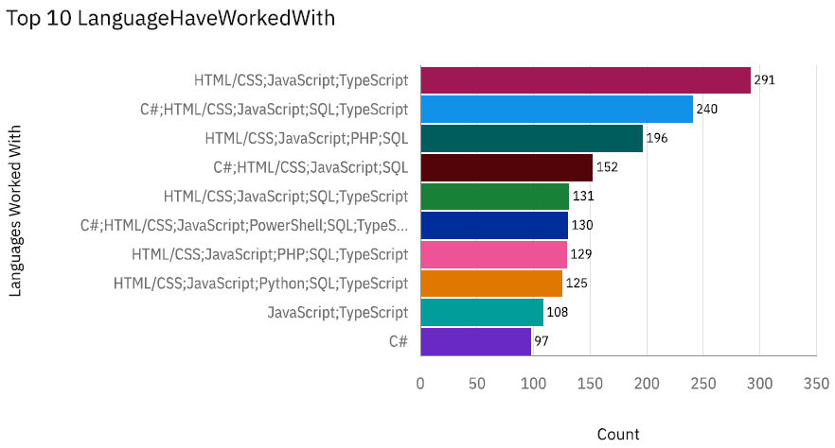
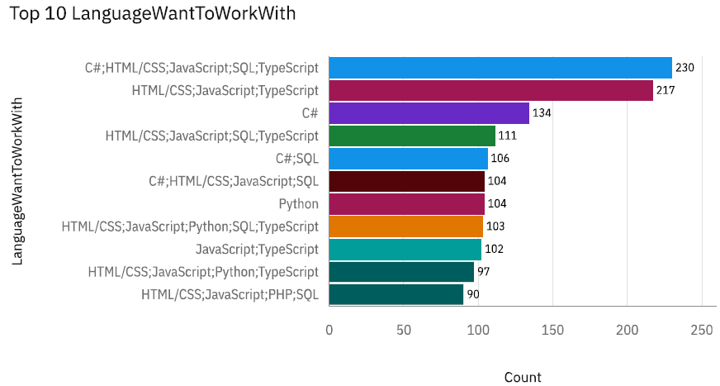
PROGRAMMING LANGUAGE TRENDS
Current Year
Next Year

Slide 9
PROGRAMMING LANGUAGE TRENDS - FINDINGS & IMPLICATIONS
Findings
HTML/CSS, JavaScript and TypeScript lead current and future usage far above other languages
Python shows significant growth in popularity
Go in future top 10, replacing C#
Implications
Sustained demand for web-development skills
Continue to prioritise JavaScript‑based expertise
Python for strategic skill investment
Growth trajectory suggests expanding opportunities in data science, AI and automation
Emerging Language Adoption
Rising interests in Go implies potential demand in cloud, backend and system development roles

Slide 10
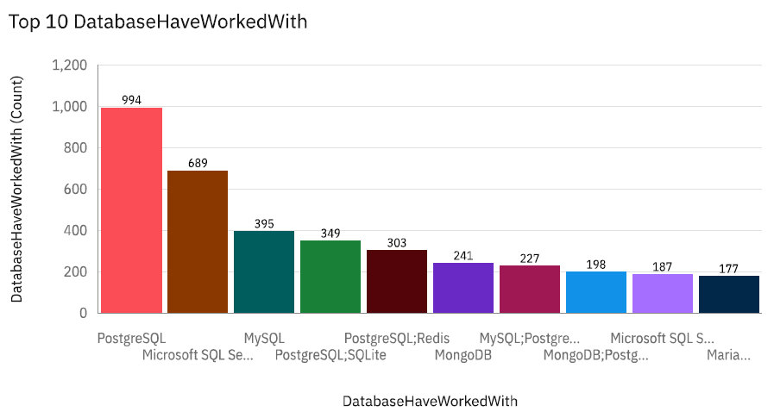
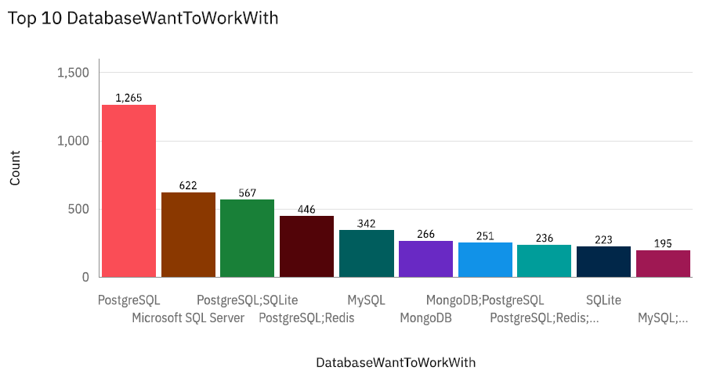
DATABASE TRENDS
Current Year
Next Year

Slide 11
DATABASE TRENDS - FINDINGS & IMPLICATIONS
Findings
PostgreSQL Dominance
Leading current usage and future interest
MongoDB Surge
Moves from 5th currently, to 2nd in future interest
Overtakes MySQL and Microsoft SQL Server
Shifting Ranks in
Firebase jumps from 9th currently to 5th in future interest
Access drops to last place
Implications
PostgreSQL is a Safe Investment
Its sustained growth suggests long-term stability and relevance
Rising NoSQL demand
MongoDB’s leap implies increasing adoption of flexible, document-oriented databases
Cloud-native database growth
Firebase’s rise reflects growing interest in serverless, real-time data solutions
Benefits mobile and web-development

Slide 12

DASHBOARD
Capstone Dashboard

Slide 13
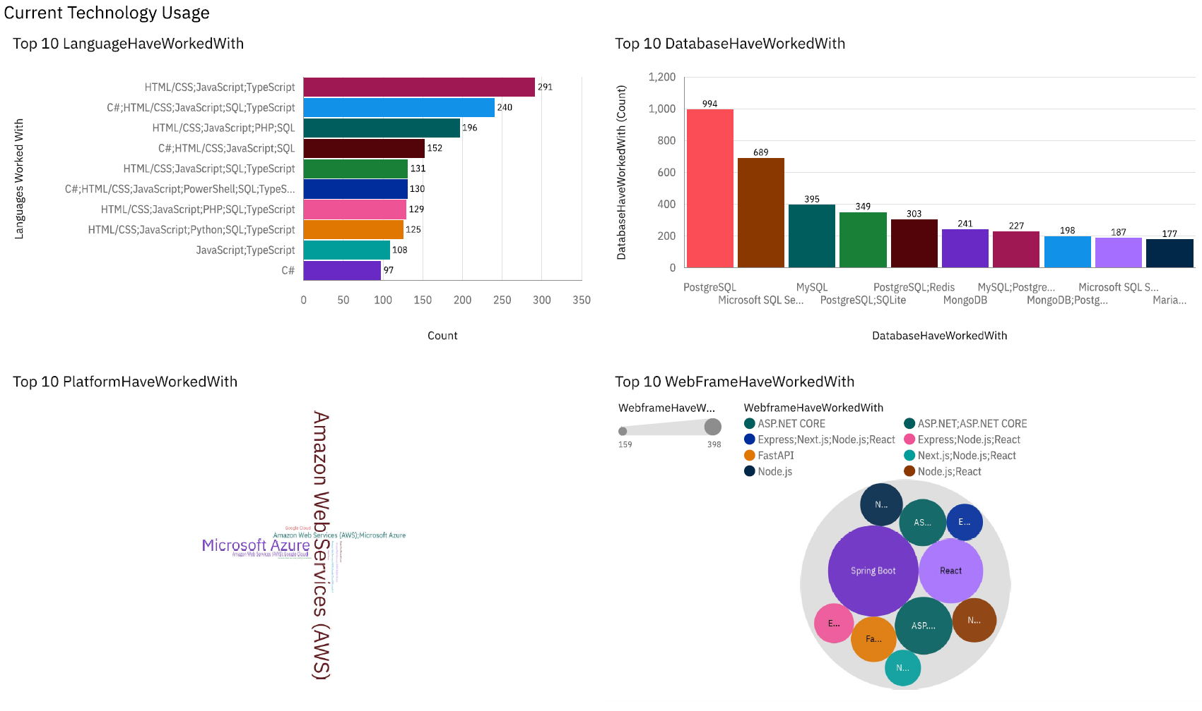
Dashboard: Current Technology Usage

Slide 14
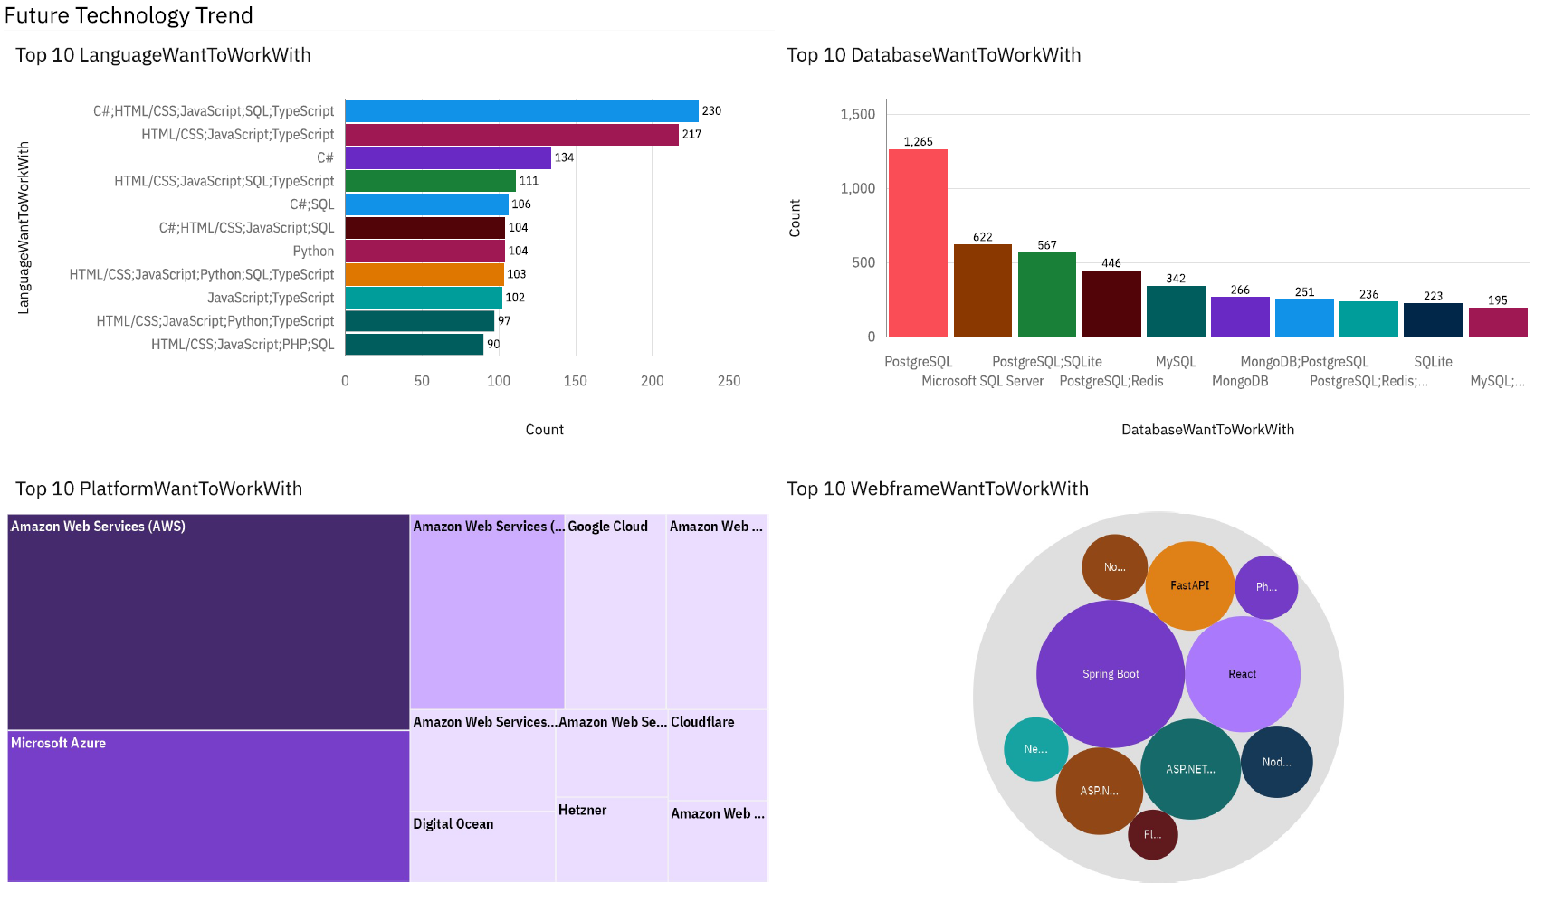
Dashboard: Future Technology Trends

Slide 15
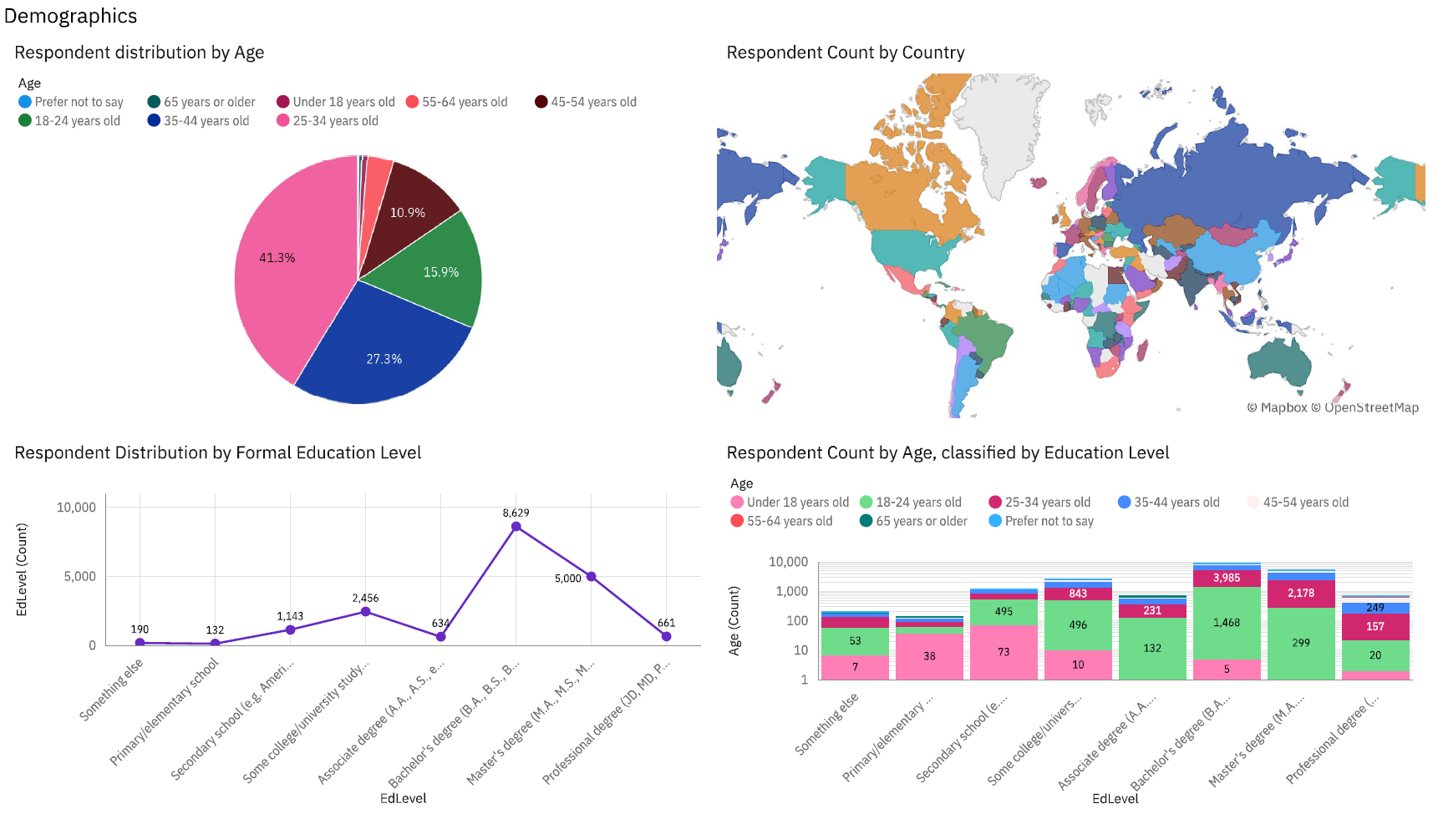
Dashboard: Demographics

Slide 16
DISCUSSION
Integration of Trends
Core technologies continue dominating, signalling stability in foundational skills
New interests in TypeScript, Go, MongoDB, and Firebase (needs in modern web, backend, and cloud‑native development)
Cross‑Dashboard Insights
Demographic patterns align with adoption of newer, open‑source, and cloud‑friendly tools
Future preferences often extend existing skill sets rather than replace them
Trends mirror broader market movements
Growth in AI/data science, Cloud adoption, and modern frameworks

Slide 17
OVERALL FINDINGS & IMPLICATIONS
Findings
Stable Core Stack
JavaScript, Python, SQL, and PostgreSQL dominate current and future rankings, showing enduring relevance
Emerging Growth Areas
TypeScript, Go, MongoDB, and Firebase show significant jumps in future interest, signalling evolving developer priorities
Demographics Drive Trends
A young, degree‑educated, globally distributed developer base is shaping adoption patterns toward open‑source, cloud‑native, and modern frameworks
Implications
Skill Development Strategy
Developers should maintain core stack expertise while upskilling in high‑growth technologies to stay competitive
Hiring and Training Alignment
Employers can future‑proof teams by investing in both established and emerging tools, especially in cloud and NoSQL domains
Curriculum and Program Design
Educators should balance foundational skills with modern, in‑demand technologies to meet industry needs

Slide 18

CONCLUSION
The 2024 Stack Overflow survey reveals a stable core tech stack (JavaScript, Python, SQL, PostgreSQL) alongside emerging growth areas
Future interest trends highlight rising demand for TypeScript, Go, MongoDB, and Firebase
Demographic patterns show a young, degree‑educated, globally distributed developer base driving adoption
Insights support strategic decision‑making for developers, employers, and educators in skill development, hiring, and curriculum design

